Slide 1
ASKE Kickoff Perspective AMIDOL Team
Eric Davis, Alec Theriault, Ryan Wright
https://github.com/GaloisInc/AMIDOL/
This research was supported by the ASKE program under
DARPA-PA-18-02-AIE-FP-039

Slide 2
Modeling Stack/ASKE Layers
Abstract Knowledge
(Domain specific, semantically rich)
render
inform
Structured Knowledge
(Domain agnostic, mathematical model)
parse
generate
Executable Knowledge
(Machine specific, executable)

Slide 3

AMIDOL Project Layers
AMIDOL’s implementation fits easily into the three layer ASKE Model.
The Abstract Knowledge layer is fulfilled by AMIDOL’s VDSOLs, containing domain knowledge and context.
The VDSOL is used to generate an IR representation, on which transforms can be performed for optimization.
The Inference Engine generates executable code by compiling the IR.
VDSOLs
render
generate
AMIDOL IR
extract
compile
Generated Solver Code

Slide 4
GTRI x Galois x Arizona Demo
Extant
Extracted
Enhanced
Docs
extract
Visualization
compare
Visualization
render
render
transform
Formulation
IR Model
IR Model
parse
generate
Fortran Code
extract
Julia Code
compare
Julia Code
Notes:
Demo Plan:
Arizona extracts a Fortran model to a Julia model
GTRI parses the Julia code into an IR structured model
Galois renders the IR structured model
GTRI transforms the IR model to create several new models
Galois renders the new models
GTRI generates the new IR models to Julia models
Visualizations are compared to see the semantic differences between the models
Julia models are compared to see performance and result differences
The three columns are:
Extant: materials that are written by the primary scientist users / existing in the literature
Extracted: representations of the extant sources/models/documents in our formats
Enhanced: representations of new models that we have derived from the extracted representations.
The colors indicate the layers on the previous slides.
The Formulation is in light blue because it doesn’t exist in the primary source materials, but needs to be expressed to complete the 3x3 matrix.
In terms of the four stage framework (problem, formulation, model, code) are represented by the boxes, “Docs, Formulation, IR Model, Julia Code.”

Slide 5
Metamodeling Operations Workflow

Slide 6
Metamodeling Operations Workflow

Slide 7
Frameworks, Methods, and Implementation
AMIDOL VDSOLs
VDSOLs defined in JSON schema to pair visual objects in the grammar with IR elements.
AMIDOL IR
Labeled transition systems – specified in JSON. Universal, Turing Complete, exchange layer.
Transforms can be performed to optimize the model’s representation, or to enable more efficient solution. All transforms result in models in the same IR.
AMIDOL Inference Engine
Code generation engine to build solvers. Compiles models defined in the IR into executable code.
Executable code/library combinations have to have translators defined so they can be valid compile targets.

Slide 8
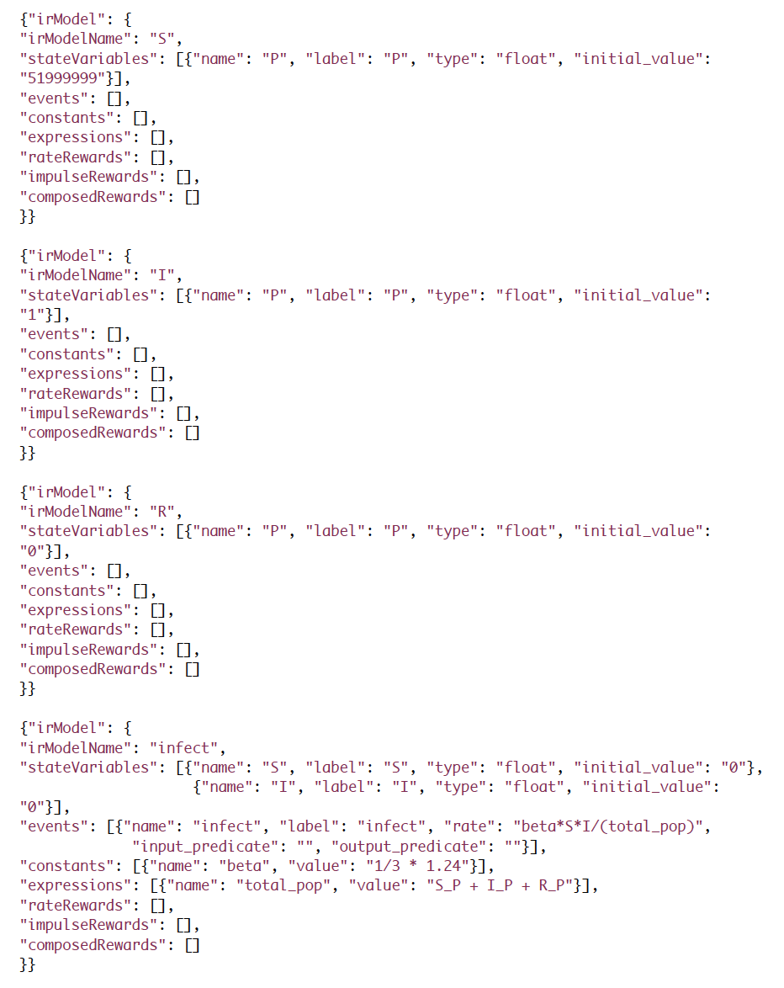
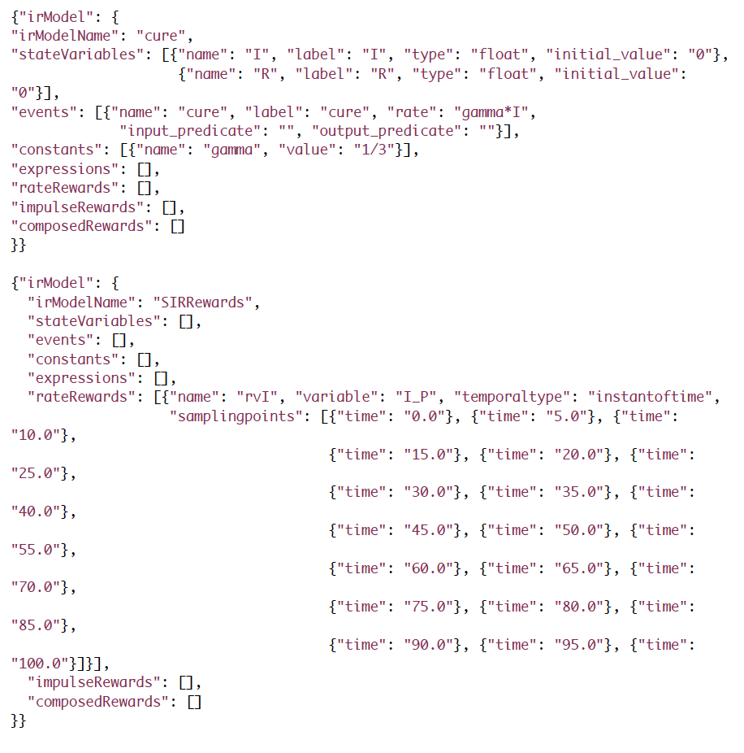
AMIDOL IR Example for SIR Model

Slide 9
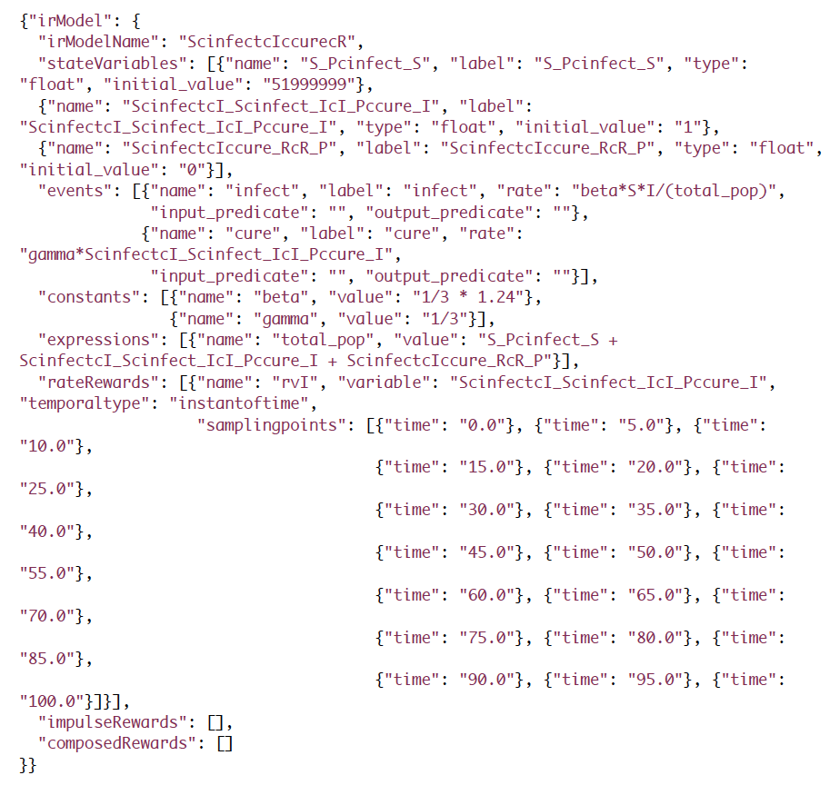
Transformed SIR Model

Slide 10
Representing Models with AMIDOL’s IR
The IR used by AMIDOL is a labeled transition system made up of:
State Variables – Their joint marking (or current values) make up the state of the system.
Events – Define how and when state variable markings are updated.
Input Predicates – Allow for state variable dependent enabling conditions for events.
Output Predicates – Allow for state variable dependent marking updates for events.

Slide 11
Representing Models with AMIDOL’s IR
The IR for AMIDOL is Turing Complete.
Based on proofs for Petri-nets with inhibitor arcs.
Rough sketch – input and output predicates allow for Petri-nets to implement one-instruction set computers (OISCs), by allowing for a sbnz/subleq type instruction.

Slide 12
AMIDOL Stack
Structured Knowledge Layer
Abstract Knowledge Layer
Executable Code Layer
Translations

