Slide 1
Automated Scientific Knowledge Extraction AMIDOL
Eric Davis, Alec Theriault, Ryan Wright
https://github.com/GaloisInc/AMIDOL/
This research was supported by the ASKE program under
DARPA-PA-18-02-AIE-FP-039

Slide 2
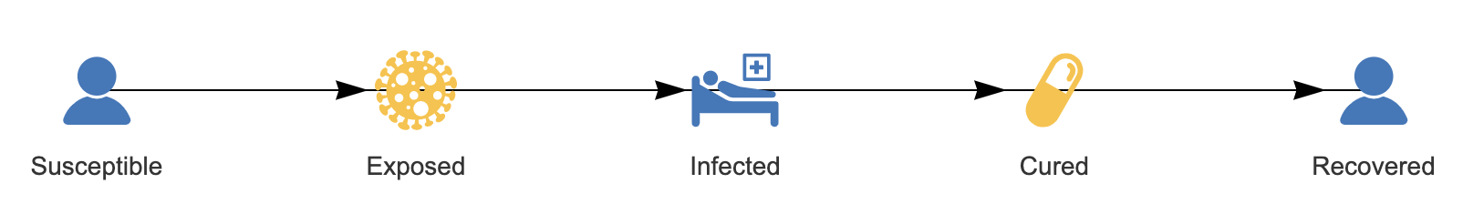
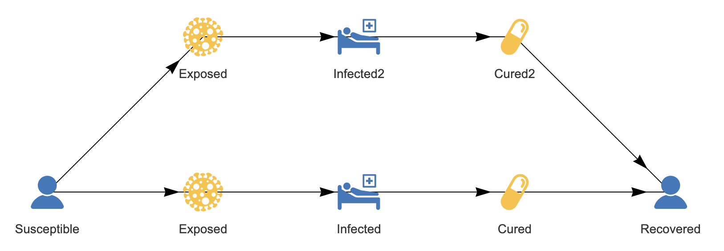
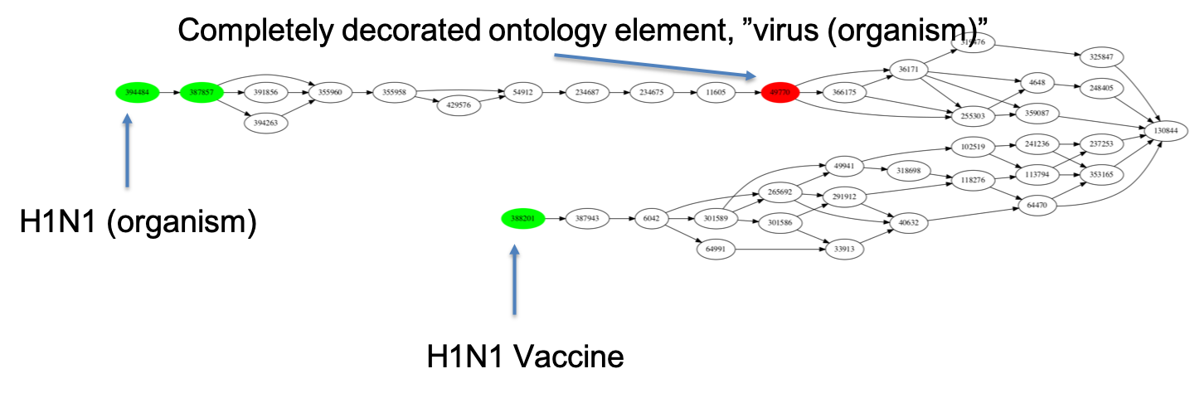
Knowledge Discovery and Curation
AMIDOL models are stored as:
Abstract Knowledge Layer formulations to allow scientists to interact directly.
Structured Knowledge Layer models in universal forms for curation and transformation.
AMIDOL allows models and formulations to be connected to domain-specific ontologies, curating knowledge and relating it to semantic content.

Slide 3
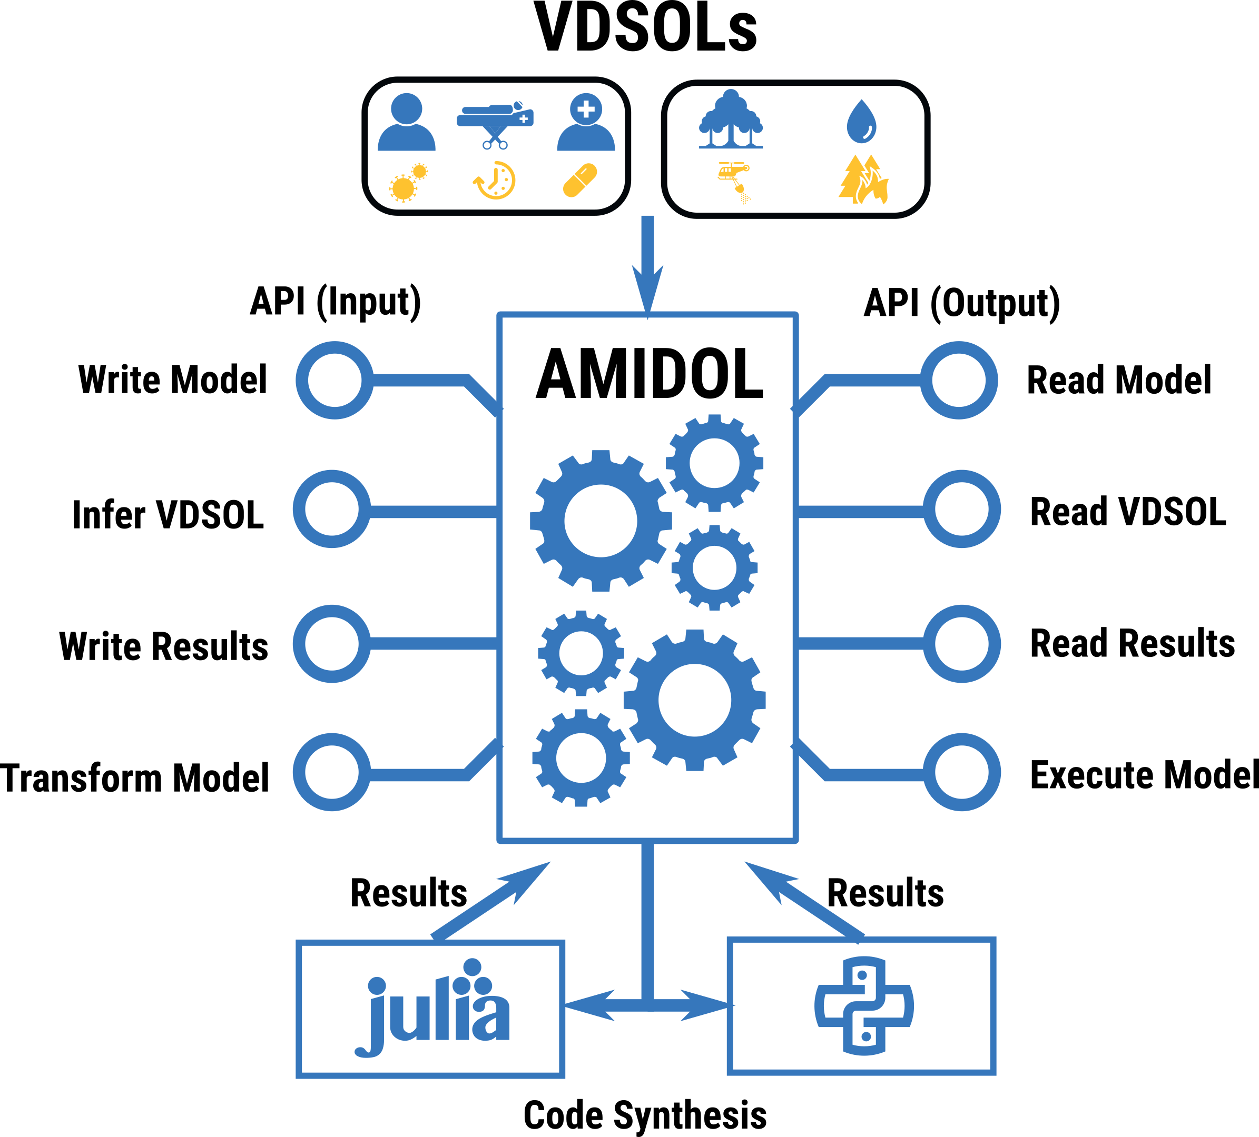
Constructing, Transforming, and Sharing Models
AMIDOL allows for new models to be authored using domain specific languages.
Geared towards representing models in natural ways to domain scientists.
AMIDOL has also been designed to interface with other tools and pipelines.
AMIDOL API allows for tools/projects to access AMIDOL as a service.
Already implemented with Arizona and GTRI.
Soon to be available as part of our open source tool.

Slide 4
Design of Experiments and Metamodeling
AMIDOL utilizes a graph-based results database:
Stores results and data indexed by model (M) and measures (n).
Allows for automated hypothesis testing, model validation, model fitness.
Allows for model comparison, ranking, and prognostics and diagnostics.
Automated model-space exploration.
n₀
d
r
r
M₀
M₁
??
r
r
n₁
d

Slide 5
Initial Performance Benchmarks
 | Model | SIR | SIIR | Predator-Prey | SIR w/ Vital dynamics
Time(s) | Graph VDSOL to IR compilation | 1.7ms | 1.7ms | 1.1ms | 1.6ms
 | Graph VDSOL to IR compilation | 1.8s – 6s | 2.1s – 6s | n/a | n/a
 | IR compilation to Python backend | 190ms | 160ms | 30ms | 160ms
 | IR compilation to Julia backend | 24ms | 25ms | 15ms | 52ms
 | Execution of Python backend output | 2.5s | 2.4s | 1.1s | 2.5s
 | Execution of Julia backend output | 9.8s | 12s | 7.5s | 7.0s
Lines of code | Python backend output | 40 | 45 | 39 | 47
 | Julia backend output | 44 | 62 | 51 | 60

