Slide 1
AMIDOL: Agile Metamodel Inference with Domain-specific Ontological Languages ASKE TA2
Eric Davis, Ph.D.
Galois, Inc.

Slide 2
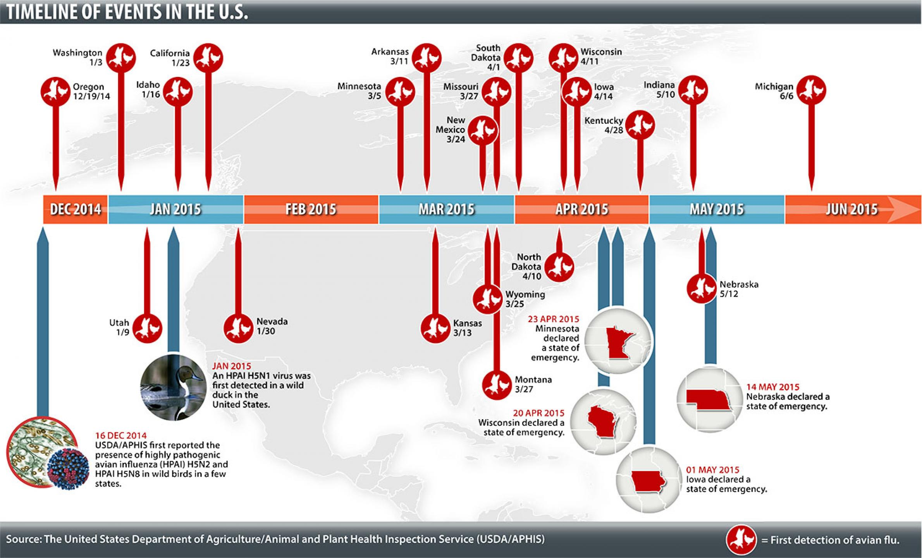
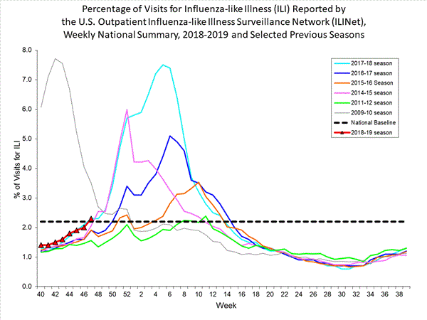
AI and Crisis Response: The Ideal
Domain experts capable of agile, performable, and high confidence modeling in response to crisis.
Leverage AI to make decisions on actions, policy, with continuous improvement and feedback to improve outcomes.

Slide 3






AI and Crisis Response: The Reality
Building models of complex systems is:
Requires large teams of modelers, mathematicians, and software engineers.
Not reusable.
Not maintainable.
Not easily developed.
Not performable.

Slide 4
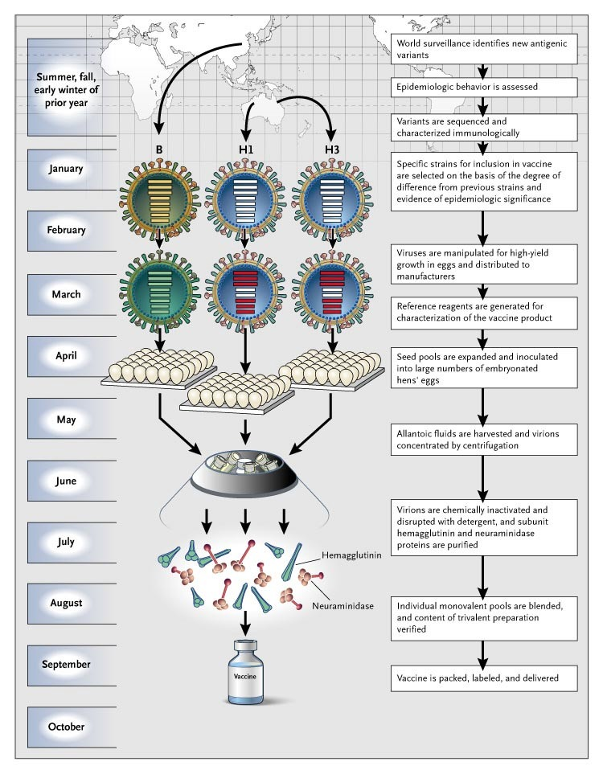
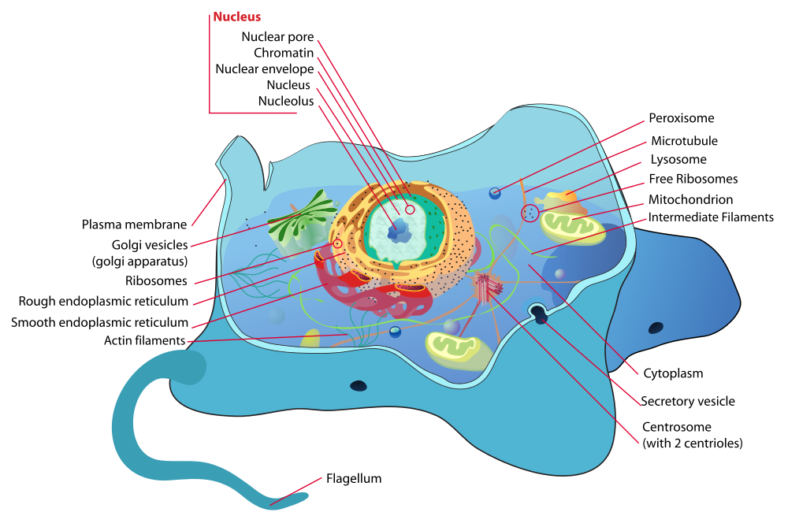
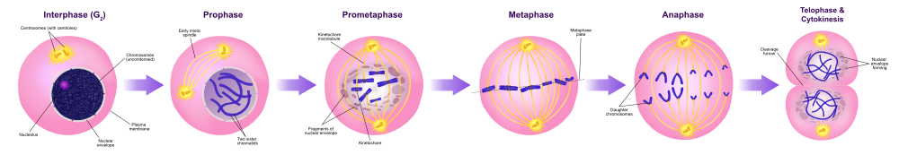
Semi-Formal Diagrams

Slide 5
Our TA2 Thesis
We can build domain specific languages using ontological diagrams to give meaning to the semi-formal diagrams domain experts usually build, and use this to architect a system for agile metamodel inference.
Leverage an intermediate language to build efficient, performable models.
Ground visual language in an intermediate language to provide formal, executable syntax.
Translate intermediate language to solvers, for reusable, maintainable models.
Leverage ontology to present results and allow interrogation.

Slide 6
Team
Eric Davis – PI
Ryan Wright – PL
Alec Theriault

Slide 7
Objectives and Project Overview

Slide 8
Technical Approach

Slide 9
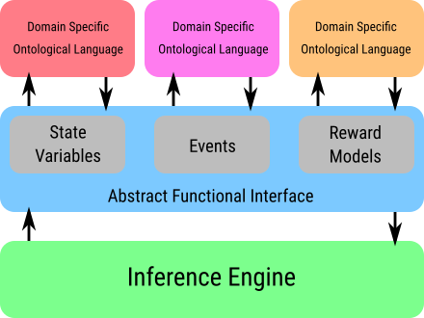
AMIDOL Architecture

Slide 10




Visual Languages for Practitioners
Give mathematical meaning and executable syntax for diagrams.
Translate results back into explainable context.

Slide 11
Visual Domain Specific Ontological Languages

Slide 12
Abstract Functional Interface
Ground visual language in mathematical primitives in the form of an intermediate language.
Allows us to construct models from visual language.
Allows us to communicate results bound to mathematical constructs, using the visual ontology.

Slide 13

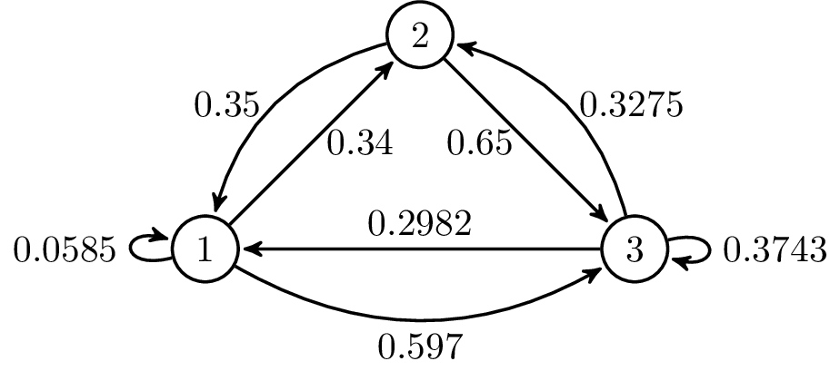
Machine-Assisted Inference Engine
Probabilistic programming:
Optimization
Regression
Bayesian inference
Discrete Event Simulation and Numerical Solution
Prediction, conditional forecasting, comparative impact

Slide 14
Putting it Together

Slide 15
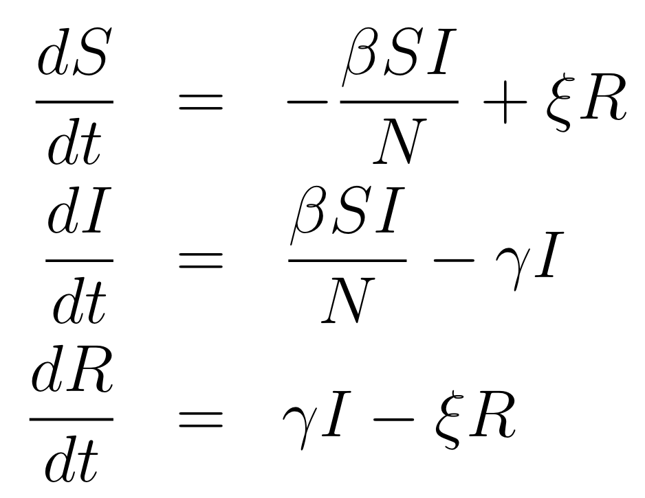
Putting it Together

Slide 16
Communicating Results
Ontology of visual formalism preserved through levels.
Communicate results of solvers in a human readable format, grounded in the original ontology using reward structures.

Slide 17



Outputs vs. Machine Assisted Inference
Bad
Good
Raw statistical Learning results
Planning
Derived Knowledge
Policy
Actionable Results

Slide 18
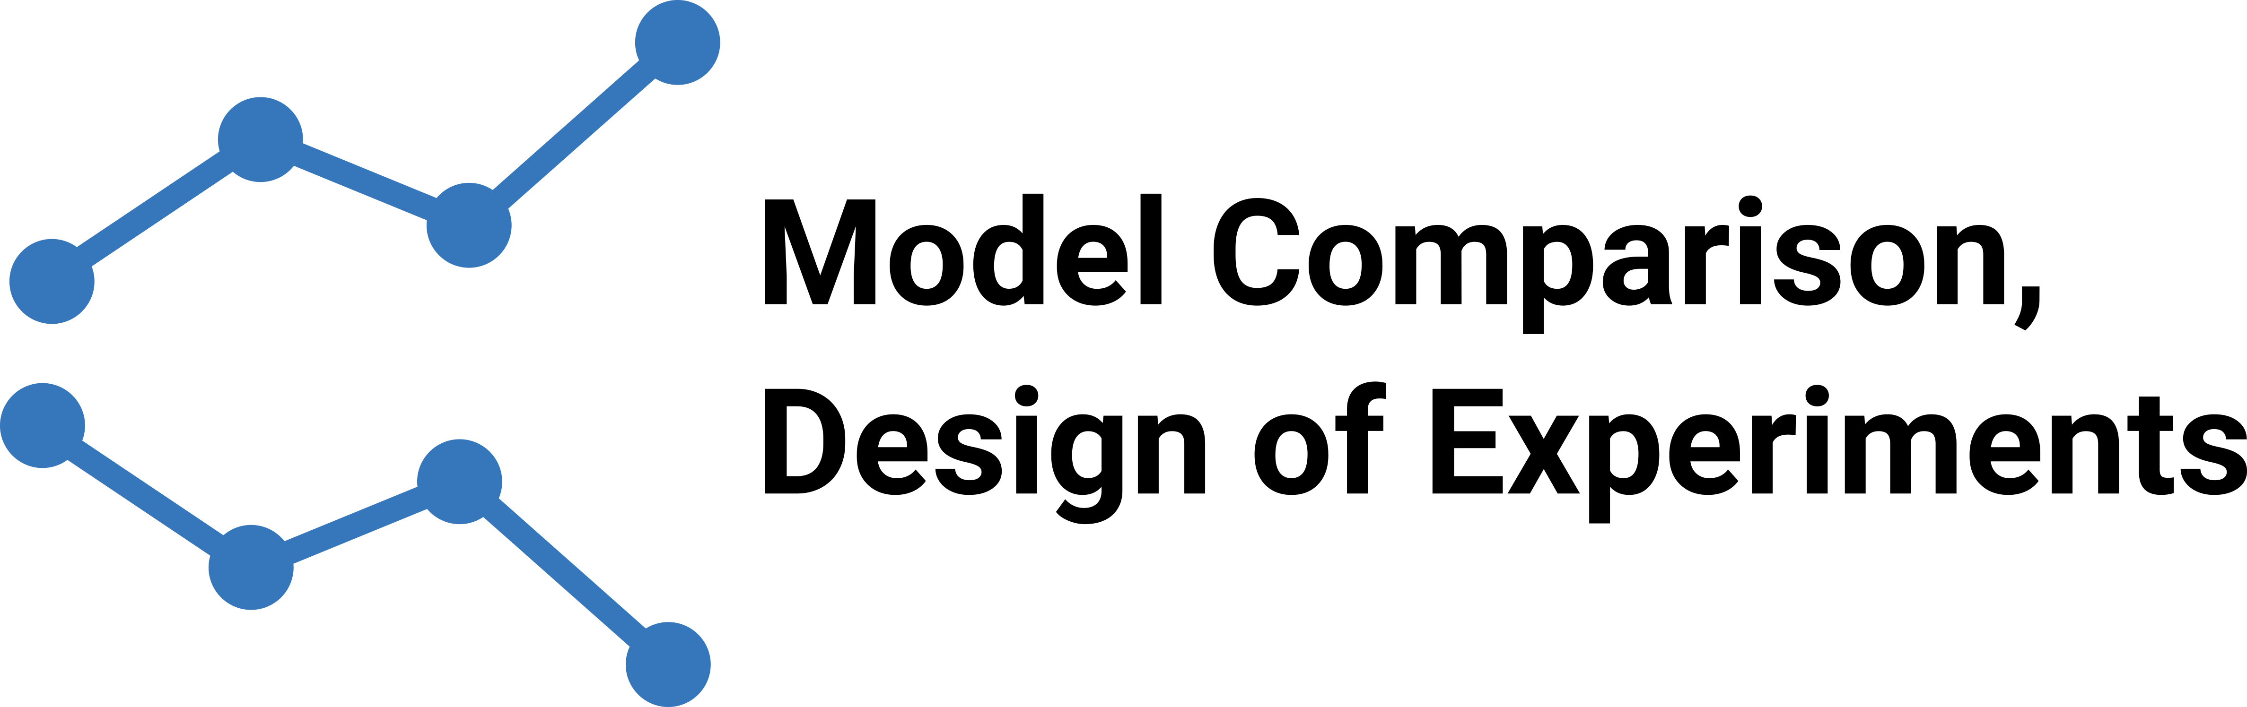


Interrogatability
Prediction
How will the system evolve in the near future?
Risk assessment:
What is the risk of X?
Conditional forecasting
How will the system respond if X changes?
Counterfactual analysis
What would have happened if X had been Y?
Comparative impact
What is the difference in utility between strategy X and strategy Y?
Optimal planning:
What is the optimal amount of X to introduce to maximize utility Y?
Risk assessment:
What is the risk of X?
Outcome avoidance:
What is the optimal action or intervention to reduce the risk of X decreasing more than Y?

Slide 19


Scientific Domain
Epidemic Management and Outbreak Response
Open source models available
High quality data for validation
Benchmarking possible without extensive data cleaning
Well documented in literature.
Specific Models
H5N1 influenza outbreak and management
1990s outbreak and treatment
H3N2 influenza vaccine effectiveness
Repeated vaccine application
Serial vaccine hypothesis
Intra-season vaccine model
DARPA Relevance
Real-time planning with complex models
Incident response
Warfighter health management
Biological incident response and countermeasure modeling

Slide 20
The VDSOL Advantage
Not limited to a single domain.
AFI allows solver reuse, and easy definition of new visual domain specific languages.

Slide 21
Summary

Slide 22
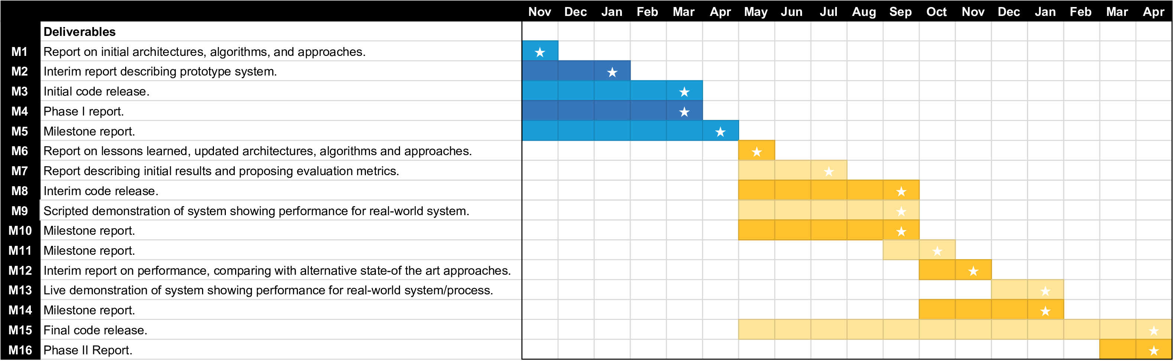
Milestones and Schedule

Slide 23
We bridge the gap between domain experts and modeling challenges during the modeling phase, by providing novel Visual Domain Specific Ontological Languages (VDSOLs) which produce executable models using intermediate abstractions, and a library of machine-assisted inference techniques.
We achieve explainability and allow rich prognostic queries by binding results to elements of our abstraction and objects in the VDSOLs with robust reward model algorithms which structure the results of machine-assisted inference with contextual information.
Traditional machine learning and complex system modeling is a slow, error prone process. Normally it results in bias-prone low performance models, and difficulty leveraging results for real-time problems.
Our method improves the capability of domain experts to build, verify, and validate models.
Our algorithms result in orders of magnitude improvement in runtime vs. hand coded models.
Impulse and rate reward models allow us to leverage results quicker, and more easily turn outcomes of modeling and machine learning into actionable knowledge.
Most existing approaches are bespoke, hand coded, and unperformable.
Most existing approaches deliver outcomes that rarely connect contextually, and are hard to extract new knowledge from, or to use in order to develop understanding about the modeled system.
We provide a generalizable solution that leverages intermediate abstractions and contextual ontologies to address these shortcomings.

Slide 24

Creating trustworthiness in critical systems
Leaders in high assurance research and development
Please feel free to ask me any questions now; or email me at ewdavis@galois.com.
Galois [gal-wah]
Named after French mathematician Évariste Galois
All trademarks, service marks, trade names, trade dress, product names, and logos appearing in these slides are the property of their respective owners, including in some instances Galois, Inc.

