Slide 1
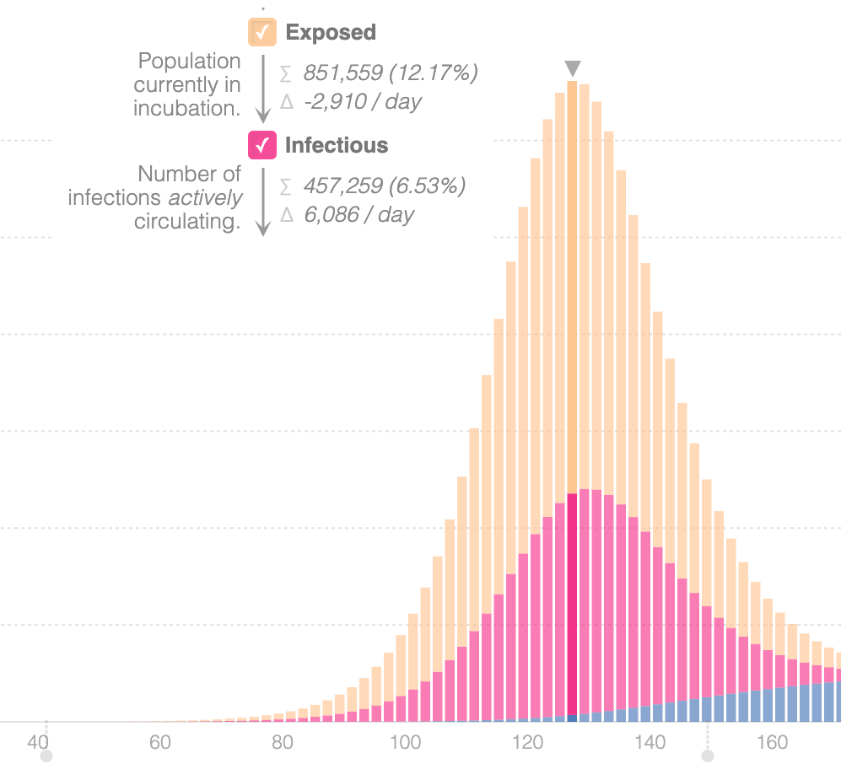
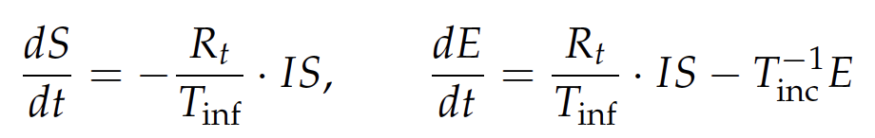
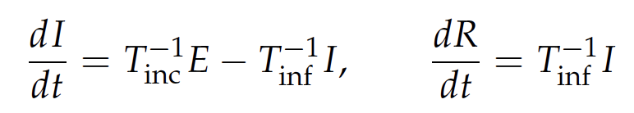
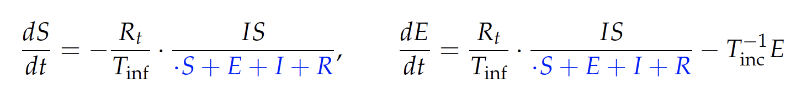
Example Fail: Inconsistent/Incorrect Models
Situation
Models are rarely published as easily evaluatable artifacts. The models used in the implemented code can differ from the published papers, documentation, and other artifacts.
Checking for consistency and correctness is a time and labor intensive task, but necessary to prevent errors from proliferating, or follow on studies or uses of models in other contexts from using untrustworthy models.
Many individuals and governments are using compartmental models to predict the impact of COVID-19. One popular resource cited 11 different sources, all with subtly different models, and published an incorrect version of the model, missing a key spatial parameter.
Lessons
Artifacts which cannot be executed or tested can result in a) inconsistency between models, b) incorrect models when assumptions cannot be automatically checked, c) proliferating errors when results from one study are incorrect, yet used to inform new studies.
Fixing these problems requires large teams spending time to implement and evaluate all artifacts, and to check those implementations for consistency with the original artifacts.
Published Model (Incorrect)
Corrected Model

