Slide 1
Team Unagi
Team Introduction & Solutions
T. Akiba (NII), K. Imajo (Google),
H. Iwami (Google), Y. Iwata (U Tokyo),
T. Kataoka (U Tokyo), N. Takahashi (AtCoder)

Slide 2
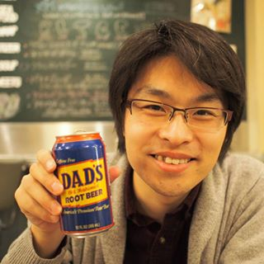

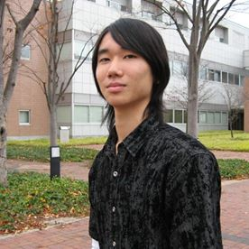

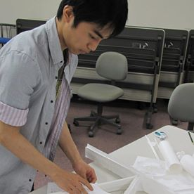
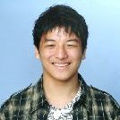
Team Unagi
2nd place @ ICFP Contest 2011
1st place @ ICFP Contest 2013
2nd place @ ICFP Contest 2014

Slide 3
Our Submitted System
Problem
Solver 1
(C#)
Front-end
(PHP&C++)
Solution
Problem
Sover 2
(Java)
Solution
Solve each problem with two solvers in parallel
Evaluate their solutions and submit the best one

Slide 4
Our Two Solvers
Chokudai (by N. Takahashi)
  Basic strategy: Beam search
  Phrase embedding: Heuristics
  Faster, and hence wider beam
Wata (by Y. Iwata)
  Basic Strategy: Beam search
  Phrase embedding: Dynamic programming
  Slower, and thus narrow beam
  but higher phrase density

Slide 5
Other Effort
Parallel Evaluation System (PHP&C++)
  Internal score board
  Instantly evaluate new solvers
Phrase Detection (Ruby&Java)
  Web-based phrase testing tool
  Phrase embedding by dynamic programming
  We found 16 phrases (out of 18)

