Slide 1
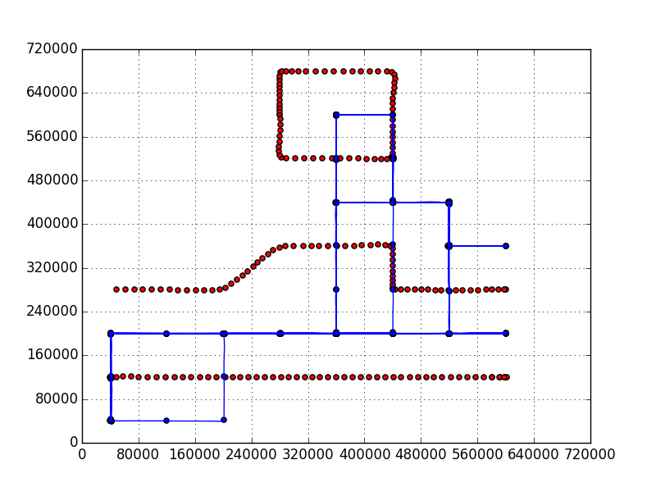
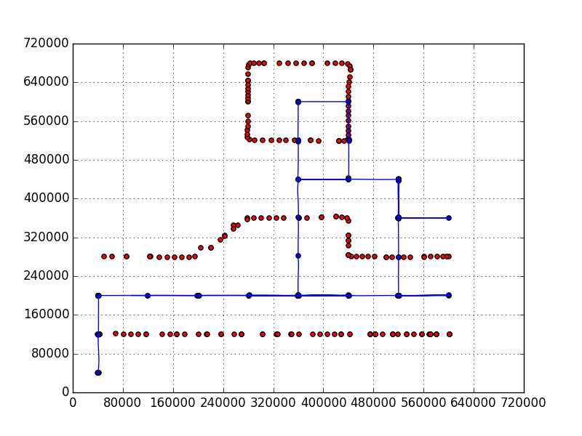
The distance between the center of adjacent cells is 72 meters.
The maximum packets dropping rate without failing is 80%.
The time between position request is 2 seconds.
Problem size: 8x9 (576 meters x 648 meters).
A main controller for multiple sub reactive controllers.
Assumptions:
The area of operation for each obstacle is predefined.
The obstacle may move one or two steps or stays in place at every step.
No packets dropping
80% packets dropped

