Slide 1
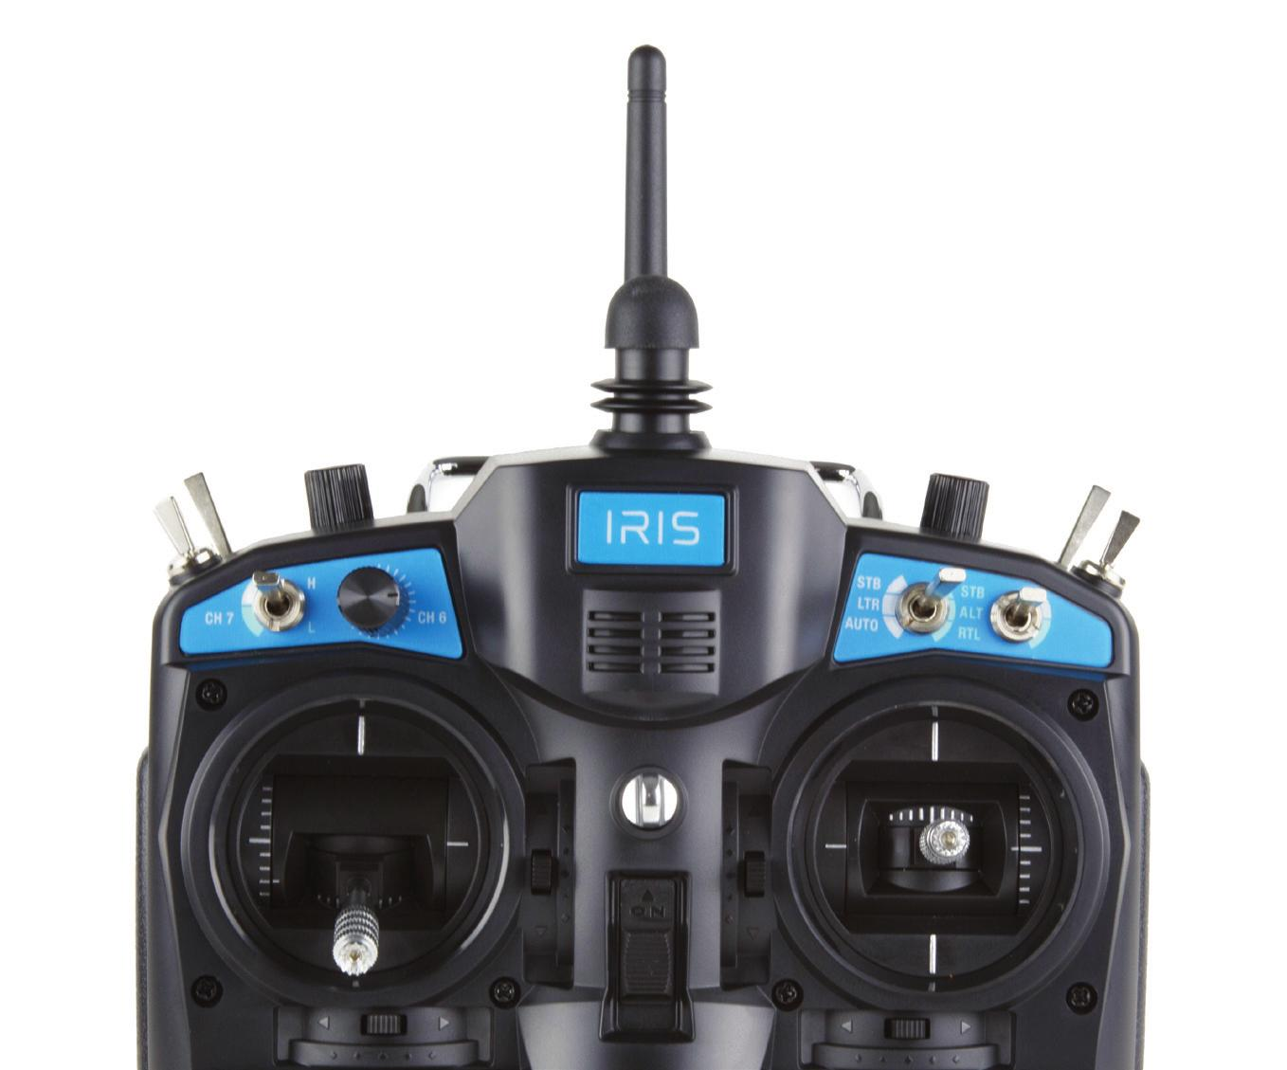
KILL SWITCH
MODE SWITCH
- MANUAL
- ALT-HOLD
-GCS Input

Slide 2
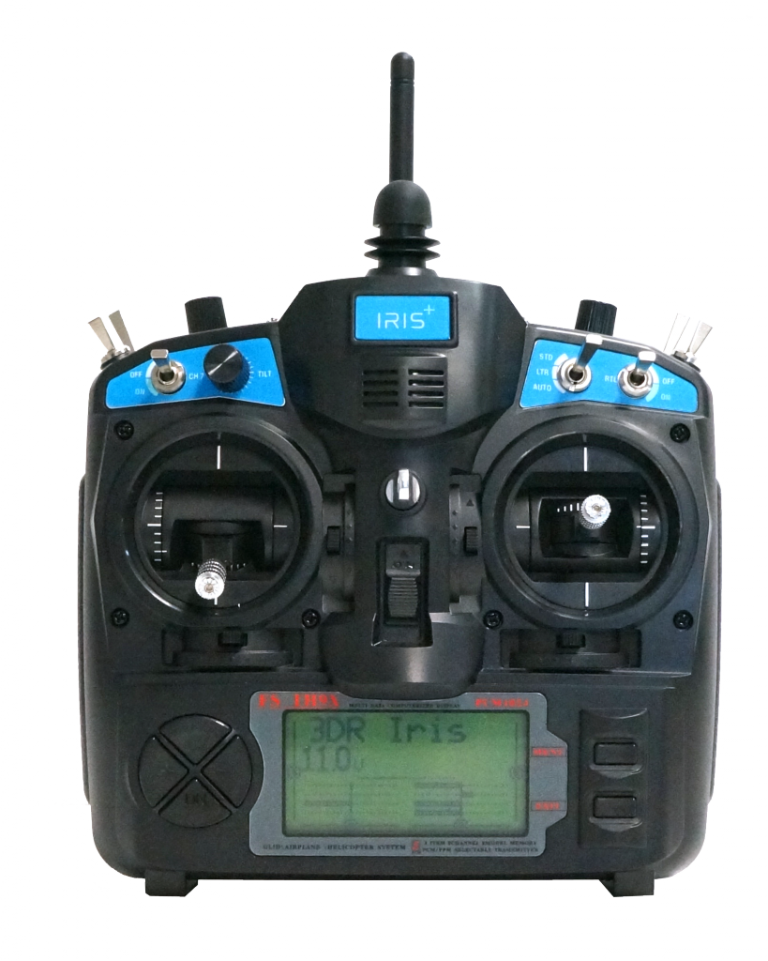
Throttle trim (DONT USE)
Pitch trim
Yaw trim
Roll trim

Slide 3
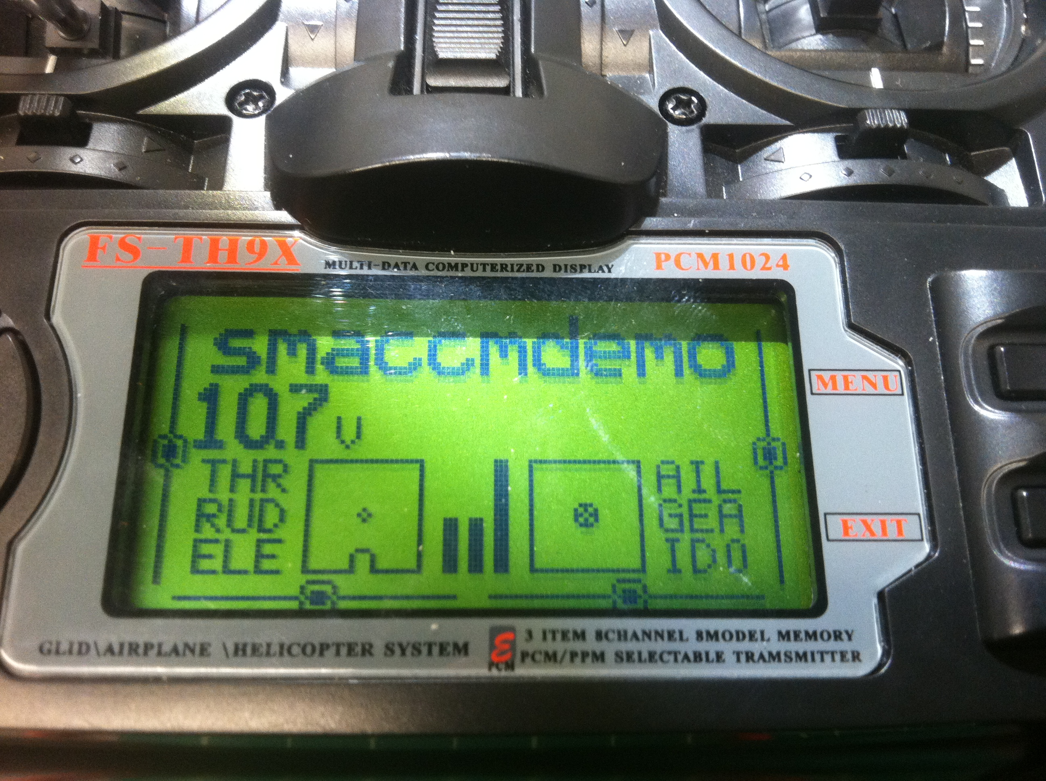
Trims are zeroed out (red circles)

