Slide 1

los ingresos de los mexicanos
Alfonso Reyes

Slide 2
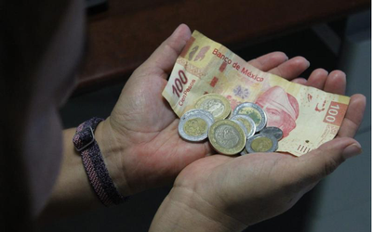
El objetivo de ésta presentación es dar un panorama hacia los ingresos de los mexicanos, y dando referencia a los sectores económicos que pertenecen.

Slide 3
Ingresos de los mexicanos
Todos los datos de ésta presentación son del año 2020
Salario mínimo | Equivalente a pesos | Al mes (considerando 26 días de trabajo)
1 | $123.22 | $2,303.72
2 | $246.44 | $6,407.44
3 | $369.66 | $9,611.16
4 | $492.88 | $12,814.88
5 | $616.1 | $16,018.6

Slide 4
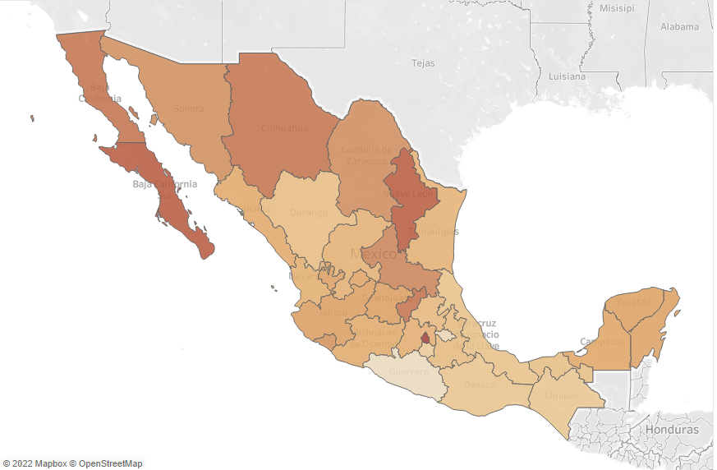
Estado | ingreso promedio
Ciudad de México | $18,709.00
Baja california Sur | $16,906.00
Nuevo León | $16,774.00
Queretaro | $15,448.00
Baja california | $15,404.00
chihuahua | $15,321.00
San Luis Potosí | $14,347.00
Coahuila | $13,874.00
Sonora | $13,806.00
Colima | $13,459.00
Jalisco | $12,627.00
Guanajuato | $12,543.00
Quintana Roo | $12,393.00
Yucatán | $12,380.00
Aguascalientes | $12,361.00
Campeche | $12,127.00
Sinaloa | $11,882.00
Michoacán | $11,816.00
Estado de México | $11,646.00
Nayarit | $11,583.00
Tamaulipas | $11,495.00
Zacatecas | $11,441.00
Hidalgo | $10,997.00
Puebla | $10,835.00
Durango | $10,705.00
Tabasco | $10,616.00
Veracruz | $10,476.00
Oaxaca | $10,310.00
Chiapas | $10,134.00
Morelos | $9,956.00
Tlaxcala | $9,172.00
Guerrero | $8,797.00

Slide 5
Ingreso mínimo para estar dentro del 1% de los mas ricos por cada estado
Estado | Ingreso minimo | población | c/ de personas
Ciudad de México | $87,000 | 9 209 944 | 92,099
Sonora | $68,000 | 2 944 840 | 29,448
Nuevo León | $63,000 | 5 784 442 | 57,844
Colima | $59,000 | 731 391 | 7,314
Aguascalientes | $59,000 | 1 425 607 | 14,256
Queretaro | $57,000 | 2 368 467 | 23,685
Sinaloa | $55,000 | 3 026 943 | 30,269
Jalisco | $54,000 | 8 348 151 | 83,482
Campeche | $52,000 | 928 363 | 9,284
Baja california Sur | $50,000 | 798 447 | 7,984
Coahuila | $49,000 | 3 146 771 | 31,468
Morelos | $49,000 | 1 971 520 | 19,715
Yucatán | $48,000 | 2 320 898 | 23,209
Puebla | $48,000 | 6 583 278 | 65,833
Quintana Roo | $46,000 | 1 857 985 | 18,580
Tamaulipas | $46,000 | 3 527 735 | 35,277
Baja california | $45,000 | 3 769 020 | 37,690
Nayarit | $45,000 | 1 235 456 | 12,355
Hidalgo | $44,000 | 3 082 841 | 30,828
chihuahua | $42,000 | 3 741 869 | 37,419
Estado de México | $41,000 | 16 992 418 | 169,924
Guanajuato | $39,000 | 6 166 934 | 61,669
Tabasco | $39,000 | 2 402 598 | 24,026
San Luis Potosí | $38,000 | 2 822 255 | 28,223
Zacatecas | $36,000 | 1 622 138 | 16,221
Durango | $35,000 | 1 832 650 | 18,327
Veracruz | $34,000 | 8 062 579 | 80,626
Michoacán | $34,000 | 4 748 846 | 47,488
Guerrero | $33,000 | 3 540 685 | 35,407
Tlaxcala | $31,000 | 1 342 977 | 13,430
Chiapas | $30,000 | 5 543 828 | 55,438
Oaxaca | $29,000 | 4 132 148 | 41,321
Promedio de $46,437.00

Slide 6
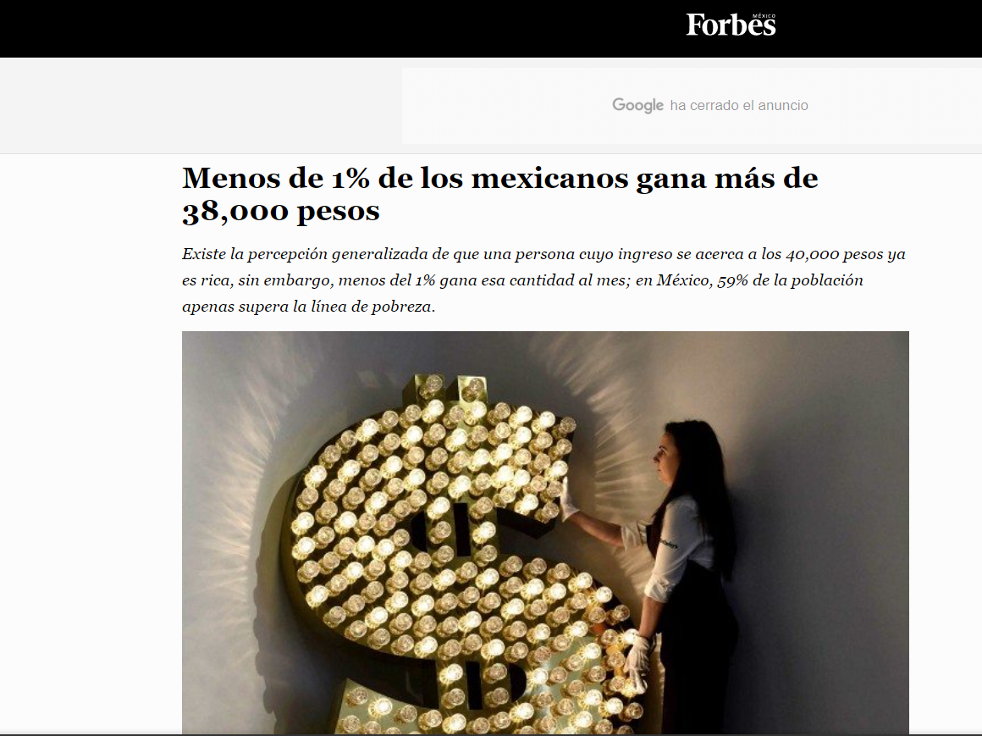

Slide 7
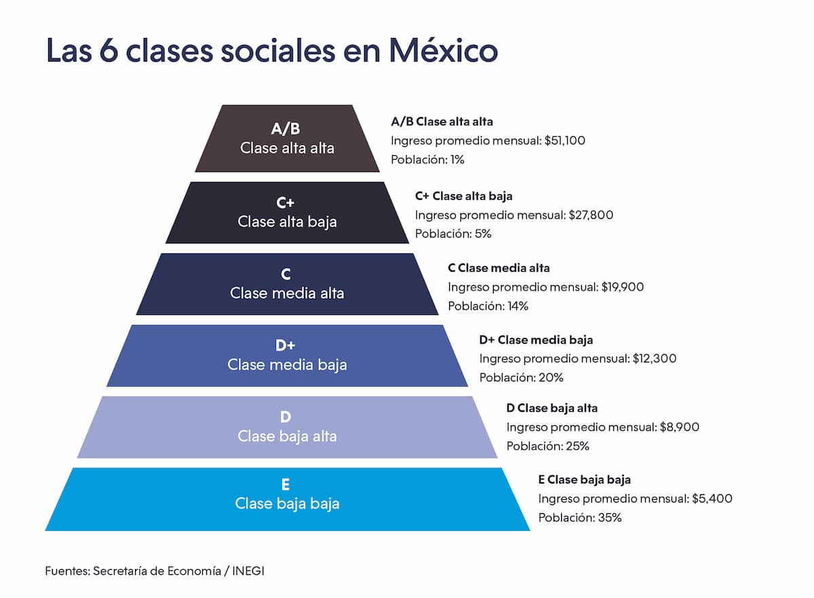
A partir de ingresos superiores a $38,000 una persona es considerada rica

