Slide 1
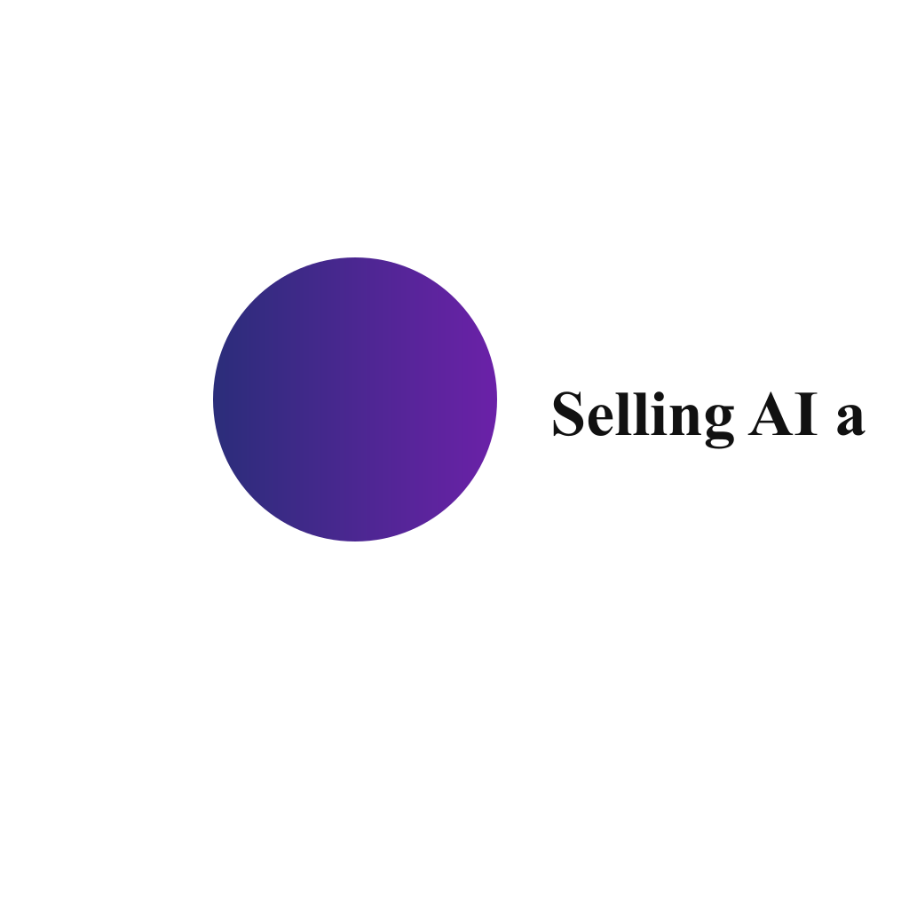
Selling AI agents as a service/product online

Slide 2
Problem / Opportunity
The AI agent market is still in its early stages with significant room for innovation. There's a growing need for specialized, domain-specific AI agents. No-code/low-code interfaces for AI agents could open up a large market. Integration capabilities with existing systems are increasingly important. Trust and explainability are becoming key differentiators.

Slide 3
Solution / Product
Solution details not available

Slide 4
Market & TAM
300000000000

Slide 5
Business Model & Financials (illustrative)
Pricing model not provided

Slide 6
Go-to-Market
GTM not available

Slide 7
Validation, Risks & Next Steps
[
"Focus on a specific niche or vertical rather than being a general provider",
"Develop strong integration capabilities with popular platforms",
"Emphasize ease of use and no-code interfaces for non-technical users",
"Build strong security and privacy features",
"Focus on transparent and explainable AI",
"Consider a tiered pricing model to appeal to different customer segments",
"Build a strong community and developer ecosystem"
]

Slide 8

Brand Identity
Brand story not available

