Slide 1
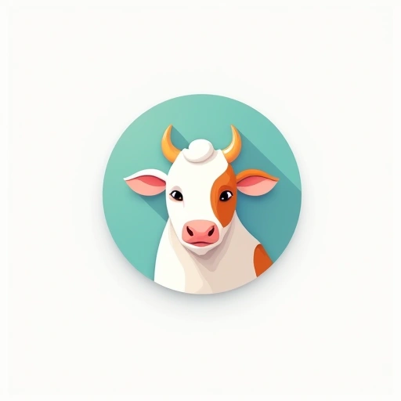
online dairy business

Slide 2
Problem / Opportunity
The online grocery market has grown significantly, with dairy representing a substantial portion of grocery spending. Consumers increasingly value convenience and are willing to pay premium prices for home delivery. There's growing demand for organic, sustainable, and specialty dairy products. Subscription models and farm-to-table approaches are gaining popularity, and technology integration enhances the customer experience. Sustainability concerns are driving demand for eco-friendly packaging solutions.

Slide 3
Solution / Product
Solution details not available

Slide 4
Market & TAM
30000000000

Slide 5
Business Model & Financials (illustrative)
Pricing model not provided

Slide 6
Go-to-Market
GTM not available

Slide 7
Validation, Risks & Next Steps
[
"Identify a specific niche within the online dairy market",
"Develop a strong value proposition to differentiate from competitors",
"Focus on a specific geographic area initially",
"Invest in reliable cold chain logistics",
"Build relationships with quality dairy suppliers",
"Implement a subscription model for recurring revenue",
"Emphasize sustainability in packaging and delivery",
"Consider offering value-added services like recipe suggestions"
]

Slide 8


Brand Identity
Brand story not available

