Slide 1
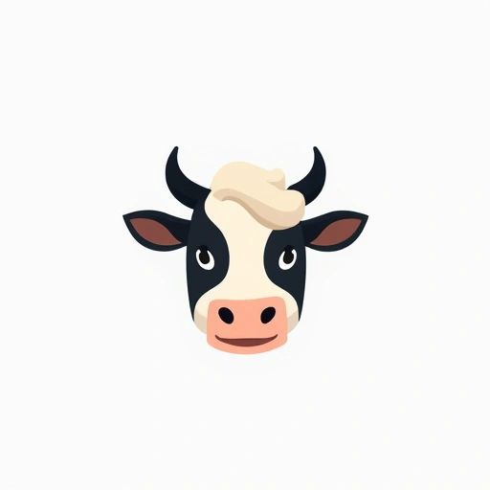
online dairy business

Slide 2
Problem / Opportunity
The online grocery segment is growing at 15-20% annually, with dairy products representing a significant category. Consumers are increasingly seeking organic, specialty, and sustainable dairy options. Direct-to-consumer models offer better margins and stronger brand relationships. Subscription models provide recurring revenue, but freshness is a key concern for dairy purchases online.

Slide 3
Solution / Product
Solution details not available

Slide 4
Market & TAM
14600000000

Slide 5
Business Model & Financials (illustrative)
Pricing model not provided

Slide 6
Go-to-Market
GTM not available

Slide 7
Validation, Risks & Next Steps
[
"Focus on niche premium dairy rather than commodity products",
"Invest heavily in cold chain logistics",
"Develop farm-to-consumer storytelling",
"Implement hybrid subscription/one-time purchase model",
"Partner with local dairy producers for unique offerings",
"Create robust quality assurance system",
"Develop user-friendly platform with detailed product information",
"Implement generous return policy for perishables"
]

Slide 8


Brand Identity
Brand story not available

