Slide 1

online dairy business

Slide 2
Problem / Opportunity
The online dairy market is growing as consumers increasingly prioritize convenience and home delivery. However, the perishable nature of dairy products presents significant logistical challenges. Success will likely depend on niche positioning (organic, artisanal, local), strong supply chain relationships, efficient cold chain logistics, and a subscription model for predictable revenue.

Slide 3
Solution / Product
Solution details not available

Slide 4
Market & TAM
75000000

Slide 5
Business Model & Financials (illustrative)
Pricing model not provided

Slide 6
Go-to-Market
GTM not available

Slide 7
Validation, Risks & Next Steps
[
"Start with a specific niche (organic, artisanal, local dairy)",
"Develop partnerships with local dairy producers",
"Implement a subscription model for predictable revenue",
"Focus on efficient cold chain logistics",
"Start with a limited geographic area before expanding",
"Add complementary products to increase average order value",
"Build brand trust through transparency about sourcing and quality"
]

Slide 8
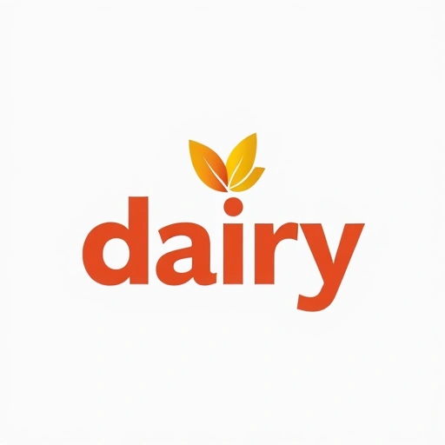

Brand Identity
Brand story not available

