Slide 1
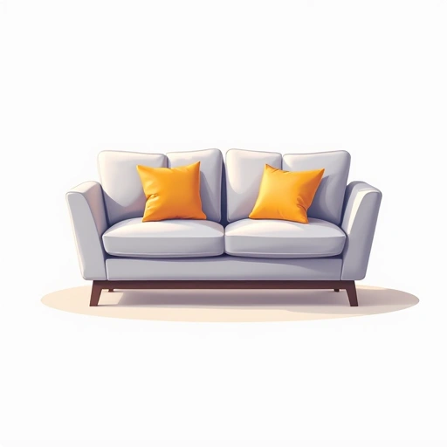
Selling furniture

Slide 2
Problem / Opportunity
The furniture market is large ($650B+) but highly competitive. E-commerce has disrupted traditional retail, but opportunities exist in sustainable materials, direct-to-consumer models, niche segments (small spaces, multifunctional pieces), customization, AR visualization tools, and partnerships with designers. Success requires clear differentiation and exceptional customer experience.

Slide 3
Solution / Product
Solution details not available

Slide 4
Market & TAM
800000000000

Slide 5
Business Model & Financials (illustrative)
Pricing model not provided

Slide 6
Go-to-Market
GTM not available

Slide 7
Validation, Risks & Next Steps
[
"Identify a specific niche or unique value proposition",
"Consider a hybrid online/offline approach",
"Focus on sustainable materials and practices",
"Implement AR technology for visualization",
"Build strong relationships with interior designers",
"Offer flexible payment options",
"Develop a compelling brand story",
"Invest in supply chain efficiency",
"Create content around home styling and trends"
]

Slide 8
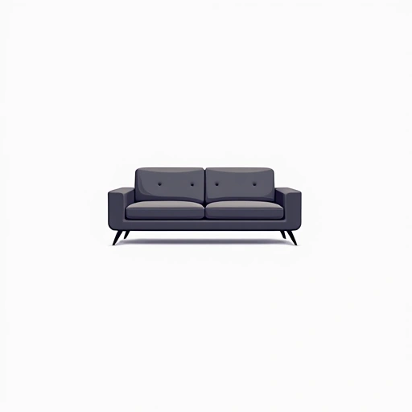

Brand Identity
Brand story not available

