Slide 1
Data Structures in C
Graphs

Slide 2
Acknowledgement
These lecture slides are based on slides by Professor Simon Hood and Professor Georg Feil
Additional sources are cited separately

Slide 3
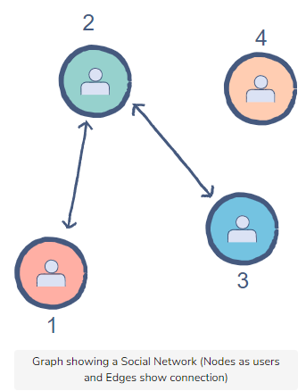
Graph definition
A graph is a set of vertices along with a set of edges
between pairs of vertices
It represents pairs of objects which are related in some way
The edges may be directed or undirected
Adjacency – nodes connected with arrows (both ways) and beside each other

Slide 4
Graphs and Trees
A tree is just a special case of a graph
Graphs are more general than trees – an edge can connect to any node, not just nodes further down the tree
Unlike trees, graphs can have cycles
Many difficult problems can be modeled and analyzed in terms of graphs

Slide 5
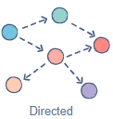
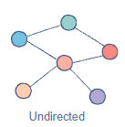
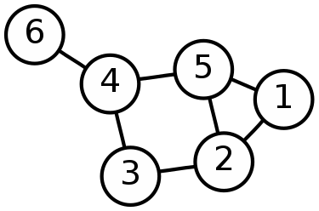
Types of graphs
Directed and undirected graphs
The image shows a graph with 6 vertices and 7 edges that is undirected
The edges go in both directions
The vertices are also called nodes

Slide 6
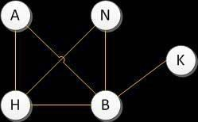
Undirected Graphs
In an undirected graph, we have two sets of information
Vertices {A, B, H, K, N}
The edges between the vertices
{(A,H),(H,B),(B,K),(B,A),(N,H),(N,B)}

Slide 7
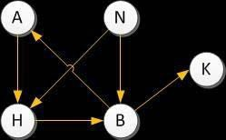
Directed Graphs
A directed graph is just like an undirected graph (a set of
vertices and edges), but the edges have a direction
Note: this means that below there is an edge from A to H, but not from H to A

Slide 8
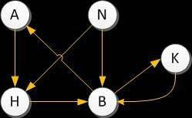
Directed Graphs
There’s an edge from B to K
If we want to draw an additional edge from K back to B,
in a directed graph we often do so with an additional line
Notice there are two lines instead of one line with two
arrows

Slide 9
Paths and Cycles
A simple “path” through our graph might be
N -> H -> B -> A
This is a path of length 3 (three edges are traversed)
Many graphs contain cycles (this is one of the main points where graphs differ from trees)
A cycle in this graph is A -> H -> B-> A

Slide 10
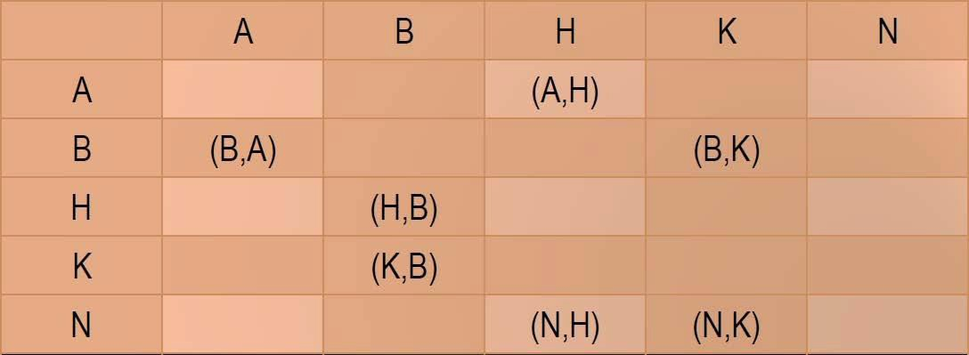
How to represent a graph
There are two common ways to represent a graph
An n x n adjacency matrix (where n is the number of vertices)
n adjacency lists
A 5 x 5 adjacency matrix for the previous graph might be drawn like this
(N,B)

Slide 11
How to represent a graph
The same graph can also be represented as a series of ‘n’
adjacency lists
Our 5 adjacency lists are as follows
Don’t read these as linked lists –they denote that the first vertex points to each other vertex to the right, but not in any particular order
1. A -> H
2. B -> A -> K
3. H -> B
4. N -> B -> H
5. K -> B

Slide 12
Which representation?
What do we use and when? Adjacency matrix or
adjacency lists?
It depends on the number of edges and the kinds of operations we may need to perform
You can use the implementation you prefer
To be efficient, if the graph is dense (has a lot of edges), the matrix representation takes less space, but for a sparse graph, the list is more space efficient
10

Slide 13
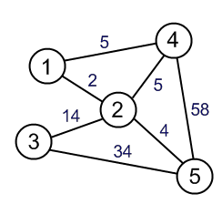
Weighted graphs
We can assign each edge a number or weight
It could represent a cost or length
For example if the vertices are cities the weights could be driving distances along highways between the cities

Slide 14
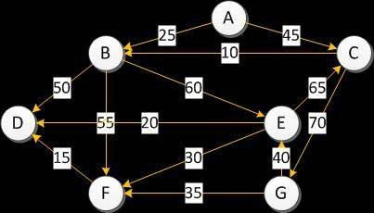
Building a graph
Let’s see how to build a graph with the following data – imagine it’s stored in a file called “graph.txt”
7
A B C D E F G
A 2 B 25 C 45
B 3 D 50 E 60 F 55
C 2 B 10 G 70
D 0
E 3 C 65 D 20 F 30
F 1 D 15
G 2 E 40 F 35

Slide 15
Building a graph
The first line of the file says there are seven vertices. The
next line gives the names or labels of the vertices
It’s followed by seven more lines, each of which
describes the edges leaving a vertex
The first item of these seven lines is the name of the vertex,
followed by the number of edges leaving it
The next items in the seven lines are a series of pairs of values describing each individual edge
The vertex the edge leads to, and its weight

Slide 16
Building a graph
So what does this look like?
That’s a pretty complex graph!
It only took a small file to represent it

Slide 17
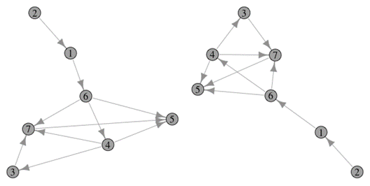
Different forms
Note that there are many ways to draw the same graph
How you draw it can make it look simpler or more
complicated

Slide 18
C code for a graph
I won’t show a complete implementation of a graph, but
let’s look at the data structure (struct) definitions
We’ll need a list of vertices, and a list of edges
Vertices:
typedef
char in t
s t r u c t {
id[MaxWordSize];
parent, cost, dis cover , f i nish, inDegree;
GEdge* f i rst Ed ge;
} GVertex;
The id field holds the name of the vertex, and firstEdge points to the first edge node

Slide 19
C code for a graph
An edge leading from a vertex to a “child” vertex
It has a next pointer so we can make a linked list of all
edges for a particular vertex
typedef s t r u c t gedge {
in t | ch ild ; | / / | chil d | i s | a | verte x | a rray | i ndex
i n t | weight;
s t r u c t
} GEdge;
gedge* nextEdge;

Slide 20
C code for a graph
We can store the graph vertices in an array
We’ll also need a variable (numV) to store the number of
vertices
Let’s create a graph structure
ty pedef | st r uct | graph | {
i n t | numV;
GVertex
} Graph;
vertex[MaxVertices
+ 1 ] ;

Slide 21

Exercise 1
Draw the directed graph denoted by the following adjacency list
This is as much an exercise in art as it is understanding the graph
file structure we are using
There are no incorrect answers as long as your graph follows the structure below
7
A B C D E F G
A 3 D 20 F 15 G 10
B 0
C 2 B 60 E 35
D 2 B 30 E 50
E 2 A 40 B 25
F 2 E 55 G 45
G 1 C 65
Expect your page to be a complete mess of arrows and weights! After you have a correct version try to optimize the layout on a new page.

Slide 22
Traversing a Graph
Depth-First Traversal, Breadth-First Traversal,
Dijkstra’s Algorithm for Shortest Path

Slide 23
Traversing a graph
See next set of slides
Data Structures in C
21

