Slide 1


Slide 2
What is Annotation
Annotations are a kind of comment or meta-data you can insert in your Java code and apply to:
  package declarations
  type declarations
  constructors
  methods
  fields
  parameters
  variables.
Can be processed:
  at compile time by pre-compiler tools
  or at runtime via Java Reflection
Notes:
Annotations is a new feature from Java 5 Annotations are like meta-tags that you can add to your code. They are a structured and typechecked means of adding metadata to your code without rendering it unreadable and messy. They can help remove the tedium of writing deployment descriptors and other generated files.
V. Metadata
• Decorates programs with additional information
• Annotations don't directly affect program semantics
─ They can affect treatment by tools and libraries
• Can be read from: source, class file, or reflectively
• Ad hoc examples: transient, @deprecated

Slide 3
What is Annotation
An annotation is the meta-tag that you will use in your code to give it some life.
Helpful ways to indicate whether your methods are dependent on other methods, whether they are incomplete, whether your classes have references to other classes, and so on.

Slide 4
Using annotations
Annotation-based development relieves Java developers from the pain of cumbersome configuration.
Annotation-based development enable tools to generate code from annotations in the source code. This leads to a declarative programming style where the programmer says what should be done (not how) and tools emit the code to do it.
Annotations are a mechanism for associating a meta-tag with program elements and allowing the compiler or the VM to extract program behaviors from these annotated elements and generate interdependent codes when necessary.
Notes:
Why Metadata?
• Many APIs require a fair amount of boilerplate
─ Example: JAX-RPC web service requires
paired interface and implementation
─ Boilerplate could be generated automatically
• Many APIs require “side files” to be maintained
─ Examples: BeanInfo class, deployment descriptor
─ Information could be maintained in program
• Many APIs use naming patterns
─ Example: JUnit
─ Naming pattern could be replace by annotation
Metadata Benefits
• Encourages a declarative programming style
─ Tell computer what to do, not how to do it
• Should vastly simplify many programming tasks
─ Web services, enterprise app development
• Many other uses, limited only by imagination
─ Test frameworks, Parser generators, DBC, etc.
http://www.ibm.com/developerworks/java/library/j-annotate1/
Special kind of modifier
─ Can be applied to any declaration
─ By convention, precede other modifiers
Annotation type, element-value pairs
─ Values must be compile-time constants

Slide 5
Using annotations
Annotations have a number of uses, among them:
Information for the compiler — Annotations can be used by the compiler to detect errors or suppress warnings.
Compiler-time and deployment-time processing — Software tools can process annotation information to generate code, XML files, and so forth.
Runtime processing — Some annotations are available to be examined at runtime.

Slide 6
Annotation Type
There are two things you need to consider with annotations:
  one is the "annotation" itself;
  another is the "annotation type“. Annotation type is used for defining an annotation. You will use it when you want to create your own custom annotation.
The type is the actual construct used, and the annotation is the specific usage of that type.
An annotation type definition takes an "at" (@) sign, followed by the interface keyword plus the annotation name.
An annotation takes the form of an "at" sign (@), followed by the annotation type (This is simplest form of annotation). Additionally, you can put data within parenthesis after the annotation name
Notes:
Annotation Type Declarations
• Similar to interface declarations
• Methods define annotation type elements
• Method return type: primitives, String,
Class, enums, annotations, arrays of same
• Methods have no parameters, throws clause
• Methods can have default value

Slide 7
Simple example
public @interface MyAnnotation {
String doSomething();
}
MyAnnotation (doSomething="What to do")
public void myMethod() { .... }

Slide 8
Rules for definition
Here are some rules-of-thumb when defining an annotation type:
  Annotation declaration should start with an 'at' sign like @, following with an interface keyword, following with the annotation name.
  Method declarations should not have any parameters.
  Method declarations should not have any throws clauses.
  Return types of the method should be one of the following:
    primitives
    String
    Class
    Enum
    Array of the above types

Slide 9
Annotation Types
Annotation are divided in 3 types by how many arguments they have:
Marker: Marker type annotations have no elements, except the annotation name itself.
  Example:
public @interface MyAnnotation { }
  Usage:
@MyAnnotation public void myMethod() {…}

Slide 10
Annotation Types
Single-Element: Single-element, or single-value type, annotations provide a single piece of data only. This can be represented with a data=value pair or, simply with the value only (a shortcut syntax), within parenthesis.
  Example:
public @interface MyAnnotation {
String value();
}
  Usage:
  @MyAnnotation ("What to do")
  public void myMethod() { .... }

Slide 11
Annotation Types
Full-value or multi-value: Full-value type annotations have multiple data members. Therefore, you must use a full data=value parameter syntax for each member.
  Example:
  public @interface MyAnnotation {
  String doSth();
  int count;
  String date();
  }
  Usage:
  @MyAnnotation (doSth="What?", count=1,date=“today") public void myMethod() { .... }

Slide 12
Annotation Types
There are two types of annotations available with JDK5:
  Simple annotations: These are the basic types, which you can use to annotate your code only; you cannot use those to create a custom annotation type.
  Meta annotations: These are the annotation types designed for annotating annotation-type declarations. Simply speaking, these are called the annotations-of-annotations

Slide 13
Simple Annotations
Override
Deprecated
SuppressWarnings

Slide 14
The Override annotation
An override annotation indicates that the annotated method is required to override a method in a super class. If a method with this annotation does not override its super-class's method, the compiler will generate an error. Following example demonstrates the override annotation:
Example
public class Test_Override {
@Override public String toString() {
return super.toString() + " Testing annotation name: 'Override'";
}
}
Notes:
What happens if a spelling mistake occurs with the method name? For example, if you change the name of the toString() method to "tostring" and compile the code, you will get something like the following:
Method does not override a method from its superclass @Override 1 error BUILD FAILED (total time: 0 seconds)

Slide 15
The Deprecated annotation
This annotation indicates that when a deprecated program element is used, the compiler should warn you about it. Following example shows you the deprecated annotation.
Example
First, create a class with the deprecated method as follows:
public class Test_Deprecated {
@Deprecated public void doSomething() {
System.out.println("Testing annotation name: 'Deprecated'");
}
}

Slide 16
The Deprecated annotation
Next, try to invoke this method from another class:
public class TestAnnotations {
public TestAnnotations() {
Test_Deprecated t2=new Test_Deprecated();
t2.doSomething();
}
public static void main(String arg[]) throws Exception {
new TestAnnotations();
}
}
Notes:
The doSomething() method in this example is declared as a deprecated method. Therefore, this method should not be used when this class is instantiated by other classes. If you compile Test_Deprecated.java, no warning messages will be generated by the compiler. But, if you try to compile TestAnnotations.java where the deprecated method is used, you will see something like this:
Compiling 1 source file to … TestAnnotations.java(Line): warning: [deprecation] doSomething() in Test_Deprecated has been deprecated t2.doSomething(); 1 warning

Slide 17
The SuppressWarnings annotation
This annotation indicates that compiler warnings should be shielded in the annotated element and all of its sub-elements. The set of warnings suppressed in an element is the superset of the warnings in all of its containing sub-elements. As an example, if you annotate a class to suppress one warning and one of its methods to suppress another warning, both warnings will be suppressed at the method level only.
Note: It is a good idea to use this annotation at the most deeply nested element where it is effective. Therefore, if you want to suppress a warning in a particular method, you should annotate that method rather than its class.
Notes:
all to suppress all warnings
boxing to suppress warnings relative to boxing/unboxing operations
cast to suppress warnings relative to cast operations
dep-ann to suppress warnings relative to deprecated annotation
deprecation to suppress warnings relative to deprecation
fallthrough to suppress warnings relative to missing breaks in switch statements
finally to suppress warnings relative to finally block that don’t return
hiding to suppress warnings relative to locals that hide variable
incomplete-switch to suppress warnings relative to missing entries in a switch statement (enum case)
nls to suppress warnings relative to non-nls string literals
null to suppress warnings relative to null analysis
rawtypes to suppress warnings relative to un-specific types when using generics on class params
restriction to suppress warnings relative to usage of discouraged or forbidden references
serial to suppress warnings relative to missing serialVersionUID field for a serializable class
static-access to suppress warnings relative to incorrect static access
synthetic-access to suppress warnings relative to unoptimized access from inner classes
unchecked to suppress warnings relative to unchecked operations
unqualified-field-access to suppress warnings relative to field access unqualified
unused to suppress warnings relative to unused code

Slide 18
The SuppressWarnings annotation
Example
public class TestAnnotations {
public static void main(String arg[]) throws Exception {
new TestAnnotations().doSomeTestNow();
}
@SuppressWarnings({"deprecation"})
public void doSomeTestNow() {
Test_Deprecated t2 = new Test_Deprecated(); t2.doSomething();
}
}
Notes:
In this example, you are suppressing the deprecation warning for the method listing shown in Example 2. Because the method is suppressed, you are unlikely to view the "deprecation" warning any more.

Slide 19
Meta-Annotations
(Annotation Types)
Meta-annotations, which are actually known as the annotations of annotations, contain four types. These are:
  Target
  Retention
  Documented
  Inherited

Slide 20
The Target annotation
The target annotation indicates the targeted elements of a class in which the annotation type will be applicable. It contains the following enumerated types as its value:
  @Target(ElementType.TYPE)—can be applied to any element of a class
  @Target(ElementType.FIELD)—can be applied to a field or property
  @Target(ElementType.METHOD)—can be applied to a method level annotation
  @Target(ElementType.PARAMETER)—can be applied to the parameters of a method
  @Target(ElementType.CONSTRUCTOR)—can be applied to constructors
  @Target(ElementType.LOCAL_VARIABLE)—can be applied to local variables
  @Target(ElementType.ANNOTATION_TYPE)—indicates that the declared type itself is an annotation type

Slide 21
The Target annotation
Example
First, define an annotation named Test_Target with @Target metadata, as follows:
  @Target(ElementType.METHOD)
  public @interface Test_Target {
  public String doTestTarget();
  }
Notes:
The @Target(ElementType.METHOD) indicates that this annotation type can be used to annotate only at the method levels.

Slide 22
The Target annotation
Example
Next, create a class that will use the Test_Target annotation:
  public class TestAnnotations {
    @Test_Target(doTestTarget="Hello World !")
    public void doTestTarget() {
    System.out.printf("Testing Target annotation");
    }
    public static void main(String arg[]) {
    new TestAnnotations().doTestTarget();
    }
  }
Notes:
The @Target(ElementType.METHOD) indicates that this annotation type can be used to annotate only at the method levels. If you compile the preceding code, no warning messages will be shown.

Slide 23
The Target annotation
Example
Now, if you declare a String variable and apply your newly created annotation, what will happen?
public class TestAnnotations {
@Test_Target(doTestTarget="Hello World !")
private String str;
public static void main(String arg[]) {
new TestAnnotations().doTestTarget();
}
public void doTestTarget() {
System.out.printf("Testing Target annotation");
}
}
Notes:
The only change you can see from above is that the annotation declaration is shifted from method-level to field-level, which is not correct. Because you have defined your annotation @Test_Target to be applicable only at method-level, if you try to compile this class, you are likely to get something like this:
"TestAnnotations.java": D:R_AND_DTestAnnotationsrctestmyannotation TestAnnotations.java:16: annotation type not applicable to this kind of declaration at line 16, column 0 @Test_Target(doTestTarget="Hello World !") ^ Error in javac compilation

Slide 24
The Retention annotation
The retention annotation indicates where and how long annotations with this type are to be retained. There are three values:
  RetentionPolicy.SOURCE – Annotations retained only at the source level and will be ignored by the compiler
  RetentionPolicy.CLASS - Annotations retained by the compiler at compile time, but will be ignored by the VM (run-time)
  RetentionPolicy.RUNTIME – Annotations retained by the VM so they can be read only at run-time

Slide 25
The Retention annotation
Example (RetentionPolicy.RUNTIME value in action):
@Retention(RetentionPolicy.RUNTIME)
public @interface Test_Retention {
String doTestRetention();
}
In this example, the @Retention(RetentionPolicy.RUNTIME) annotation indicates that your Test_Retention annotation is to be retained by the VM so that it can be read reflectively at run-time.

Slide 26
The Documented annotation
The documented annotation indicates that an annotation with this type should be documented by the javadoc tool. By default, annotations are not included in javadoc. But if @Documented is used, it then will be processed by javadoc-like tools and the annotation type information will also be included in the generated document.
@Documented public @interface Test_Documented {
String doTestDocument();
}
Next, update your TestAnnotations class as follows:

Slide 27
The Documented annotation
public class TestAnnotations {
public static void main(String arg[]) {
new TestAnnotations().doSomeTestRetention();
new TestAnnotations().doSomeTestDocumented();
}
@Test_Retention (doTestRetention="Hello retention test")
public void doSomeTestRetention() {
System.out.printf("Testing annotation 'Retention'");
}
@Test_Documented(doTestDocument="Hello document")
public void doSomeTestDocumented() {
System.out.printf("Testing annotation 'Documented'");
}

Slide 28
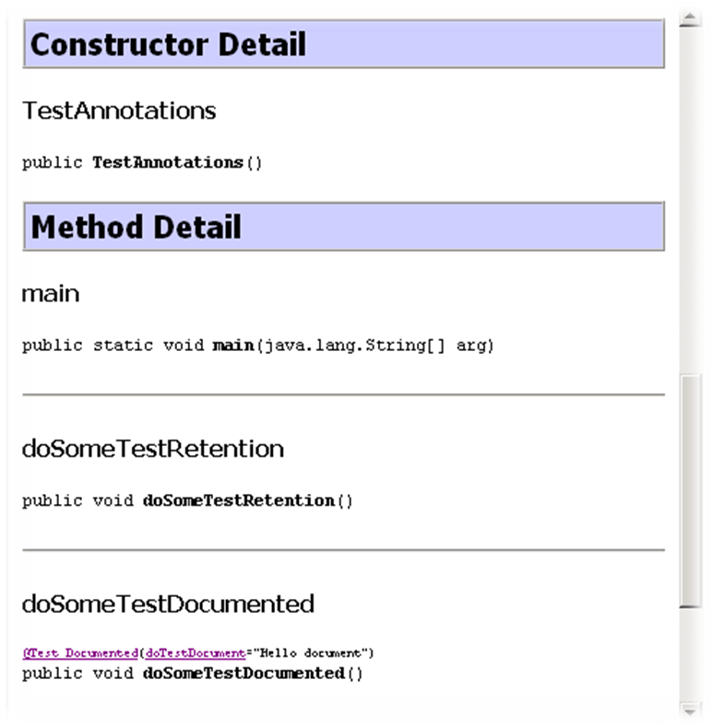
The Documented annotation
Now, if you run the
javadoc command and
view the generated
TestAnnotations.html
file, you will see
something like :
Notes:
As you can see from the screenshot, there is no annotation-type information for the doSomeTestRetention() method. But, this description is provided for the doSomeTestDocumented() method. This is because of the @Documented tag attached with your Test_Documented annotation. Your earlier annotation Test_Retention did not include this tag.

Slide 29
The Inherited annotation
This is a bit of a complex annotation type. It indicates that the annotated class with this type is automatically inherited. More specifically, if you define an annotation with the @Inherited tag, then annotate a class with your annotation, and finally extend the class in a subclass, all properties of the parent class will be inherited into its subclass.

Slide 30
The Inherited annotation
@Target(ElementType.TYPE) @Retention(RetentionPolicy.RUNTIME)
public @interface A {}
@Target(ElementType.METHOD) @Retention(RetentionPolicy.RUNTIME)
public @interface B {}
@A public interface BaseInterface {
@B public void method1();
}
public class BaseClass {
@B public void method2(){}
}
public class Derived extends BaseClass implements BaseInterface{
public void method1(){}
public void method2(){}
}

Slide 31
Conclusion
Annotations do not directly affect the semantics of a program. Development and deployment tools can read these annotations and process them in some fashion, perhaps producing additional Java programming language source files, XML documents, or other artifacts to be used in conjunction with the program containing the annotations. You now can do the same things as you would do before, but with less code and better compile-time error detection. The objective is to spend less time on unhandy code-writing and focus more on business logic rules.
The fact that the @deprecated Javadoc tag has been superseded by the @Deprecated annotation is just one indication of how much better suited annotations are for describing information about classes than are comments.
Providers of APIs and frameworks will start providing annotations as part of their toolkits. As you can imagine by seeing the @Unit system, it is very likely that annotations will cause significant changes in our Java programming experience.

Slide 32


