Slide 1
Educational platform for programming courses
Done by: Tazhben A., Sattibay G., Tursynbek B .
Checked by: Sarsembayev A.

Slide 2

Content
Introduction (User story)
Planning and task assigning
Research
Architecture
Site map

Slide 3
Introduction (User story)
We founded courses and in the process of teaching we had problems with:
Lack of convenience for checking homework
Inconvenient structure in teaching for students when send all material to the messengers(telegram , whatapp)
The time limit for the broadcast
Expensive subscription of similar online platform
After all of these, we wanted to solve this problem for ourselves
Build a platform that will be convenient for users and business customers
Will build a safe and fast system with userFriendly interface

Slide 4
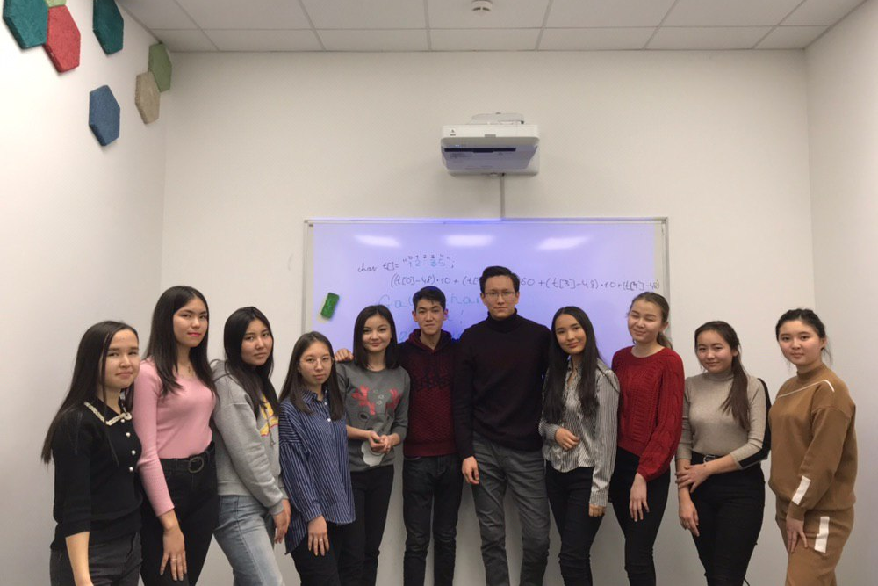
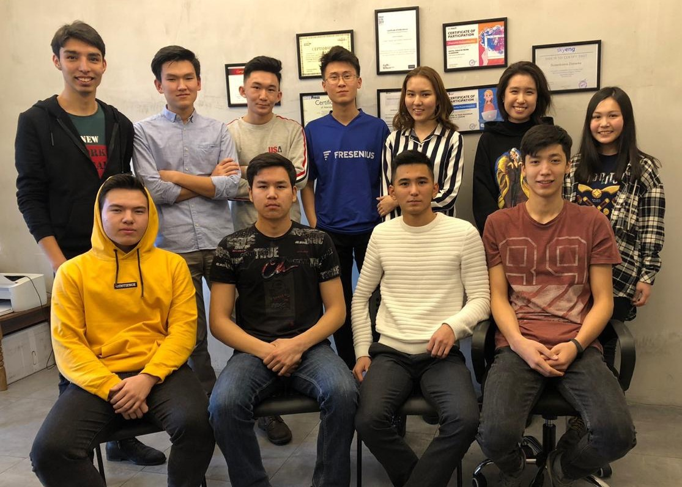
Target audience
The service will be used by students of our courses

Slide 5
Relevant Survey
54 graduates were interviewed
23 students (43%) are not satisfied with the ease of access to materials. Difficult to find or not find the right material The course materials were in the Telegram chat. They were thrown off as messages. Materials: lectures in text format, disassembled codes in the classroom, additional videos from teachers, useful links.
29 students (54%) are not satisfied with the technical quality of online classes. Due to the fact that streaming services were loaded for a long time, there were delays in the introduction of classes

Slide 6
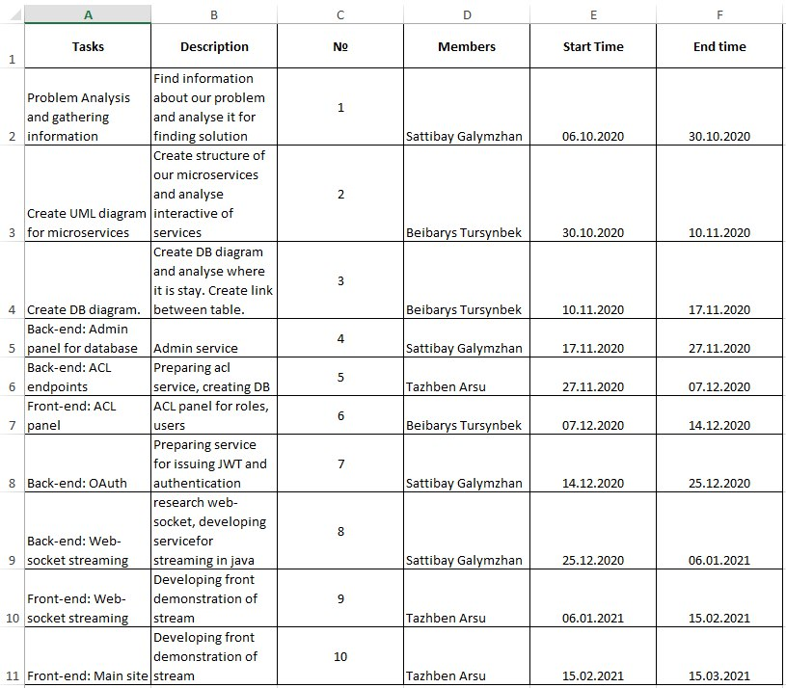
Planning and task assigning

Slide 7
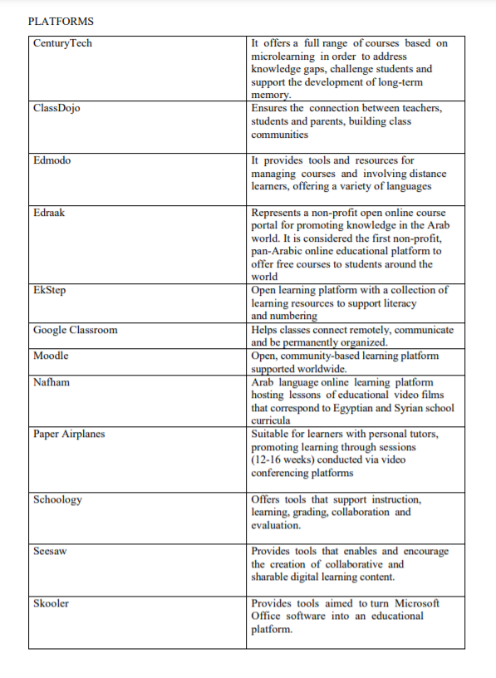
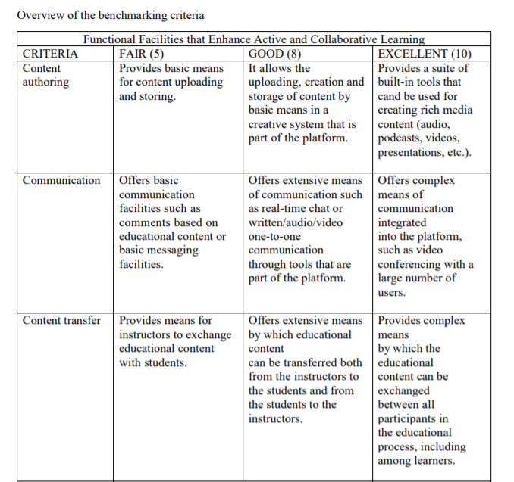
Market research

Slide 8
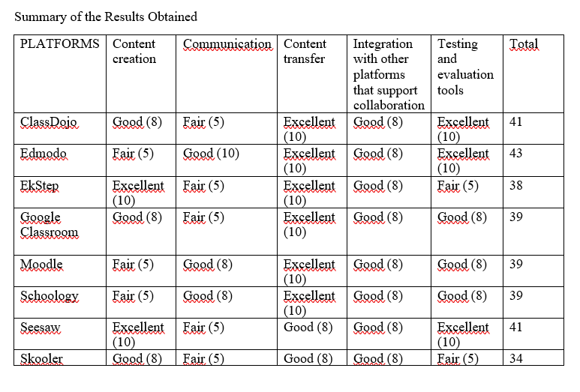
Market research Result

Slide 9
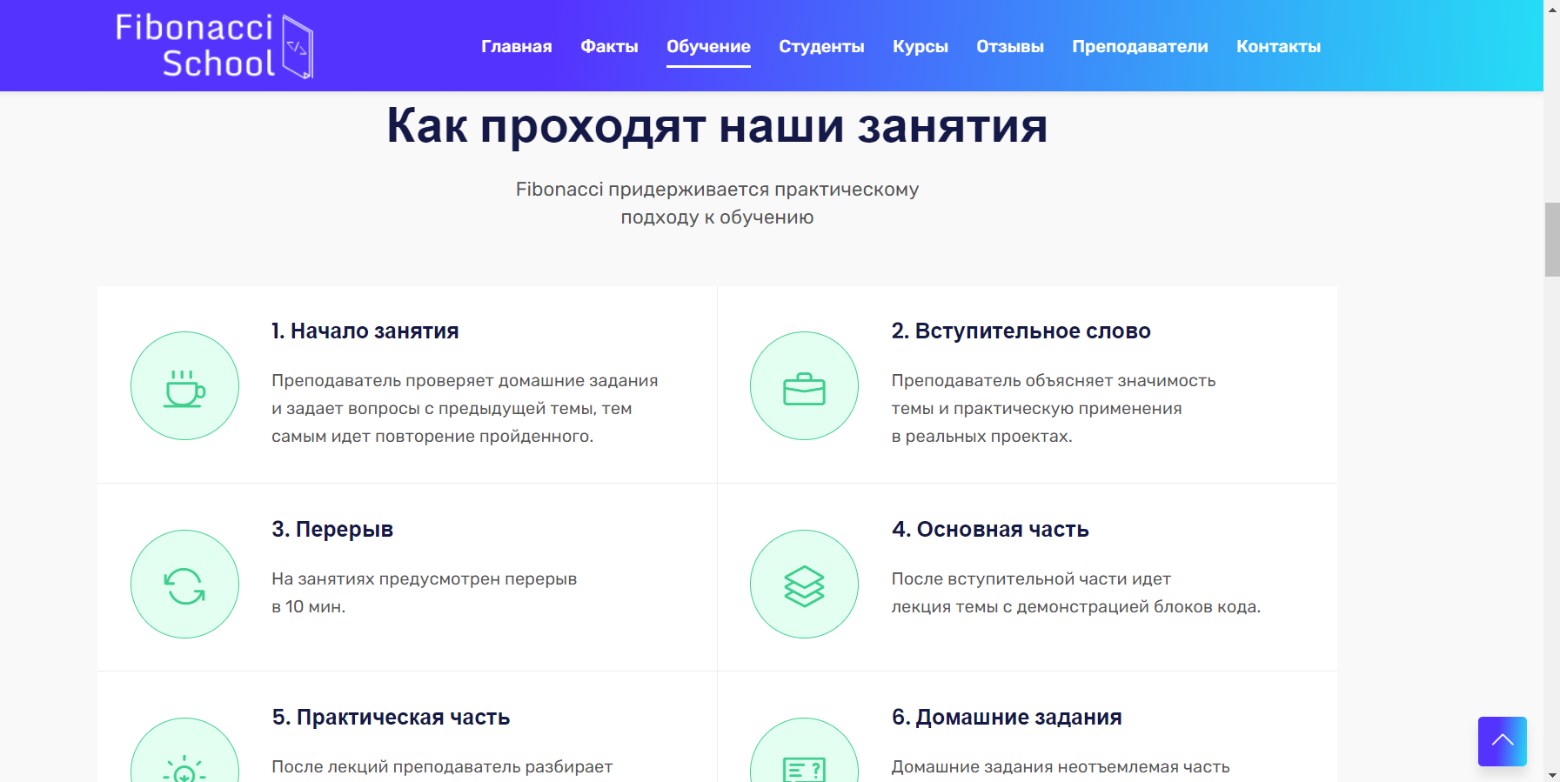
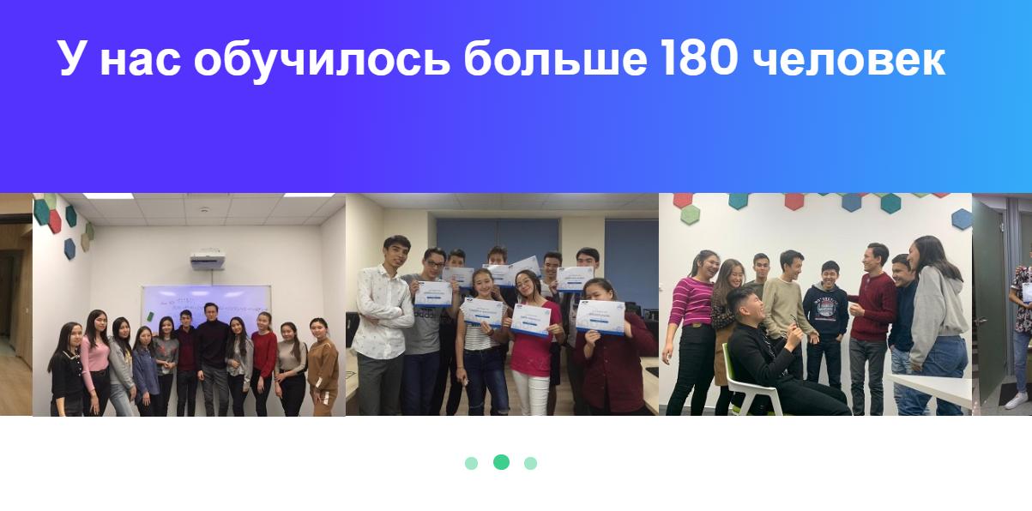
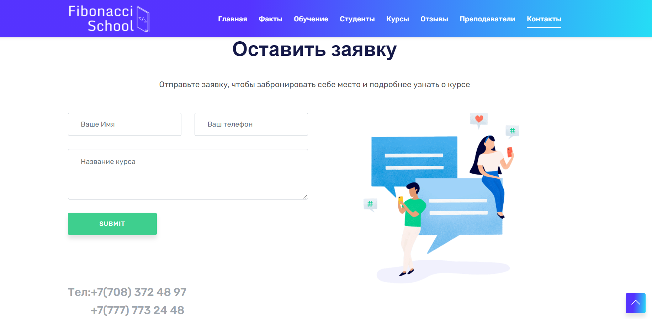
What are we done for today?
Finished the full landing page.
Created relationships between tables and microservices
Link for our page: http://fibonacci-school.kz/

Slide 10
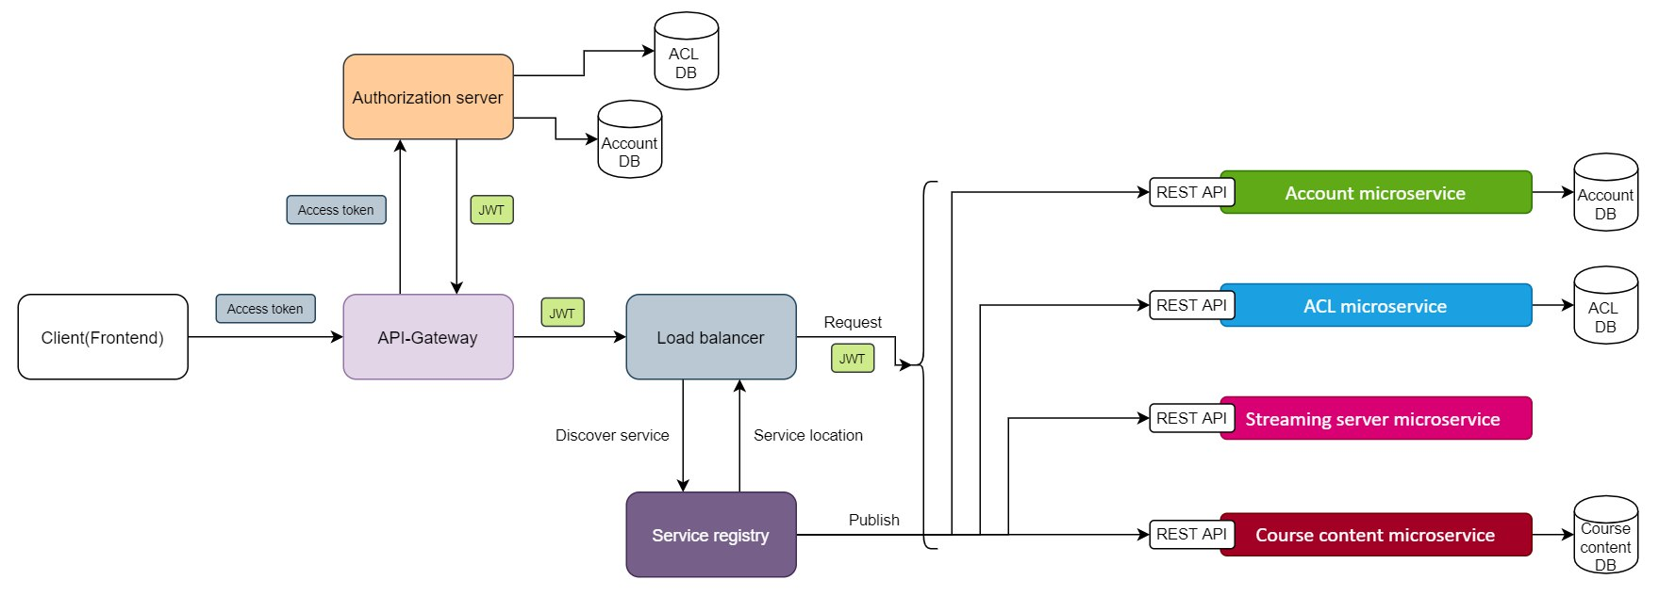
Microservice architecture

Slide 11
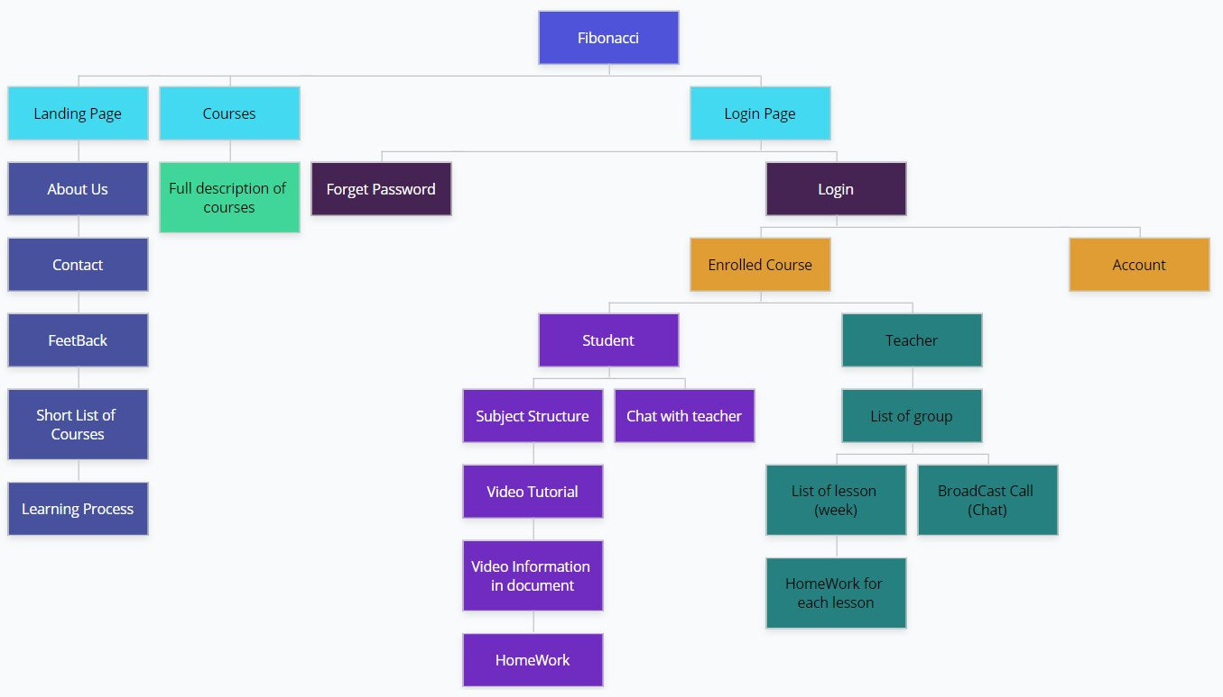
Site map

