Slide 1

Numbers representations
Representations for integers:
  unsigned representation: only for natural numbers
  signed representations (codes): for integers with sign
    direct code
    inverse code (one’s complement)
    complementary code (two’s complement)
Representations for real numbers:
  fixed-point representation
  floating-point representation

Slide 2
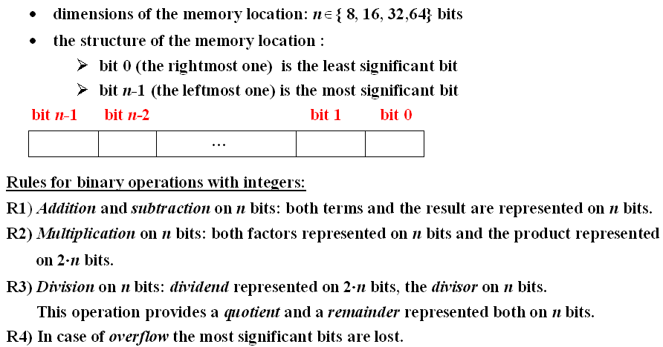
Binary representations of integers

Slide 3
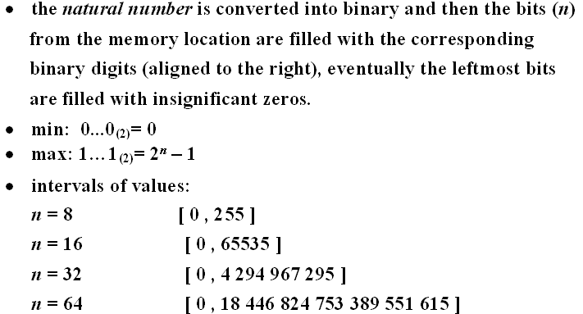
Unsigned representation

Slide 4
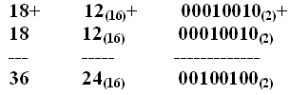
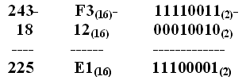
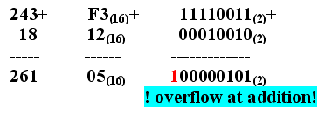
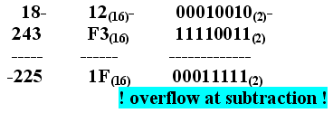
Examples of representations and operations on 8 bits

Slide 5
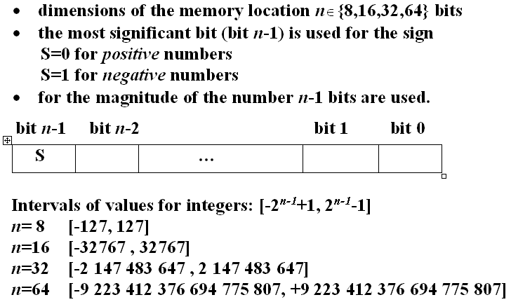
Signed representations – codes
(direct, inverse, complementary)

Slide 6
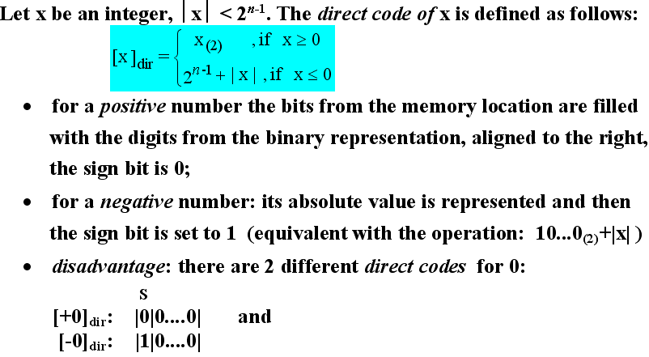
Direct code

Slide 7
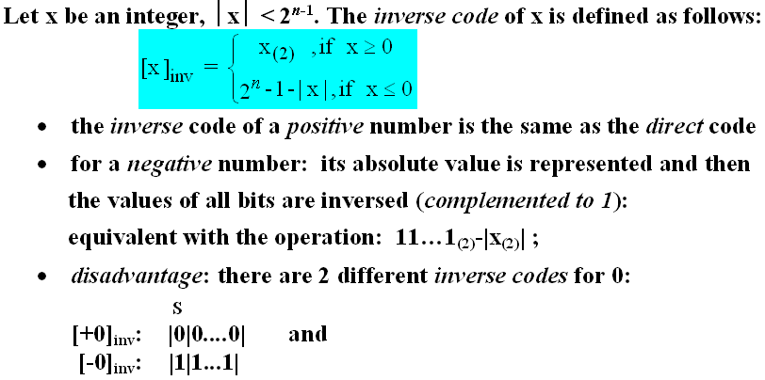
Inverse code (one’s complement)

Slide 8
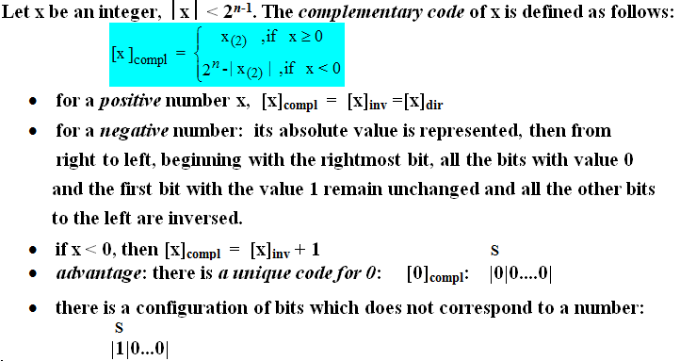
Complementary code (two’s complement)

Slide 9
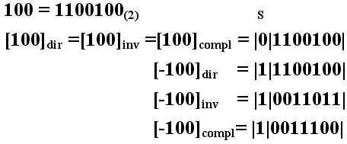
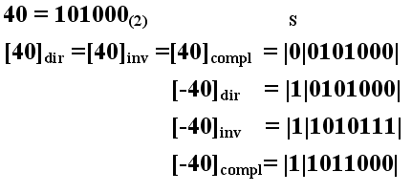
Examples of codes on 8 bits

Slide 10
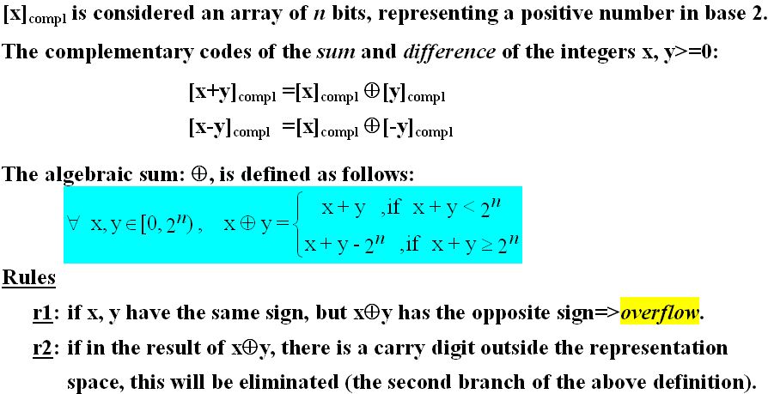
Addition and subtraction of integers in complementary code

Slide 11
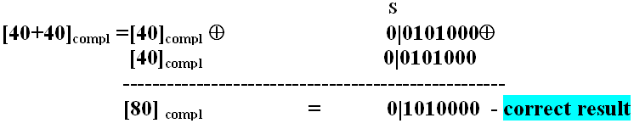
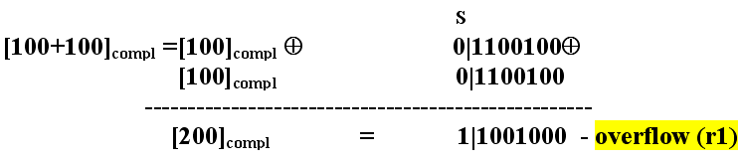
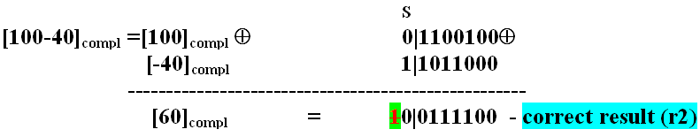
Examples

Slide 12
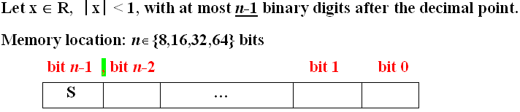
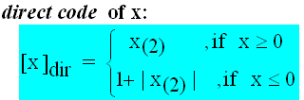
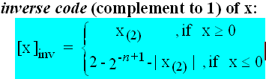
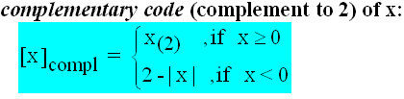
Subunitary convention

Slide 13
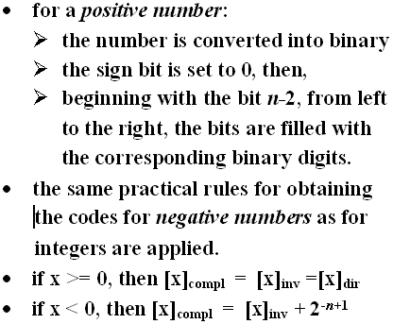
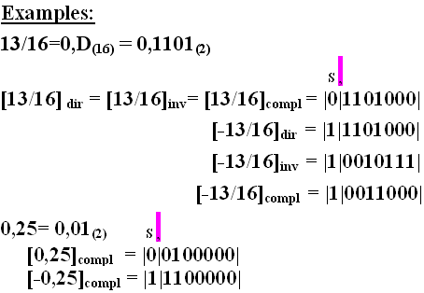
Codes for signed subunitary numbers

Slide 14
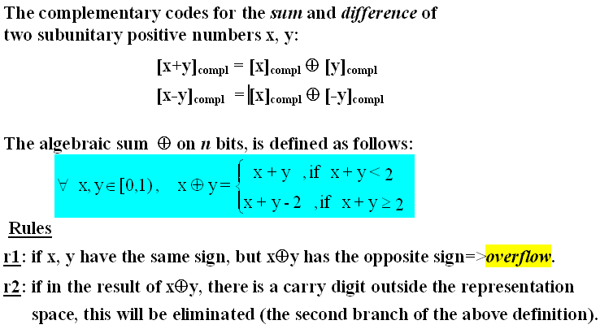
Addition and subtraction of subunitary numbers in complementary code

Slide 15
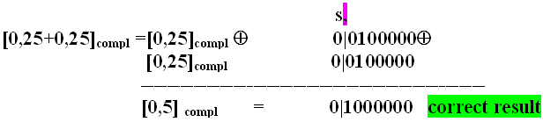
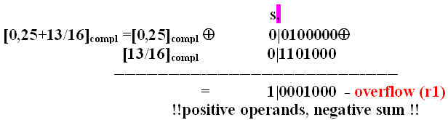
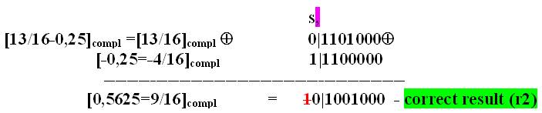
Examples: addition and subtraction of subunitary numbers

Slide 16
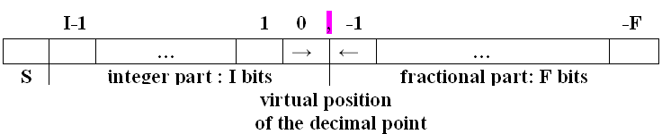
Fixed-point representation of real numbers
  Dimensions of memory location: n = 16,32,64 bits
  3 zones of the memory location with predefined dimensions (1,I,F): 1+I+F = n bits
  the most significant bit (S), position n-1, is the sign bit with the values: 0 for positive numbers and 1 for negative numbers;
  the decimal point has a fixed position, a virtual one, separating the integer part from the fractional one;

Slide 17
Fixed-point representation (contd.)
  the integer part (I bits)
    memorizes (aligned to the right relative to the virtual position of the decimal point) the digits of the absolute integer value of the number converted into binary;
    if I > the number of digits of the binary representation of the absolute integer value of the number, the remaining bits to the left are filled with 0.
    if I < the number of digits of the binary representation of the absolute value of the number, then the most significant digits of the integer part are lost (!! disadvantage).
  the fractional part (F bits)
    memorizes (aligned to the left relative to the virtual position of the decimal point) the digits of the fractional part
    if F > the number of binary digits of the fractional part then the remaining digits to the right are filled with 0.
    if F < the number of binary digits of the fractional part then the least significant digits of the fractional part are lost.

Slide 18
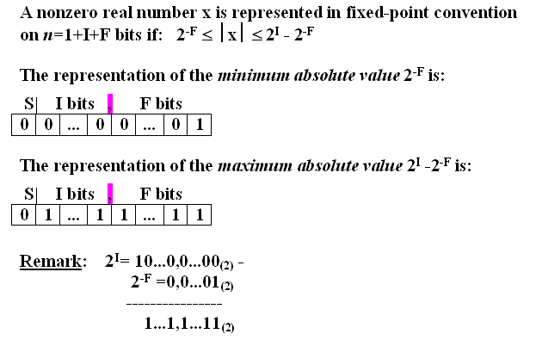
Fixed-point representation (contd.)

Slide 19
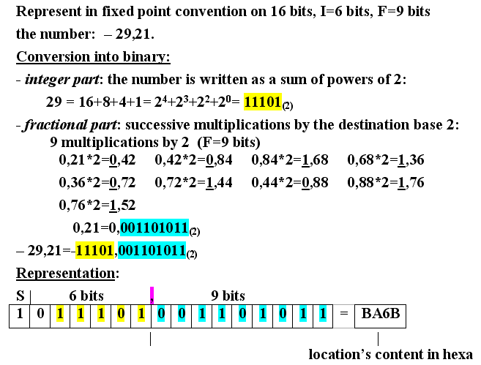
Example 1

Slide 20
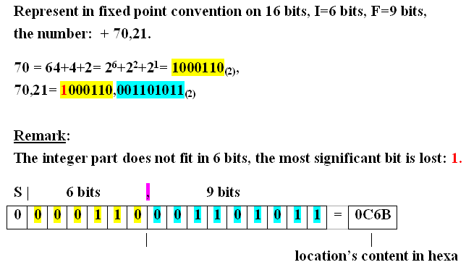
Example 2

Slide 21
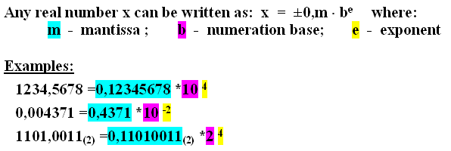
Floating point representation of real numbers
used to represent very large and very small numbers with a high precision
advantage:
if there is an overflow, then the least significant digits are lost

Slide 22
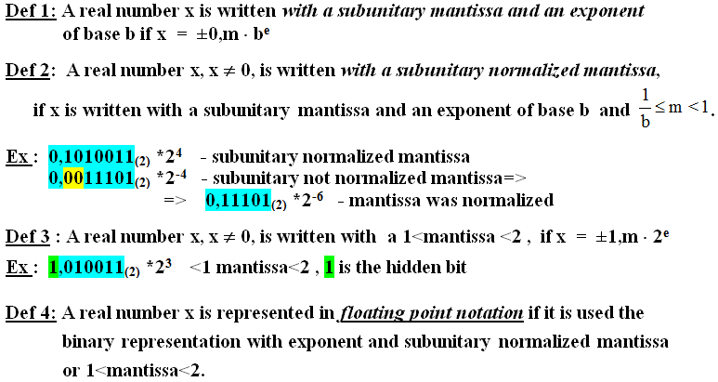
Definitions

Slide 23
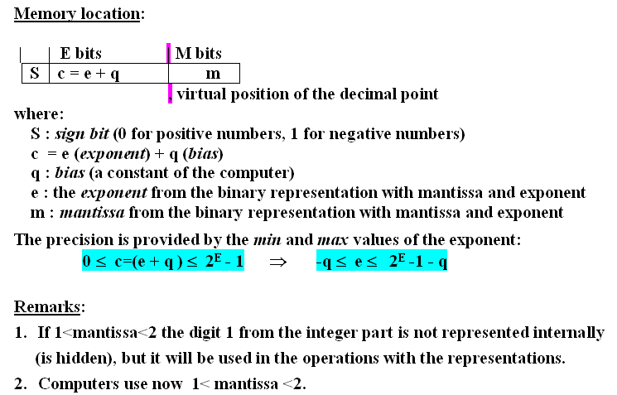
Floating point representation (contd.)

Slide 24
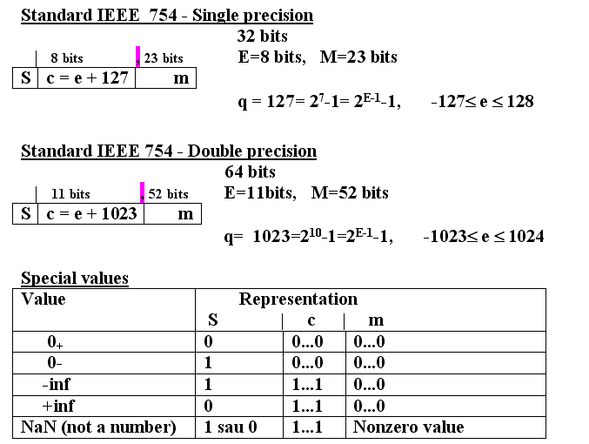
IEEE Standards: 1<mantissa< 2

Slide 25
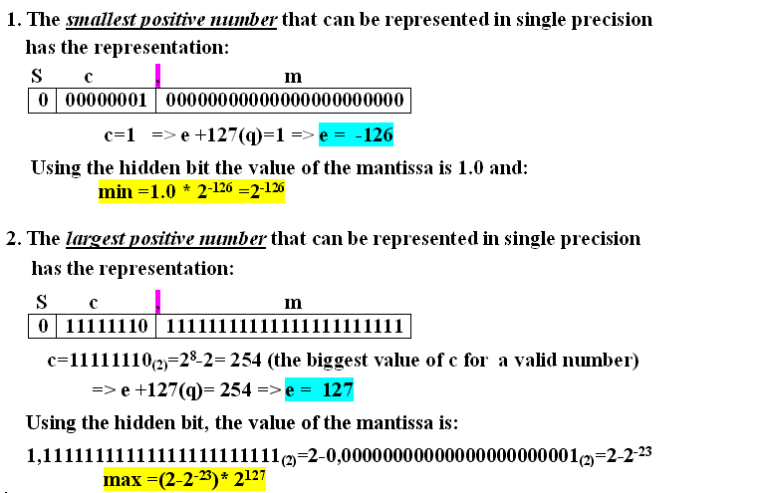
Floating point representation (contd.)

Slide 26
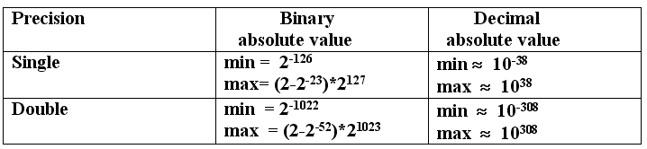
Min and max values

Slide 27
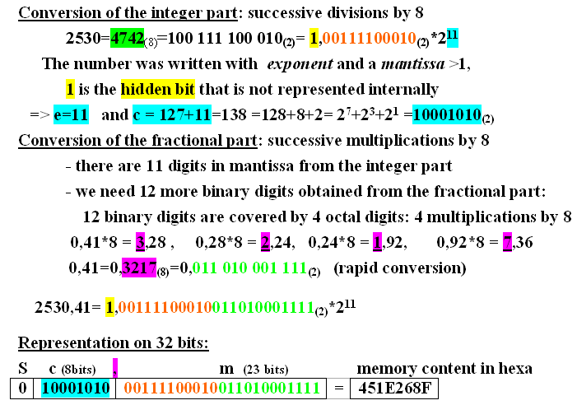
Example: Represent in floating point notation, single precision, with mantissa>1, the number 2530,41.

