Slide 1

Resolution in predicate Logic
Normal forms of predicate (first-order) formulas
  prenex, Skolem, clausal normal forms
Substitutions and unifiers
Resolution formal system
Refinements of predicate resolution

Slide 2
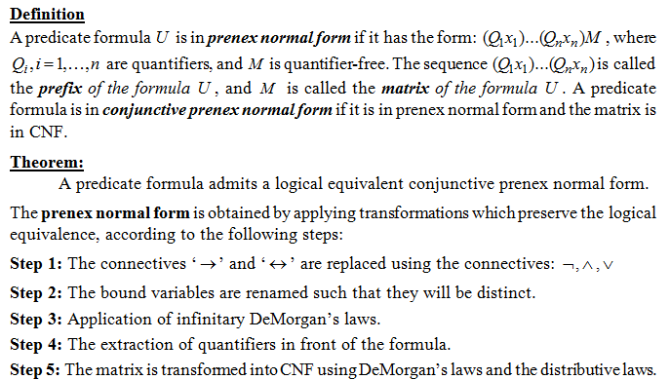
Prenex normal form

Slide 3
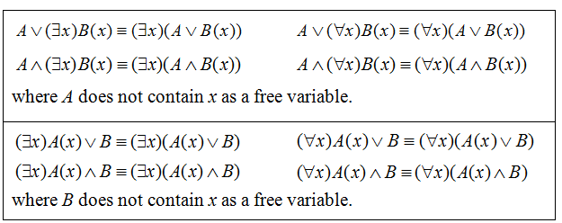
Extraction of quantifiers in front of the formula

Slide 4
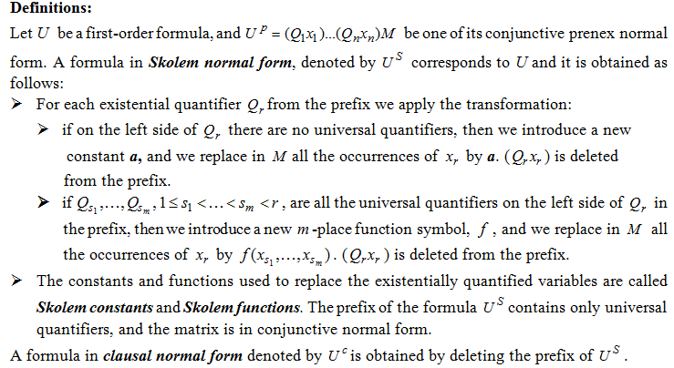
Skolem and clausal normal forms

Slide 5
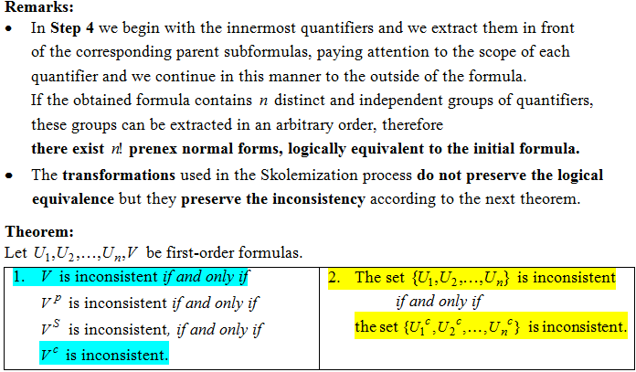
Theoretical results

Slide 6
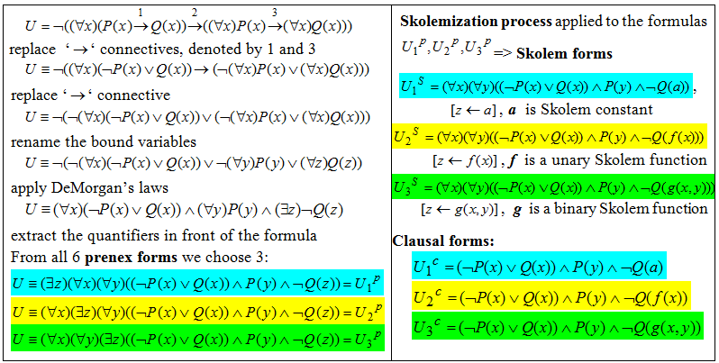
Example 1 Transform into normal forms the formula:

Slide 7
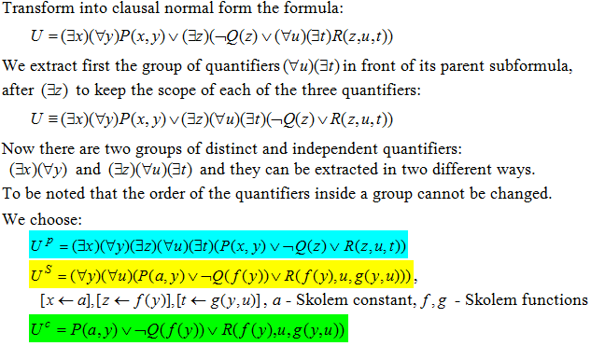
Example 2

Slide 8
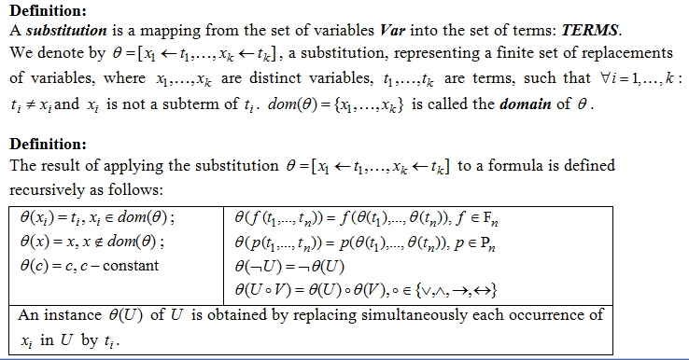
Substitutions

Slide 9
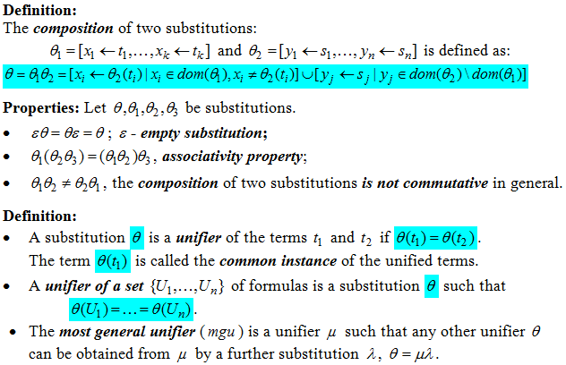
Substitutions and unifiers

Slide 10
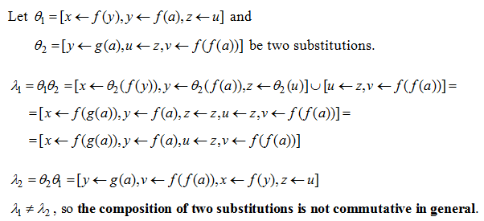
Example 3

Slide 11
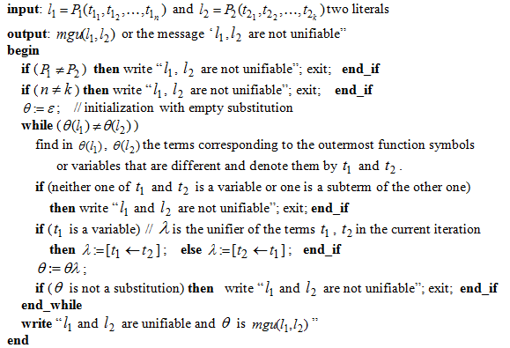
Algorithm for computing the mgu of two literals

Slide 12
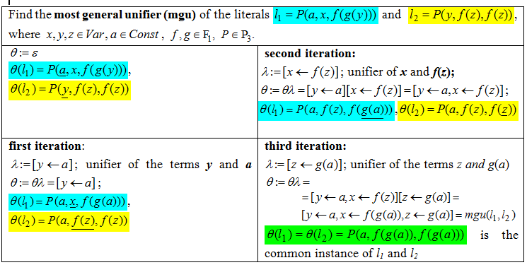
Example 4

Slide 13
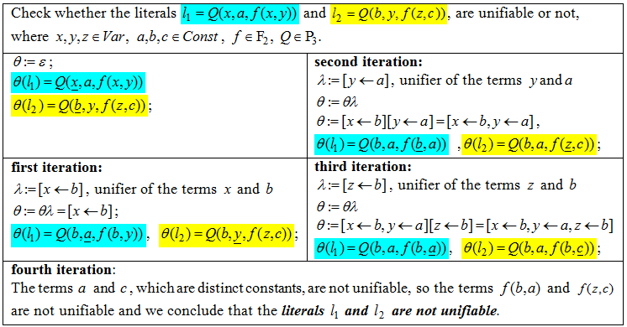
Example 5

Slide 14
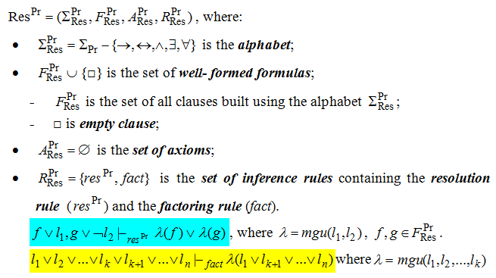
Predicate resolution
- formal (axiomatic system) -

Slide 15
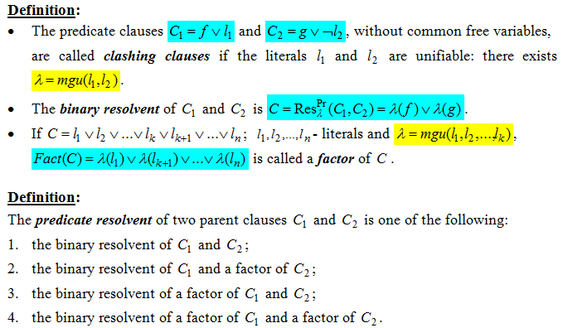
Definitions

Slide 16
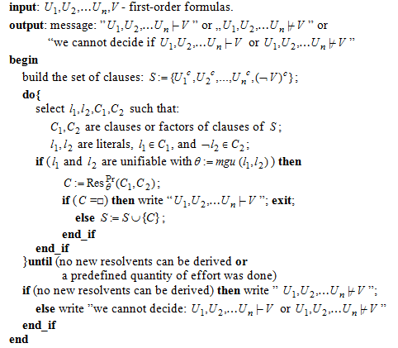
Algorithm: Predicate Resolution

Slide 17
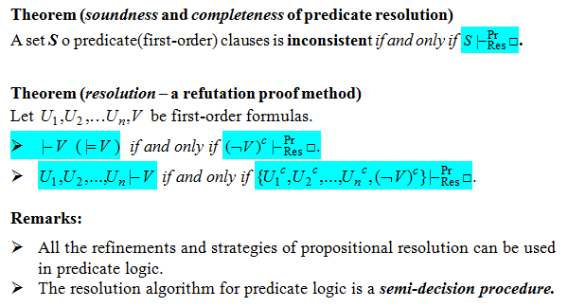
Theoretical results

Slide 18
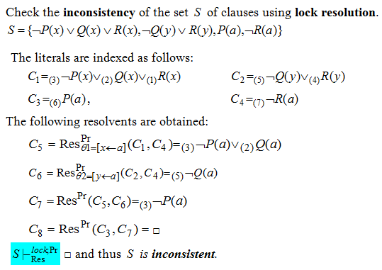
Example 6

Slide 19
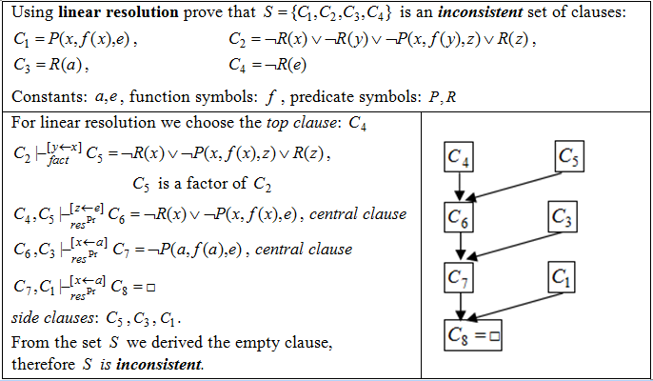
Example 7

Slide 20
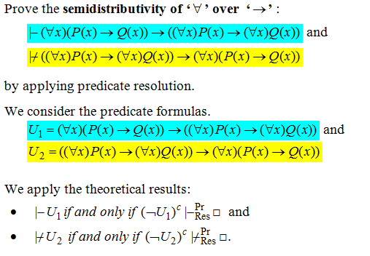
Example 8

Slide 21
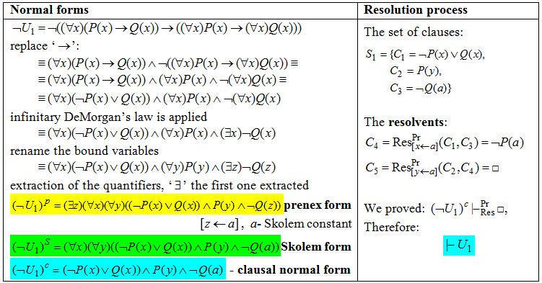
Example 8 (contd.)

Slide 22
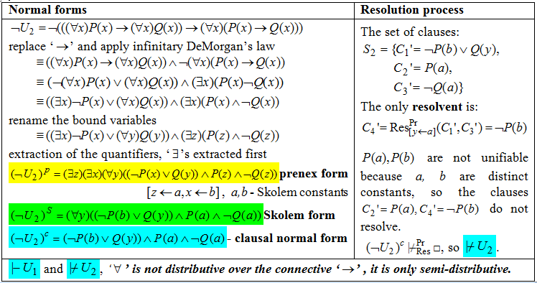
Example 8(contd.)

