Slide 1

Resolution Proof Method
IN PROPOSITIONAL LOGIC

Slide 2
Resolution Proof Method
It was proposed by J.A. Robinson in 1965 as a proof method for classical logics
Dedicated theorem provers based on resolution:
OTTER, PCPROOVE, AMPHION, Jape
It was easily adapted to nonstandard logics (modal, temporal, many-valued, non-monotonic).
Its basic aim is to check the consistency/inconsistency of a set of clauses.
It is based on syntactic considerations => syntactic method
The validity of a formula is proved by contradiction=>
=> refutation method

Slide 3
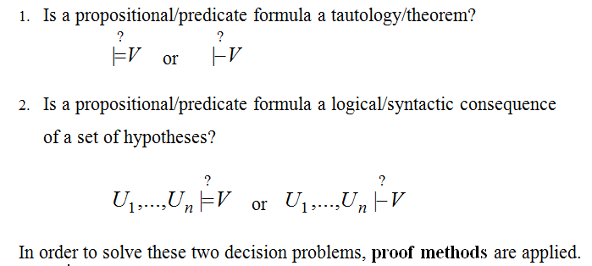
DECISION PROBLEMS IN
PROPOSITIONAL/PREDICATE LOGIC

Slide 4
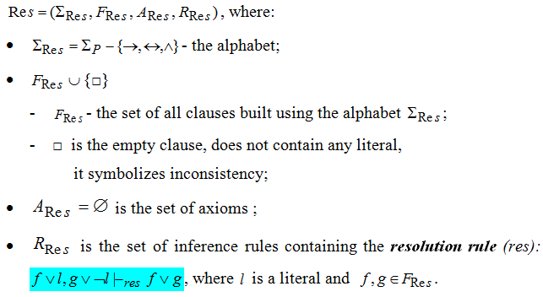
Resolution method
- formal system for propositional logic -

Slide 5
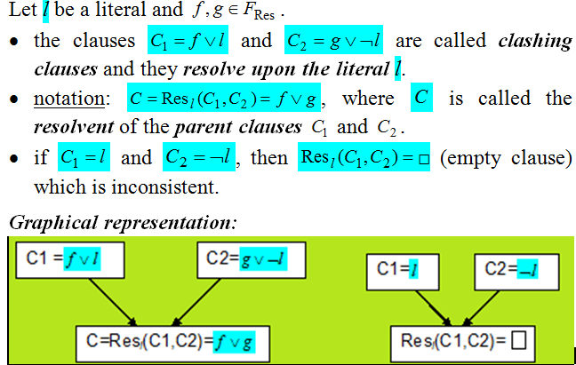
Definitions

Slide 6
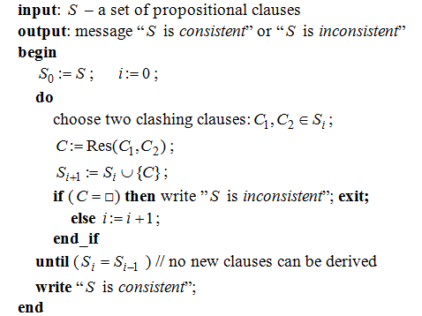
Algorithm: propositional_resolution

Slide 7
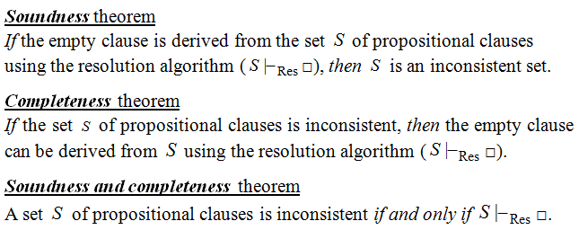
Theorems

Slide 8
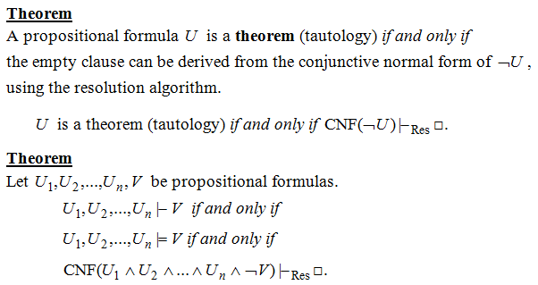
Resolution - a refutation Proof method

Slide 9
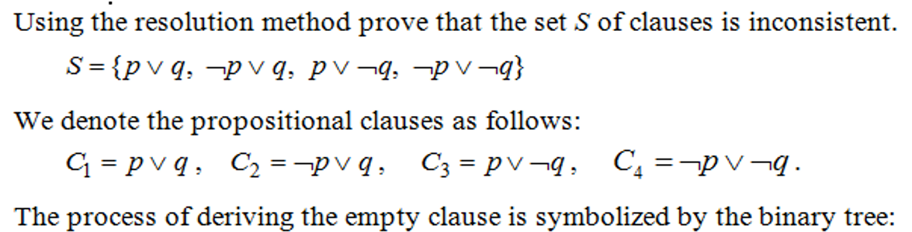
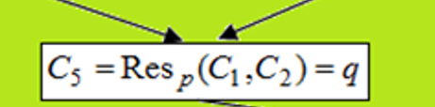
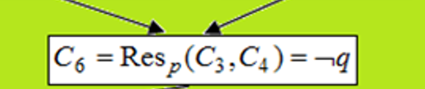

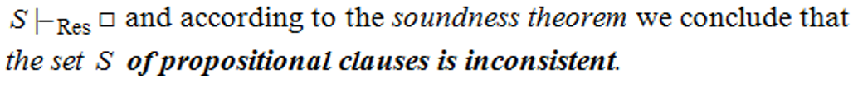
Example 1

Slide 10
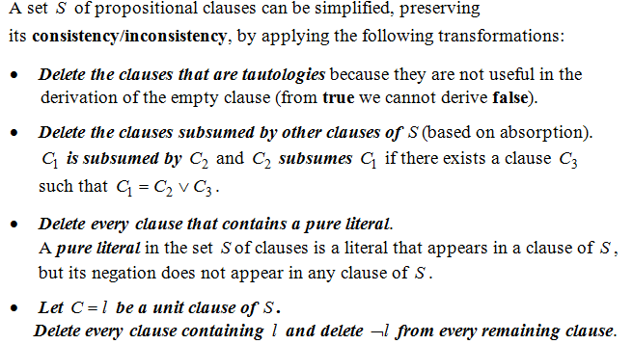
Theorem
(based on Davis-Putman procedure)

Slide 11
Strategies and Refinements of Resolution
Strategies:
  assure that all the possible clauses to be derived are generated
  try to avoid the derivation of redundant and irrelevant clauses in order to obtain the empty clause.
  level-saturation strategy, deletion strategy,
  set-of-support strategy
Refinements
  make the resolution process more efficient by imposing restrictions on the clashing clauses
  lock resolution, linear resolution,
  semantic resolution

Slide 12
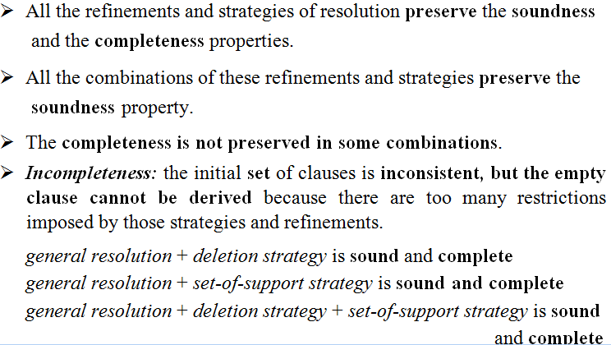
Remarks

Slide 13
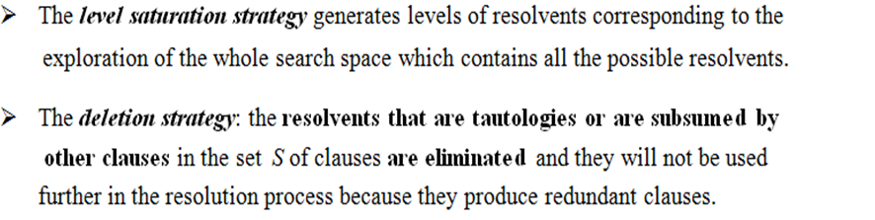
Strategies of Resolution

Slide 14
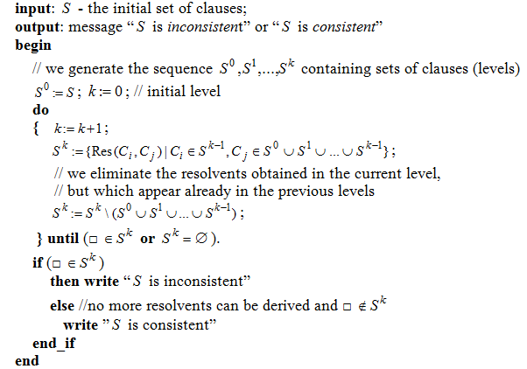
Algorithm: level-saturation-strategy

Slide 15
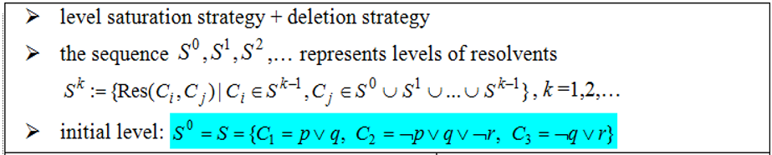
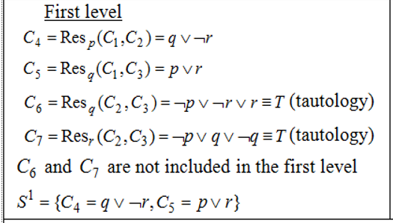
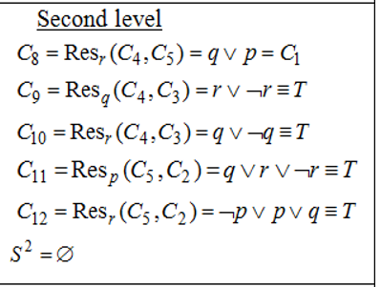

Example 2

Slide 16
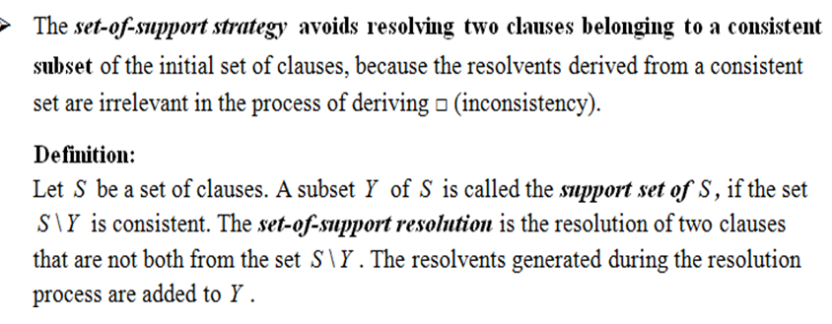
Strategies of Resolution (contd.)

Slide 17
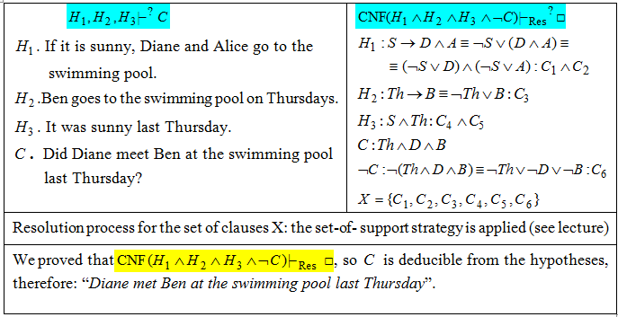
Example 3. Modeling reasoning

Slide 18
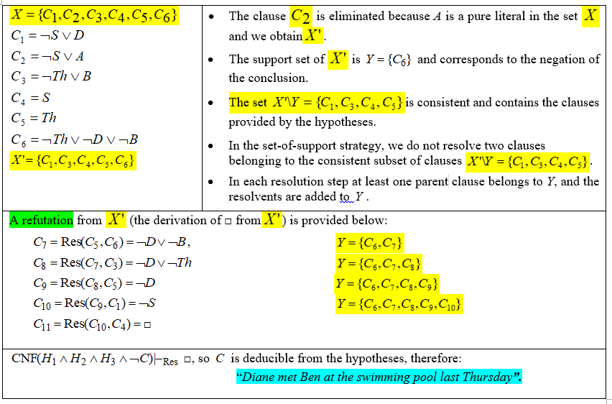
Example 3. the set-of-support strategy

Slide 19
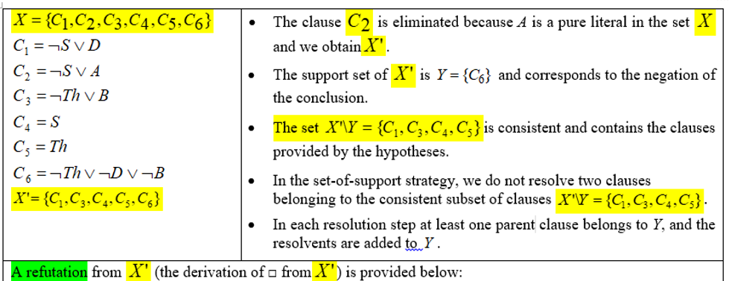
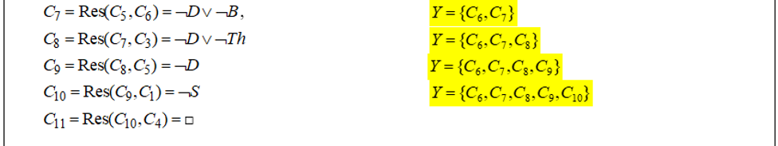
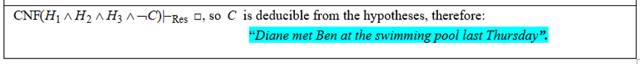
Example 3. the set-of-support strategy

Slide 20
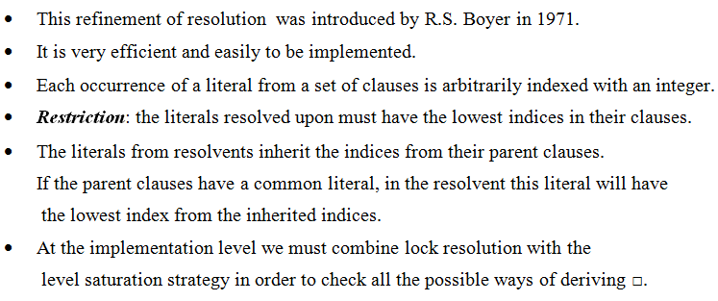
Lock Resolution

Slide 21
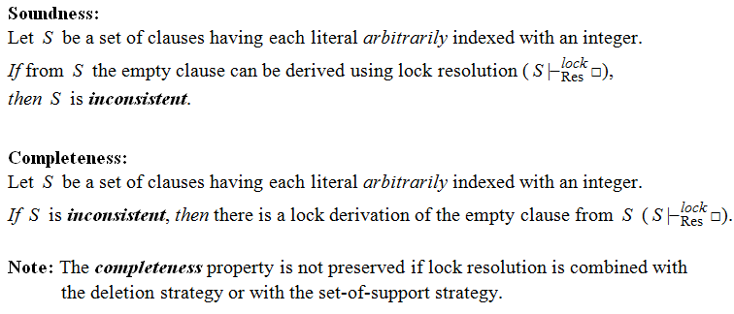
Theorems – Lock resolution

Slide 22
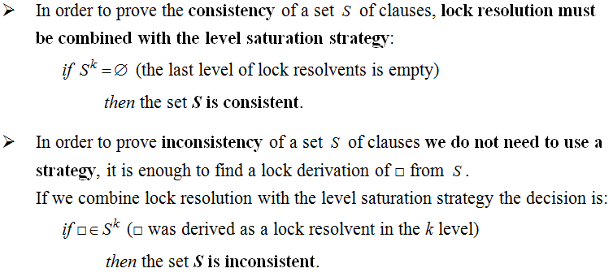
Remarks

Slide 23
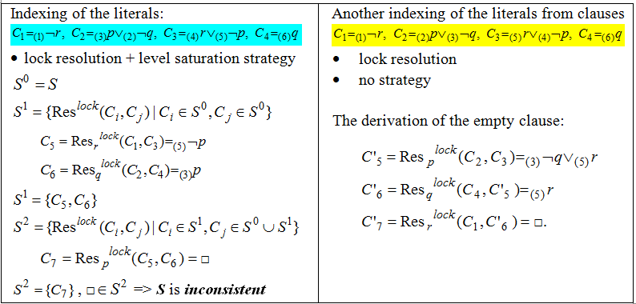
Example 4

Slide 24
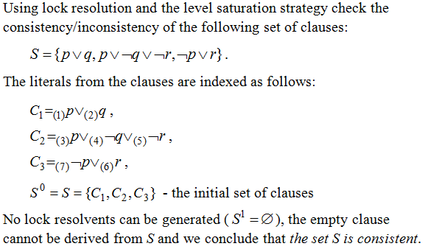
Example 5

Slide 25
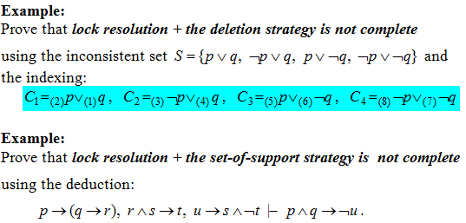
Examples (Homework)

Slide 26
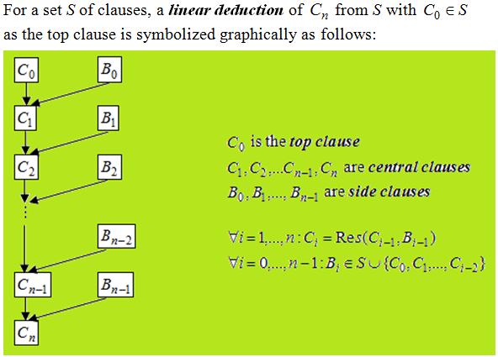
Linear Resolution (Loveland 1971)

Slide 27
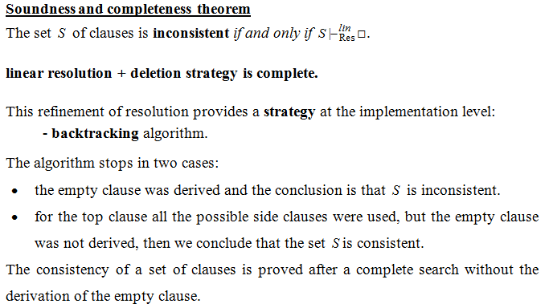
Theoretical results

Slide 28
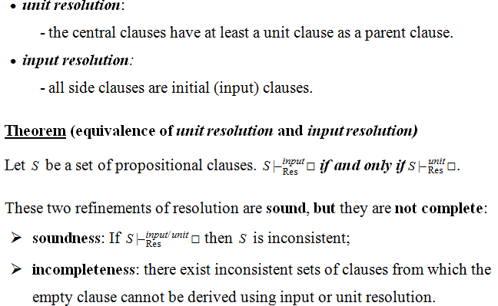
Special cases of linear resolution

Slide 29
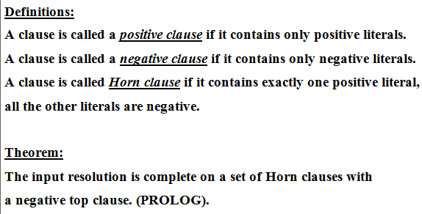
Theoretical results

Slide 30
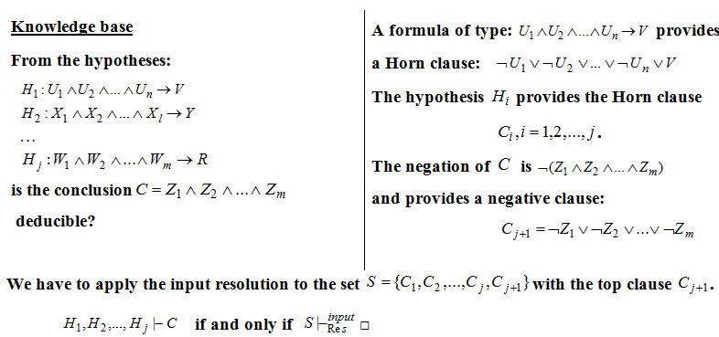
Theoretical results

Slide 31
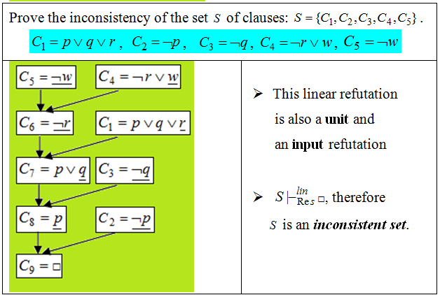
Example 6

Slide 32
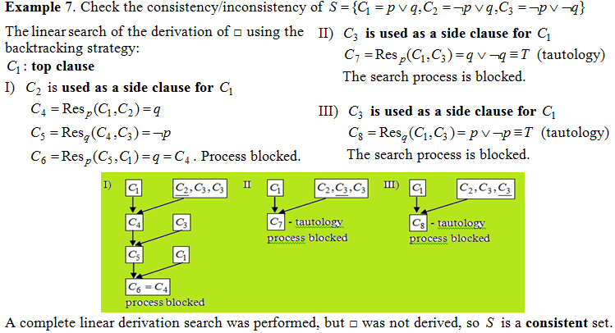

Slide 33
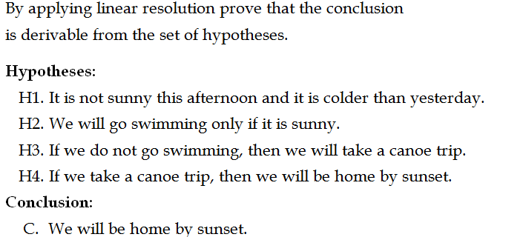
Example 8. Modeling reasoning

