Slide 1
GRPC
gRPC is a open-source RPC (Remote Procedure Call) framework used to build scalable and fast APIs

Slide 2
It allows the client and server applications to communicate transparently and develop connected systems
This framework relies on HTTP/2, protocol buffers, and other modern technology stacks to ensure maximum API security, performance, and scalability

Slide 3
Protocol Buffers
Protocol buffers, or Protobuf, is Google’s serialization/deserialization protocol that enables the easy definition of services and auto-generation of client libraries. gRPC uses this protocol as their Interface Definition Language (IDL) and serialization toolset. Its current version is proto3, which has the latest features and is easier to use.
gRPC services and messages between clients and servers are defined in proto files. The Protobuf compiler, protoc, generates client and server code that loads the .proto file into the memory at runtime and uses the in-memory schema to serialize/deserialize the binary message. After code generation, each message is exchanged between the client and remote service

Slide 4
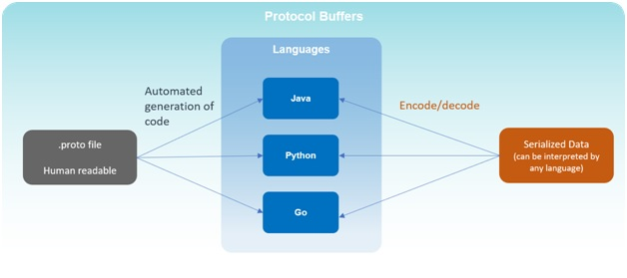
.
The entire flow shows that Protobuf offers some great benefits over JSON and XML. Parsing with Protobuf requires fewer CPU resources since data is converted into a binary format, and encoded messages are lighter in size. So, messages are exchanged faster, even in machines with a slower CPU, such as mobile devices

Slide 5
Streaming
Streaming is another key concept of gRPC, where many processes can take place in a single request. The multiplexing capability (sending multiple responses or receiving multiple requests together over a single TCP connection) of HTTP/2 makes it possible. Here are the main types of streaming:
Server-streaming RPCs – The client sends a single request to the server and receives back a stream of data sequences. The sequence is preserved, and server messages continuously stream until there are no messages left.
Client-streaming RPCs – The client sends a stream of data sequences to the server, which then processes and returns a single response to the client. Once again, gRPC guarantees message sequencing within an independent RPC call.
Bidirectional-streaming RPCs – It is two-way streaming where both client and server sends a sequence of messages to each other. Both streams operate independently; thus, they can transmit messages in any sequence. The sequence of messages in each stream is preserved.

Slide 6
HTTP/2
Binary Framing Layer – Unlike HTTP/1.1, HTTP/2 request/response is divided into small messages and framed in binary format, making message transmission efficient. With binary framing, the HTTP/2 protocol has made request/response multiplexing possible without blocking network resources.
Streaming – Bidirectional full-duplex streaming in which the client can request and the server can respond simultaneously.
Flow Control – Flow control mechanism is used in HTTP/2, enabling detailed control of memory used to buffer in-flight messages.
Header Compression – Everything in HTTP/2, including headers, is encoded before sending, significantly improving overall performance. Using the HPACK compression method, HTTP/2 only shares the value different from the previous HTTP header packets.
Processing – With HTTP/2, gRPC supports both synchronous and asynchronous processing, which can be used to perform different types of interaction and streaming RPCs.
All these features of HTTP/2 enable gRPC to use fewer resources, resulting in reduced response times between apps and services running in the cloud and longer battery life for a client running mobile devices

Slide 7
Channels
Channels are a core concept in gRPC. The HTTP/2 streams allow many simultaneous streams on one connection; channels extend this concept by supporting multiple streams over multiple concurrent connections. They provide a way to connect to the gRPC server on a specified address and port and are used in creating a client stub.

Slide 8
gRPC Architecture
In the following gRPC architecture diagram, we have the gRPC client and server sides. In gRPC, every client service includes a stub (auto-generated files), similar to an interface containing the current remote procedures. The gRPC client makes the local procedure call to the stub with parameters to be sent to the server. The client stub then serializes the parameters with the marshaling process using Protobuf and forwards the request to the local client-time library in the local machine.

Slide 9
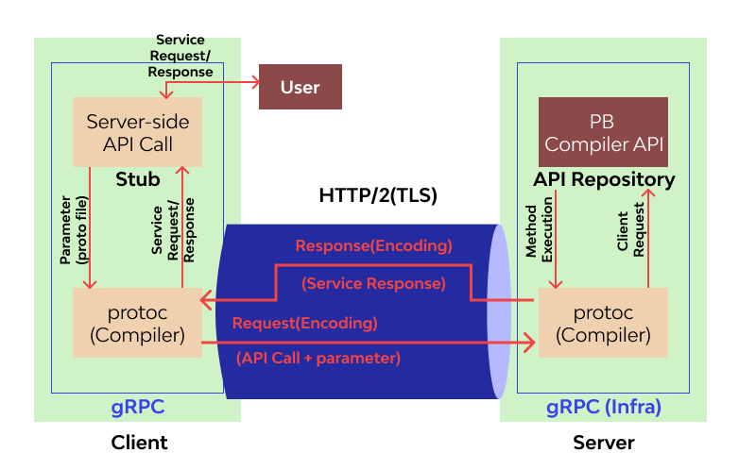

Slide 10
gRPC Advantages
Performance
By different evaluations, gRPC offers up to 10x faster performance and API-security than REST+JSON communication as it uses Protobuf and HTTP/2. Protobuf serializes the messages on the server and client sides quickly, resulting in small and compact message payloads. HTTP/2 scales up the performance ranking via server push, multiplexing, and header compression. Server push enables HTTP/2 to push content from server to client before getting requested, while multiplexing eliminates head-of-line blocking. HTTP/2 uses a more advanced compression method to make the messages smaller, resulting in faster loading

Slide 11
Streaming
Client-to-server streaming
Server-to-client streaming
Bi-directional streaming

Slide 12
Interoperability
gRPC tools and libraries are designed to work with multiple platforms and programming languages, including Java, JavaScript, Ruby, Python, Go, Dart, Objective-C, C#, and more. Due to the Protobuf binary wire format and efficient code generation for virtually all platforms, programmers can develop performant applications while still using full cross-platform support.

Slide 13
gRPC Disadvantages
Limited Browser Support
As gRPC heavily uses HTTP/2, it is impossible to call a gRPC service from a web browser directly. No modern browser provides the control needed over web requests to support a gRPC client. Therefore, a proxy layer and gRPC-web are required to perform conversions between HTTP/1.1 and HTTP/2.
Non-human Readable Format
Protobuf compresses gRPC messages into a non-human readable format. This compiler needs the message’s interface description in the file to deserialize correctly. So, developers need additional tools like the gRPC command-line tool to analyze Protobuf payloads on the wire, write manual requests, and perform debugging.

