Slide 1
Retail Sales Dashboard
Executive · Product · Geographic Analytics
5,200 orders | 2022-01-02 → 2024-12-30 Total Sales $3.20M · Total Profit $656.0K · Profit Margin 20.5%
This deck exports the interactive dashboard visuals for presentations and teaching. Theme: Corporate Blue / Dark Gray / White · Source: Retail_Sales_StarSchema
Power BI Retail Dashboard Package

Slide 2
Page 1 — Executive Dashboard · KPI Overview
Total Sales
Total Profit
Total Orders
Total Customers
$3.20M
$656.0K
5,200
850
AOV $616
Margin 20.5%
Distinct Order IDs
Unique Customer IDs
KPI — Sales vs Target
KPI — Profit vs Target
$3.20M
$656.0K
Target $3.46M · Achievement 92.6%
Target $721.6K · Achievement 90.9%

Slide 3
Page 1 — Executive Dashboard · Segment Mix
Segment Insights
Consumer $1.70M (53.1%)
Corporate $975.3K (30.5%)
Home Office $527.6K (16.5%)
Slicers in live dashboard: Year · Category · Region

Slide 4
Page 2 — Product Analysis · Top Products
Product Name | Category | Qty | Sales | Profit
Laptop Pro 15-inch | Technology | 468 | $552.6K | $78.4K
Conference Table 8-Seat | Furniture | 394 | $478.3K | $102.1K
Sofa Sectional Gray | Furniture | 521 | $430.5K | $78.5K
Lounge Chair Leather | Furniture | 362 | $252.3K | $51.7K
Executive Desk Oak | Furniture | 355 | $199.3K | $57.8K
Tablet 10-inch | Technology | 499 | $185.8K | $34.3K
Monitor 27-inch 4K | Technology | 435 | $182.1K | $29.1K
Standing Desk Adjustable | Furniture | 358 | $149.7K | $46.6K
Smart Watch Series X | Technology | 414 | $114.7K | $19.8K
Office Chair Ergonomic | Furniture | 427 | $96.6K | $22.2K

Slide 5
Page 2 — Product Analysis · Matrix (Category × Year)
Category | 2022 Sales | 2022 Profit | 2023 Sales | 2023 Profit | 2024 Sales | 2024 Profit
Furniture | $523.2K | $120.0K | $644.6K | $138.9K | $700.3K | $160.4K
Office Supplies | $19.1K | $3.5K | $23.2K | $4.5K | $28.8K | $5.6K
Technology | $367.1K | $63.2K | $454.0K | $81.1K | $442.1K | $78.7K
In Power BI: Matrix rows = Category → Sub Category, columns = Year, values = Sales & Profit (with drill-down).

Slide 6
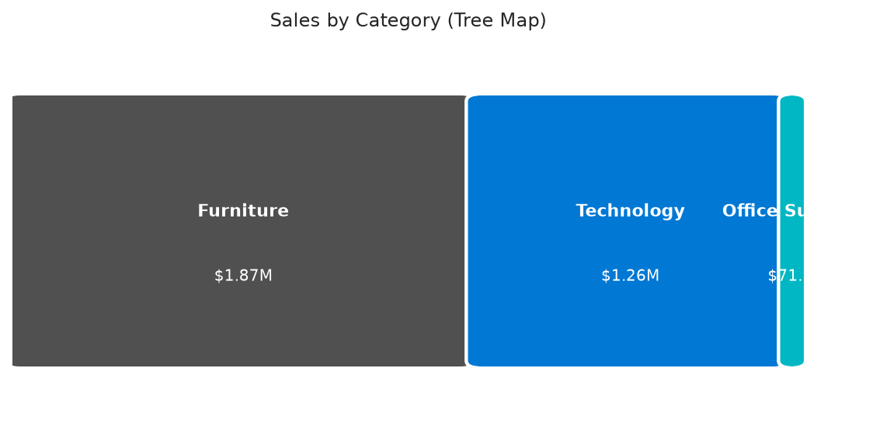
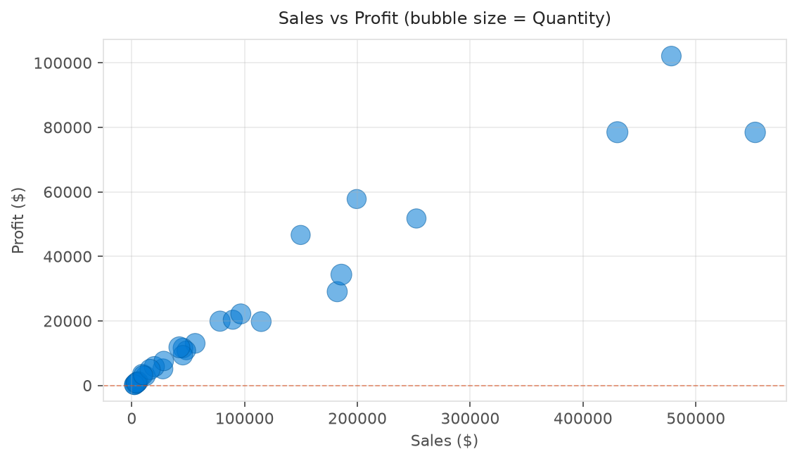
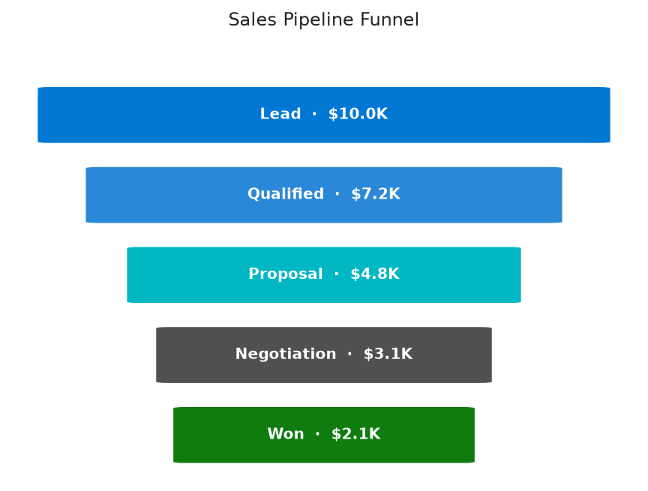
Page 2 — Product Analysis · Advanced Visuals

Slide 7
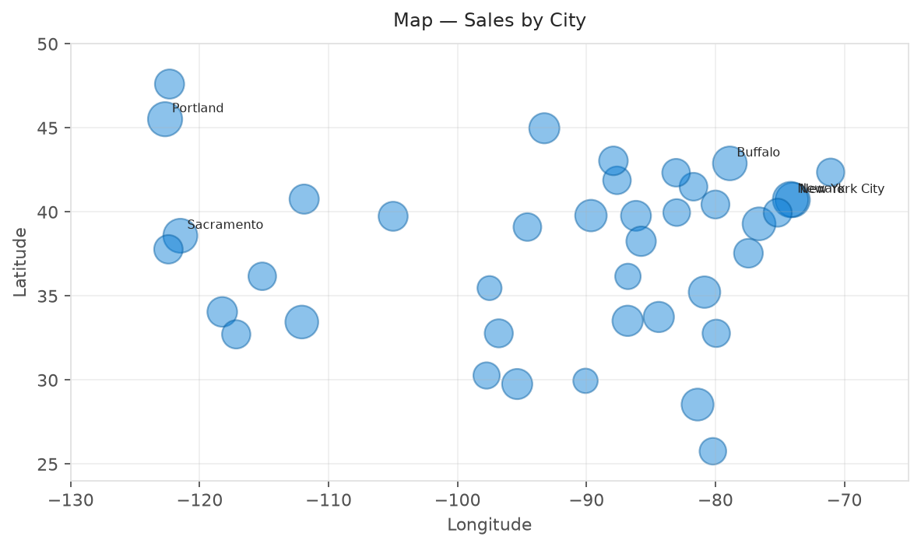
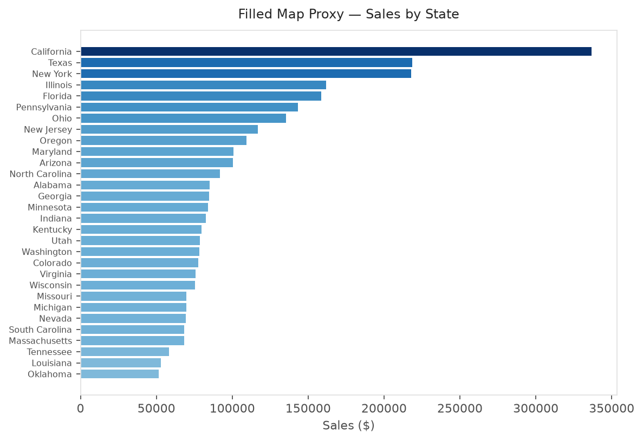
Page 3 — Geographic Dashboard · Maps

Slide 8
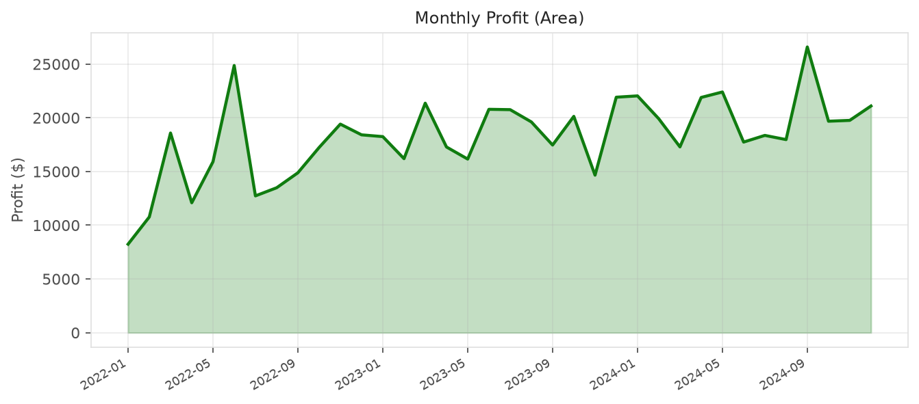
Page 3 — Geographic Dashboard · Trends

Slide 9
Visual Coverage Checklist
✓ Card Executive — Sales, Profit, Orders, Customers
✓ Bar Chart Top 10 Products by Sales
✓ KPI Executive — Sales/Profit vs Target
✓ Tree Map Sales by Category
✓ Slicer Live HTML/Power BI — Year, Category, Region
✓ Scatter Chart Sales vs Profit (size = Quantity)
✓ Line Chart Monthly Sales Trend · Monthly Quantity
✓ Pie Chart Sales by Payment Mode
✓ Column Chart Sales by Category · Sales by Region
✓ Funnel Chart Lead → Qualified → Proposal → Negotiation → Won
✓ Donut Chart Sales by Segment
✓ Map Sales by City
✓ Table Product metrics (Name, Category, Qty, Sales, Profit)
✓ Filled Map Sales by State
✓ Matrix Category × Year Sales & Profit
✓ Area Chart Monthly Profit

Slide 10
Thank You
Interactive dashboard: PowerBI_Retail_Dashboard/dashboard/dashboard.html Power BI build guide: docs/02_Build_Guide.md

