Slide 1
FANTASY FOOTBALL ANALYTICS AND PREDICTOR

Slide 2
Fantasy At A Glance
$18.6 Billion
47 Million
Fantasy Footballs Yearly Market: Which is 6X more than the NFLs current revenue and 4.5X more than the Dallas Cowboys value.
Fantasy Football Players in the United States Yearly.

Slide 3
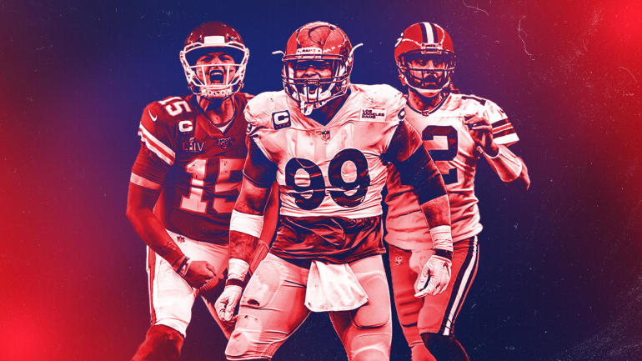
Fantasy Football Rosters
1 QB | Quarterback
2 RBs | Running Back(s)
2 WRs | Wide Receiver(s)
1 TE | Tight End
1 FLEX | WR, RB, TE
I DEF | Defense
1 K | Kicker

Slide 4
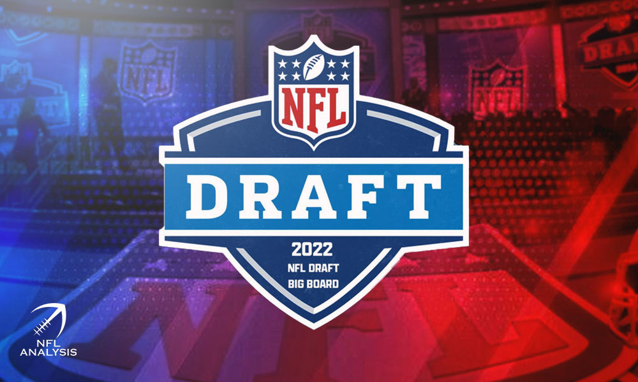
Nailing The Fantasy Football Draft
Draft Order & Team Numbers
Rounds and Determining Value
Draft Strategies
ADP or Average Draft Position
League Winners
Sleepers (Maximum Value for low cost)
Cheat The Draft and Leverage Stats to Determine Value

Slide 5
NFL Stats Player Profile
Positional Rankings in ADP
Position Breakdown
98%
2%
Interests and Features
Machine Learning Models
14%
38%
28%
20%
QBs/Skill Positions
Defense /Kickers
QBs
WRs
RBs
TEs
30%
50%
20%
Production
Usage
Targets
Keras
Logistic Regression
Clusters

Slide 6
OPERATING TABLE OF CONTENTS
01
02
03
Data Processing
Machine Learning
Predictions
Data munging and transformation
Unsupervised and Supervised
& Algorithms
Players by Round and
Website Demo

Slide 7
01
Data Processing

Slide 8
Data Munging and Transformation
Data
Feature Engineering
Average Draft Position
Pro-Football Reference for Veterans and Web-Scraping for Rookies
Creating Target Features and ensuring players are eligible for drafting in 2022
FantasyPros and connecting dataframes

Slide 9
02
Machine Learning
Predicting How Well Players Will Do
Notes:
As Ronnie Stated our goal is to predict “sleepers”, those players who have potential for big Fantasy Scores but are overlooked by the current models. Since, we are providing the suggested draft order for the entire fantasy squad this had to be balanced with “conventional wisdom”, we had to make sure that in our efforts to predict “sleepers” that favored candidates still appeared in draft locations that insured a winning fantasy team.

Slide 10
Machine Learning
Database
Data Collection
Evaluating Models
CSVs are sent to AWS RDS SQL database
Writing scripts and features that produce target features
Data sent to algorithm that makes the predictions
Notes:
One of the biggest challenges we faced, was that all players are not created equal, what makes a player valuable depends on the position they play, historic performance and projected performance. The statistics around these are impacted by injuries, years in the league, likelihood to play and for rookies they have no history at all.
With all of these factors in mind we looked at a wide range of models in each of the disciplines. We looked at unsupervised learning and while our data did lend itself to clustering, which you will see in a later slide, it could not produce that ranked data that we looking to achieve. We also looked at deep-learning models. We ran our largest dataset though 179 Keras turner trials. However, the deep learning models struggled to produce good results. We chose to concentrate on supervised learning models to achieve our ideal prediction results.

Slide 11
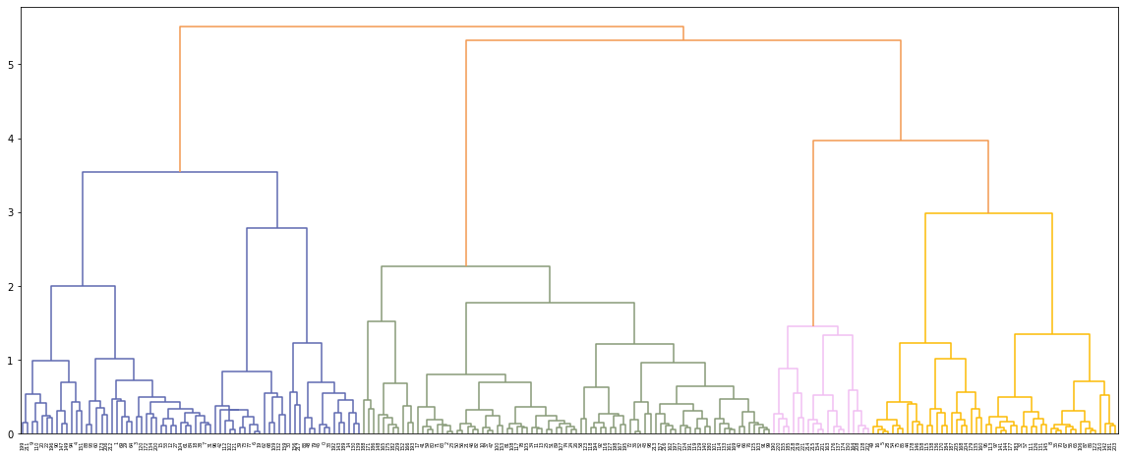
Skill Players Clusters by Position
Notes:
While our data did form the expected clusters by skill position – the models were unable to produce the ranked results we were looking to get.

Slide 12
Machine Learning
Predictions
Functions and Scalars
Testing and Training
Scaling data, fitting model, dimensionality reduction
Players, ADP, and Sleepers who will perform well in 2022
Reshaping, Splitting the data, Classifiers
Notes:
For our supervised learning models, we tested our data against 9 algorithms, with 6 scalers. We ran each of our 4 sets of data independent of each other. Not all datasets performed equally with each model. Each data set has it own saved ML model.

Slide 13
Choosing The Right Model
Unsupervised
Supervised
Neural Networks
KNN
Predictions
Accuarcy
Algorithms clusters unlabled datasets
Labeled datasets train algorithms to classify and predict
Uses Proximity to make classifications
Series of algorithms trys to recognize underlying relationships
Output of an algorithm after being trained
Which model was the most accurate and precise
Notes:
In total we ran our largest dataset through over 450 models. In the end linear regression and extra trees regressions produced the best results respective to their input datasets.

Slide 14
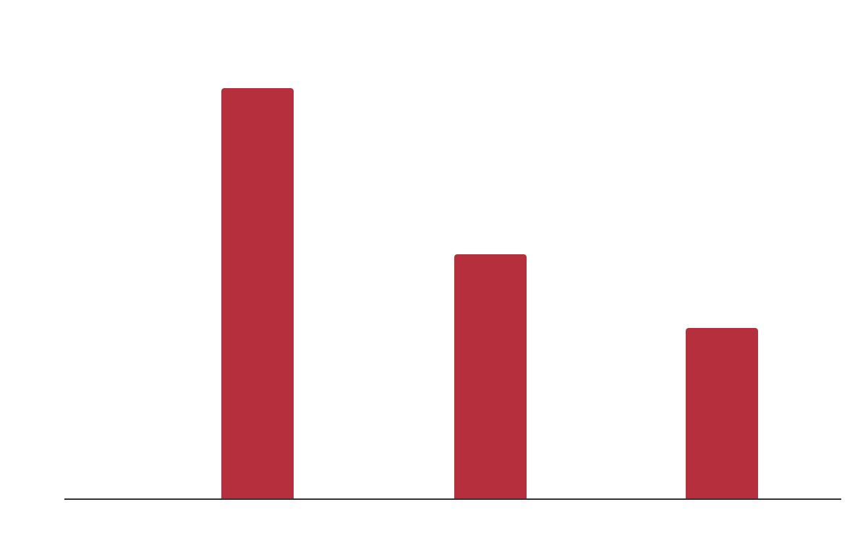
OUR MACHINE LEARNING RESULTS
Rookies Model
Veterans Model
96.7%
99.4%
WR, TE, RB
QB
Rookies
Testing
Training
Prediction Accuracy
Notes:
After establishing some effective models – we focused on creating features and standardizing input features to produce our desired rankings. The wizardry really did happen in this step, If you are interested in seeing how we calculated our magic features by all means check it out in the NFL_Fantasy_improve _Target_woQB notebook.
We were able to verify our magic, by watching a specific player we predicted as a sleeper – move up in the draft order during the few days we had to monitor changes! Yay our magic worked.

Slide 15
03
PREDICTIONS
Website Demo and Predictions

Slide 16
AWARDS
Jonathan Taylor
Austin Ekeler
Christian McCaffery
RB1 according to all models.
RB2 according to all models.
RB3 according to all models.
2
3

Slide 17
OUR CHALLENGES A GAME OF INCHES
Reliable Sources
Combining The Data
Predicting the Future
Quality Product
Completing Database
Creating Working Model
Training the Algorithm
Lots of Moving Parts
Few sources as possible, to ensure continuity.
Web-Scraping
Making Learning Algorithm
Creating the Website
Search for NFL Players
View Statistics
Machine Based Predictions
Reliable Results
Functionality
Sortable by Player, Rounds, and ADP

Slide 18

PROJECT METHODS AND LANGUAGES
PYTHON
PANDAS/Jupyter
SQL AWS RDS
FLASK & API
Data Cleaning Jupyter/Python
NFL Data from
2019, 2020, 2021
CSVx
AWS, RDS via
SQL or PostGres
Flask (Python) API
Interface Backend
Data with Model
Logic
01
02
03
04
Index.js, Javascript
Functions make request to API per user
Heroku Webcode
Python AL/ML
Modeling
05
06
07
Heroku
Javascript
Machine Learning

Slide 19
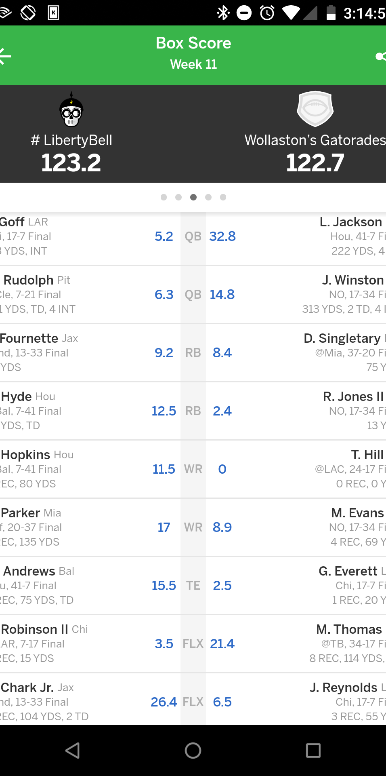
OUR NFL FantasyAI Website
Go check out Who You Should Draft @ http://www.ourFantasyAI.com

Slide 20
AWESOME WORDS!

Slide 21
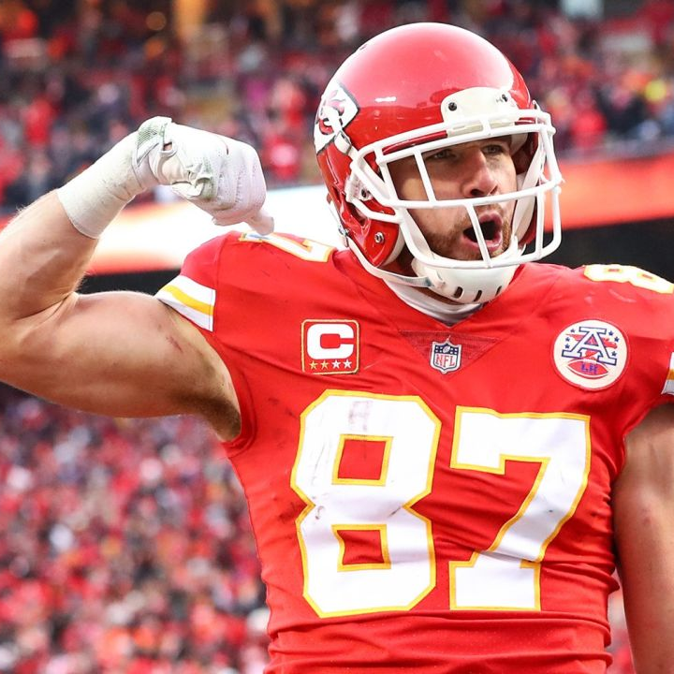
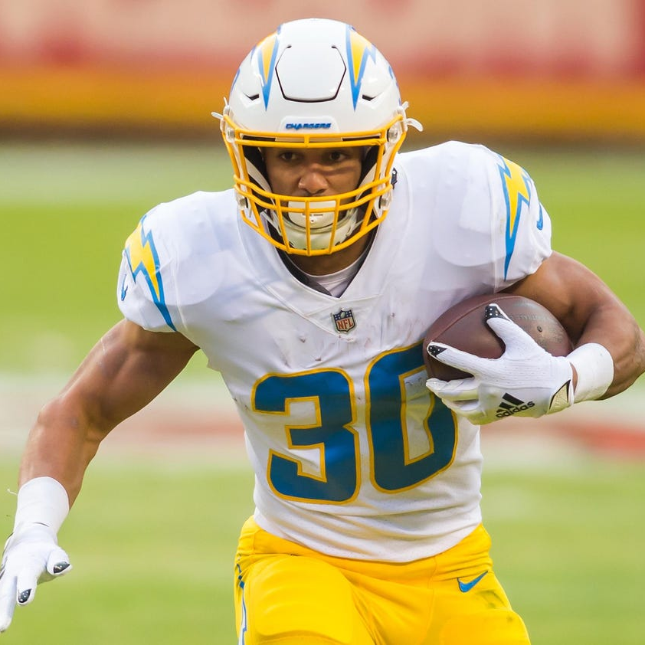
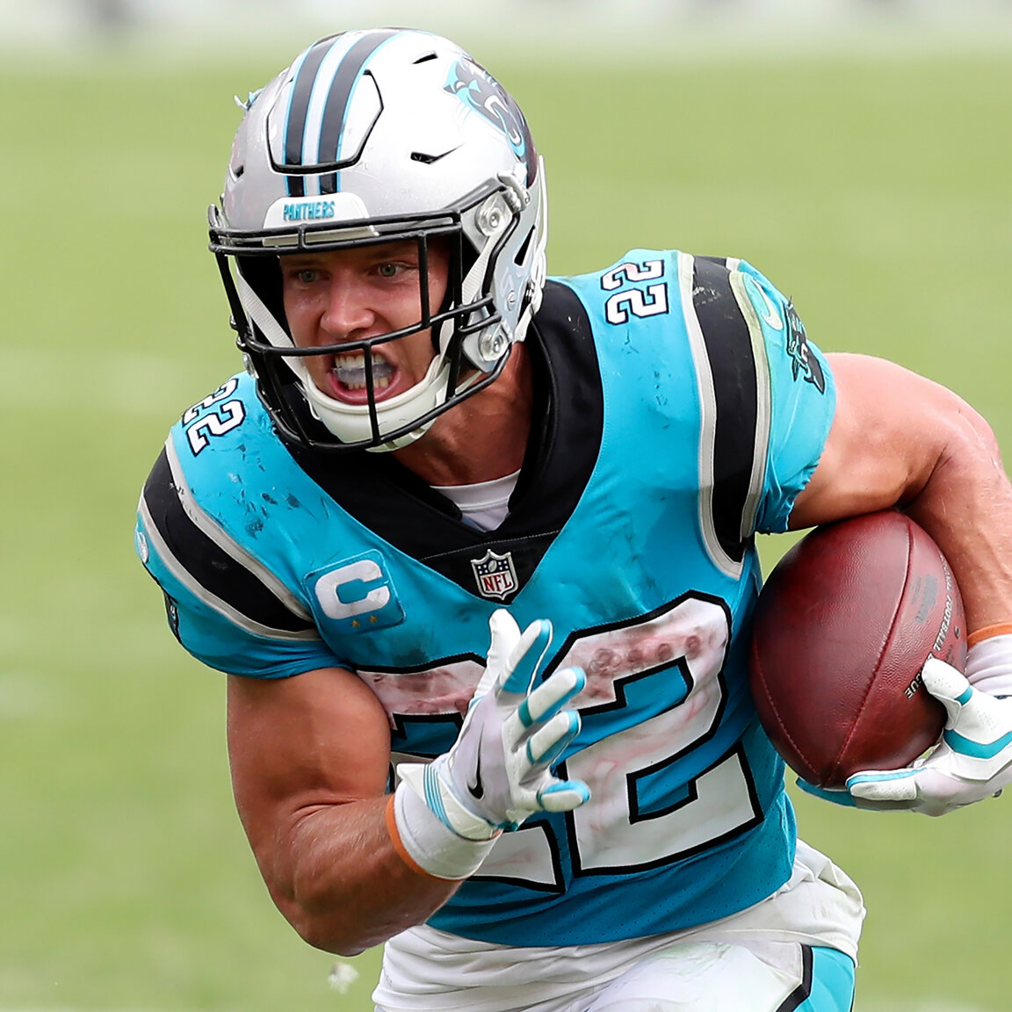
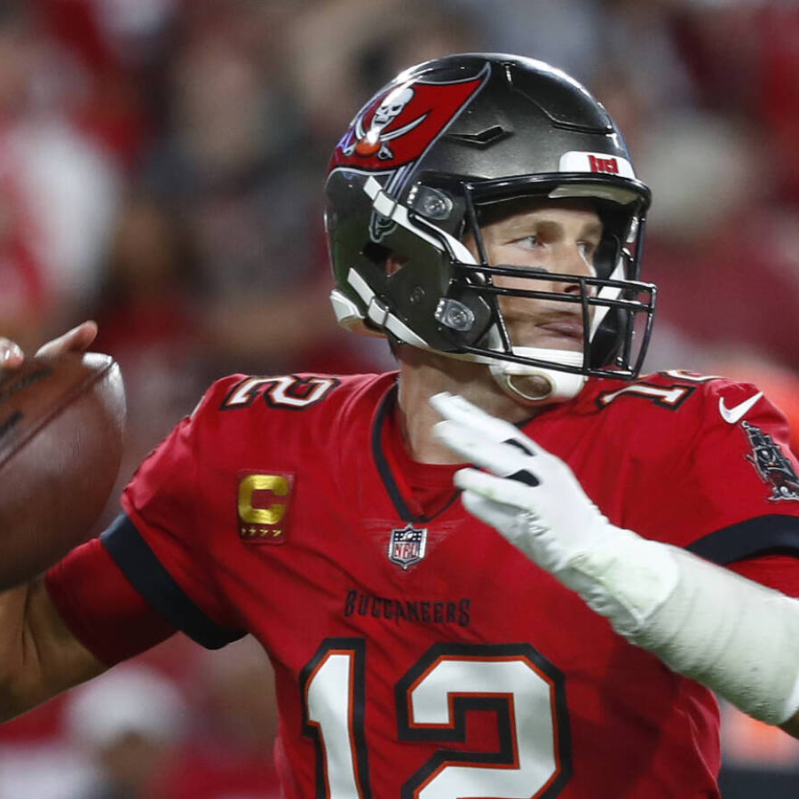
OUR TEAM
Ronnie Phillips
Jesse Perez
Lynne Freilich
Yi Huang

Slide 22
THANKS!
Do you have any questions?
Ronnie Phillips
Lynne Freilich
Jesse Perez
Yi Huang

Slide 23
NFL PREDICTIVES RESOURCES
NFL DATA & APIs
Pro-Football Reference
FantasyPros ADP
FantasyPros Rookies
Machine Learning
Sklearn
TensorFlow
Keras

