Slide 1
Negative Pressure Booth
Vishwakarma Institute of Technology
Team Garudashwa
Yatharth Garg
Ansh Gaikwad
Arshad Patel
“
”
- Real time solution to help frontline warriors for quick sample collection in rural, urban areas

Slide 2
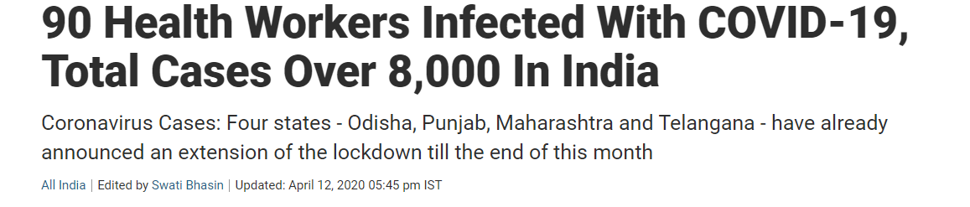
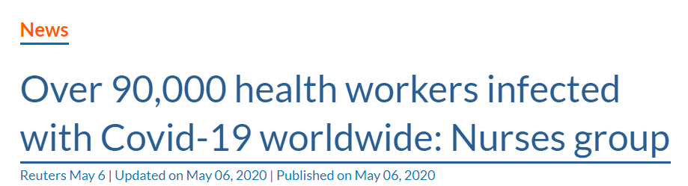
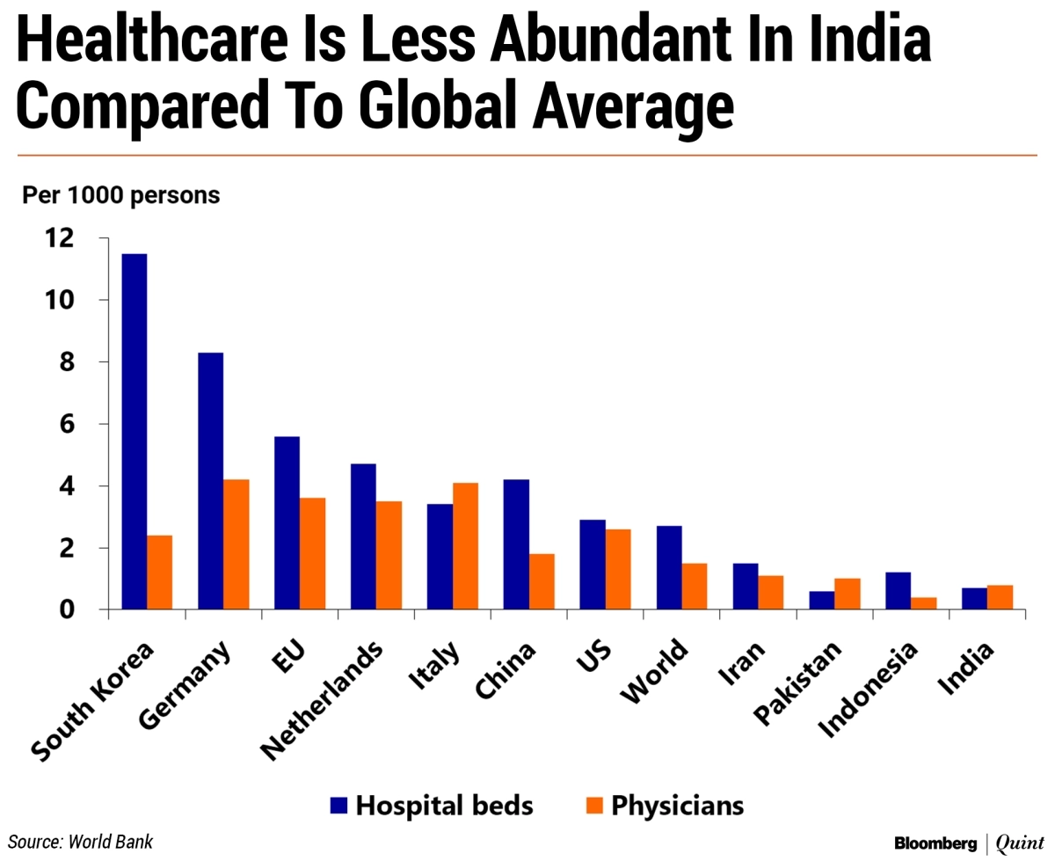
The true heroes of our nation are the doctors and the paramedical officers which helps the one who is affected and save our lives by putting their own in harms way, but day by day the number of cases are increasing and these also include the doctors. Proposed model through which we can implement contactless diagnosis .

Slide 3
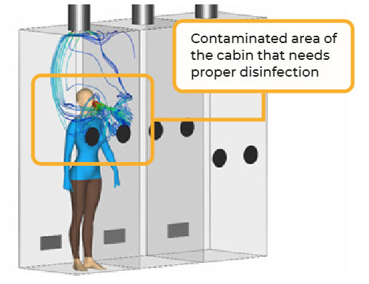
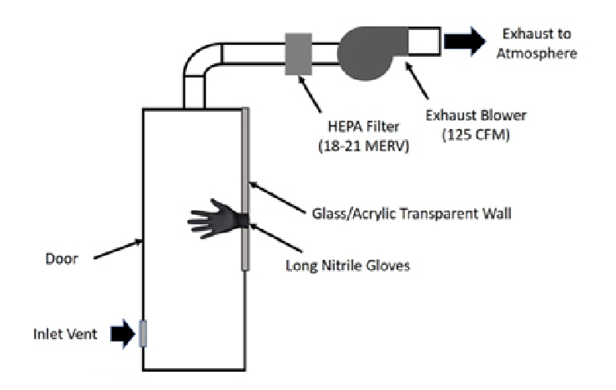
SOLUTION
It is a multiple sample collecting booth where Negative pressure is maintained to prevent leakage of any contaminants outside.
The health workers interacts with the patient through isolation glove box to avoid direct contact.
Ventilated air is filtered through HEPA unit and discarded in environment in 2.5min which is filled in the center at the top of the cabin.
The booth has additional facility of Phone , Stethoscope, Temperature detection ,Contaminated detection for security purposes.
The size of the inlet vent and circular exhaust are selected such that the flow are area at the inlet and exhaust are similar.
Parameter | Value
Cabin dimensions | 2.5 ft. x 2.5 ft. x 7 ft.
Inlet vent size | 10 in.
Inlet vent location | 6 in. above ground
Exhaust vent diameter | 8 in.
Air flow rate | 24 air changes per hour (ACH)
Exhaust velocity | ~1fps

Slide 4
Our solution over others
OUR SOLUTION OVER OTHERS
Traditional Method
NPB method
Social distancing
Direct physical contact between patient and health workers.
Infection
Leakage of contaminants.
Slow Process
Only one patient can be treated at a time , so it is difficult to test large number of people
No proper Protection
BSL- 2 condition fully not satisfied
Proper Social distancing
Health workers interact with patient through isolation glove box.
Protection from Infection
Ventilated air filtered through HEPA filtration unit and exhausted in air.
Fast Process
NPB is mobile unit which can test 3 patients simultaneously in approximately 7 minutes , so large number of people can be tested in short time safely
Proper Protection
Follows BSL-2 standards.

Slide 5
Janitor
Sample Collecting Staff
Hospital Staff & Doctors
Time Management
Testing Procedure
N.B.P. Platform
Protected Camber For Testing Safe Testing Air Cleaner
Less Doctor-Patient Interaction
Hospital Staff Municipal Office
R & D Innovation Sales and Marketing Advertising and marketing
Surge Pricing Ad Revenues
Platform and Algorithm Development
Marketing to balancing Supply and Demand
Key Partners
Key Activities
Key Resources
Value Proportion
Customer Relation
Channels
Customer Segments
Revenue Streams
Business Model

