Slide 1
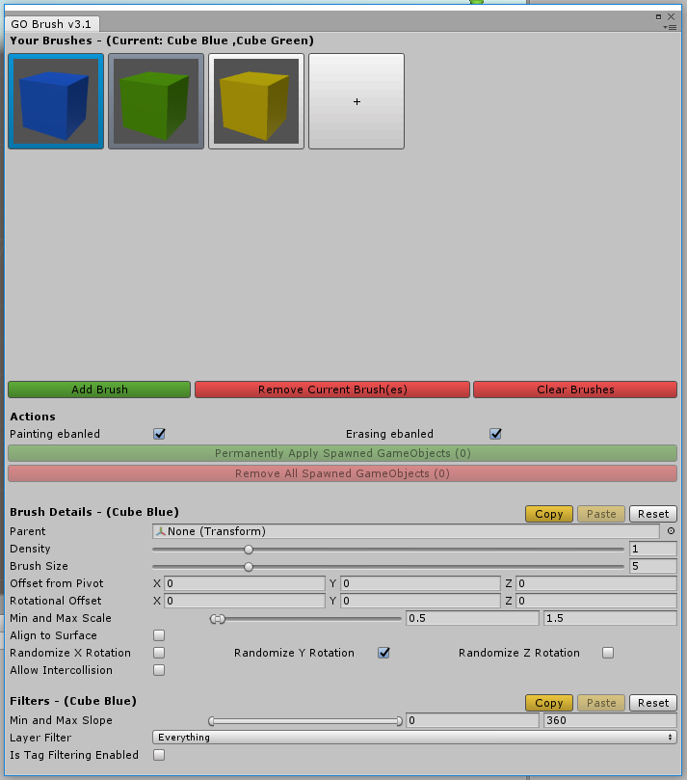

Slide 2
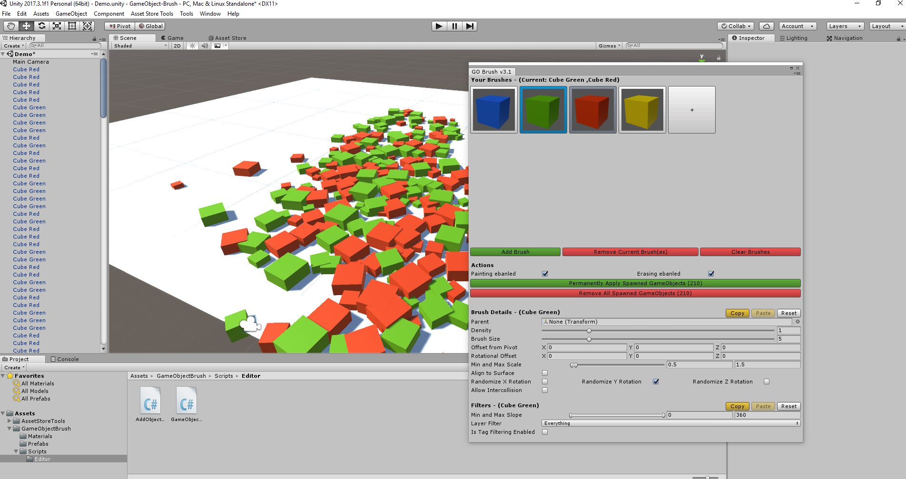
Parenting
Multi-Brush-Painting
Density
Copy And Paste
Brush Size
Enable/Disable Painting
Offset From Pivot
Rotational Offset
Randomize Rotation
Align to Surface
Allow Intercollision
Filter by Slope
Filter by Layer
Min and Max Scale
Filter by Tag

