Slide 1
Finding Similar New York Neighbourhoods with Data Science
By Santiago Marquez

Slide 2
Problem:
We want to create a map that recommends similar neighbourhoods to people in New York city based on where they currently live in case they need to move.

Slide 3
Data:
We are going to use data from Wikipedia to find a list of all neighbourhoods.
In addition to that we will use Foursquare and Google Maps APIs.

Slide 4
Model:
We will use a K-means clustering algorithm to perform the clustering based on the venues each neighbourhood has.

Slide 5
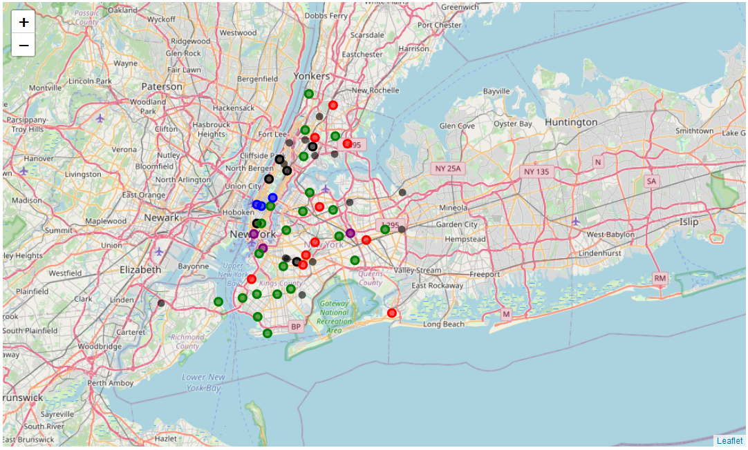
Result:
Here is the final result:

