Slide 1
394C: Algorithms for Computational Biology
Tandy Warnow
Sept 9, 2013

Slide 2
Phylogenetic reconstruction methods
Hill-climbing heuristics for hard optimization criteria (Maximum Parsimony and Maximum Likelihood)
Local optimum
Cost
Global optimum
Phylogenetic trees
Polynomial time distance-based methods: UPGMA, Neighbor Joining, FastME, Weighbor, etc.

Slide 3
Performance criteria
Running time.
Space.
Statistical performance issues (e.g., statistical consistency) with respect to a Markov model of evolution.
“Topological accuracy” with respect to the underlying true tree. Typically studied in simulation.
Accuracy with respect to a particular criterion (e.g. tree length or likelihood score), on real data.

Slide 4
How can we infer evolution?
While there are more than two taxa, DO
Find the “closest” pair of taxa and make them siblings
Replace the pair by a single taxon
Note: the input is a dissimilarity matrix, and you need to specify how to update the matrix after you replace two taxa by one taxon.

Slide 5
Updating the matrix
How do we update the dissimilarity matrix, after we make two nodes x and y siblings?
Various options, but here’s one:
  Replace the pair of siblings by a new node “xy”.
  For each remaining taxon v in the matrix, set D(xy,v) = ½ (D(x,v) + D(y,v))

Slide 6
That was called “UPGMA”
Advantages: UPGMA is polynomial time and works well under the “strong molecular clock” hypothesis.
Disadvantages: UPGMA does not work well in simulations, perhaps because the molecular clock hypothesis does not generally apply.
Other polynomial time methods, also distance-based, work better. One of the best of these is Neighbor Joining.

Slide 7
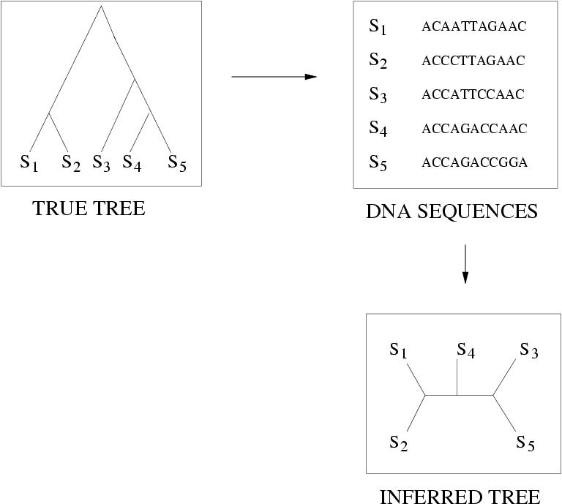
Quantifying Error
FN
FN: false negative
(missing edge)
FP: false positive
(incorrect edge)
50% error rate
FP

Slide 8
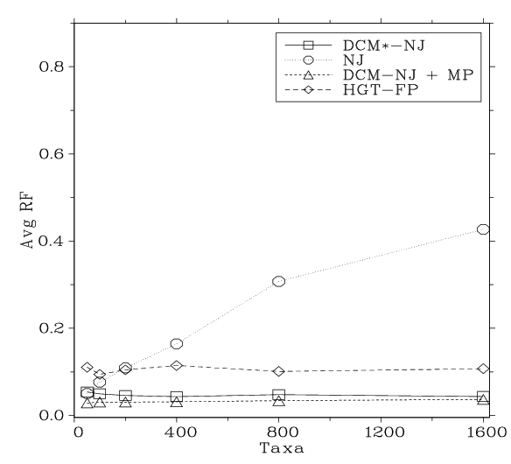
Neighbor joining has poor performance on large diameter trees [Nakhleh et al. ISMB 2001]
Simulation study based upon fixed edge lengths, K2P model of evolution, sequence lengths fixed to 1000 nucleotides.
Error rates reflect proportion of incorrect edges in inferred trees.
0.8
NJ
0.6
Error Rate
0.4
0.2
0
0
400
800
1200
1600
No. Taxa

Slide 9
Other standard polynomial time methods don’t improve substantially on NJ (and have the same problem with large diameter datasets).
What about other approaches?

Slide 10
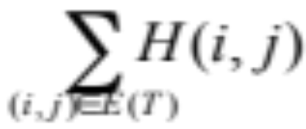
Maximum Parsimony
Input: Set S of n aligned sequences of length k
Output:
  A phylogenetic tree T leaf-labeled by sequences in S
  additional sequences of length k labeling the internal nodes of T
such that
is minimized, where H(i,j) denotes the Hamming distance between sequences at nodes i and j

Slide 11
Maximum parsimony (example)
Input: Four sequences
  ACT
  ACA
  GTT
  GTA
Question: which of the three trees has the best MP scores?

Slide 12
Maximum Parsimony
ACT
GTA
ACA
ACT
GTT
ACA
GTT
GTA
ACA
GTA
ACT
GTT

Slide 13
Maximum Parsimony
ACT
GTA
ACA
ACT
2
GTT
GTA
ACA
ACT
1
3
1
3
GTT
2
ACA
GTT
GTA
MP score = 5
MP score = 7
ACA
GTA
ACA
GTA
1
2
1
ACT
GTT
MP score = 4
Optimal MP tree

Slide 14
Maximum Parsimony: computational complexity
Optimal labeling can be
computed in linear time O(nk)
ACA
GTA
ACA
GTA
1
2
1
ACT
GTT
MP score = 4
Finding the optimal MP tree is NP-hard

Slide 15
Dynamic Programming
Fixed tree maximum parsimony has dynamic programming solutions – a simple one for unweighted maximum parsimony, and a slightly more complicated one for weighted maximum parsimony.
What is dynamic programming?

Slide 16
Fibonacci numbers
F(1) = F(2) = 1
F(x) = F(x-1)+F(x-2) if x>2
Calculating F(x) using recursion is exponential, but calculating F(x) using dynamic programming is O(x) time.

Slide 17
DP algorithm
Dynamic programming algorithms on trees are common – there is a natural ordering on the nodes given by the tree.
Example: computing the longest leaf-to-leaf path in a tree can be done in linear time, using dynamic programming (bottom-up).

Slide 18
DP algorithm for unweighted MP
When all substitutions have the same cost, then there is a simple DP method for calculating the MP score on a fixed tree.
Example: DNA sequences, so 4 letters (A, C, T, G). Let “Set(v)” denote the set of optimal nucleotides at node v (for an MP solution to the subtree rooted at v).

Slide 19
Special case for unweighted MP
Let “Set(v)” denote the set of optimal nucleotides at node v. Then:
  If v is a leaf, then Set(v) is {state(v)}.
  Else we let the two children of v be w and x.
    If Set(w) and Set(x) are disjoint, then Set(v) = Set(w) union Set(x)
    Else Set(v) = Set(w) intersection Set(x)
After you assign values to Set(v) for all v, you go to Phase 2 (picking actual states)

Slide 20
Special case for unweighted MP
Assume we have computed values to Set(v) for all v. Note that Set(v) is not empty.
Start at the root r of the tree. Pick one nucleotide from Set(r) for the state at r.
Now visit the children x,y of r, and pick states. If the state of the parent is in Set(x), the use that state; otherwise, pick any element of Set(x).

Slide 21
DP for weighted MP
Single site solution for input tree T.
Root tree T at some internal node. Now, for every node v in T and every possible letter X, compute
Cost(v,X) := optimal cost of subtree of T rooted at v, given that we label v by X.
Base case: easy
General case?

Slide 22
DP algorithm (con’t)
Cost(v,X) =
min_{Y}{Cost(v₁,Y)+cost(X,Y)} + min_{Y}{Cost(v₂,Y)+cost(X,Y)}
where v₁ and v₂ are the children of v, and Y ranges over the possible “states”, and cost(X,Y) is an arbitrary cost function.

Slide 23
DP algorithm (con’t)
We compute Cost(v,X) for every node v and every state X, from the “bottom up”.
The optimal cost is
min_{X}{Cost(root,X)}
We can then pick the best states for each node in a top-down pass (just like the algorithm for unweighted MP).

Slide 24
DP algorithm (con’t)
Running time? Accuracy?
How to extend to many sites?

Slide 25
Maximum Compatibility
Maximum Compatibility is another approach to phylogeny estimation, often used with morphological traits instead of molecular sequence data. (And used in linguistics as well as in biology.)
Input: matrix M where M_{ij} denotes the state of the species s_{i} for character j.
Output: tree T on which a maximum number of characters are compatible.

Slide 26
Characters
A character is a partition of the set of taxa, defined by the states of the character
Morphological examples: presence/absence of wings, presence/absence of hair, number of legs
Molecular examples: nucleotide or residue (AA) at a particular site within an alignment

Slide 27
Character Compatibility
A character c is compatible on a tree T if the states at the internal nodes of T can be set so that for every state, the nodes with that state form a connected subtree of T.
Equivalently, c is compatible on T if the maximum parsimony score for c on T is k-1, where c has k states at the leaves of T.

Slide 28
Computing the compatibility score on a tree
Given a matrix M of character states for a set of taxa, and given a tree T for that input, how do we calculate the compatibility score?
One approach: run maximum parsimony on the input, and determine which characters are compatible.

Slide 29
Character compatibility
More general problem: given matrix M of character states for a set S of taxa, find the tree with the highest character compatibility score.
This is NP-hard, even for binary (presence/absence) characters!

Slide 30
Binary character compatibility
Here the matrix is 0/1. Thus, each character partitions the taxa into two sets: the 0-set and the 1-set.
Note that a binary character c is compatible on a tree T if and only if the tree T has an edge e whose bipartition is the same as c.

Slide 31
Solving binary character compatibility
Input: matrix M of 0/1.
Output: tree T that maximizes character compatibility
Graph-based Algorithm:
  Vertex set: one node v_{c} for each character c
  Edge set: (v_{c},v_{c’}) if c and c’ are compatible as bipartitions (can co-exist in some tree)

Slide 32
Solving maximum binary character compatibility
Vertex set: one node v_{c} for each character c
Edge set: (v_{c},v_{c’}) if c and c’ are compatible as bipartitions (can co-exist in some tree)
Note: Every clique in the graph defines a set of compatible characters.
Hence, finding a maximum sized clique solves the maximum binary character compatibility problem.

Slide 33
Solution to binary character compatibility
Max Clique is NP-hard, so this is not a fast algorithm. This algorithm shows that Maximum Character Compatibility reduces to Max Clique – not the converse.
But the converse is also true. So Maximum Character Compatibility is NP-hard.

Slide 34
Solving NP-hard problems exactly is … unlikely
#leaves | #trees
4 | 3
5 | 15
6 | 105
7 | 945
8 | 10395
9 | 135135
10 | 2027025
20 | 2.2 x 10²⁰
100 | 4.5 x 10¹⁹⁰
1000 | 2.7 x 10²⁹⁰⁰
Number of (unrooted) binary trees on n leaves is (2n-5)!!
If each tree on 1000 taxa could be analyzed in 0.001 seconds, we would find the best tree in
2890 millennia

Slide 35
Approaches for “solving” MP/MC/ML
Hill-climbing heuristics (which can get stuck in local optima)
Randomized algorithms for getting out of local optima
Approximation algorithms for MP (based upon Steiner Tree approximation algorithms).
Local optimum
Cost
Global optimum
Phylogenetic trees
MP = maximum parsimony, MC = maximum compatibility,
ML = maximum likelihood

Slide 36
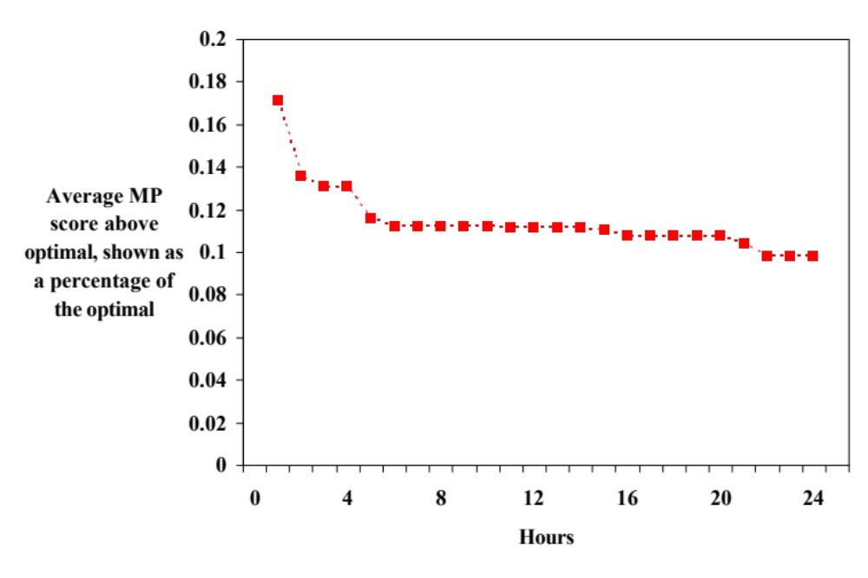
Problems with current techniques for MP
Shown here is the performance of a heuristic maximum parsimony analysis on a real dataset of almost 14,000 sequences. (“Optimal” here means best score to date, using any method for any amount of time.) Acceptable error is below 0.01%.
Performance of TNT with time

Slide 37
Observations
The best heuristics cannot get acceptably good solutions within 24 hours on most of these large datasets.
Large datasets may need months (or years) of further analysis to reach reasonable solutions.
Apparent convergence can be misleading.

Slide 38
What happens after the analysis?
The result of a phylogenetic analysis is often thousands (or tens of thousands) of equally good trees. What to do?
Biologists use consensus methods, as well as other techniques, to try to infer what is likely to be the characteristics of the “true tree”.

Slide 39
Supertree methods
Input: collection of trees (generally unrooted) on subsets of the taxa
Output: tree on the entire set of taxa
Basic questions:
  is the set of input trees compatible?
  can we find a tree satisfying a maximum number of input trees?

Slide 40
Triplet-based methods
Triplet Compatibility: does a tree exist that satisfies all the input triplets? If so, find it. Polynomial time solvable!
Aho, Sagiv, Szymanski, and Ullman algorithm (works on any input)

Slide 41
Quartet-based methods
Quartet Compatibility: does there exist a tree compatible with all the input quartet trees? If so, find it. (NP-hard)
Naïve Quartet Method solves Quartet Compatibility (must have a tree on every quartet)

Slide 42
Tree compatibility
Unrooted trees: NP-hard
Rooted trees: Polynomial
But rooted trees are even harder to get exactly correct than unrooted trees!

Slide 43
Real data
Cannot reliably obtain accurate rooted triplets
Cannot reliably obtain accurate quartet trees
All input trees will have some error
“Supertree” methods need to be able to handle error in the input trees

Slide 44
Quartet-based methods
Maximum Quartet Compatibility: find a tree satisfying a maximum number of quartet trees (NP-hard)
PTAS for case where the set contains a tree for every four leaves (Jiang et al.)
Heuristics (Quartets MaxCut by Snir and Rao, Weight Optimization by Ranwez and Gascuel, Quartet Cleaning by Berry et al., etc.)

Slide 45
MRP
Matrix Representation with Parsimony
Encode each input source tree as a matrix with entries from {0,1,?}, and run maximum parsimony
Solves “tree compatibility” exactly!

Slide 46
SuperFine
Swenson et al., Systematic Biology 2012
Supertree method “booster”
Two-step procedure: first construct a “constraint” tree (using the strict consensus merger), then refine each polytomy using the preferred supertree method
Improves MRP and other supertree methods

Slide 47
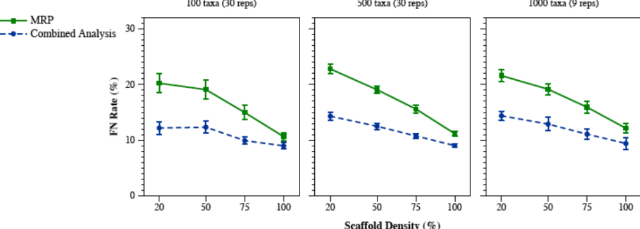
False Negative Rate
Scaffold Density (%)

Slide 48
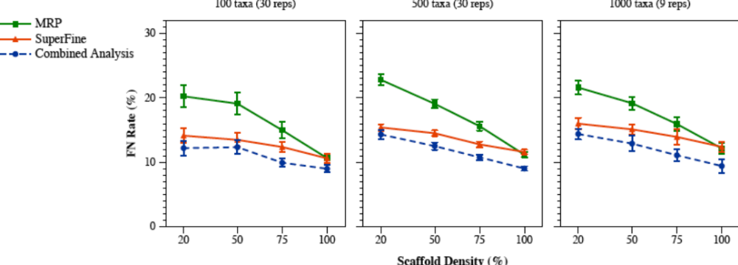
False Negative Rate
Scaffold Density (%)

Slide 49
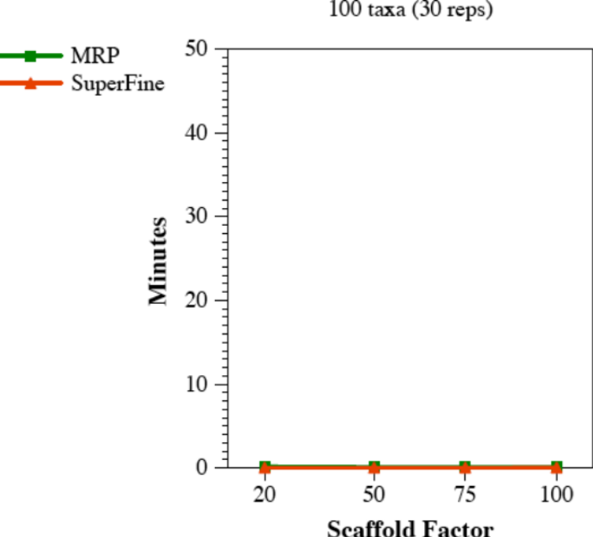
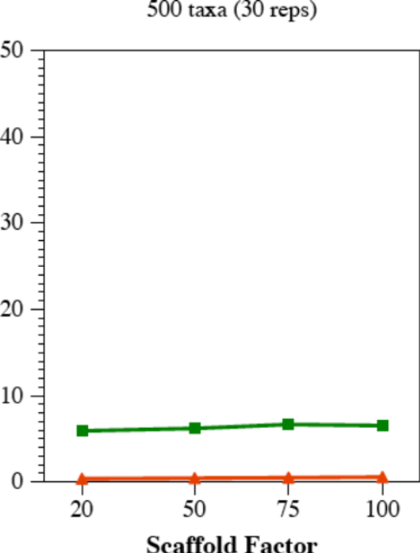
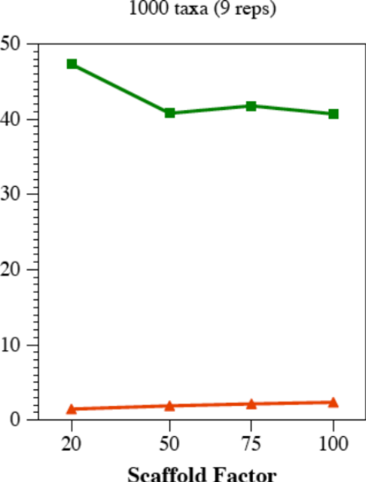
Running Time
SuperFine vs. MRP
MRP 8-12 sec.
SuperFine 2-3 sec.
Scaffold Density (%)
Scaffold Density (%)
Scaffold Density (%)

Slide 50
Homework (due 9/18)
Find some paper related to supertree or quartet-based tree estimation, read it, and write a 1-2 page discussion of what is in the paper – its claims, whether it’s important, and whether you agree with the conclusions (i.e., critique the paper, don’t just summarize it).
This can be a paper that describes a new method, a paper that evaluates such a method on some data, or a paper that uses any such method to analyze some data (e.g., a biological dataset analysis).
Google Scholar is one way to look for papers; you probably have others.

Slide 51
Some Quartet Tree papers to read
“Quartets Max Cut…”, by Snir and Rao, IEEE/ACM TCBB, vol. 7, no. 4, pp. 704-708
“Quartet-based phylogenetic inference: improvements and limits”, by Ranwez and Gascuel, http://mbe.oxfordjournals.org/content/18/6/1103.full.pdf
“Short Quartet Puzzling…”, by Snir and Warnow. Journal of Computational Biology, Vol. 15, No. 1, January 2008, pp. 91-103.
“An experimental study of Quartets MaxCut and other supertree methods” by Swenson et al. Journal of Algorithms for Molecular Biology 2011, 6(7),
“A polynomial time approximation scheme for inferring evolutionary trees from quartet topologies and its applications” by Jiang, Kearney, and Li, SICOMP 2001, http://dl.acm.org/citation.cfm?id=586889
"Performance study of phylogenetic methods: (unweighted) quartet methods and neighbor-joining,” Proceedings SODA 2001 and J. of Algorithms, 48, 1 (2003), 173-193 . (PDF)
“Quartet Cleaning…” by Berry et al, ESA 1999, LNCS Vol. 1643, pp. 313-324.

Slide 52
SuperFine papers
Swenson et al. 2012, Systematic Biology (2012) 61(2):214-227
Nguyen, Mirarab, and Warnow, MRL and SuperFine+MRL: new supertree methods." Journal Algorithms for Molecular Biology 7:3, 2012.
The literature on supertree methods is enormous – look for something recent (last 3 years).

