Slide 1
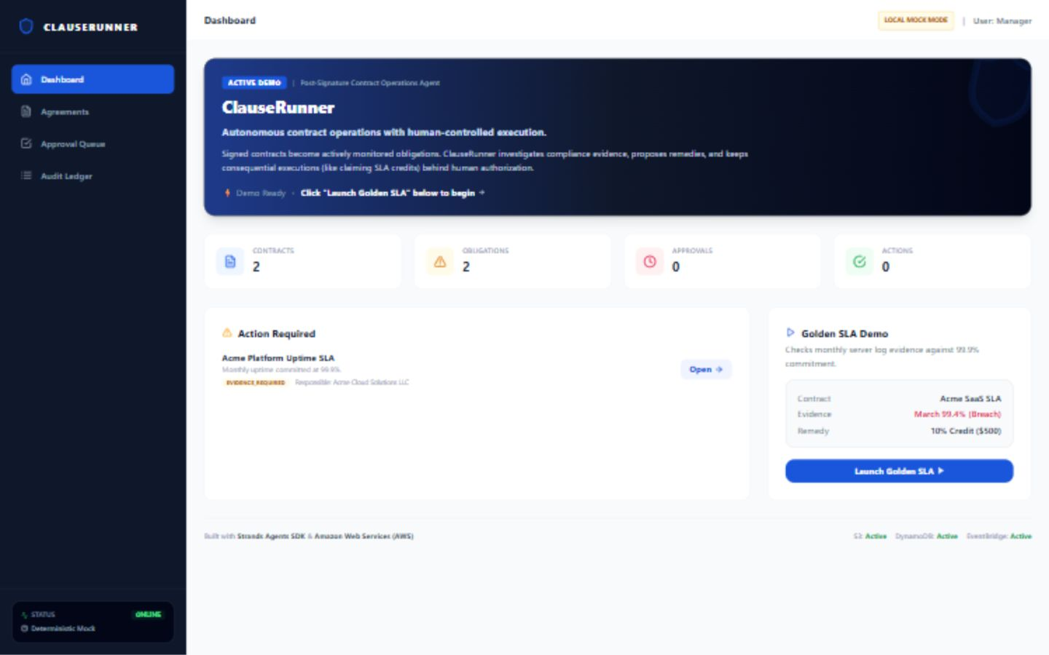
PROFESSIONAL AGENTS
ClauseRunner
Autonomous post-signature contract operations
with human-authorized execution.
Built with Strands Agents SDK + AWS
Video flow: problem → live workflow → architecture → close
Live AWS-hosted demo

Slide 2
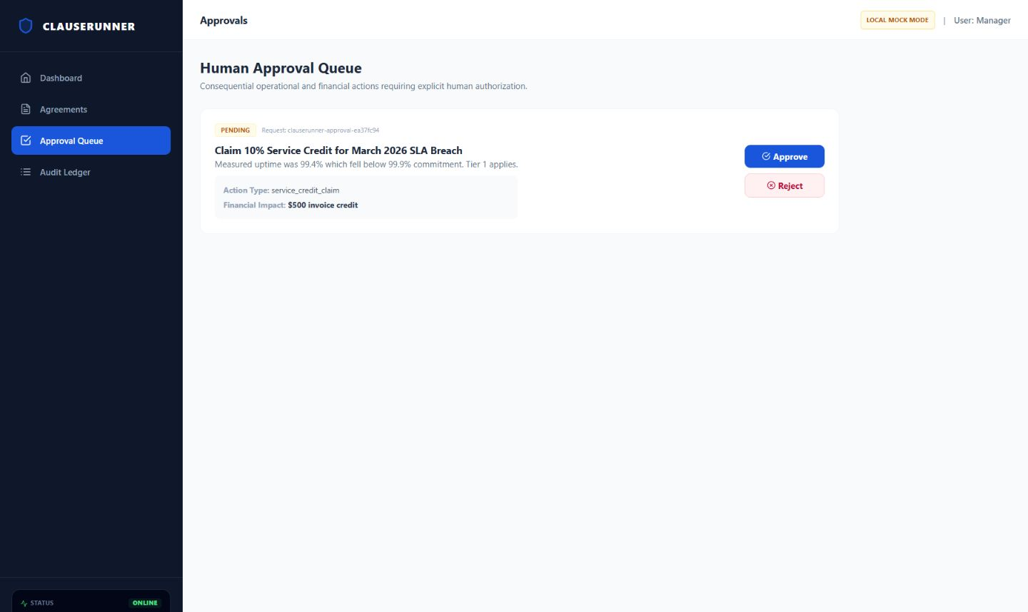
The problem starts after signature
Contracts are signed once. Obligations keep running.
Most teams still monitor post-signature duties manually.
SLAs, credits, renewals and compliance evidence live across PDFs, spreadsheets, inboxes and calendars.
Missed remedies
Manual monitoring
Breaches can expire before anyone claims the credit.
People repeatedly re-check contracts instead of handling exceptions.
Weak traceability
Fragmented evidence
Decisions become hard to reconstruct months later.
Logs, approvals and follow-ups live in different systems.
The work is repetitive, judgment-heavy and consequential.

Slide 3
ClauseRunner turns contracts into active workflows
One agentic path, with deterministic controls where it matters.
Contract
Obligations
Evidence
Investigation
Action
Approval
Audit
CONTRACTUAL SLA
OBSERVED EVIDENCE
PROPOSED REMEDY
EXECUTION
99.9%
99.4%
$500
BLOCKED
monthly uptime commitment
verified breach
10% service credit
until human approval
Golden SLA demo
Evidence shows a breach. ClauseRunner prepares the remedy. Policy-in-code prevents execution until approval is persisted.
Agentic investigation
Deterministic policy
Human authority
Auditable outcome

Slide 4
Autonomy is bounded by approval
The agent can investigate and prepare. Consequential actions need human authority.
POLICY IN CODE
Agent proposes.
Human authorizes.
Financial, legal and externally visible actions require explicit approval before execution.
• SLA + remedy logic
deterministic
• Approval state
persisted
• Execution without approval
blocked
• After action
full audit trail

Slide 5
Now switching to the live app
One golden path. No side quests.
1
Dashboard
Start from the Demo Ready landing screen.
2
Golden SLA
99.9% commitment vs 99.4% evidence.
3
Approval Queue
Review the $500 service-credit action.
4
Audit Ledger
Show evidence → investigation → approval → execution.

Slide 6
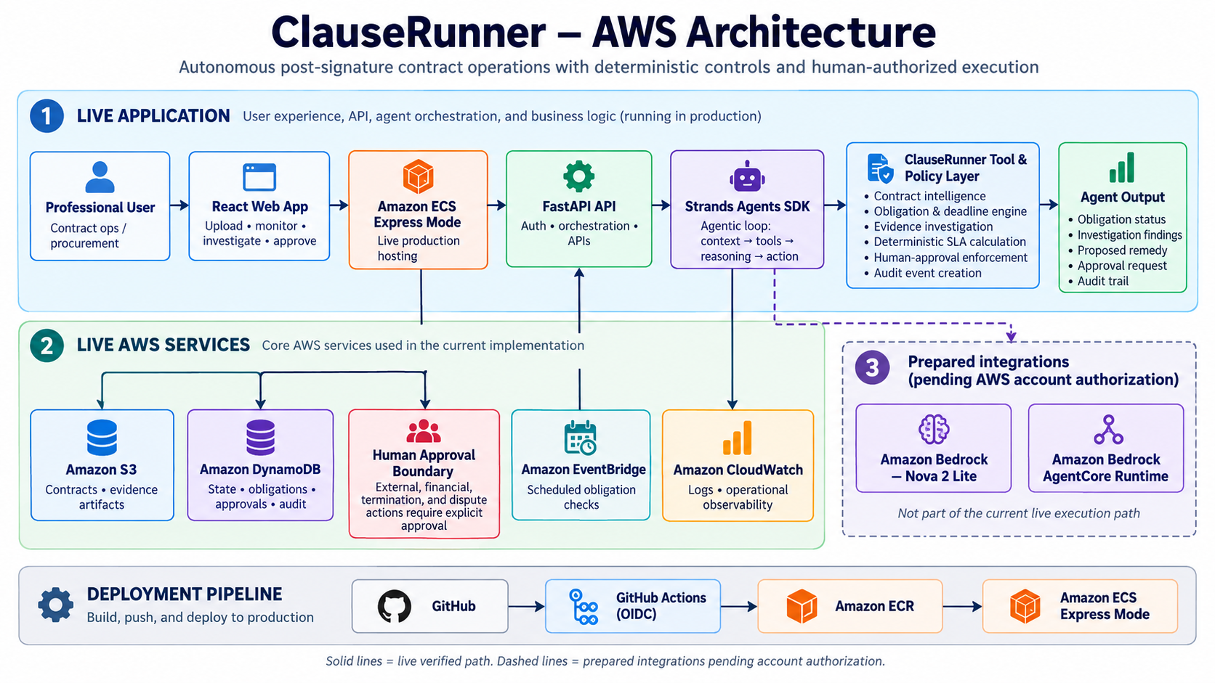
Architecture: live AWS system, prepared model path
Solid = live verified. Dashed = prepared integrations pending AWS authorization.

Slide 7
CLOSING
ClauseRunner is not a contract chatbot.
It is an operational agent pattern:
agentic investigation + deterministic policy + human authority + auditable execution
Professional impact
Bounded autonomy
Live AWS workflow
Less manual checking. Fewer missed remedies.
Agents prepare. Humans approve consequences.
State, scheduling, logs, approvals and audit.
Live demo: cl-a7d669f525024e6a8413b2e0f7b851c8.ecs.us-east-1.on.aws

