Slide 1
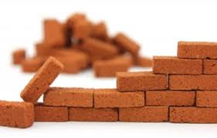
BRICKS

Slide 2
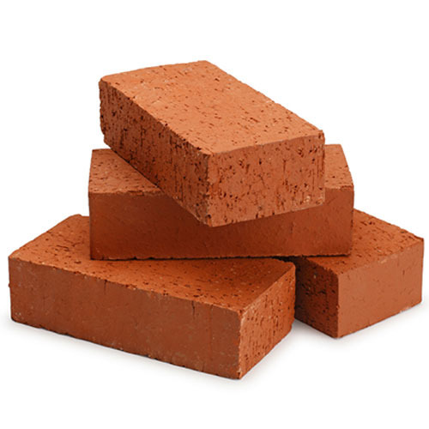
BRICKS
Obtained by moulding clay in rectangular blocks of uniform size and then drying and burning in kilns.
They have
Durability
Strength
Reliability
Low cost
Easy availability

Slide 3
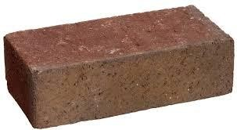
Composition
Silica:
50-60%
Prevents cracking, shrinking and warping of raw bricks
Imparts uniform shape to the bricks
In excess- makes the bricks brittle
Alumina:
20-30%
Imparts plasticity to the bricks- moulded easily
In excess- raw bricks warp & shrink during drying & burning

Slide 4
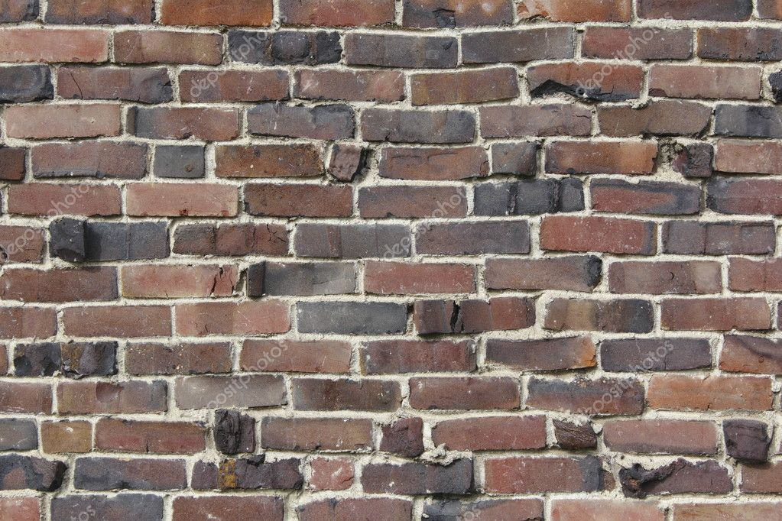
Notes:
bend or twist out of shape, especially from a straight or flat form,

Slide 5
Composition cont..
Oxide of iron
5-6%
Act as flux to cause the grains of sand to melt and bind the particles of clay together
Imparts red colour to brick on burning
In excess- makes the brick dark blue
Lime:
<5%
Causes the grains of sand to melt and bind the particles of clay together
Prevents shrinkage of raw bricks
In excess- causes the brick to melt & loses its shape

Slide 6
Composition cont..
Magnesia:
<2%
Imparts yellow colour to the brick
Decreases shrinkage
In excess- decay of bricks

Slide 7
Manufacturing of bricks
Preparation of soil- It involves removal of loose materials at the top of the ground(30 cm).
Required soil is dried and spread on a level ground
Earth is exposed to atmosphere for softening.(few weeks to a season)
The clay is then blended with suitable ingredients.
Moulding- clay is moulded to the required shape in moulds
2 types
Hand moulding- By hand in wooden moulds- if done on ground it is ground moulding ,if on table, table moulding.
Machine moulding- using machines
Drying - Damp bricks will crack and get distorted, so they are dried before burning
Bricks are allowed to dry for 7 to 14 days
Burning- to make the bricks attain adequate strength, hardness and less moisture absorbent and durable they are burnt at high temperatures in clamps or kilns

Slide 8
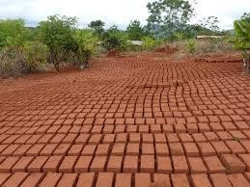
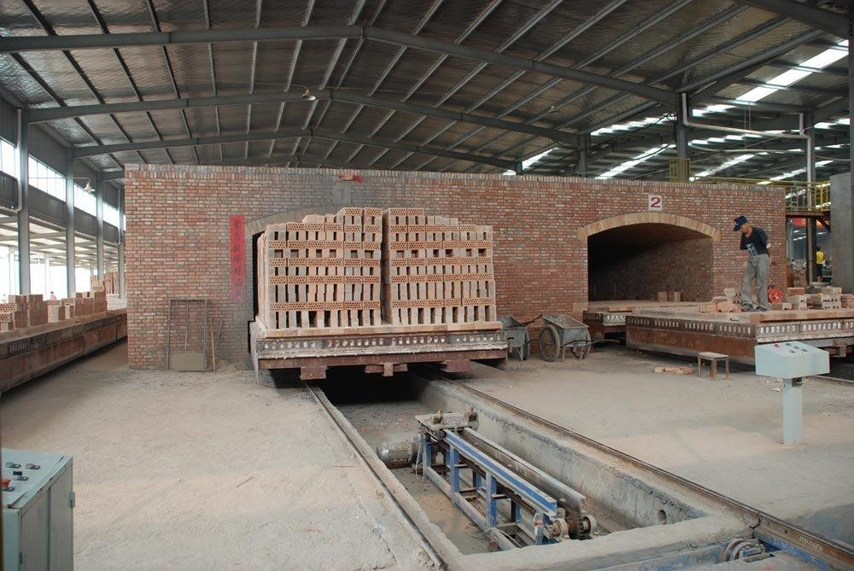
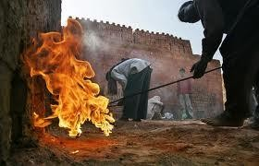

Slide 9
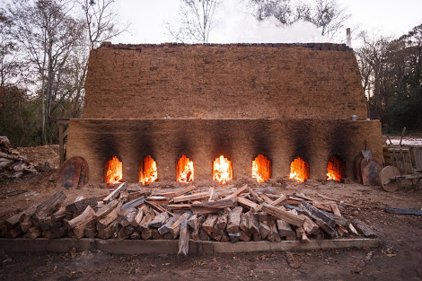
Clamp Burning of Brick

Slide 10
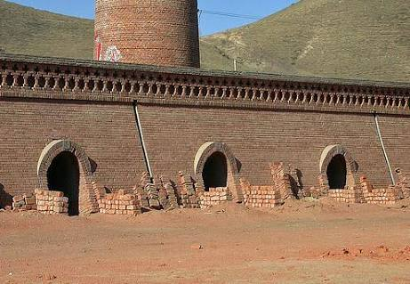
Kiln Burning of Brick

Slide 11
Size and weight
Size:
Standard size- 190mm x 90mm x 90mm
Nominal size of modular brick- 200mm x 100mm x 100 mm
Weight:
Weight of 1 m³ of brick earth- 18 kN
Average weight of a brick- 30 -35 kN (3 to 3.5 kg)

Slide 12
Test on bricks
Crushing strength test or compressive strength test
Bricks are tested in the equipment called Compression testing Machine (CTM).
Brick to be tested is placed in the platform of the machine, and load is applied till it breaks.
The maximum load is noted.
The compressive strength ort crushing strength is obtained by dividing the load by area of face of the brick.
The minimum compressive strength should be 3.5 N/mm²
Water absorption test
To find the amount of water absorbed by the brick.
First the weight of the brick is noted.
It is then immersed in water for 16 hours.
After that it is taken out and weighed.
The increase in weight is expressed as percentage of water absorption.

Slide 13
Efflorescence Test
Presence of soluble salts causes efflorescence on bricks.
Brick is immersed in water for 24 hours .
Then it is taken out and dried under shade.
After drying if a thin layer of white or grey powder is seen on the surface of the brick, there are soluble salts in brick.
% of white layer on surface | Efflorescence
10 % | slight
<50% | moderate
> 50 % | heavy

Slide 14
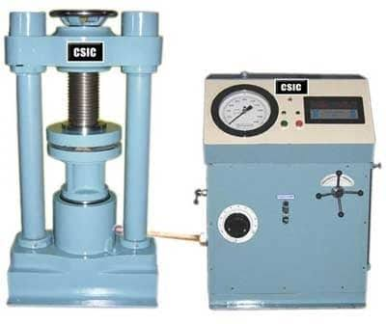
Compressive Testing Machine

Slide 15
Hardness Test
Scratch on the brick by fingernails.If no impession is left on the brick, then it is hard.
Soundness test
Two bricks are struck together slightly. A good brick shows a clear bell ringing sound and the bricks should not break.
Toughness test
A brick is taken and dropped flat from a height of 1 m on a firm platform, if it does not break then it is tough.
Structure
When a brick is broken it should be homogenous , compact, and free from holes and lumps.

Slide 16
Quality classification
First class | Second class | Third class | Fourth class
Machine or table moulded | Ground moulded | Ground moulded | Ground moulded
Burnt in kilns | Burnt in kilns | Burnt in clamps | Burnt in clamps
Rectangular shape with sharp edges and uniform size | Rectangular shape with sharp edges and slight irregularities in size | No regular shape and size | Irregular shape and size
Free from cracks, flaws and lumps | Free from cracks and slight flaws & lumps are permitted | Slightly over burnt and under burnt | Over burnt
Crushing strength > 10.5 N/mm² | Crushing strength > 7 N/mm² | -Crushing strength > 3.5 N/mm² | -
Water absorption < 20 % | Water absorption < 22 % | Water absorption < 24 % | -
Uniform colour and texture | - | Dull sound when struck together | Not used in normal construction works

Slide 17
Properties of good bricks
Should have perfect edges, well burnt in kilns, copper coloured, free from cracks with sharp & square edges
Shape- uniform shape & standard size
Colour- uniform & bright colour
Texture- should possess fine, dense and uniform texture - no fissures, cavities and unburnt lime
When broken it should have a bright homogeneous and uniform compact structure free from voids
Soundness- Perfect ringing sound when struck with each other.
Water absorption should be less than 20% for first class and 22 % for second class when soaked in water for 24 hrs.

Slide 18
Properties of good bricks
Hardness- Should be sufficiently hard- no nail impression when scratched
Strength- crushing strength should be greater than 3.5 N/mm^{2.} It shouldn’t break when dropped from s height of 1m
It should have low thermal conductivity so that building remain cool in summer and warm in winter.
Should be sound proof and fire resistant.
Efflorescence- It shouldn’t show any white or grey deposits of salt when immersed in water and dried. White patches are due to presence of sulphate of Ca, Mg and Potassium.

Slide 19
THANK YOU

