Slide 1
Title
Description

Slide 2
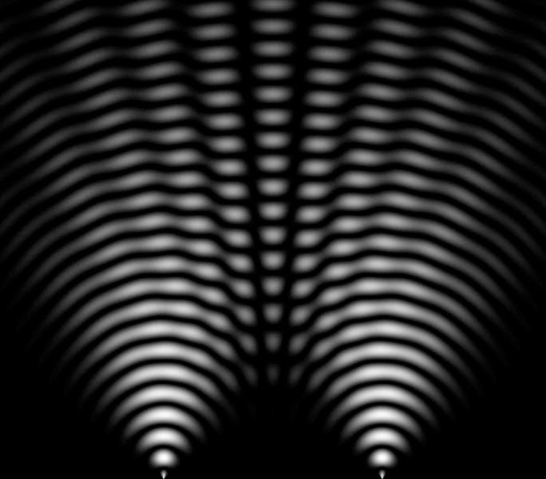
Huygens Principle
The Huygens principle states that every point on a wavefront acts as the starting point of a new wave. The new wavefront results from the superposition of all elementary waves.

Slide 3

Wave Propagation
If the coordinate system set so that one axis corresponds to the propagation direction, the deflection of the wave can be described as
$$W\left(x,t\right)=A\cos\left(2πf\left(\frac{x}{c}−t\right)+φ\right)$$
where $A$ is the amplitude, $f$ the wave frequency, $c$ the propagation speed, and $φ$ the phase.

Slide 4
Diffraction and Interference
Whenever a wave hits an obstacle diffraction occurs. Diffraction is the result of the formation of new waves along a wavefront according to the Huygens principle. The superposition of all these elementary waves result in a new wavefront, which is usually identical to the old one. If there is an obstacle, the elementary waves cannot interfere with partial waves at the edges of the obstacle.

Slide 5
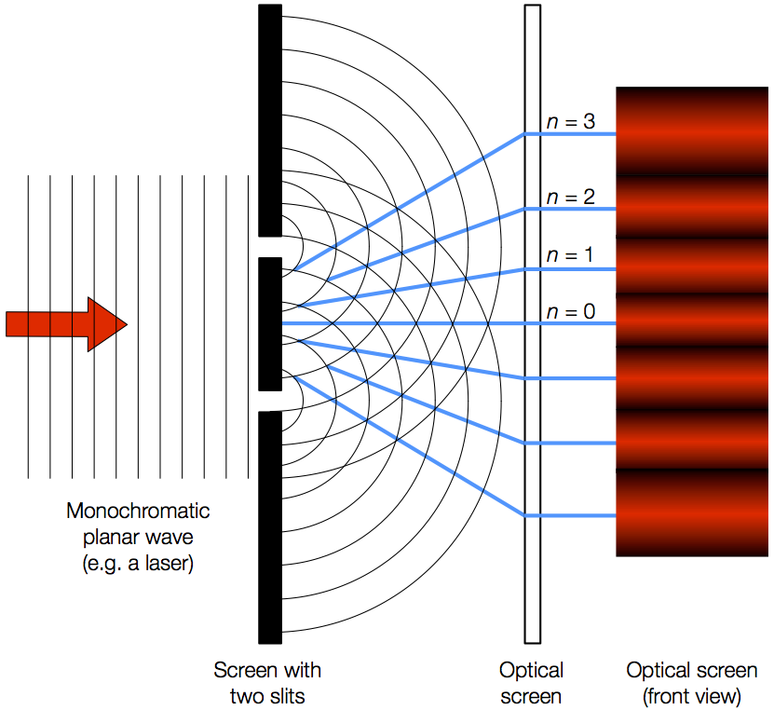
Double Slit Diffraction

Slide 6

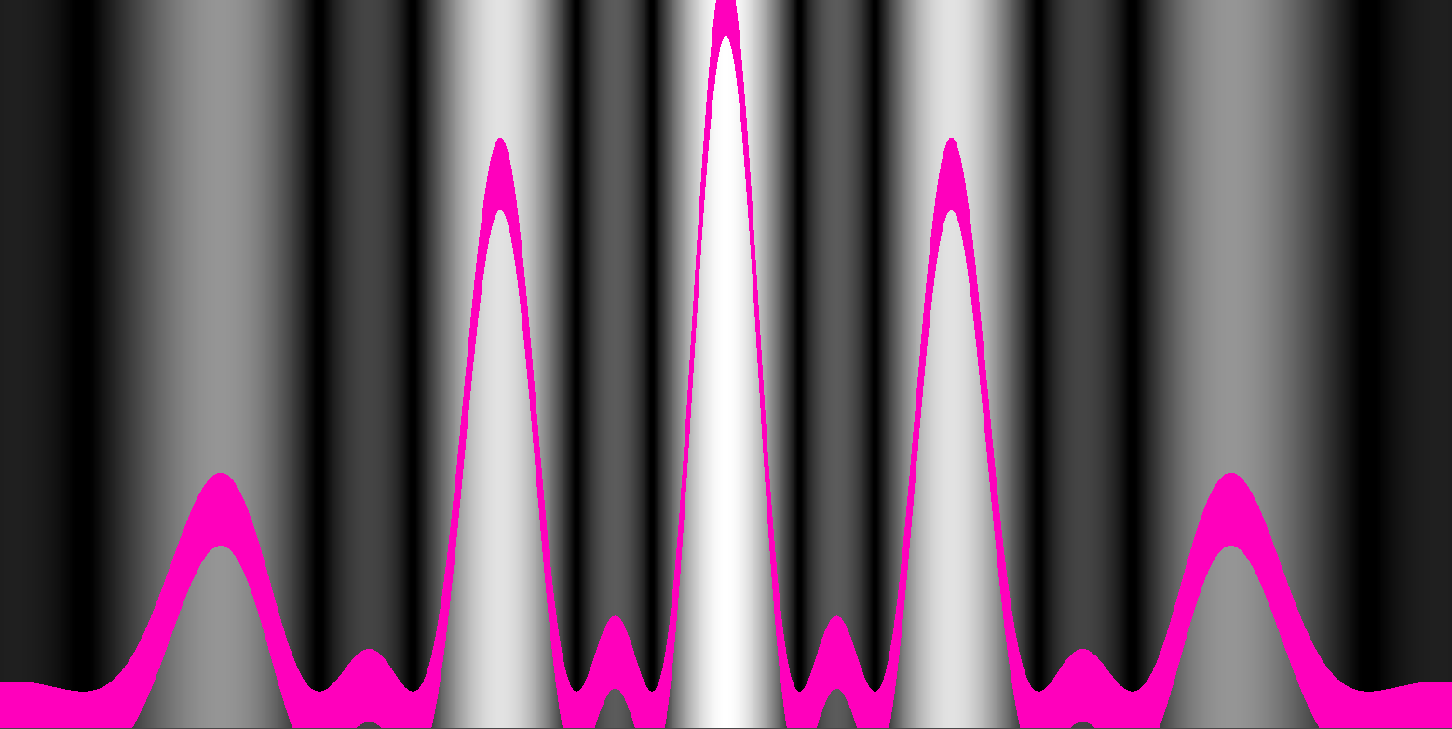
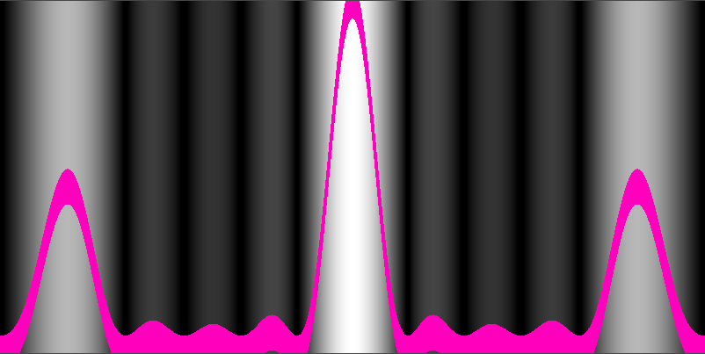
Intensity Distributions
1
2
3

Slide 7
Intensity Distributions
1
2

Slide 8
Worksheet
Observe the behavior of the waves when passing through a one-, two- or three-slit plate.
Which different interference patterns are created by the slit plates?
How can you effect the interference outcomes?
Which physical phenomenon occurs when two waves encounter each other?

