Slide 1
11726번 2xn 타일링

Slide 2
2xn 타일링
2x1
2x2
f(1) = 1
f(2) = 2

Slide 3
2xn 타일링
2x3
2x3
2x2
2x1
f(3)
=
f(2)
+
f(1)

Slide 4
2xn 타일링
2x4
2x4
2x3
2x2
f(4)
=
f(3)
+
f(2)

Slide 5
2xn 타일링
2xn
2xn
 |  | …
 |  | …
2xn-1
2xn-2
f(n)
=
f(n-1)
+
f(n-2)

Slide 6
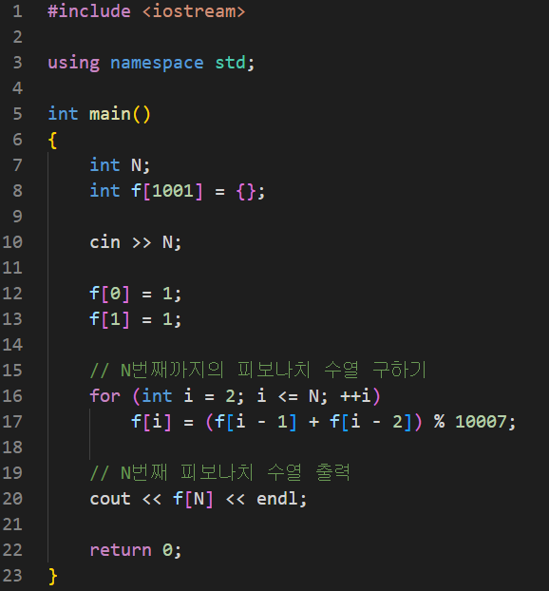

Slide 7
12865번 평범한 배낭

Slide 8
평범한 배낭
 | 0 | 1 | 2 | 3 | 4 | 5 | 6 | 7
0 | 0 | 0 | 0 | 0 | 0 | 0 | 0 | 0
1 6 / 13 | 0
2 4 / 8 | 0
3 3 / 6 | 0
4 5 / 12 | 0
W
N

Slide 9
평범한 배낭
 | 0 | 1 | 2 | 3 | 4 | 5 | 6 | 7
0 | 0 | 0 | 0 | 0 | 0 | 0 | 0 | 0
1 6 / 13 | 0 | 0 | 0 | 0 | 0 | 0
2 4 / 8 | 0
3 3 / 6 | 0
4 5 / 12 | 0
W
N

Slide 10
평범한 배낭
 | 0 | 1 | 2 | 3 | 4 | 5 | 6 | 7
0 | 0 | 0 | 0 | 0 | 0 | 0 | 0 | 0
1 6 / 13 | 0 | 0 | 0 | 0 | 0 | 0 | 13 | 13
2 4 / 8 | 0
3 3 / 6 | 0
4 5 / 12 | 0
W
N

Slide 11
평범한 배낭
 | 0 | 1 | 2 | 3 | 4 | 5 | 6 | 7
0 | 0 | 0 | 0 | 0 | 0 | 0 | 0 | 0
1 6 / 13 | 0 | 0 | 0 | 0 | 0 | 0 | 13 | 13
2 4 / 8 | 0 | 0 | 0 | 0
3 3 / 6 | 0
4 5 / 12 | 0
W
N

Slide 12
평범한 배낭
 | 0 | 1 | 2 | 3 | 4 | 5 | 6 | 7
0 | 0 | 0 | 0 | 0 | 0 | 0 | 0 | 0
1 6 / 13 | 0 | 0 | 0 | 0 | 0 | 0 | 13 | 13
2 4 / 8 | 0 | 0 | 0 | 0 | 8 | 8
3 3 / 6 | 0
4 5 / 12 | 0
W
N

Slide 13
평범한 배낭
 | 0 | 1 | 2 | 3 | 4 | 5 | 6 | 7
0 | 0 | 0 | 0 | 0 | 0 | 0 | 0 | 0
1 6 / 13 | 0 | 0 | 0 | 0 | 0 | 0 | 13 | 13
2 4 / 8 | 0 | 0 | 0 | 0 | 8 | 8 | 13 | 13
3 3 / 6 | 0
4 5 / 12 | 0
W
N

Slide 14
평범한 배낭
 | 0 | 1 | 2 | 3 | 4 | 5 | 6 | 7
0 | 0 | 0 | 0 | 0 | 0 | 0 | 0 | 0
1 6 / 13 | 0 | 0 | 0 | 0 | 0 | 0 | 13 | 13
2 4 / 8 | 0 | 0 | 0 | 0 | 8 | 8 | 13 | 13
3 3 / 6 | 0 | 0 | 0
4 5 / 12 | 0
W
N

Slide 15
평범한 배낭
 | 0 | 1 | 2 | 3 | 4 | 5 | 6 | 7
0 | 0 | 0 | 0 | 0 | 0 | 0 | 0 | 0
1 6 / 13 | 0 | 0 | 0 | 0 | 0 | 0 | 13 | 13
2 4 / 8 | 0 | 0 | 0 | 0 | 8 | 8 | 13 | 13
3 3 / 6 | 0 | 0 | 0 | 6
4 5 / 12 | 0
W
N

Slide 16
평범한 배낭
 | 0 | 1 | 2 | 3 | 4 | 5 | 6 | 7
0 | 0 | 0 | 0 | 0 | 0 | 0 | 0 | 0
1 6 / 13 | 0 | 0 | 0 | 0 | 0 | 0 | 13 | 13
2 4 / 8 | 0 | 0 | 0 | 0 | 8 | 8 | 13 | 13
3 3 / 6 | 0 | 0 | 0 | 6 | 8 | 8
4 5 / 12 | 0
W
N

Slide 17
평범한 배낭
 | 0 | 1 | 2 | 3 | 4 | 5 | 6 | 7
0 | 0 | 0 | 0 | 0 | 0 | 0 | 0 | 0
1 6 / 13 | 0 | 0 | 0 | 0 | 0 | 0 | 13 | 13
2 4 / 8 | 0 | 0 | 0 | 0 | 8 | 8 | 13 | 13
3 3 / 6 | 0 | 0 | 0 | 6 | 8 | 8 | 13
4 5 / 12 | 0
W
N

Slide 18
평범한 배낭
 | 0 | 1 | 2 | 3 | 4 | 5 | 6 | 7
0 | 0 | 0 | 0 | 0 | 0 | 0 | 0 | 0
1 6 / 13 | 0 | 0 | 0 | 0 | 0 | 0 | 13 | 13
2 4 / 8 | 0 | 0 | 0 | 0 | 8 | 8 | 13 | 13
3 3 / 6 | 0 | 0 | 0 | 6 | 8 | 8 | 13 | 14
4 5 / 12 | 0
W
N

Slide 19
평범한 배낭
 | 0 | 1 | 2 | 3 | 4 | 5 | 6 | 7
0 | 0 | 0 | 0 | 0 | 0 | 0 | 0 | 0
1 6 / 13 | 0 | 0 | 0 | 0 | 0 | 0 | 13 | 13
2 4 / 8 | 0 | 0 | 0 | 0 | 8 | 8 | 13 | 13
3 3 / 6 | 0 | 0 | 0 | 6 | 8 | 8 | 13 | 14
4 5 / 12 | 0 | 0 | 0 | 6 | 8
W
N

Slide 20
평범한 배낭
 | 0 | 1 | 2 | 3 | 4 | 5 | 6 | 7
0 | 0 | 0 | 0 | 0 | 0 | 0 | 0 | 0
1 6 / 13 | 0 | 0 | 0 | 0 | 0 | 0 | 13 | 13
2 4 / 8 | 0 | 0 | 0 | 0 | 8 | 8 | 13 | 13
3 3 / 6 | 0 | 0 | 0 | 6 | 8 | 8 | 13 | 14
4 5 / 12 | 0 | 0 | 0 | 6 | 8 | 12
W
N

Slide 21
평범한 배낭
 | 0 | 1 | 2 | 3 | 4 | 5 | 6 | 7
0 | 0 | 0 | 0 | 0 | 0 | 0 | 0 | 0
1 6 / 13 | 0 | 0 | 0 | 0 | 0 | 0 | 13 | 13
2 4 / 8 | 0 | 0 | 0 | 0 | 8 | 8 | 13 | 13
3 3 / 6 | 0 | 0 | 0 | 6 | 8 | 8 | 13 | 14
4 5 / 12 | 0 | 0 | 0 | 6 | 8 | 12 | 13
W
N

Slide 22
평범한 배낭
 | 0 | 1 | 2 | 3 | 4 | 5 | 6 | 7
0 | 0 | 0 | 0 | 0 | 0 | 0 | 0 | 0
1 6 / 13 | 0 | 0 | 0 | 0 | 0 | 0 | 13 | 13
2 4 / 8 | 0 | 0 | 0 | 0 | 8 | 8 | 13 | 13
3 3 / 6 | 0 | 0 | 0 | 6 | 8 | 8 | 13 | 14
4 5 / 12 | 0 | 0 | 0 | 6 | 8 | 12 | 13 | 14
W
N

Slide 23
평범한 배낭
 | 0 | 1 | 2 | 3 | 4 | 5 | 6 | 7
0 | 0 | 0 | 0 | 0 | 0 | 0 | 0 | 0
1 6 / 13 | 0 | 0 | 0 | 0 | 0 | 0 | 13 | 13
2 4 / 8 | 0 | 0 | 0 | 0 | 8 | 8 | 13 | 13
3 3 / 6 | 0 | 0 | 0 | 6 | 8 | 8 | 13 | 14
4 5 / 12 | 0 | 0 | 0 | 6 | 8 | 12 | 13 | 14
W
N

Slide 24
2096번 내려가기

Slide 25
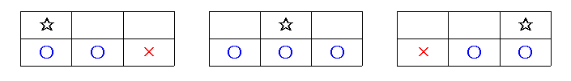
내려가기

Slide 26
내려가기
RECORD MIN | RECORD
0 | 0 | 0
0 | 0 | 0
A | B | C
1 | 2 | 3
4 | 5 | 6
4 | 9 | 0
RECORD MAX | RECORD
0 | 0 | 0
0 | 0 | 0

Slide 27
내려가기
RECORD MIN | RECORD
0 | 0 | 0
1 | 2 | 3
A | B | C
1 | 2 | 3
4 | 5 | 6
4 | 9 | 0
RECORD MAX | RECORD
0 | 0 | 0
1 | 2 | 3

Slide 28
내려가기
RECORD MIN | RECORD
1 | 2 | 3
1 | 2 | 3
A | B | C
1 | 2 | 3
4 | 5 | 6
4 | 9 | 0
RECORD MAX | RECORD
1 | 2 | 3
1 | 2 | 3

Slide 29
내려가기
RECORD MIN | RECORD
1 | 2 | 3
4 | 5 | 6
A | B | C
1 | 2 | 3
4 | 5 | 6
4 | 9 | 0
RECORD MAX | RECORD
1 | 2 | 3
4 | 5 | 6

Slide 30
내려가기
RECORD MIN | RECORD
5 | 6 | 8
4 | 5 | 6
A | B | C
1 | 2 | 3
4 | 5 | 6
4 | 9 | 0
RECORD MAX | RECORD
6 | 8 | 9
4 | 5 | 6

Slide 31
내려가기
RECORD MIN | RECORD
5 | 6 | 8
4 | 9 | 0
A | B | C
1 | 2 | 3
4 | 5 | 6
4 | 9 | 0
RECORD MAX | RECORD
6 | 8 | 9
4 | 9 | 0

Slide 32
내려가기
RECORD MIN | RECORD
9 | 14 | 6
4 | 9 | 0
A | B | C
1 | 2 | 3
4 | 5 | 6
4 | 9 | 0
RECORD MAX | RECORD
12 | 18 | 9
4 | 9 | 0

Slide 33
내려가기
RECORD MIN | RECORD
9 | 14 | 6
4 | 9 | 0
A | B | C
1 | 2 | 3
4 | 5 | 6
4 | 9 | 0
RECORD MAX | RECORD
12 | 18 | 9
4 | 9 | 0

