Slide 1
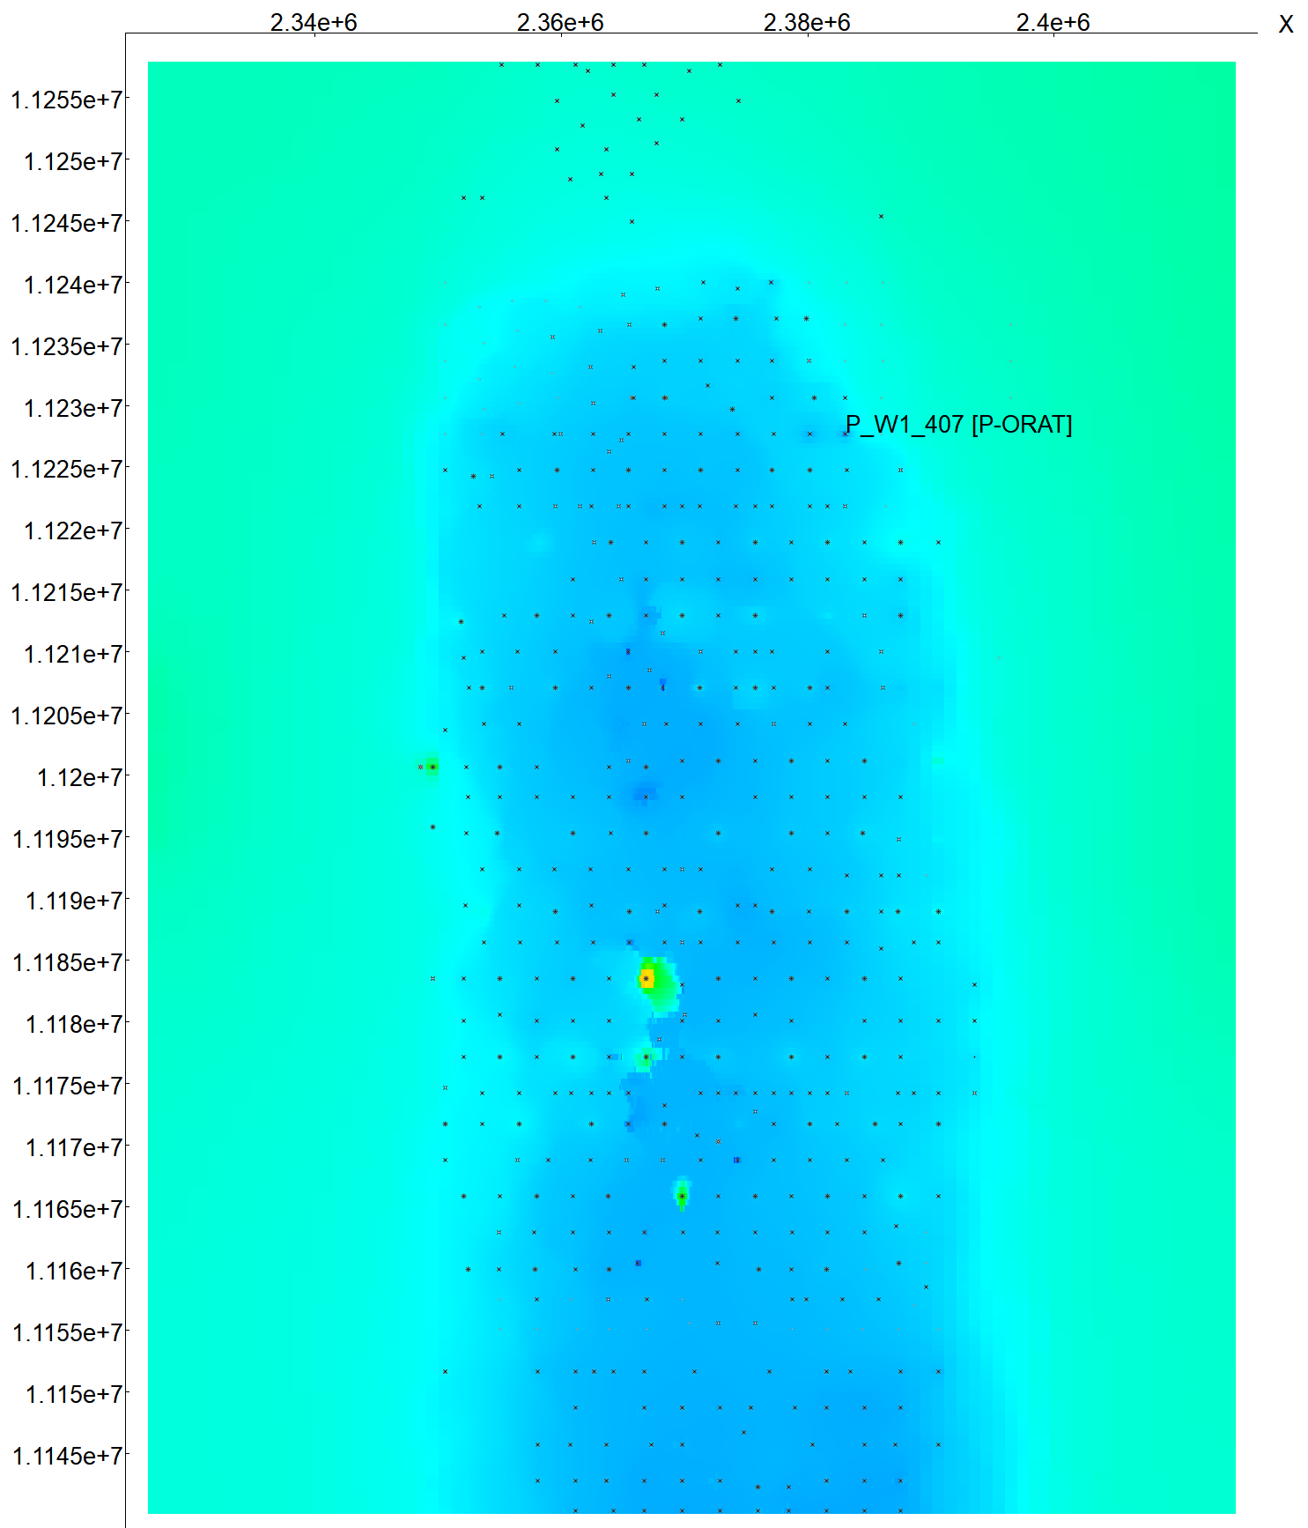
Producer
Injector
Horizontal producer
P-443
P-089
P-122
P-175
I-180
P-066
P-096
P-047
P-446
I-063
I-176
P-481
P-105
P-026
I-078
P-185
P-266
P-229
P-292
P-255
I-264
P-RN-323
P-RN-300
P-RN-500

