Slide 1

Chinese Handwriting OCR for Schools
CityU-EE Gifted Education Fund Programme: AIoT Coding, Engineering and Entrepreneurial Skills Education for Gifted Students
An innovation to paper checking
Team Members (Project ID)
27 Lo Pak Ki Kapakki

Slide 2
Introduction
Chinese Handwriting:
Hard to recognize not only for computer, but also for human eye.

Slide 3
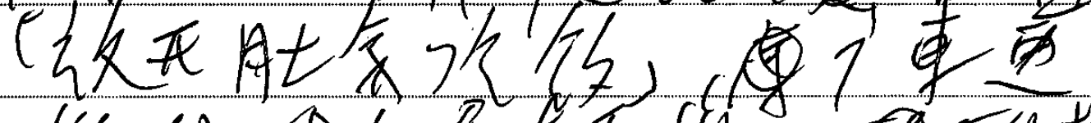
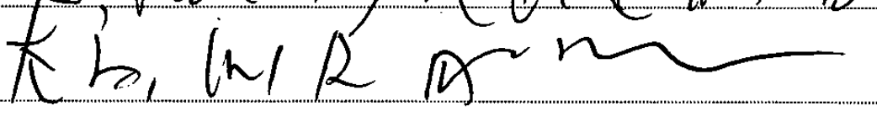
Try guessing what these sentences are
These are actual screenshots from samples of level 5 Chinese History DSE Papers.

Slide 4


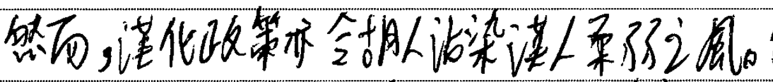
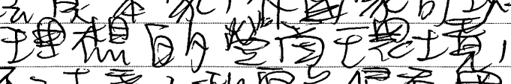

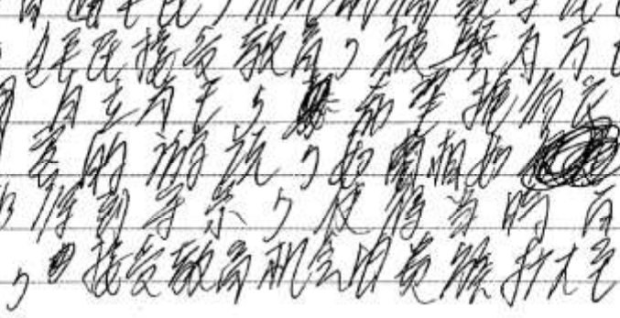
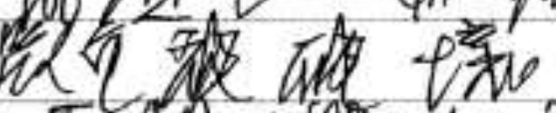
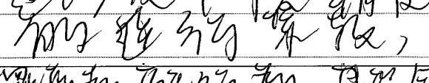


Slide 5
Why I want to do this project?
These were just snippets of the papers, the reality is that teachers in schools have to go through hundreds of papers throughout the year.
I hope to be able to create an AI which can help recognize or predict what the student is trying to write, to reduce the stress of teachers.

Slide 6
What is the target market?
4000
3000
2000
1000
0
You may use charts or graphs to illustrate the result from market research

Slide 7
What is the target market?
You may add a table to compare data
 | A | B | C
Yellow | 10 | 20 | 7
Blue | 30 | 15 | 10
Orange | 5 | 24 | 16

Slide 8
Are there existing solutions?
How the problem has been addressed by the current solution?
What technologies they use?

Slide 9
What is your solution?
Possible improvements on the current solution
What new technologies to bring about

Slide 10
What is your solution?
A
B
C
You may use graphics to visualise your idea

Slide 11
What is your solution?
4.3%
9.5%
9.5%
21.3%
31.9%
30.5%
41%
21.3%
21.3%
9.5%
You may use data to support your idea

Slide 12

What is your solution?
How does it work?
Elaborate the concepts, technologies applied, etc.

Slide 13
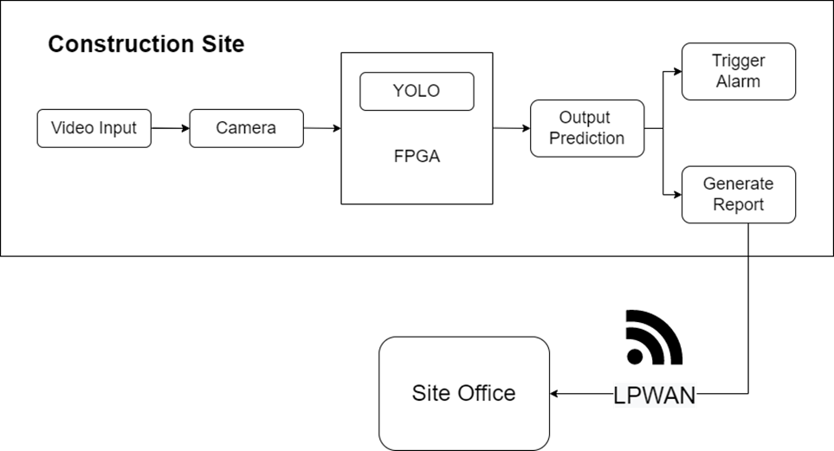
What is your solution?
You may insert a graph to illustrate the workflow of your solution, i.e.:

Slide 14
Timeline
Month/Date
Month/Date
Month/Date
Month/Date
Details of the task
Details of the task
Details of the task
Details of the task

Slide 15
Future work
Future plan to further develop the product
Plan to deploy and market the product

Slide 16
Thanks!
Any questions?
Contact details:
Email
Website, if any

