Slide 1
Deploy Infrastructre As A Service with Azure Resource Manager Templates
Will Anderson

Slide 2

Will Anderson
Director of Online Services – The DevOps Collective
Cloud Solutions Architect – Coretek Services
Microsoft Cloud and Datacentre Management MVP
@GamerLivingWill (for pretty much everything)

Slide 3



The Azure RM Vision
* As Code
Configuration
Infrastructure
Governance
Policy

Slide 4
Why Templates?
Templates combine the benefits of the underlying Azure Resource Manager with the adaptability and readability of JavaScript Object Notation (JSON). Allowing you to:
Deploy topologies and their workloads consistently.
Manage all your resources in an application together using resource groups.
Apply role-based access control (RBAC) to grant appropriate access to users, groups, and services.
Use tagging associations to streamline tasks such as billing rollups.

Slide 5
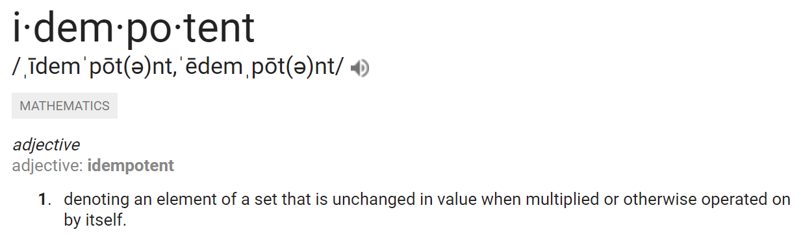

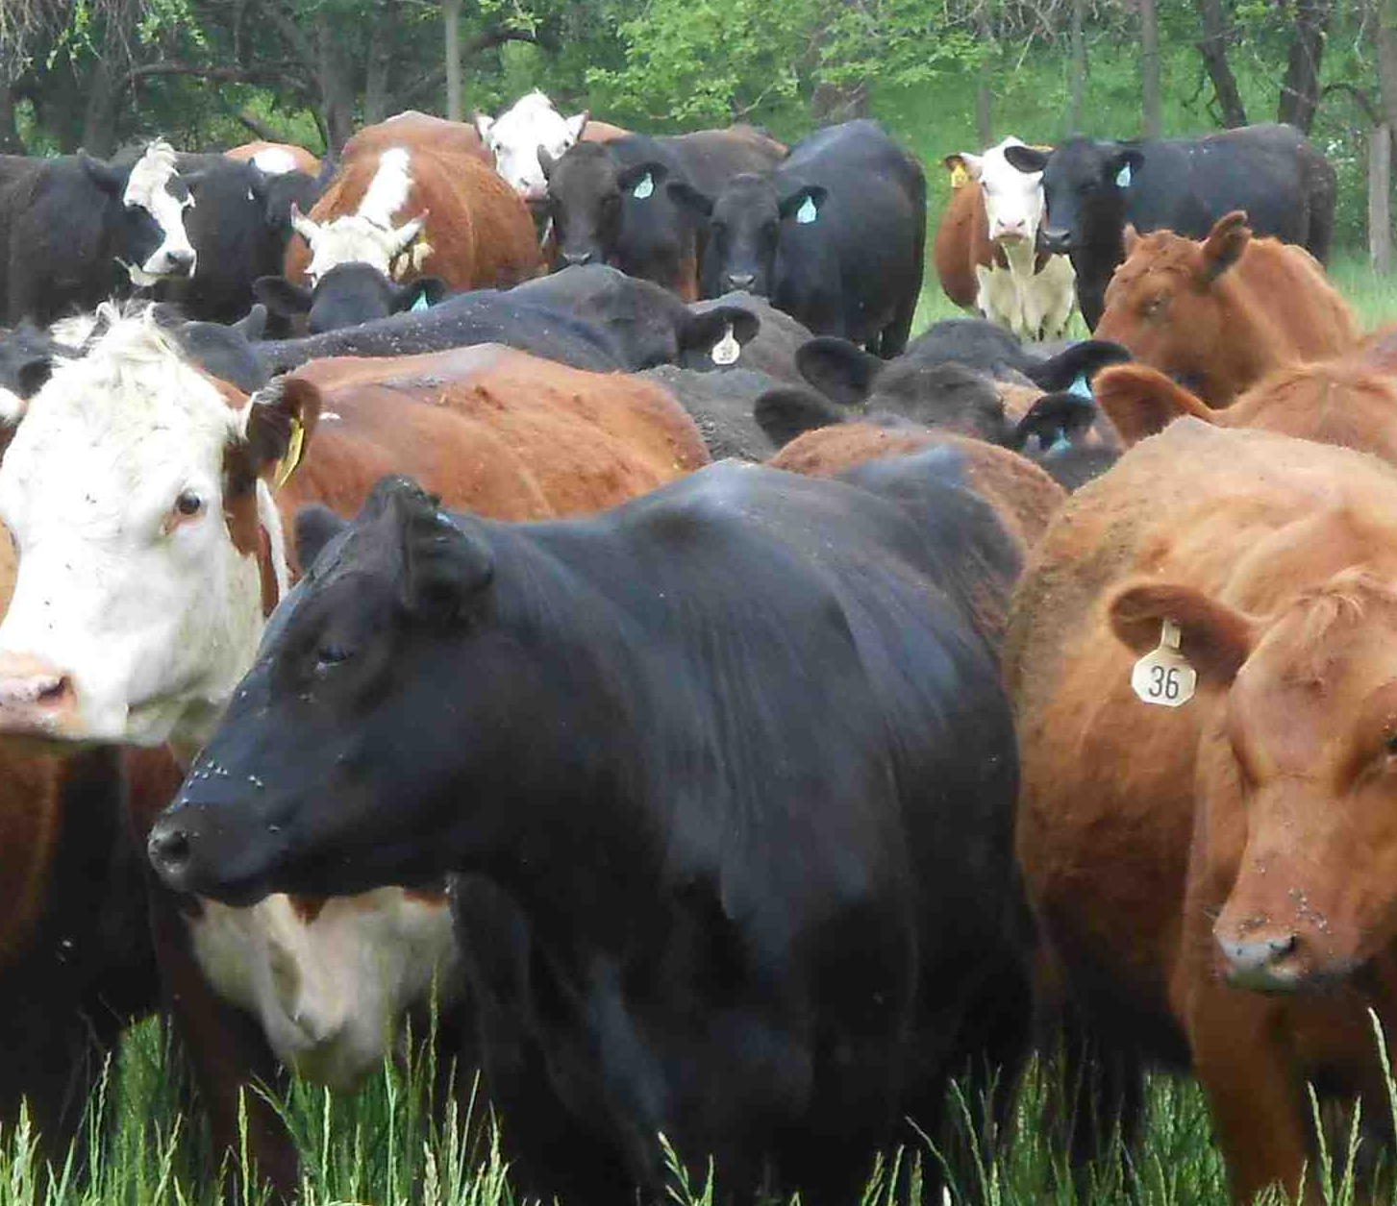
Think Idempotently
Pets
Cattle

Slide 6
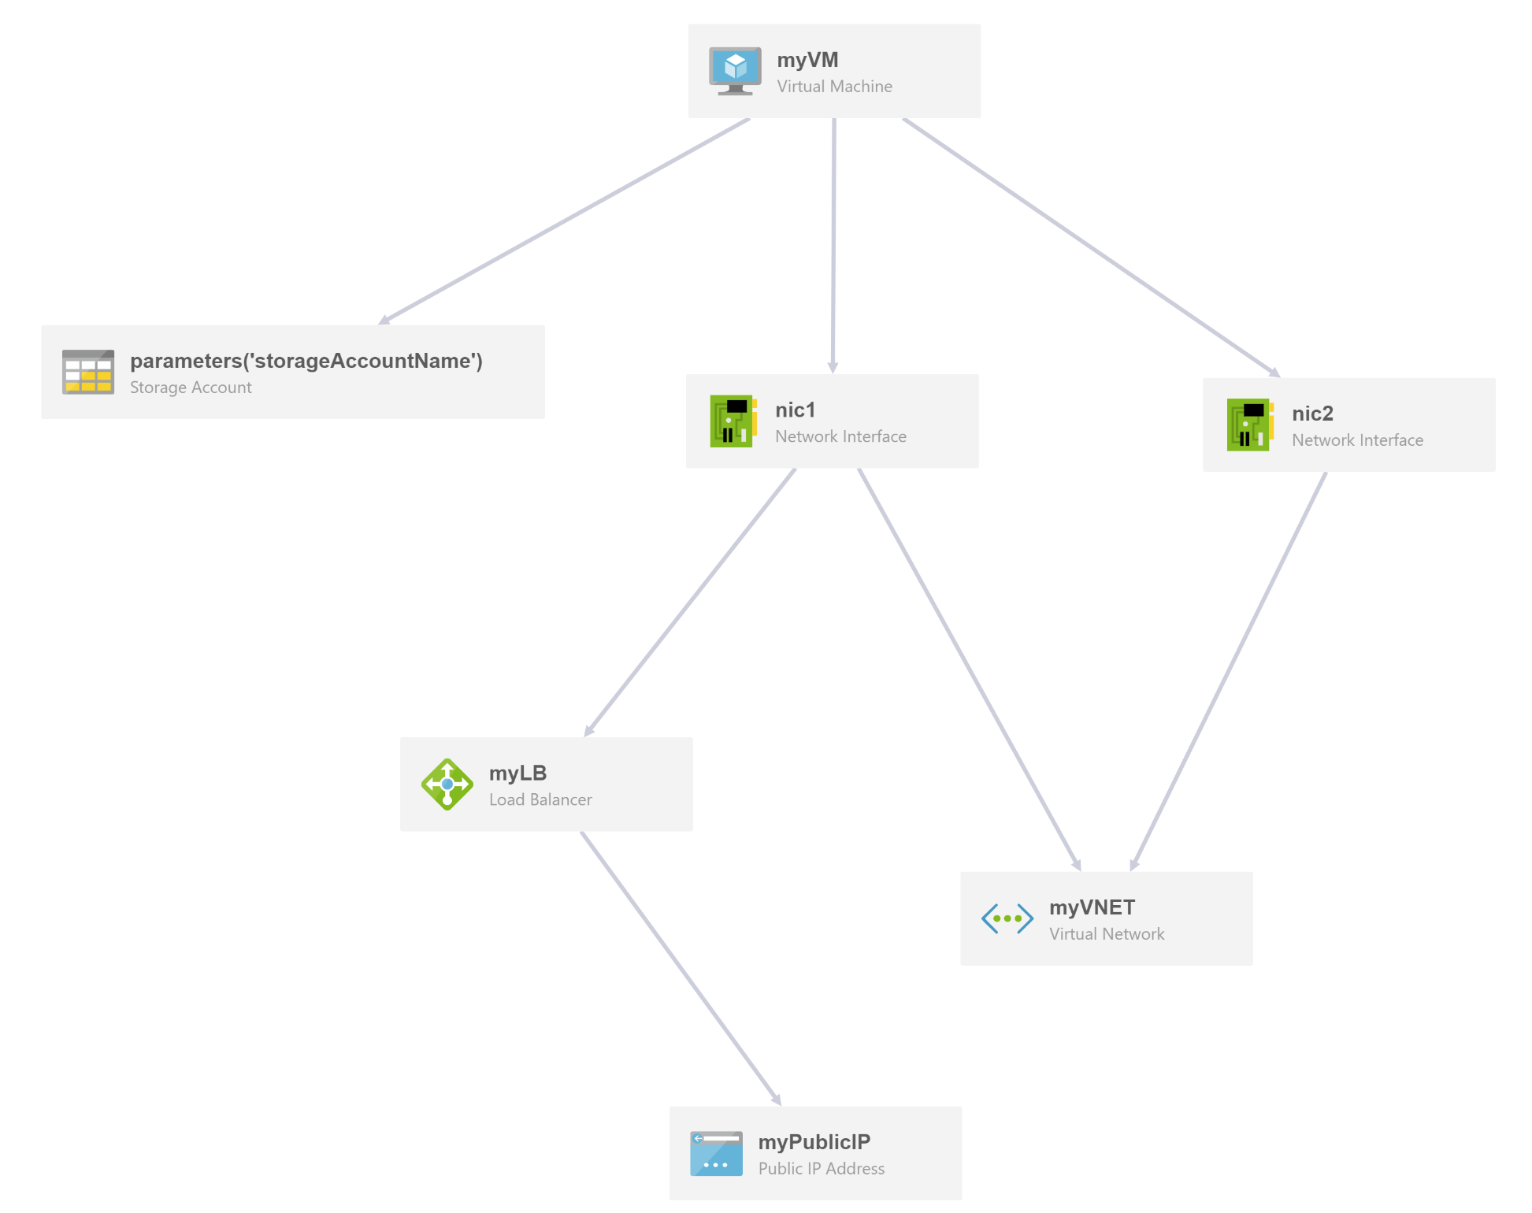
Think Imperatively
ARM templates describe the goal state of an application, and the sequence in which that state can be realized.

Slide 7

Choices vs. Decisions
Parameters –
Choices that you give your end users.
Variables –
Decisions that you make based on your users’ inputs

Slide 8
Choices vs. Decisions
Parameters –
Where do they want the environment to be located?
Is the environment for DEV? QA? UAT? PROD?
Variables
Naming convention
Size and number of virtual machines
vNet configurations
Applied configurations
Automation
Use Azure KeyVault/Automation Account Credentials to secure and implement user account names and passwords.
Use Azure Desired State Configuration to implement application configs.

Slide 9
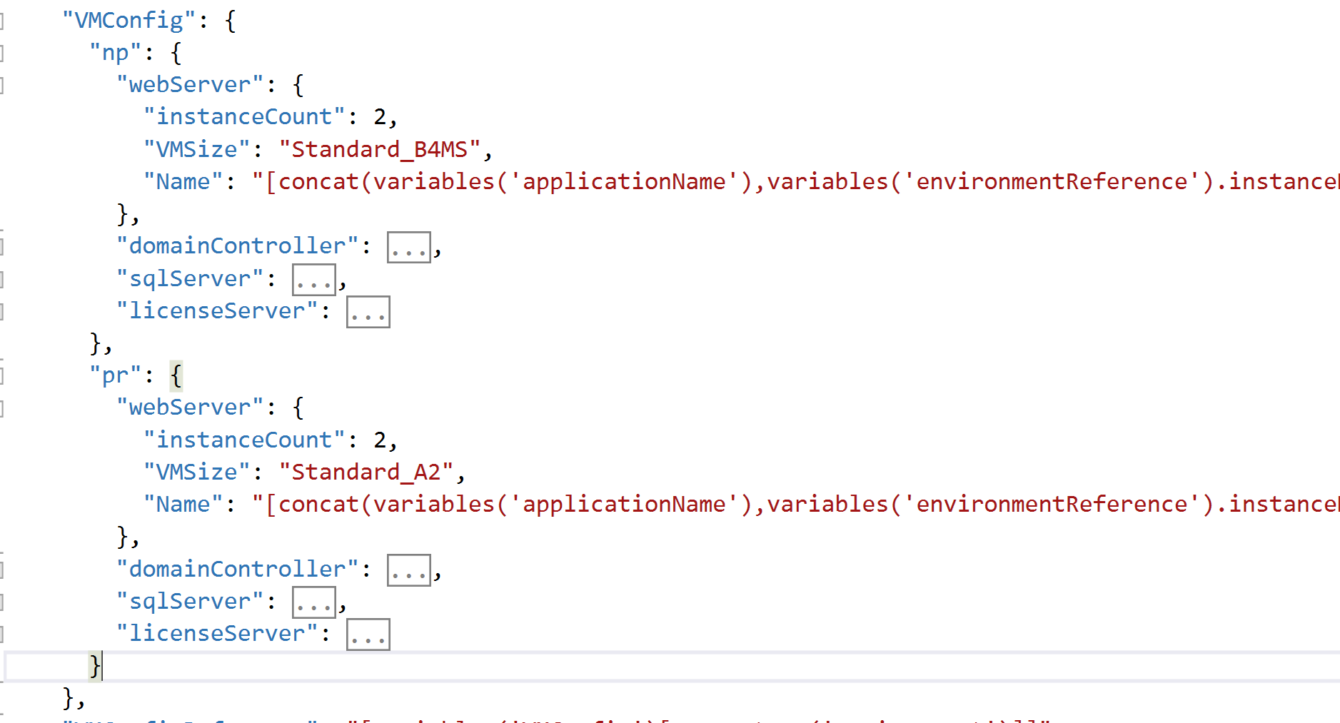
Decisions with Complex Variable Constructs

Slide 10
Keep Naming Simple and Standard
Naming Limitations –
Storage Groups –
Must be lowercase
Cannot contain hyphens
Cannot exceed 24 characters
Virtual Machines
Windows – cannot exceed 15 characters
Globally Unique Naming
Azure Storage
Web Apps
Azure Key Vault
Redis Cache
Traffic Manager
and more…
https://docs.microsoft.com/en-us/azure/azure-resource-manager/resource-manager-template-best-practices

Slide 11
Template Parameter File vs. Object
Template Parameter Files
Good for Development Scenarios
Static Files
Must be Secured
Breaks Automation
Template Parameter Objects
Good for Production Scenarios
Objects generated at Runtime
Security Lies in Automation (Azure Key Vault/Automation Accounts/etc)

Slide 12
To Link Templates or Not
Consider:
ARM Templates define the goal state of your application.
It is a defining, declarative document.
It is potentially auditable.
Different teams may want to be responsible for certain aspects (eg – Networking, Storage, Virtual Machines)
Changes made to linked templates can adversely affect your deployments. Potentially breaking automated redeployment scenarios.
Instead, allow responsible teams to define the standards for creation of objects.

Slide 13
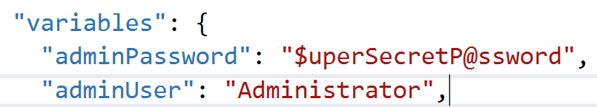
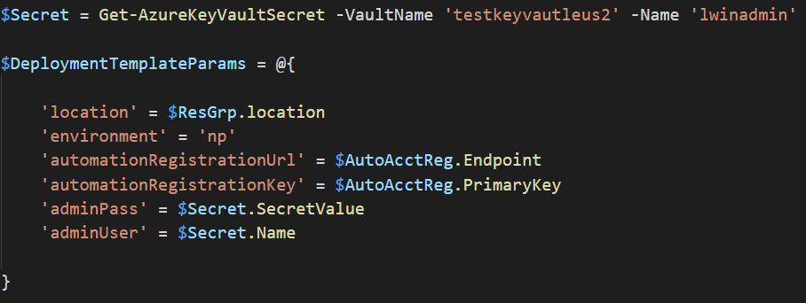
Secrets in Source
Don’t:
Do:

Slide 14
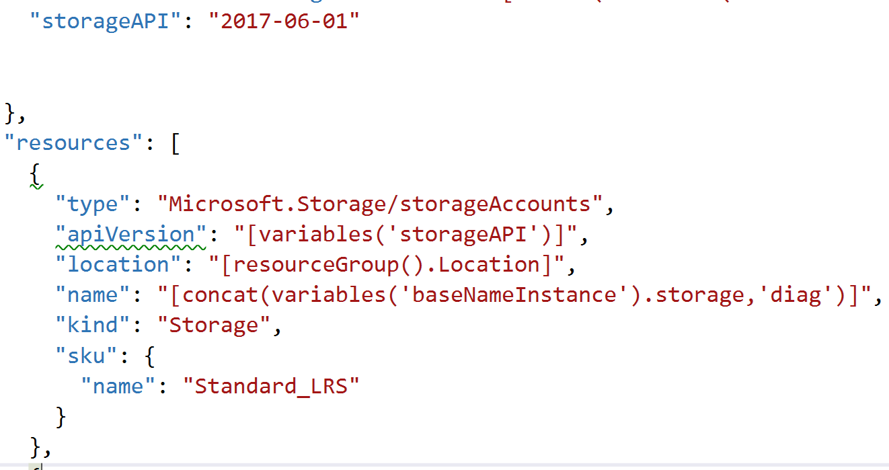
apiVersion as a Variable

Slide 15
Using the Wrong Expression
resourceId() vs. concat()
resourceId - Returns the unique identifier of a resource. You use this function when the resource name is ambiguous or not provisioned within the same template.
concat - Combines multiple string values and returns the concatenated string, or combines multiple arrays and returns the concatenated array.

Slide 16

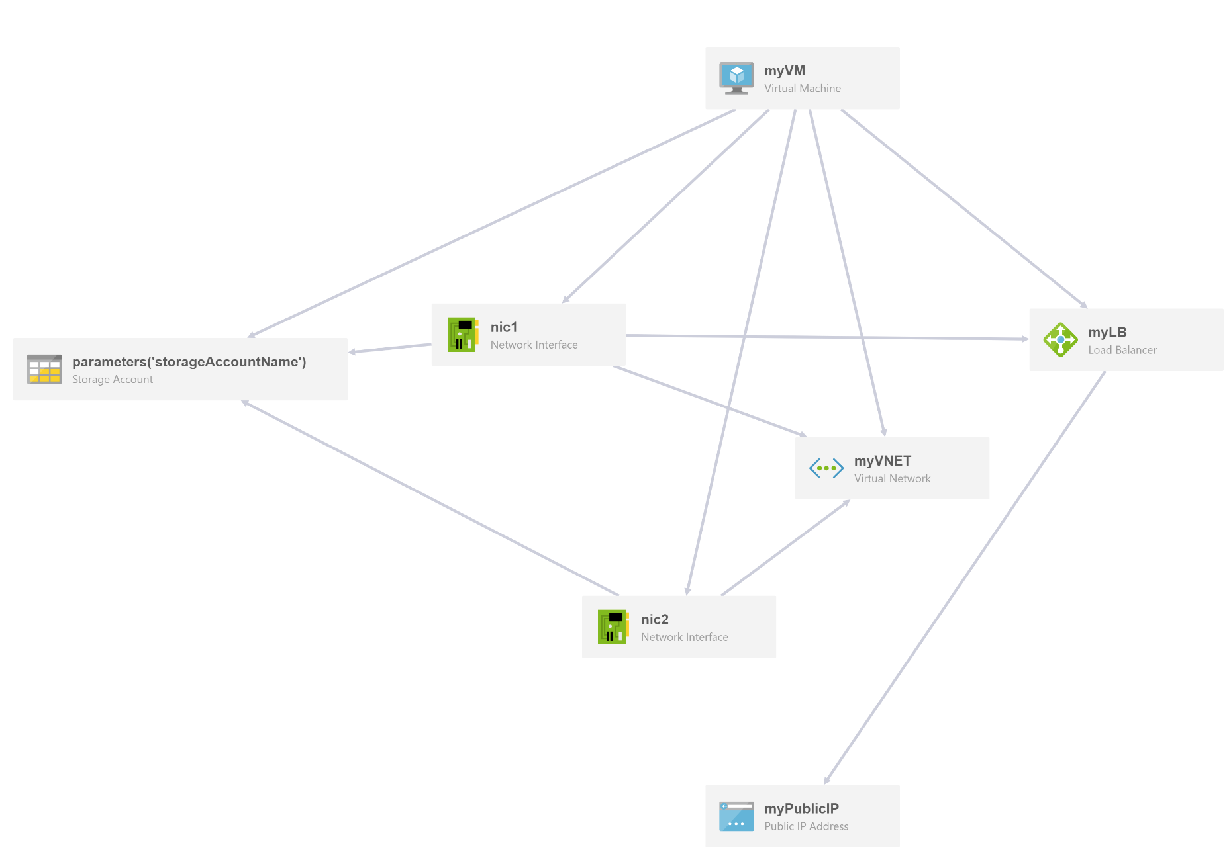
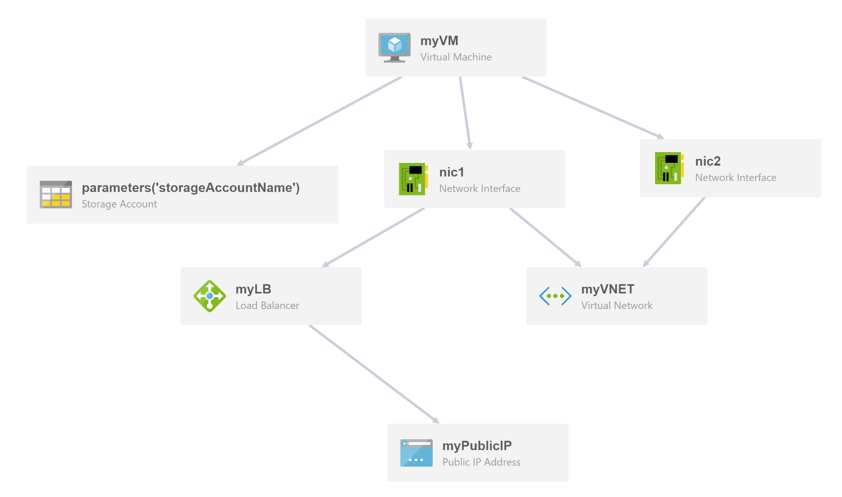

Unnecessary Dependencies

Slide 17


Starting From Scratch
Use Quickstart Gallery and Automation Script features as a Starting Point.
Use Quickstart Gallery and Automation Script features as production ready code.
Quickstart Gallery templates often do not follow best practices.
Quickstart and Automation templates are almost never idempotent.

Slide 18
Authoring Best Practices
Use Camel Case
apiVersion, not
APIVersion
Don’t specify location
use resourceGroup().location
Tag resources:
Allow automation to create your tags on the fly.
Use Outputs
Pass on information for additional automation tasks.
Send information to the end user (publicIPs, entry points, etc.)

Slide 19
Demo Time!

Slide 20
Slides and Code

