Slide 1
The Challenge of Implementing DevOps In IT
Will Anderson
Cloud Solutions Architect
will.anderson@coretekservices.com
@GamerLivingWill
2017-10-12
Notes:
Varies by audience ☺

Slide 2
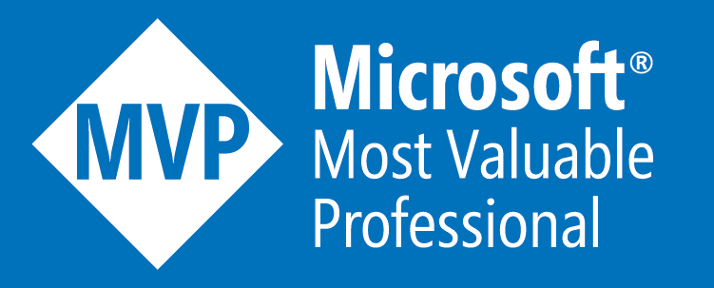


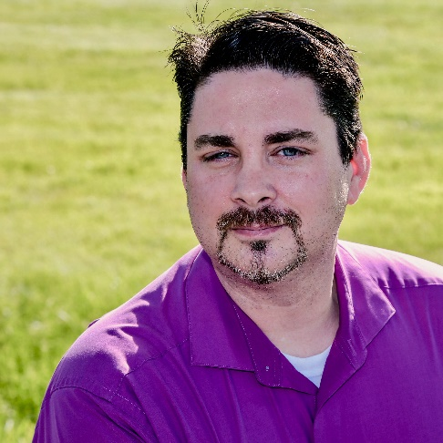
About Me
Cloud Solutions Architect – Coretek Services
2015-2017 Microsoft MVP – Cloud and Datacenter Management
2015 Honorary Scripting Guy
Board of Directors – The DevOps Collective
Co-Author – Master PowerShell Tricks Volume 2
(Volume 3 coming soon!)
Security/Patch Management/Compliance SME
Blog – https://powershell.org/author/will-anderson/

Slide 3

What Is DevOps, Really?
DevOps is the combination of cultural philosophies, practices, and tools that increases an organization’s ability to deliver applications and services at high velocity: evolving and improving products at a faster pace than organizations using traditional software development and infrastructure management processes.
-Amazon Web Services
https://aws.amazon.com/devops/what-is-devops/

Slide 4

What Is DevOps, Really?
Culture
Automation
Measurement
Sharing
DevOps is not a tool chain

Slide 5
The Break Down In Agile
Agile
Ad-hoc
Move Quickly
Defined Linear Process
Start To Finish Pipeline
Automation Focus (reusable code for future projects)
Planned one-time project
Move Quickly
Breaks Existing Processes
Chaos Ensues at Implementation
‘Get it Done’ (automation is nice, but we need the work done now)
Last minute project (we’ll plan later)

Slide 6
The Break Down In Agile
The number one challenge cited by organizations in implementing Agile was:
An organizational culture at odds with Agile values
Whereas most enterprise executives choose to believe there is only so far that Agile and DevOps can take a Fortune 500 organization, [executives at ING]choose to look at what tech “unicorns” such as Google, Zappos, Spotify, and Netflix were doing.
“We came to the realization that, ultimately, we are a technology company operating in the financial-services business. So, we asked ourselves where we could learn about being a best-in-class technology company. The answer was not other banks, but real tech firms.”
Peter Jacobs, ING
Notes:
1) State of Agile 2017 report
2) McKinsey had a really good article with Peter Jacobs (CIO) and Bart Schlatmann (Former COO) from ING , which I have linked at the end of my slides….

Slide 7
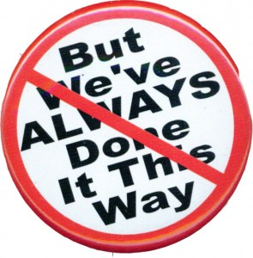
The Move To DevOps - Culture
Break down the silos
Create small, self-steering, independent teams comprising of members from appropriate orgs –
Development
Commercial
Operations
Engineering
Change the management structure
“As long as you continue to have different departments, steering committees, project managers, and project directors, you will continue to have silos—and that hinders agility.”
Peter Jacobs, ING

Slide 8
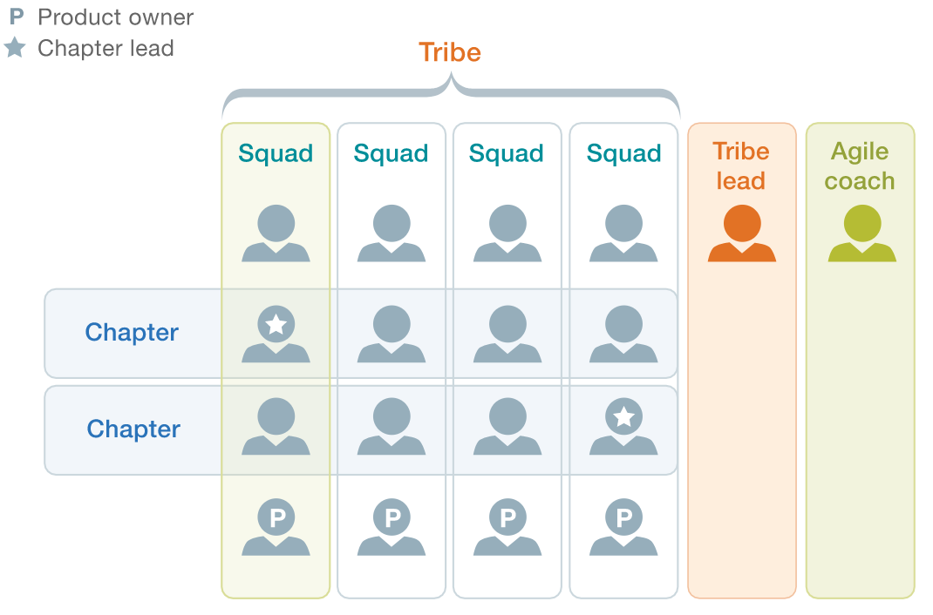
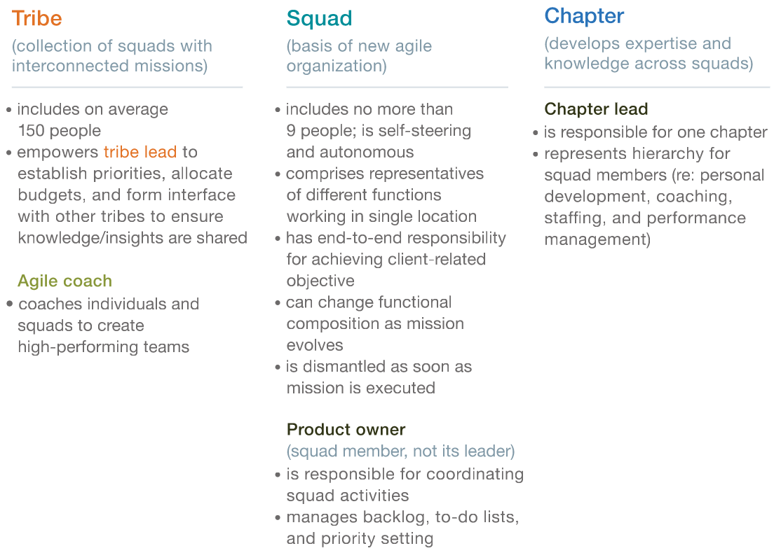
The Move To DevOps - Culture
“Culture is perhaps the most important element of this sort of change effort…Culture needs to be reflected and rooted in anything and everything that we undertake as an organization and as individuals.”
- Bart Schlatmann, ING

Slide 9
The Move To DevOps – Culture to Automation
Evaluate your processes
Outline your processes in a flowchart and highlight the roadblocks.
Challenge “we can’t” or “we’ve always done it that way”
Is it tooling?
Is it process?
Is it a legal issue?
How is the industry/community solving this problem?
If it can’t be automated, look for a new solution.
Lifting and carrying project work between tools can cause breaks in time and process – decreasing your delivery capabilities and speed.

Slide 10
The Move To DevOps - Automation
Continuous Delivery
The ability to work on iterative releases as the product matures.
Releasing new versions every few weeks instead of a few times a year.
Integration
Your tool chain (native code, code repository, pipeline, management) should work together natively.
Testing
Unit Testing (Pester)
Integration Testing

Slide 11
The Move To DevOps - Automation
Automate - Writing Automation in Code Native to the Platform (PowerShell, Bash, JSON, etc.)
Out of the box cookbooks are great! Until you change management products.
Write repeatable, reusable code. (Toolmaking)
Source Control - Centralize
GitHub
Team Foundation Server
Orchestrate
Jenkins
Ansible
Puppet

Slide 12
The Move To DevOps – Measurement
Evaluate your processes through your implementations.
What were the challenges?
Communication
Process
Timelines
What new code did we have to write?
Can it be reused for other projects?
Continuous improvement is key.

Slide 13
The Move To DevOps – Sharing
Internal -
Tools – centralized management, orchestration, and repository tools allow groups to coordinate and work closely together.
Code - can easily be reused between operations, engineering, and development teams to reduce duplication of efforts.
Experiences – Sharing challenges and solutions in projects can offer guidance and process improvement in new initiatives.
Community repositories encourage innovation
Experiences – Ask and answer questions to the community. This sharpens skills of the whole – developing talent internally and externally.
Community feedback on non-proprietary tools can further streamline your existing code based on additional use cases.

Slide 14
The Move To DevOps – The Reality
People are:
Innovative
Creative
Passionate
People can also be
Territorial
Stubborn
Unyielding to change

Slide 15
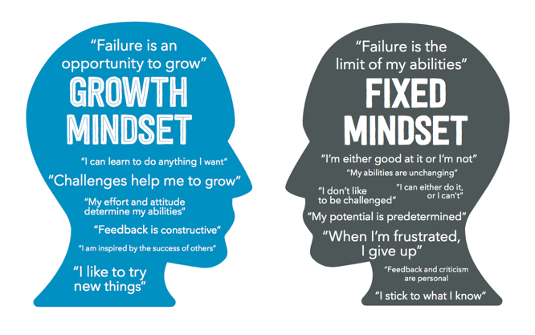
The Move To DevOps – The Reality

Slide 16
Contrast DevOps vs. Traditional Model
Traditional IT Takes Too Long
Azure Image Investigation
Traditional Datacenter Image broke when deployed to Azure.
Azure Specific Image requested, with specifics on what needed changed from Datacenter version.
Lead time requested – 6 to 8 months (Including development, testing, and deployment)
Configuration As Code Takes Less Time
Runbook for Server build was acquired.
Time to write DSC code for Company Compliant Image with Azure changes – 5 Days.
Time required to change DSC code and submit to testing – 5 minutes.
Time required to deploy updated DSC code to repository and have it ready for new builds. – 5 minutes.

Slide 17
Contrast DevOps vs. Traditional Model
Resulting Process Improvement
Base Image config had conflicts with additional SQL Configurations
Conflicting configuration was resolved in the datacenter by writing audit exception to rule and allowing configuration change.
Resultant investigation found that over 95% of systems in the datacenter had this audit exception rule.
Process Improvement – Removal of global audit exception by allowing change to base configuration. Applied configuration requirement to only those systems that required it.

Slide 18
Contrast DevOps vs. Traditional Model
Customer Case
Customer is currently manually configuring new servers for environment.
Configuration consists of just 10 items.
Takes approximately 1 hour to configure.
Proof of Concept Configuration
Configuration was written for customer. Took approximately 8 hours to write.
Takes approximately 20-35 seconds to deploy.
Result:
Approximately 120 servers can be deployed via automation compared to a single manual deployment.
Or you could operate in parallel and deploy 120 servers simultaneously in 35 seconds. (Dependent on the amount of compute power you had available of course)
Expansion to other use cases
Same automation is being looked at to deploy to existing cloud infrastructure.

Slide 19
DevOps Enterprise Wins - Disney
Business unit | Servers | Apps | Success Stories
ABC | 1536 | ABC, Watch ABC, ABC Family, Oscars, WatchDisneyChannel, WatchDisneyJunior, WatchDisneyXD, Dancing with the Stars | Using auto-scale, 300-700 servers within 15-30 minutes
Corp. Social Business | 100 | Employee Tools | New instances from days to 5-10 minutes
Digital Media Agency | 200 | DisneySpeakerSeries.com, DisneyCreativeLab.com, DisneyRewards.com, DisneyAtoZ | Deployment times reduced from several hours to a few minutes
Disney Interactive | 1119 | Infinity, Disney.com, Starwars.com, Marvel XP | No configuration of human error incidents in FY13
ESPN | 830 | Fantasy Football, March Madness | Reduction of manual steps by 75%
Guest Data Services | 450 | Disney ID, API Mgmt | DisneyID build out went from 1 day to 1 minute. 95% reduction in human errors
Parks & Resorts Online | 1742 | My Disney Experience | DR Test - Deployed entire stack in 5 minutes to 200 servers in DR data center
Studios | 287 | Disney Movies Anywhere, Digital Copy Plus, Multiple Movie Sites | Deployment times reduced from several hours to a few minutes
Studios Business | 100 | El Capitan Ticketing, Business Systems | Automation of Windows, IIS/.NET and MSSQL

Slide 20
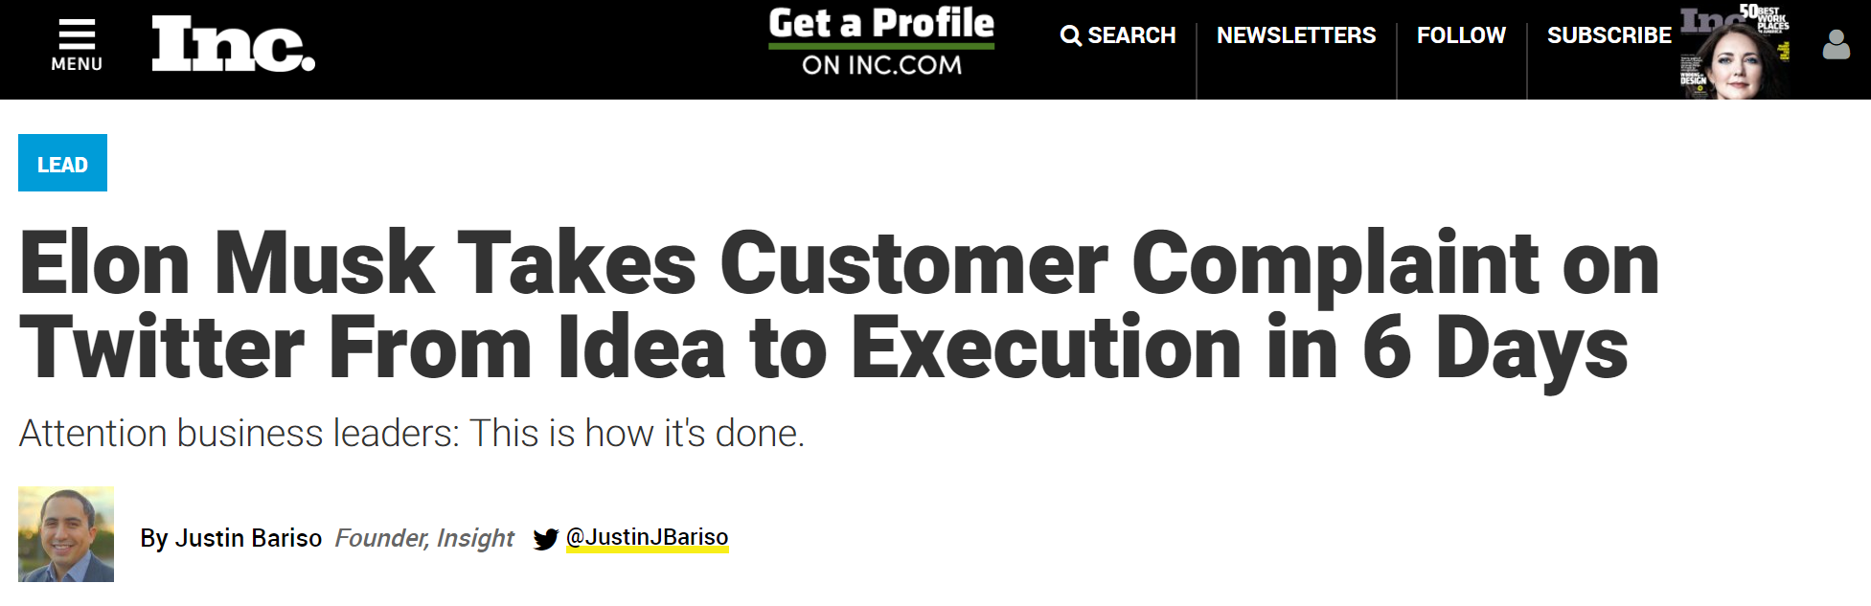
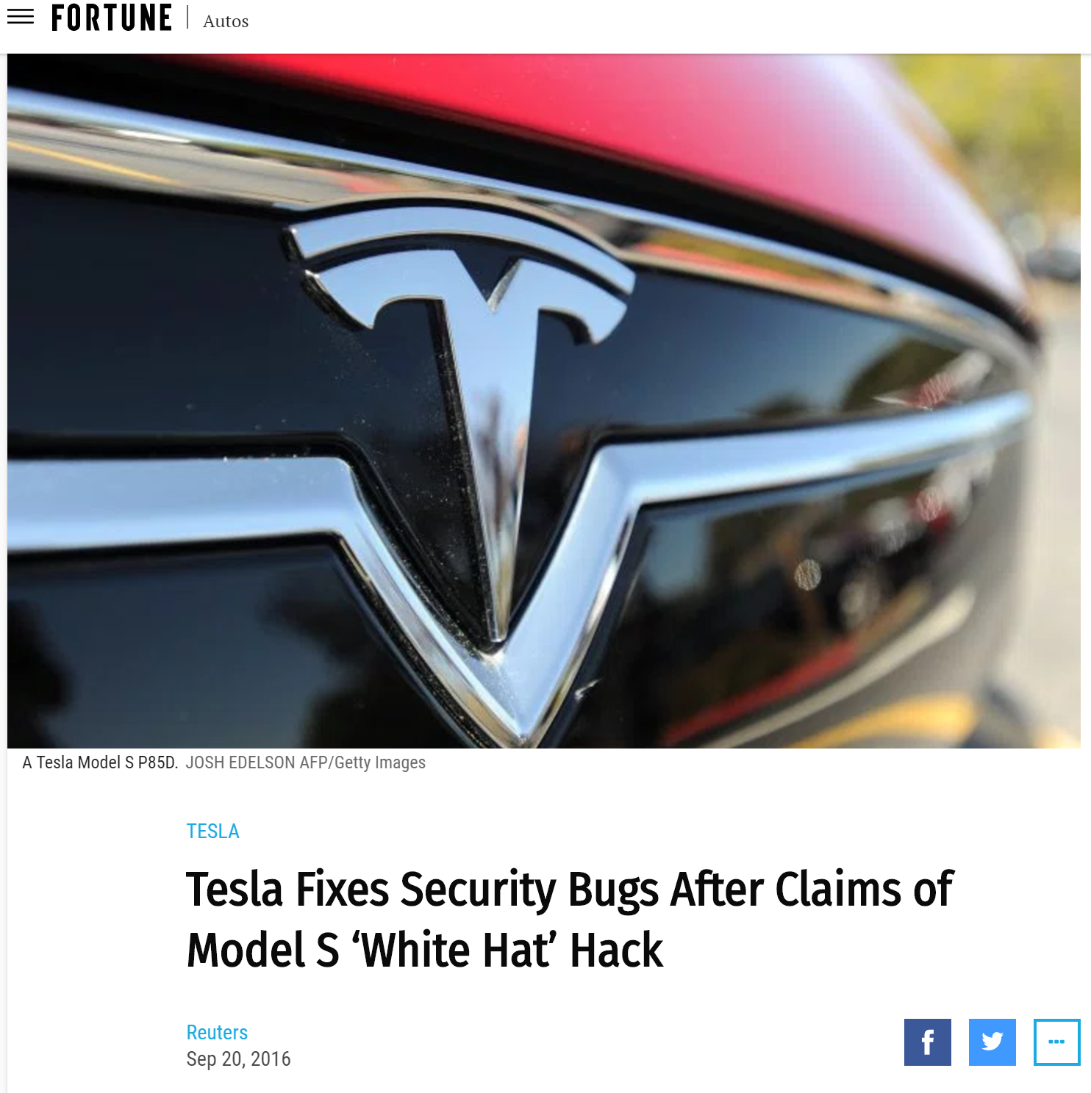
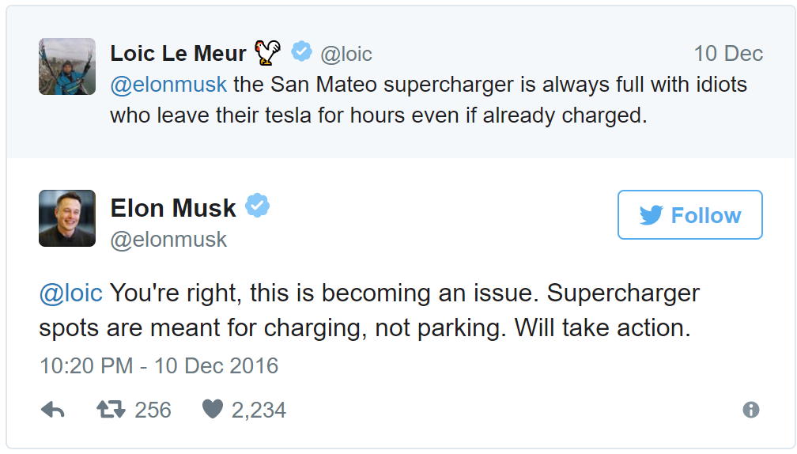
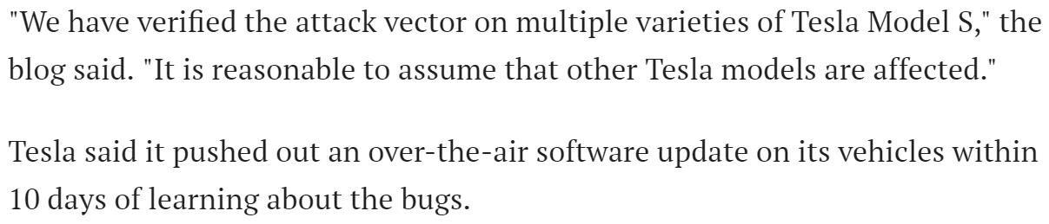
DevOps Enterprise Wins - Tesla
Notes:
Org charts can be rearranged. Processes can be changed. Culture can be shifted. But people… (Story Time)

Slide 21
DevOps Stories
TechRepublic – 10 Steps to DevOps Success in the Enterprise
http://www.techrepublic.com/article/10-steps-to-devops-success-in-the-enterprise/
Quora – How Does Tesla Manage Its DevOps?
https://www.quora.com/How-does-Tesla-manage-its-DevOps
TechBeacon - 10 Companies Killing It At DevOps
https://techbeacon.com/10-companies-killing-it-devops

Slide 22
Thank You For Coming!
VersionOne - 11th Annual State of Agile Report
https://explore.versionone.com/state-of-agile/versionone-11th-annual-state-of-agile-report-2
Plutora - Agile and DevOps are failing in Fortune 500 companies. It should be a wake-up call to all of us.
http://www.plutora.com/blog/agile-devops-failing-fortune-500-companies-wake-call-us
McKinsey - ING’s agile transformation
https://www.mckinsey.com/industries/financial-services/our-insights/ings-agile-transformation
Puppet - Disney's DevOps Journey: A DevOps Enterprise Summit Reprise
https://puppet.com/blog/disney-s-devops-journey-a-devops-enterprise-summit-reprise
Fortune - Tesla Fixes Security Bugs After Claims of Model S 'White Hat' Hack
http://fortune.com/2016/09/20/tesla-security-bug-hack/
Inc - Elon Musk Takes Customer Complaint on Twitter From Idea to Execution in 6 Days
https://www.inc.com/justin-bariso/elon-musk-takes-customer-complaint-on-twitter-from-idea-to-execution-in-6-days.html

