Slide 1

Master PowerShell Tricks
Thomas Rayner
Senior Security Service Engineer
Microsoft
Will Anderson
CEO
DevOps Collective

Slide 2
Who are you people?
Thomas Rayner
Former 4x Microsoft MVP for PowerShell, now I work at Microsoft
Honorary Scripting Guy, blogger, speaker, author, instructor
DevOps, scripting, and automation pro
@MrThomasRayner
workingsysadmin.com
Will Anderson
2015-2018 Microsoft MVP – Cloud and Datacenter Management
2015 Honorary Scripting Guy
CEO – The DevOps Collective
@GamerLivingWill
PowerShell.org

Slide 3
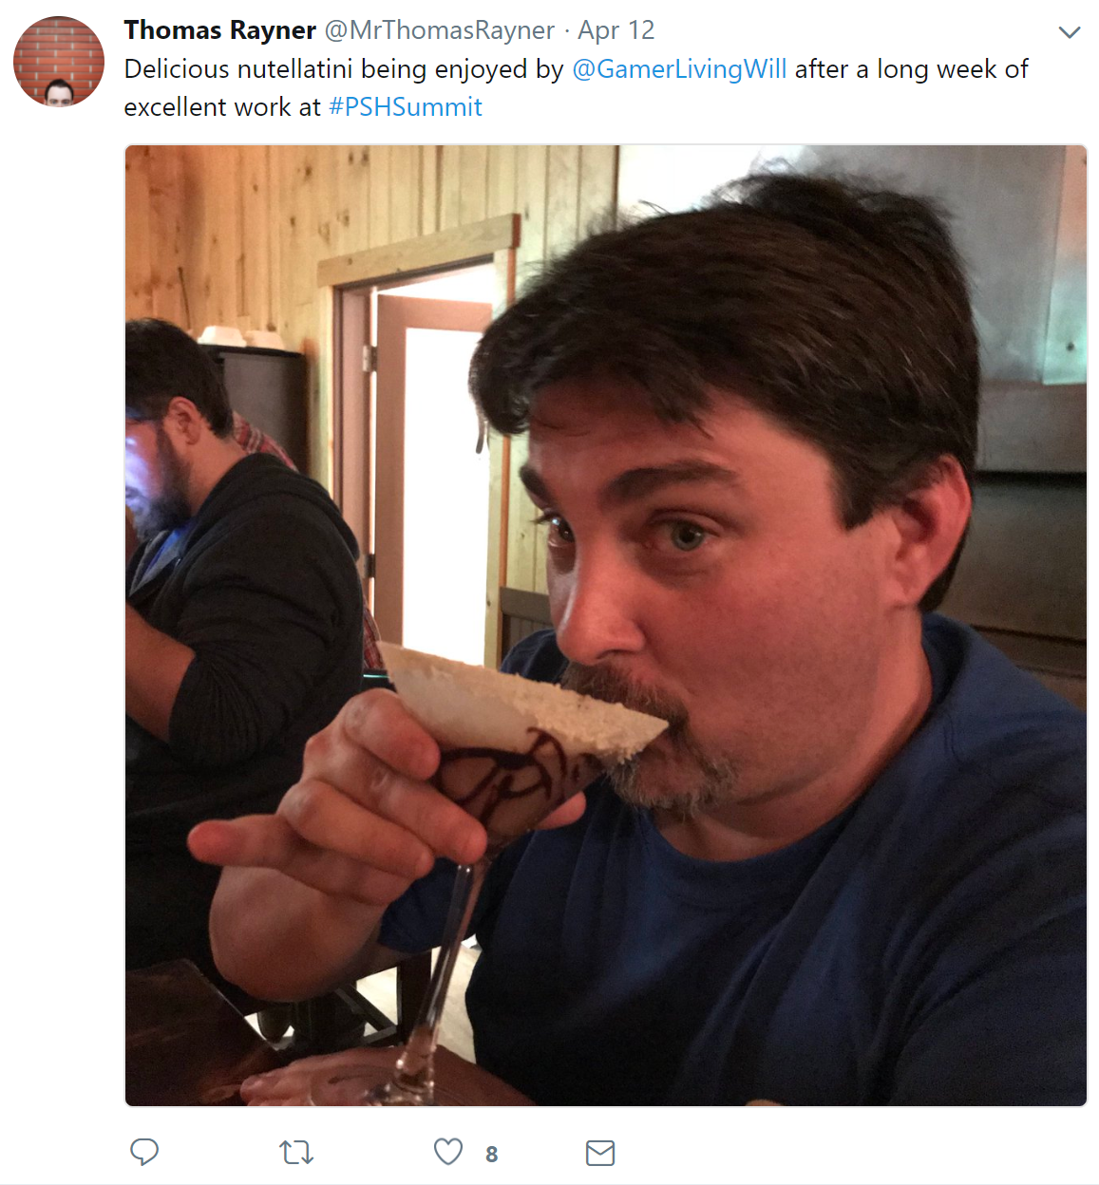
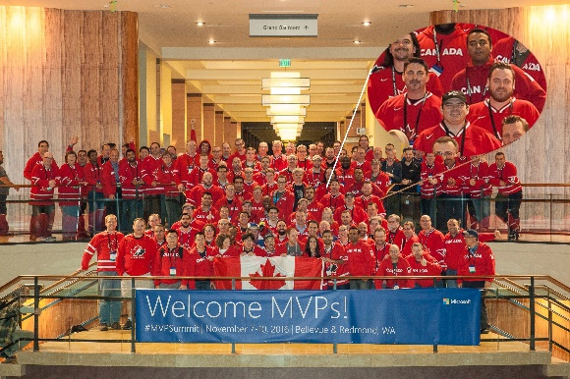
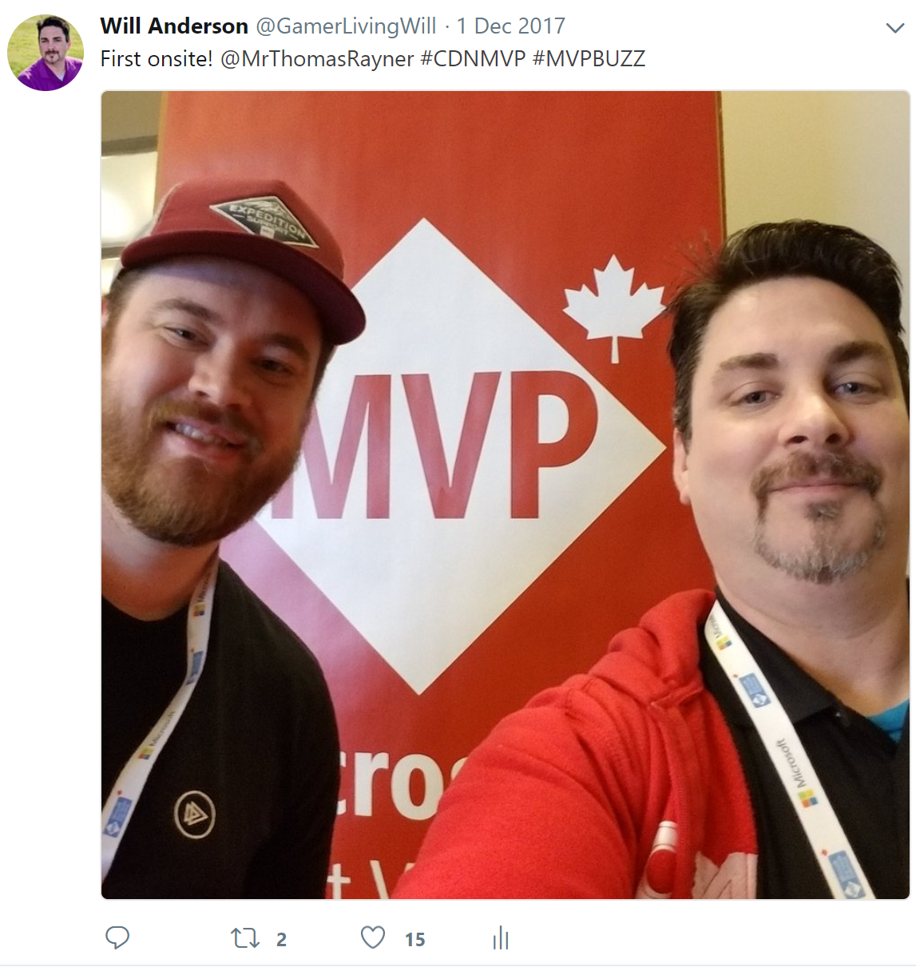
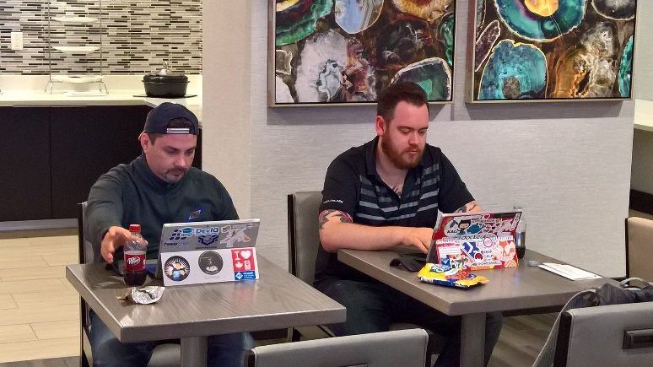


Buckle Up!

Slide 4
Less Yapping More Tapping
Demo Time

Slide 5
Ask Us Anything
Preferably about PowerShell, DevOps, Automation, Career, etc.

Slide 6
Thanks for coming!
Thomas Rayner
Former 4x Microsoft MVP for PowerShell, now I work at Microsoft
Honorary Scripting Guy, blogger, speaker, author, instructor
DevOps, scripting, and automation pro
@MrThomasRayner
workingsysadmin.com
Will Anderson
2015-2018 Microsoft MVP – Cloud and Datacenter Management
2015 Honorary Scripting Guy
CEO – The DevOps Collective
@GamerLivingWill
PowerShell.org

