Slide 1
Source: http://pandas.pydata.org/

Slide 2
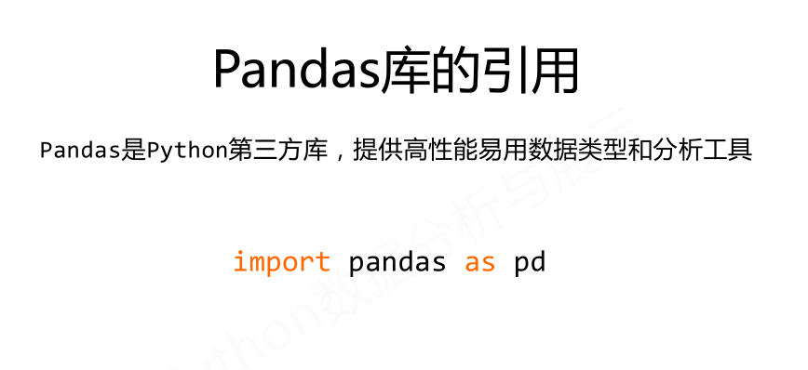
Notes:
Let’s talk about pandas. Pandas is a data manipulation library by Wes McKinney.
It is extremely useful, full of functionality.
Makes working with data very easy.
Easy access to statistical functions, data aggregation, visualization etc.

Slide 3

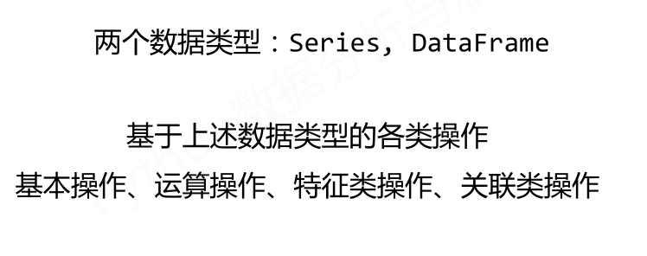

Slide 4
Pandas介绍
基本数据结构
Type
Pandas Name
Vector
(1 Dimension)
Series
Array
(2 Dimensions)
DataFrame
Notes:
Let’s see how it works.
Pandas stands for panel data sets.
It refers to data in tabular form, with rows and columns
The most basic data structure is the “series”. It’s 1 dimensional, it’s the building block for data in tabular form.

Slide 5
Pandas介绍
基本数据结构
Type
Pandas Name
Vector
(1 Dimension)
Series
Array
(2 Dimensions)
DataFrame
Notes:
And “data in tabular form” has a name: It’s called pd.DataFrame
Dataframe consists of rows and columns. 2 dimensions.
If you pop a column from a dataframe, it is a series.
If you pop a row from a dataframe, it is a series too.

Slide 6
Pandas Series的创建和索引
使用数据创建Series
Code
Output
import pandas as pd
step_data = [3620, 7891, 9761,
3907, 4338, 5373]
step_counts = pd.Series(step_data, name='steps')
print(step_counts)
>>> 0 3620
1 7891
2 9761
3 3907
4 4338
5 5373
Name: steps, dtype: int64
Notes:
Import pandas as pd is the standard syntax for importing pandas.
Here we’re creating an array.
And we’re then applying pd.Series constructor to it.
Now step_counts is a pandas series.

Slide 7
Pandas Series的创建和索引
使用数据创建Series
Code
Output
import pandas as pd
step_data = [3620, 7891, 9761,
3907, 4338, 5373]
step_counts = pd.Series(step_data, name='steps')
print(step_counts)
>>> 0 3620
1 7891
2 9761
3 3907
4 4338
5 5373
Name: steps, dtype: int64
索引
Notes:
And this is the output. It indexed the data we gave it.
Index is 0-5
And it gave this new object a name, “Steps”.

Slide 8
Pandas Series的创建和索引
向Series中添加时间范围的索引
Code
Output
step_counts.index = pd.date_range('20150329', periods=6)
print(step_counts)
>>> 2015-03-29 3620
2015-03-30 7891
2015-03-31 9761
2015-04-01 3907
2015-04-02 4338
2015-04-03 5373
Freq: D, Name: steps, dtype: int64

Slide 9
Pandas Series的创建和索引
向Series中添加时间范围的索引
Code
Output
step_counts.index = pd.date_range('20150329', periods=6)
print(step_counts)
>>> 2015-03-29 3620
2015-03-30 7891
2015-03-31 9761
2015-04-01 3907
2015-04-02 4338
2015-04-03 5373
Name: steps,dtype: int64

Slide 10
Pandas Series的创建和索引
通过索引选取数据
Code
Output
# Just like a dictionary
print(step_counts['2015-04-01'])
# Or by index position--like an array
print(step_counts[3])
# Select all of April
print(step_counts['2015-04'])
>>> 3907
>>> 3907
>>> 2015-04-01 3907
2015-04-02 4338
2015-04-03 5373
Freq: D, Name: steps, dtype: int64

Slide 11
Pandas Series的创建和索引
通过索引选取数据
Code
Output
# Just like a dictionary
print(step_counts['2015-04-01'])
# Or by index position--like an array
print(step_counts[3])
# Select all of April
print(step_counts['2015-04'])
>>> 3907
>>> 3907
>>> 2015-04-01 3907
2015-04-02 4338
2015-04-03 5373
Freq: D, Name: steps, dtype: int64
Notes:
Here it is.

Slide 12
Pandas Series的创建和索引
通过索引选取数据
Code
Output
# Just like a dictionary
print(step_counts['2015-04-01'])
# Or by index position--like an array
print(step_counts[3])
# Select all of April
print(step_counts['2015-04'])
>>> 3907
>>> 3907
>>> 2015-04-01 3907
2015-04-02 4338
2015-04-03 5373
Freq: D, Name: steps, dtype: int64
Notes:
But as opposed to dictionaries, we can also retrieeve them by index position.

Slide 13
Pandas Series的创建和索引
通过索引选取数据
Code
Output
# Just like a dictionary
print(step_counts['2015-04-01'])
# Or by index position--like an array
print(step_counts[3])
# Select all of April
print(step_counts['2015-04'])
>>> 3907
>>> 3907
>>> 2015-04-01 3907
2015-04-02 4338
2015-04-03 5373
Freq: D, Name: steps, dtype: int64
Notes:
This is not possible in dictionaries

Slide 14
Pandas Series的创建和索引
通过索引选取数据
Code
Output
# Just like a dictionary
print(step_counts['2015-04-01'])
# Or by index position--like an array
print(step_counts[3])
# Select all of April
print(step_counts['2015-04'])
>>> 3907
>>> 3907
>>> 2015-04-01 3907
2015-04-02 4338
2015-04-03 5373
Freq: D, Name: steps, dtype: int64
Notes:
We can slice effectively too. This command gets all the april records.

Slide 15
Pandas Series的创建和索引
通过索引选取数据
Code
Output
# Just like a dictionary
print(step_counts['2015-04-01'])
# Or by index position--like an array
print(step_counts[3])
# Select all of April
print(step_counts['2015-04'])
>>> 3907
>>> 3907
>>> 2015-04-01 3907
2015-04-02 4338
2015-04-03 5373
Name: steps,dtype: int64
Notes:
XXX

Slide 16
Pandas 数据类型
数据类型可以查看和转换
Code
Output
# View the data type
print(step_counts.dtypes)
# Convert to a float
step_counts = step_counts.astype(np.float)
# View the data type
print(step_counts.dtypes)
>>> int64
>>> float64
Notes:
A series can store integers, floats, strings, etc.
This is how you can view what kind of data it stores.

Slide 17
Pandas 数据类型
数据类型可以查看和转换
Code
Output
# View the data type
print(step_counts.dtypes)
# Convert to a float
step_counts = step_counts.astype(np.float)
# View the data type
print(step_counts.dtypes)
>>> int64
>>> float64
Notes:
It’s an integer.

Slide 18
Pandas 数据类型
数据类型可以查看和转换
Code
Output
# View the data type
print(step_counts.dtypes)
# Convert to a float
step_counts = step_counts.astype(np.float)
# View the data type
print(step_counts.dtypes)
>>> int64
>>> float64
Notes:
.astype is a series method which can convert the datatype.
Here, let’s see the same series converted to float.

Slide 19
Pandas 数据类型
数据类型可以查看和转换
Code
Output
# View the data type
print(step_counts.dtypes)
# Convert to a float
step_counts = step_counts.astype(np.float)
# View the data type
print(step_counts.dtypes)
>>> int64
>>> float64
Notes:
Yep, it’s now float.

Slide 20
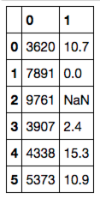
Pandas DataFrame 创建与操作
DataFrames 能由lists创建
Code
Output
# Cycling distance
cycling_data = [10.7, 0, None, 2.4, 15.3, 10.9]
step_data = [3620, 7891, 9761,
3907, 4338, 5373]
# Create a tuple of data
joined_data = list(zip(step_data, cycling_data))
# The dataframe
activity_df = pd.DataFrame(joined_data)
print(activity_df)
>>>
Notes:
Now that we are familiar with series, let’s talk about dataframes
A dataframe is basically a collection of series.
Since series are 1 dimensional, Dataframe is two dimensional.
If you visualize a series as one column, dataframe becomes visually several columns attached side by side.
So it is a table of data.
Here, we create a new list of numbers, 2 missing values
No joined data is a list, whose elements are tuples of size 2!

Slide 21
Pandas DataFrame 创建与操作
DataFrames 能由lists创建
Code
Output
# Cycling distance
cycling_data = [10.7, 0, None, 2.4, 15.3, 10.9]
step_data = [3620, 7891, 9761,
3907, 4338, 5373]
# Create a tuple of data
joined_data = list(zip(step_data, cycling_data))
# The dataframe
activity_df = pd.DataFrame(joined_data)
print(activity_df)
>>>

Slide 22
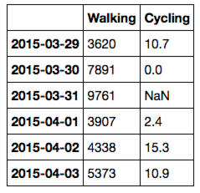
Pandas DataFrame 创建与操作
可以向DataFrame中添加列名和索引
Code
Output
# Add column names to dataframe
activity_df = pd.DataFrame(
joined_data,
index=pd.date_range('20150329', periods=6),
columns=['Walking','Cycling'])
print(activity_df)
>>>
Notes:
Let’s make this dataframe a bit more self-explanatory
Data is the same, `joined_data`
Index is going to be the same index we created for the series, namely the days.
Columns are ‘walking’ and ‘cycling’ as opposed to 0 and 1.

Slide 23
Pandas DataFrame 创建与操作
可以向DataFrame中添加列名和索引
Code
Output
# Add column names to dataframe
activity_df = pd.DataFrame(
joined_data,
index=pd.date_range('20150329', periods=6),
columns=['Walking','Cycling'])
print(activity_df)
>>>
Notes:
This DF is much more descriptive.

Slide 24
索引DataFrame行
DataFrame 的行可以通过'loc' 方法和 'iloc'方法索引
Code
Output
# Select row of data by index name
print(activity_df.loc['2015-04-01'])
>>> Walking 3907.0
Cycling 2.4
Name: 2015-04-01,
dtype: float64
Notes:
Now we have a 2dimensional data structure, so getting to elements is a bit different compared to series, which was very dictionary-like.
If we want to get a full row, we use dataframe’s .loc method
We provide the index value to .loc

Slide 25
索引DataFrame行
DataFrame 的行可以通过'loc' 方法和 'iloc'方法索引
Code
Output
# Select row of data by index name
print(activity_df.loc['2015-04-01'])
>>> Walking 3907.0
Cycling 2.4
Notes:
And what we get in return is a pd.Series.
Index of that series is the columns of the dataframe, namely ‘walking’ and ‘cycling’.

Slide 26
索引DataFrame行
DataFrame 的行可以通过'loc' 方法和 'iloc'方法索引
Code
Output
# Select row of data by integer position
print(activity_df.iloc[-3])
>>> Walking 3907.0
Cycling 2.4
Name: 2015-04-01,
dtype: float64
Notes:
If we want to get rows by position as opposed to the index value, we use .iloc (not .loc)
And here we also have the niceties of python lists, providing negative numbers as the position

Slide 27
索引DataFrame行
DataFrame 的行可以通过'loc' 方法和 'iloc'方法索引
Code
Output
# Select row of data by integer position
print(activity_df.iloc[-3])
>>> Walking 3907.0
Cycling 2.4
Notes:
We get the same answer.

Slide 28
索引DataFrame列
DataFrame 的列可以通过列名来索引
Code
Output
# Name of column
print(activity_df['Walking'])
>>> 2015-03-29 3620
2015-03-30 7891
2015-03-31 9761
2015-04-01 3907
2015-04-02 4338
2015-04-03 5373
Freq: D, Name: Walking,
dtype: int64
Notes:
If we tried to get something as in the dictionary/pd.Series case, pandas looks at the columns.
This will get the walking column.
If you had a row indexed as ‘walking’, this would get you the walking column.
If you didn’t have a column, but only an index, this would error.
Conclusion: use .loc or .iloc if you want to get rows!

Slide 29
索引DataFrame列
DataFrame 的列可以通过列名来索引
Code
Output
# Name of column
print(activity_df['Walking'])
>>> 2015-03-29 3620
2015-03-30 7891
2015-03-31 9761
2015-04-01 3907
2015-04-02 4338
2015-04-03 5373
Freq: D, Name: Walking,
dtype: int64
Notes:
The output of this is again, a Series.
This time, index of the Series is the same as the index of the DataFrame.

Slide 30
索引DataFrame列
DataFrame的列也可以通过属性来索引
Code
Output
# Object-oriented approach
print(activity_df.Walking)
>>> 2015-03-29 3620
2015-03-30 7891
2015-03-31 9761
2015-04-01 3907
2015-04-02 4338
2015-04-03 5373
Freq: D, Name: Walking,
dtype: int64
Notes:
column names can be any string, but if it happens that there is no spaces, +- signs etc., they can also be accessed as attributes of the dataframe.
Just another reason to name your DF columns well.

Slide 31
索引DataFrame列
DataFrame的列也可以通过属性来索引
Code
Output
# Object-oriented approach
print(activity_df.Walking)
>>> 2015-03-29 3620
2015-03-30 7891
2015-03-31 9761
2015-04-01 3907
2015-04-02 4338
2015-04-03 5373
Freq: D, Name: Walking,
dtype: int64
Notes:
Result is the same.

Slide 32
索引DataFrame列
DataFrame的列可以通过整数来索引
Code
Output
# First column
print(activity_df.iloc[:,0])
>>> 2015-03-29 3620
2015-03-30 7891
2015-03-31 9761
2015-04-01 3907
2015-04-02 4338
2015-04-03 5373
Freq: D, Name: Walking,
dtype: int64
Notes:
Columns can be accessed by position with this trick.
Here, we’re getting all rows by “:”, and the 0th column.

Slide 33
索引DataFrame列
DataFrame的列可以通过整数来索引
Code
Output
# First column
print(activity_df.iloc[:,0])
>>> 2015-03-29 3620
2015-03-30 7891
2015-03-31 9761
2015-04-01 3907
2015-04-02 4338
2015-04-03 5373
Freq: D, Name: Walking,
dtype: int64

Slide 34
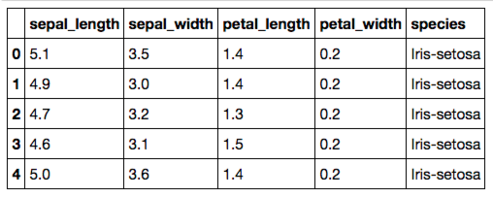
用Pandas读取数据
csv和其他常见的文件类型可以用一个命令读取
Code
Output
# The location of the data file
filepath = 'data/Iris_Data/Iris_Data.csv'
# Import the data
data = pd.read_csv(filepath)
# Print a few rows
print(data.iloc[:5])
>>>

Slide 35
用Pandas读取数据
csv和其他常见的文件类型可以用一个命令读取
Code
Output
# The location of the data file
filepath = 'data/Iris_Data/Iris_Data.csv'
# Import the data
data = pd.read_csv(filepath)
# Print a few rows
print(data.iloc[:5])
print(data.head())
>>>

Slide 36
统计每一类的数量
Code
Output
data.species.value_counts()

Slide 37
统计每一类的数量
Code
Output
data.species.value_counts()
>>>
versicolor 50
setosa 50
virginica 50
Name: species, dtype: int64

Slide 38
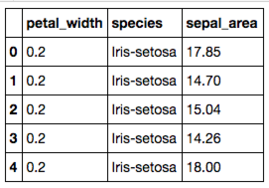
向数据中添加一个新列
Code
Output
# Create a new column that is a product
# of both measurements
data['sepal_area'] = data.sepal_length * data.sepal_width
# Print a few rows and columns
print(data.iloc[:5, -3:])
>>>
Notes:
Now we promised that data manipulation was very easy using pandas. So let’s see some examples.
Let’s create a new column out of the ones we have:
Since we have length and width, we can create area as in here.
The multiplication is a multiplication of series. Pandas understands this and multiplies elements one by one
The result is a series too. It is then assigned to the dataframe, and the column name is “sepal_area”

Slide 39
向数据中添加一个新列
Code
Output
# Create a new column that is a product
# of both measurements
data['sepal_area'] = data.sepal_length * data.sepal_width
# Print a few rows and columns
print(data.iloc[:5, -3:])
>>>
Notes:
As you see, it’s added to the end here. We’re printing the last 3 columns.

Slide 40
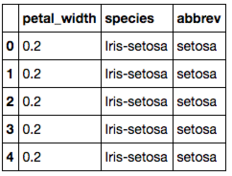
在DataFrame的列上使用函数
Code
Output
# The lambda function applies what
# follows it to each row of data
data['abbrev'] = (data
.species
.apply(lambda x: x.replace('Iris-','')))
# Note that there are other ways to
# accomplish the above
print(data.iloc[:5, -3:])
>>>
Notes:
This was a very common operation, just multiplication.
There can be other custom operations that we want to perform.
If you noticed, the values in the species column all start with “Iris-”. Let’s get rid of that.
Data.species gets the series we want to work on
.apply applies a function to every value (not the index) of the series and returns a new series.
And lambda determines the function. Lambda is just python’s way of defining functions quickly.
If you have a more involved function f, u can use it as `.apply(f)`

Slide 41
在DataFrame的列上使用函数
Code
Output
# The lambda function applies what
# follows it to each row of data
data['abbrev'] = (data
.species
.apply(lambda x: x.replace('Iris-','')))
# Note that there are other ways to
# accomplish the above
print(data.iloc[:5, -3:])
>>>
Notes:
So, this new column we created, ‘abbrev’, is appended to the dataframe.

Slide 42
使用GroupBy统计信息
Code
Output
# Use the size method with a
# DataFrame to get count
# For a Series, use the .value_counts
# method
group_sizes = (data
.groupby('species')
.size())
print(group_sizes)
>>> species
Iris-setosa 50
Iris-versicolor 50
Iris-virginica 50
dtype: int64
Notes:
One of the most essential operations when we do data analysis is “groupby”.
And when we have have groups built from dataframes, common aggregation methods such as looking at the size of groups, get the max/min/average in a group, etc are built-in to pandas.
Here we’re grouping by the column species and checking out the sizes of each group.

Slide 43
使用GroupBy统计信息
Code
Output
# Use the size method with a
# DataFrame to get count
# For a Series, use the .value_counts
# method
group_sizes = (data
.groupby('species')
.size())
print(group_sizes)
>>> species
Iris-setosa 50
Iris-versicolor 50
Iris-virginica 50
Notes:
The result is a pandas series, indexed by the different species values in the original DF.
Looks like we have 50 rows for each species in our original DF.

Slide 44
统计计算
Pandas 包括一系列的统计方法—mean, median, mode
Code
Output
# Mean calculated on a DataFrame
print(data.mean())
# Median calculated on a Series
print(data.petal_length.median())
# Mode calculated on a Series
print(data.petal_length.mode())
>>> sepal_length 5.843333
sepal_width 3.054000
petal_length 3.758667
petal_width 1.198667
dtype: float64
>>> 4.35
>>> 0 1.5
dtype: float64
Notes:
Let’s look at some stats functions one can perform on DFs.
Data.mean will compute the mean of the numerical columns

Slide 45
统计计算
Pandas 包括一系列的统计方法—mean, median, mode
Code
Output
# Mean calculated on a DataFrame
print(data.mean())
# Median calculated on a Series
print(data.petal_length.median())
# Mode calculated on a Series
print(data.petal_length.mode())
>>> sepal_length 5.843333
sepal_width 3.054000
petal_length 3.758667
petal_width 1.198667
>>> 4.35
>>> 0 1.5
dtype: float64
Notes:
Notice that it automatically excluded the columns with string data.
These are the anerage values for the columns.

Slide 46
统计计算
Pandas 包括一系列的统计方法—mean均值, median中位数, mode众数
Code
Output
# Mean calculated on a DataFrame
print(data.mean())
# Median calculated on a Series
print(data.petal_length.median())
# Mode calculated on a Series
print(data.petal_length.mode())
>>> sepal_length 5.843333
sepal_width 3.054000
petal_length 3.758667
petal_width 1.198667
dtype: float64
>>> 4.35
>>> 0 1.5
dtype: float64
Notes:
Note that these functions work on series as well.
Here, we’re getting the median value for the series data[‘petal_length’]
It’s 4.35

Slide 47
统计计算
Pandas 包括一系列的统计方法—mean均值, median中位数, mode众数
Code
Output
# Mean calculated on a DataFrame
print(data.mean())
# Median calculated on a Series
print(data.petal_length.median())
# Mode calculated on a Series
print(data.petal_length.mode())
>>> sepal_length 5.843333
sepal_width 3.054000
petal_length 3.758667
petal_width 1.198667
dtype: float64
>>> 4.35
>>> 0 1.5
dtype: float64
Notes:
And this is the mode.

Slide 48
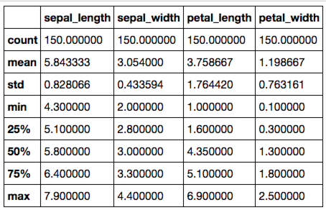
统计计算
多个列的统计值可以用describe方法展现
Code
Output
print(data.describe())
>>>
Notes:
With all these statistical functions, code can get messy if you wanted to call all of them one by one.
Instead, pandas DFs has a nice .describe method which will summarize the info contained in the dataframe.

Slide 49
统计计算
多个列的统计值可以用describe方法展现
Code
Output
print(data.describe())
>>>
Notes:
Here it is, with one call, we’re able to see the count (size), mean, std, min, max and quantiles.
Notice that it dropped the non-numeric fields automatically.

Slide 50
Matplotlib
Notes:
Finally let’s talk briefly about data visualization.
Matplotlib is the main library to create plots and graphs. It has a lot of features and tweaks. Definitely very useful.
Pandas offer convenient wrapper functions around matplotlib’s apis, so plots can be created easily on the fly. It’s very convenient, however, it’s less powerful compared to matplotlib. Often it’s good enough.
Seaborn is a library built on top of matplotlib, and it creates very pretty plots. It has shorthand methods to create statistically interesting plots such as linear model plots, pairwise correlation plts etc which would take a long time with matplotlib. Also, once imported, seaborn’s preferences are incorporated by matplotlib, so if you import seaborn and use matplotlib, it would look like you used seaborn, which is a good thing as we will see in a minute.

Slide 51
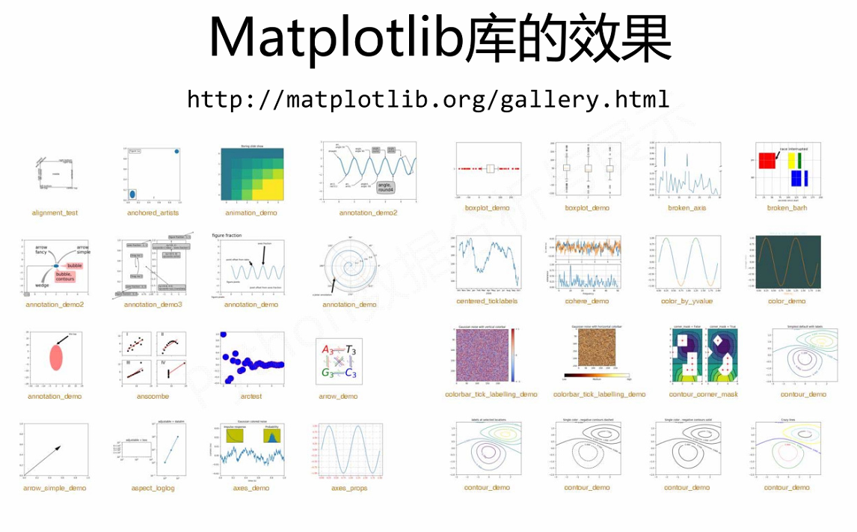

Slide 52
Matplotlib画折线图
Code
Output
# 导入Matploylib库
from matplotlib import pyplot as plt
# 在notebook中画图
%matplotlib inline
# 画布上画图
plt.plot([1,2,3],[4,5,1])
# 在画布上显示
plt.show()
Notes:
There it is. It divides the range specified by the min and max into 25 bins and counts the records in each bin.

Slide 53
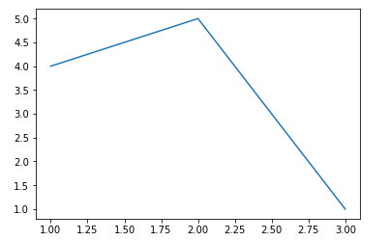
Matplotlib画折线图
Code
Output
# 导入Matploylib库
from matplotlib import pyplot as plt
# 在notebook中画图
%matplotlib inline
# 画布上画图
plt.plot([1,2,3],[4,5,1])
# 在画布上显示
plt.show()
Notes:
There it is. It divides the range specified by the min and max into 25 bins and counts the records in each bin.

Slide 54
给图片添加标题和xy轴的标签
Code
Output
from matplotlib import pyplot as plt
%matplotlib inline
x = [5,2,7]
y = [2,16,4]
plt.plot(x,y)
#图片的标题
plt.title('Image Title')
#坐标轴Y轴
plt.ylabel('Y axis')
#坐标轴X轴
plt.xlabel('X axis')
plt.show()
Notes:
There it is. It divides the range specified by the min and max into 25 bins and counts the records in each bin.

Slide 55
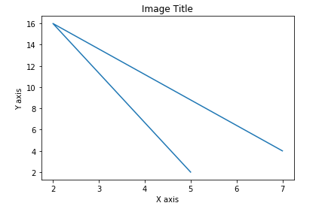
给图片添加标题和xy轴的标签
Code
Output
from matplotlib import pyplot as plt
%matplotlib inline
x = [5,2,7]
y = [2,16,4]
plt.plot(x,y)
#图片的标题
plt.title('Image Title')
#坐标轴Y轴
plt.ylabel('Y axis')
#坐标轴X轴
plt.xlabel('X axis')
plt.show()
Notes:
There it is. It divides the range specified by the min and max into 25 bins and counts the records in each bin.

Slide 56
Matplotlib画直方图
Code
Output
import matplotlib.pyplot as plt
population_age = [22,55,62,45,75,65,54,44,43,42,48]
plt.hist(population_age, bins=5, color='b', rwidth=0.8)
plt.xlabel('age groups')
plt.ylabel('Number of people')
plt.title('Histogram')
plt.show()
Notes:
There it is. It divides the range specified by the min and max into 25 bins and counts the records in each bin.

Slide 57
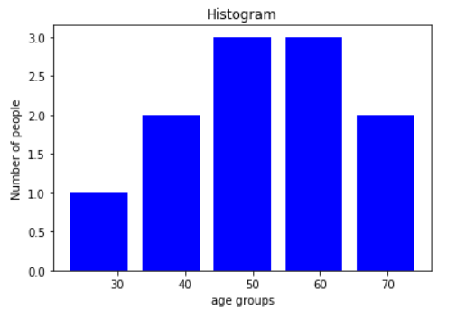
Matplotlib画直方图
Code
Output
import matplotlib.pyplot as plt
population_age = [22,55,62,45,75,65,54,44,43,42,48]
plt.hist(population_age, bins=5, color='b', rwidth=0.8)
plt.xlabel('age groups')
plt.ylabel('Number of people')
plt.title('Histogram')
plt.show()
Notes:
There it is. It divides the range specified by the min and max into 25 bins and counts the records in each bin.

Slide 58
Matplotlib画散点图并添加legend
Code
Output
import matplotlib.pyplot as plt
x = [1,1.5,2,2.5,3,3.5,3.6]
y = [7.5,8,8.5,9,9.5,10,10.5]
x1=[8,8.5,9,9.5,10,10.5,11]
y1=[3,3.5,3.7,4,4.5,5,5.2]
plt.scatter(x,y, label='high income low saving',color='r')
plt.scatter(x1,y1,label='low income high savings',color='b')
plt.xlabel('saving*100')
plt.ylabel('income*1000')
#添加legend
plt.legend()
plt.show()
Notes:
There it is. It divides the range specified by the min and max into 25 bins and counts the records in each bin.

Slide 59
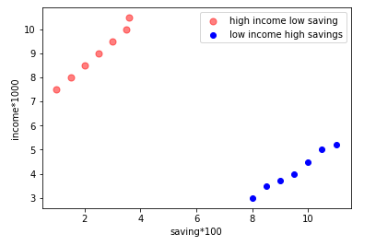
Matplotlib画散点图并添加legend
Code
Output
import matplotlib.pyplot as plt
x = [1,1.5,2,2.5,3,3.5,3.6]
y = [7.5,8,8.5,9,9.5,10,10.5]
x1=[8,8.5,9,9.5,10,10.5,11]
y1=[3,3.5,3.7,4,4.5,5,5.2]
plt.scatter(x,y, label='high income low saving',color='r',s=50, alpha=0.5)
plt.scatter(x1,y1,label='low income high savings',color='b')
plt.xlabel('saving*100')
plt.ylabel('income*1000')
#添加legend
plt.legend()
plt.show()

