Slide 1
TEAM FORK BOMB

Slide 2
TEAM MEMBERS
Akshay S A
Parvathy P
Sanju Jacob

Slide 3
AGENDA
CAPSTONE PROJECT OVERVIEW
APPROACH TAKEN
ARCHITECTURE
OUTPUT
EDA and CORRELATION SUMMARY
CONCLUSION

Slide 4
Capstone Project Overview
TECHNOLOGIES USED:
Python
Django
HTML
CSS
JavaScript

Slide 5
Approach Taken
FRAMEWORK: DJANGO
FEATURES:
1. Authentication
2. Database
3. Form Handling
4.Modular apps
LOAN ESTIMATOR: Random Forest(.pkl)
FRONTEND:
Bootstrap 5
TESTING: Unit Tests

Slide 6
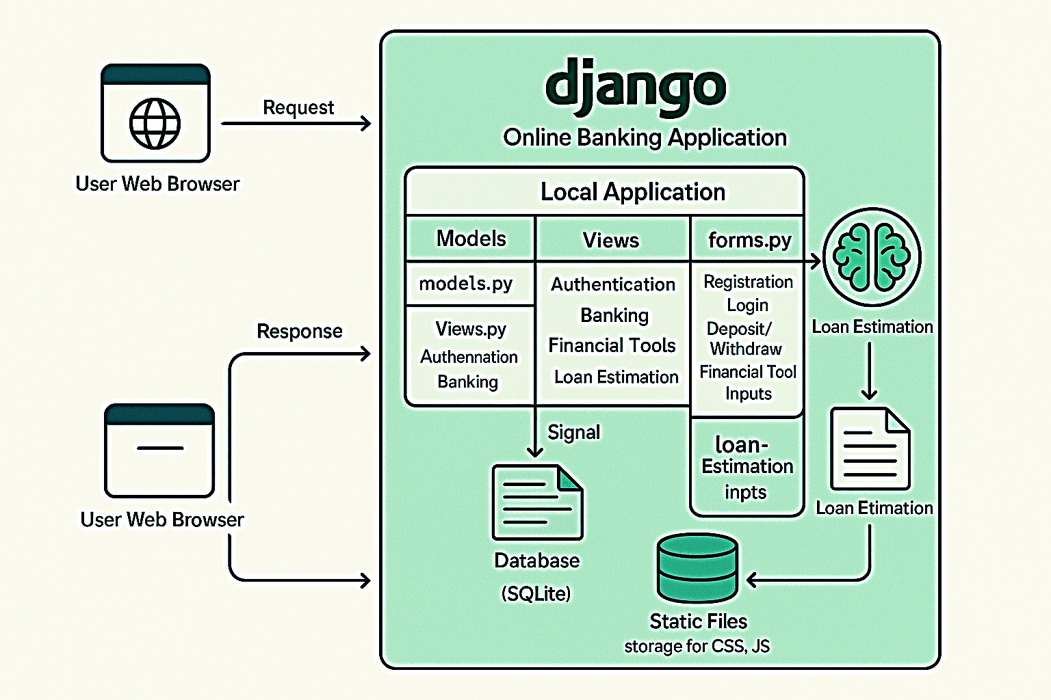
Architecture

Slide 7
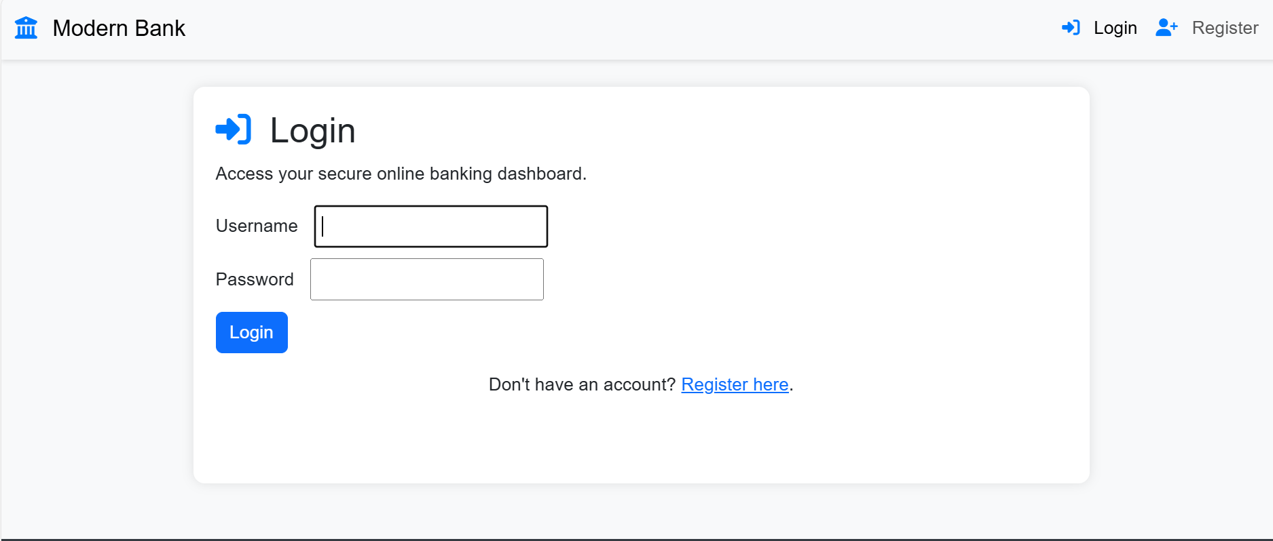
Home Page

Slide 8
Data Preprocessing ,Model creation and EDA

Slide 9
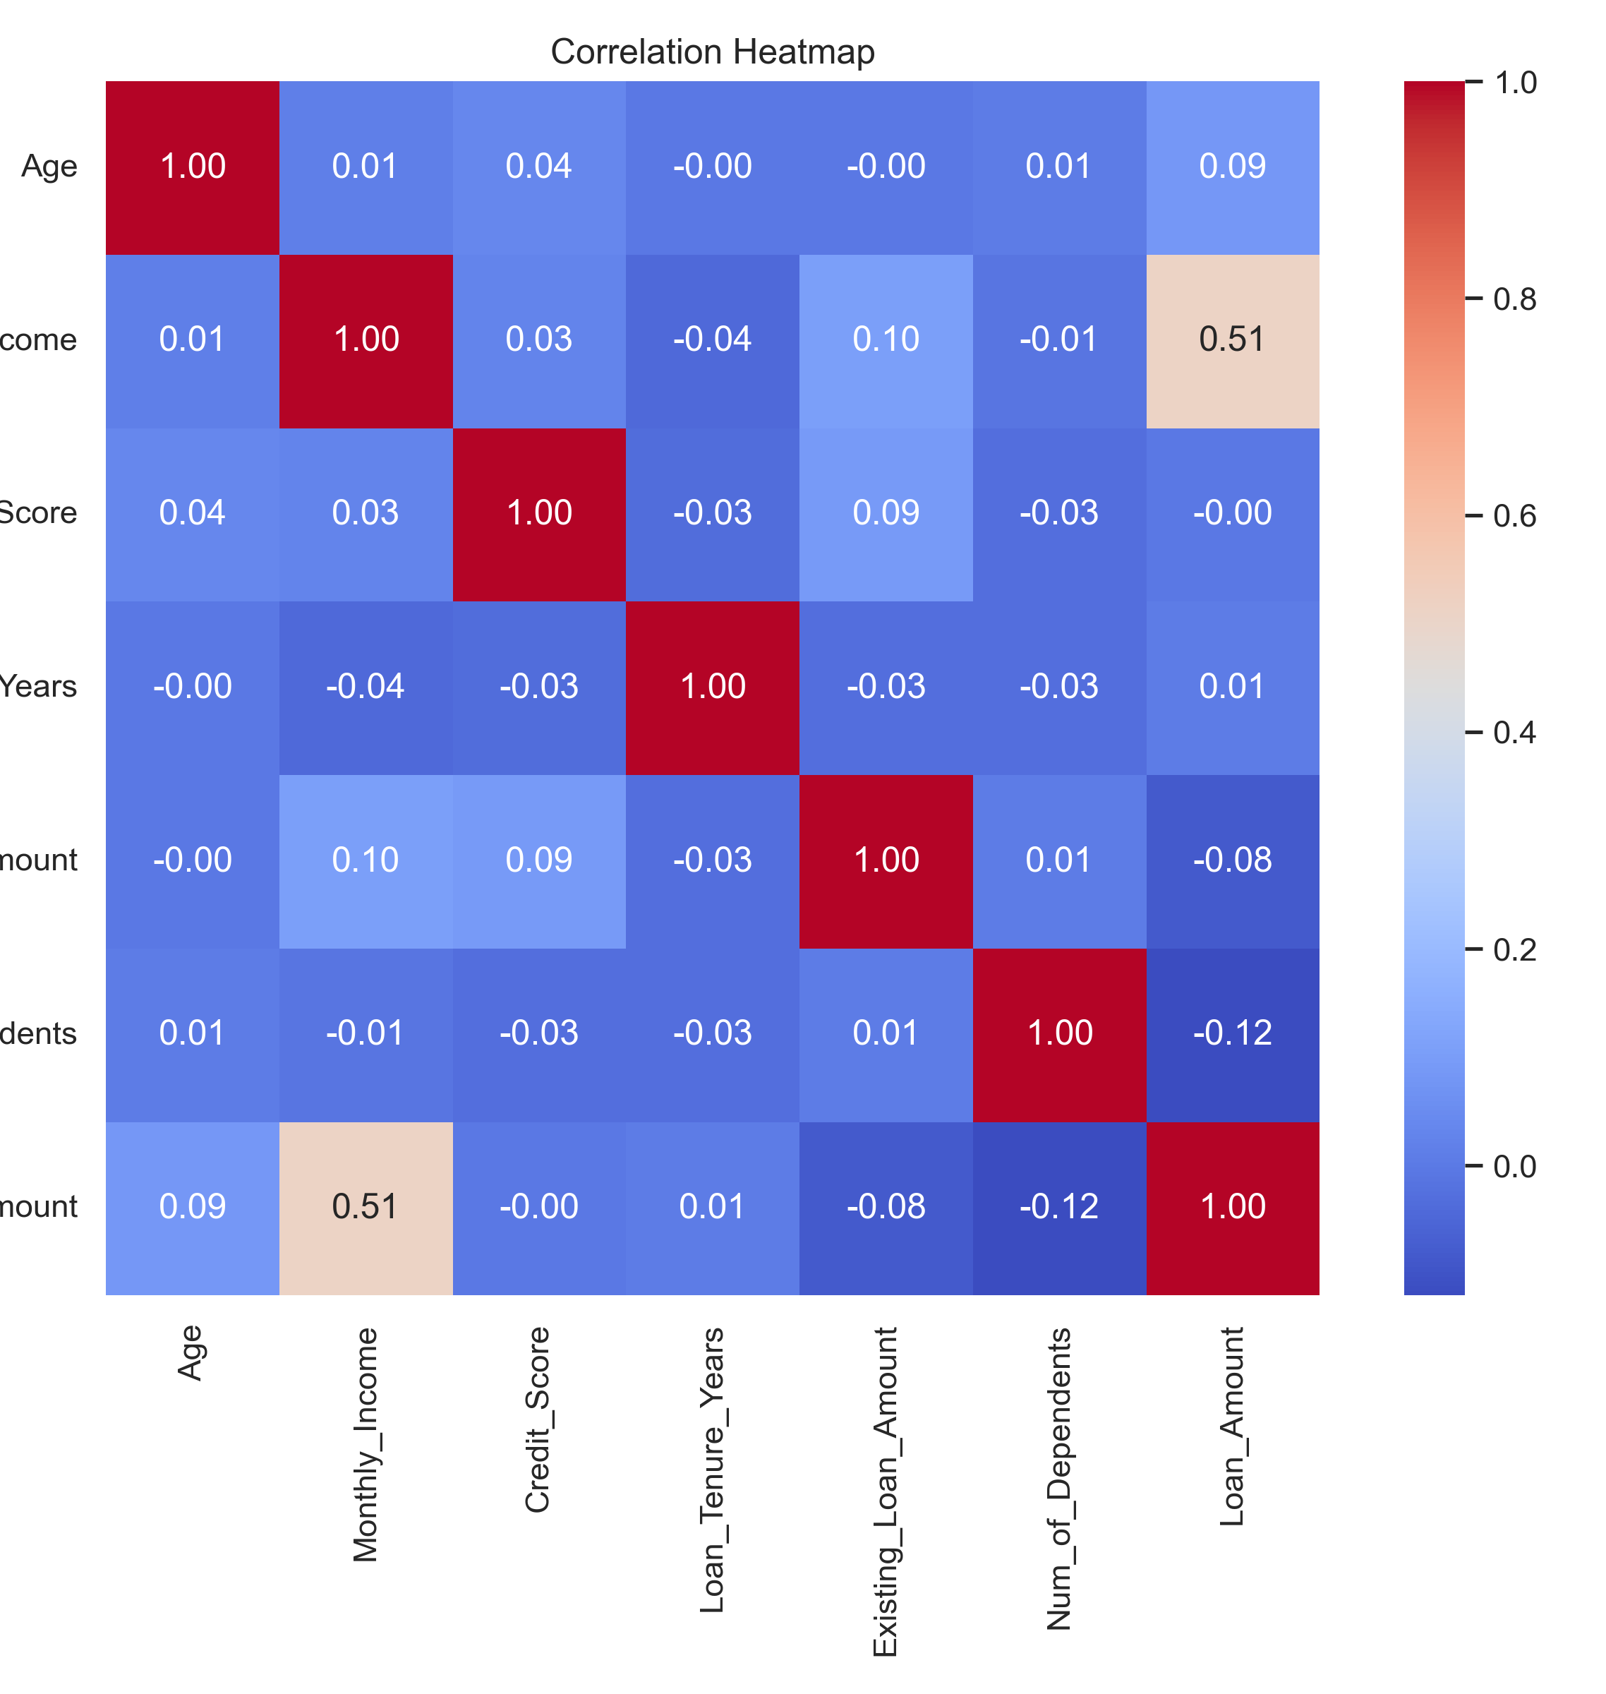
Correlation Summary:
Loan Amount shows:
Strongest positive correlation with Monthly Income (0.513)
Negative correlation with Num of Dependents (-0.120) and Existing Loan Amount (-0.085)
Credit Score has weak positive relationships with Income and Existing Loan Amount
Age and Loan Tenure are mostly uncorrelated with other variables

Slide 10
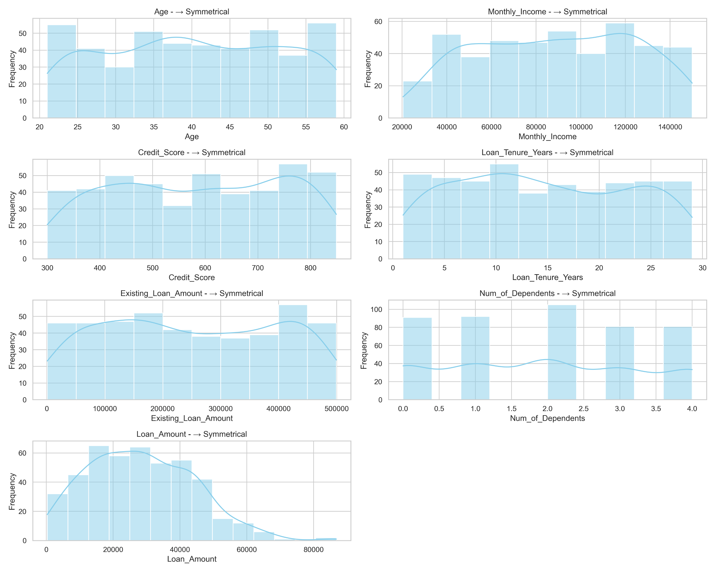
Data Skewness
Most features (Age, Income, Credit Score) are symmetrically distributed.
Loan Amount is moderately right-skewed (0.41) Some applicants are requesting larger-than-average loans.
Loan Tenure, Dependents, and Existing Loan show slight right skew

Slide 11
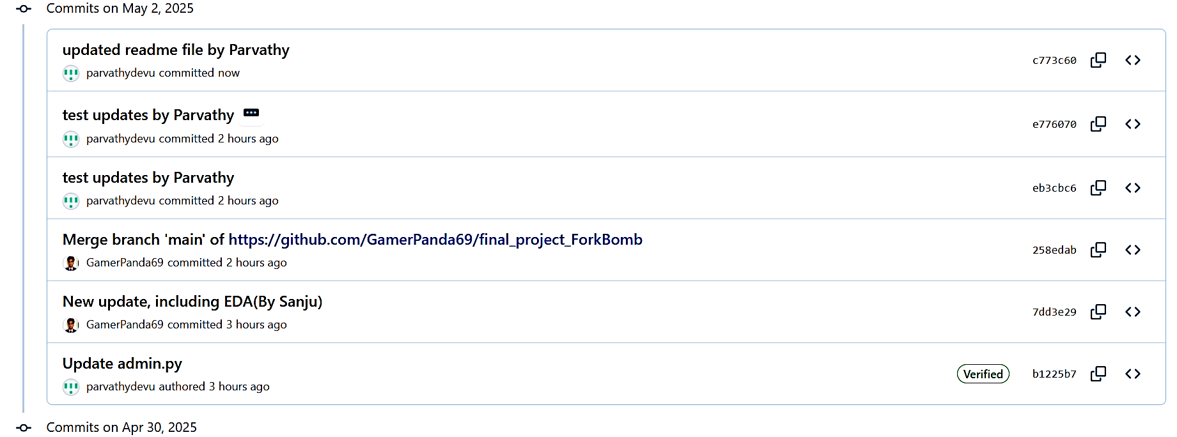
Git commit log

Slide 12
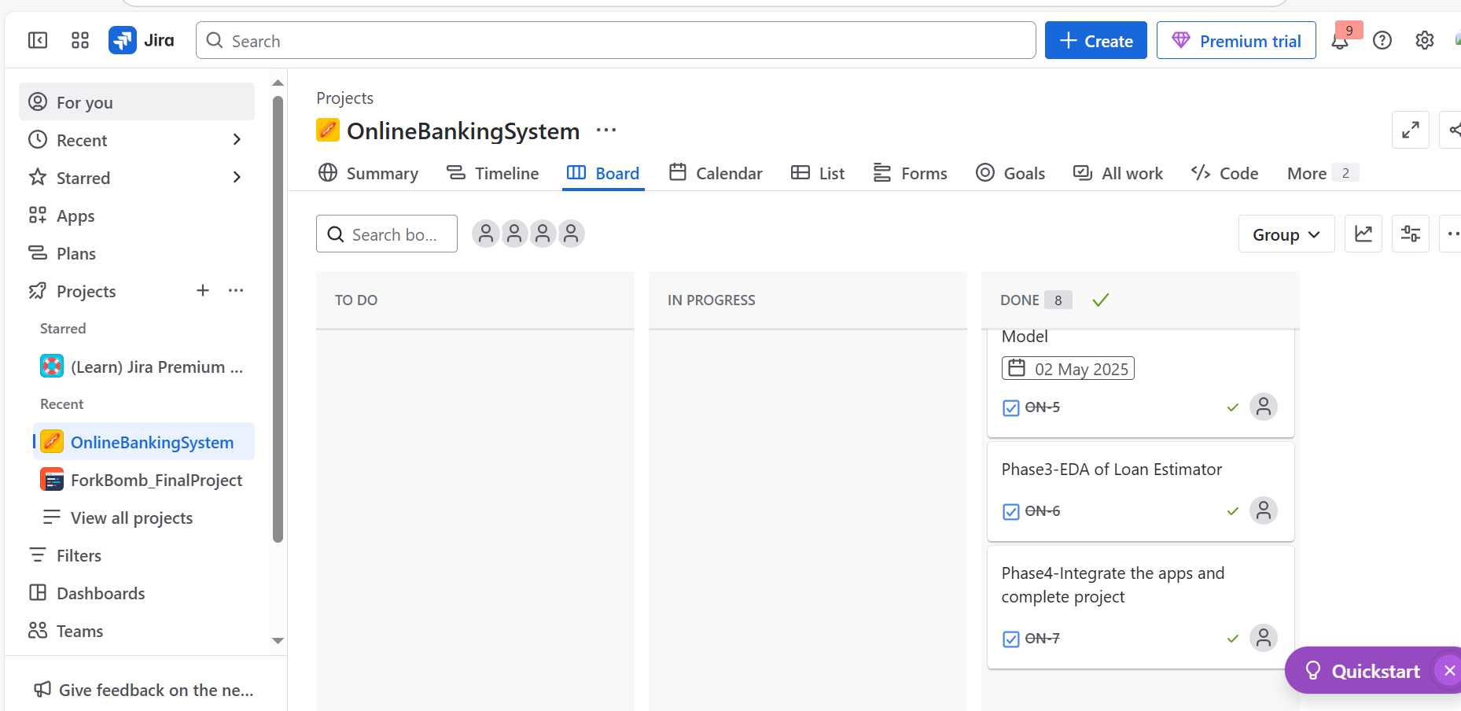
Jira Board

Slide 13
Conclusion
Inferred the problem statement, and successfully designed and implemented a Proof of Concept (POC)
All key functionalities mentioned in the problem statement were incorporated and validated.
The model and analysis lay the groundwork for further enhancements and deployment in real-world scenarios

