Slide 1
Software Cluster Project Part 1
EatEatHappy.com
Khemani Luv Ashok
2071541c

Slide 2
List of Items:
Site Navigation Diagram
Wireframes
Write-up of web application’s functionalities
References

Slide 3
Site Navigation Map
Home
Restaurants
Map
Register
Login
About
Forgot Password
My Reviews
Favourites
Restaurant Page
Add/Edit/Delete Review
Links to
Unlocks

Slide 4
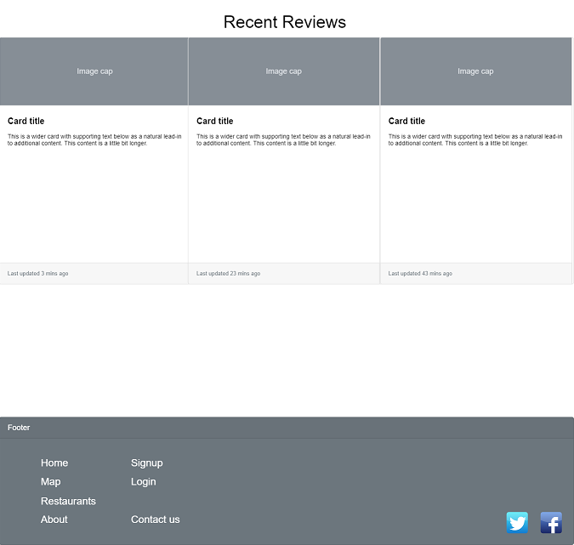
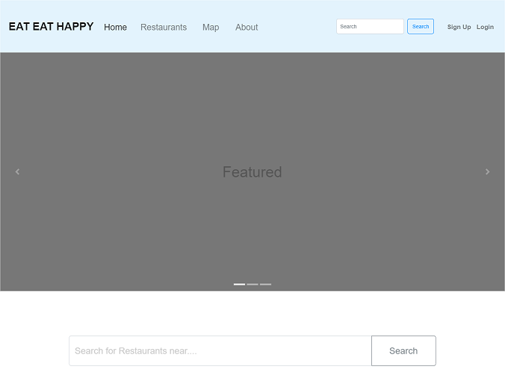
Wireframe
index.html (1/2)
index.html (2/2)

Slide 5
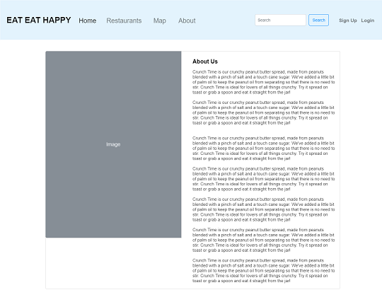
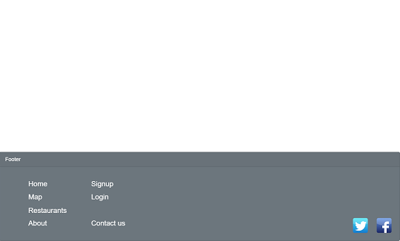
Wireframe
about.html (1/2)
about.html (2/2)

Slide 6
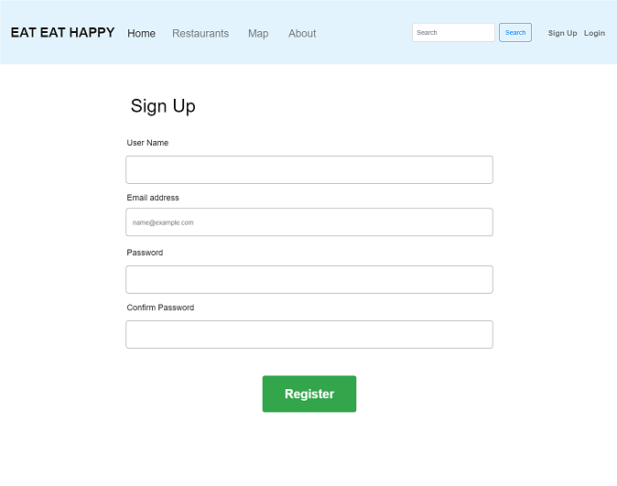
Wireframe
register.html (1/2)
register.html (2/2)

Slide 7
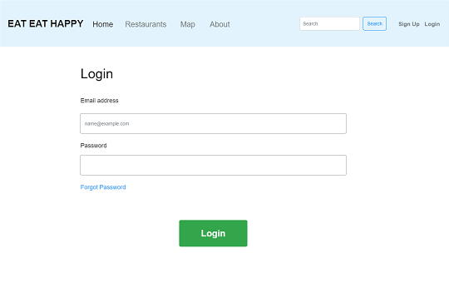
Wireframe
login.html (1/2)
login.html (2/2)

Slide 8
Functionalities of Web Application

Slide 9
References

Slide 10
Guides

Slide 11
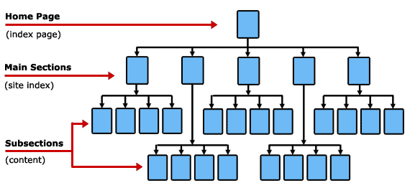
Basic Website Hierarchy

Slide 12
Basic Website > Navigation Diagram
HOME
Promotion
Menu
Delivery
My Cart
Contact us
Set A
Set B
Set C

