Slide 1
Software Cluster Project Part 1
EatEatHappy.com
Khemani Luv Ashok
2071541c

Slide 2
List of Items:
Site Navigation Diagram
Wireframes
Write-up of web application’s functionalities
References

Slide 3
Site Navigation Map
Home
Restaurants
Map
Register
Login
About
Forgot Password
My Account
Restaurant
Page
Links to
Unlocks

Slide 4
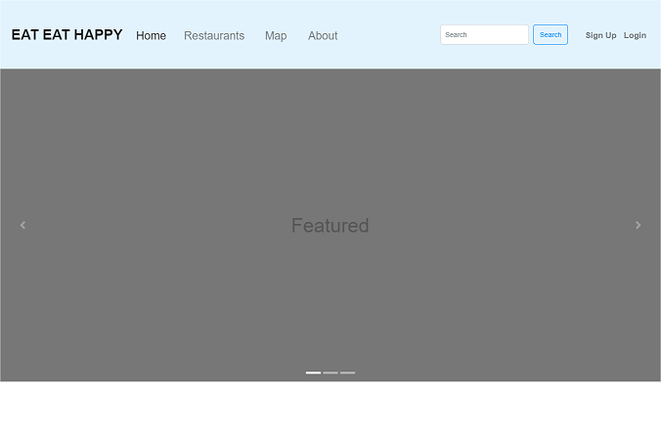
Wireframe
Home page (Top half)
Navigation bar links to other pages and allows user to search and Register/Login
1) Carousel Slideshow
Showing featured/promoted restaurants
2) Account section
If user is logged in, Sign Up and Login will be hidden and Username and profile pic will be shown instead (See myaccount.html later for image)
3) Search bar
User can search for restaurants by name or other attributes (address/cuisine type/keywords). Clicking on search will load restaurants.html page with listed results filtered by their search query
3
2
1
index.html (1/2)

Slide 5
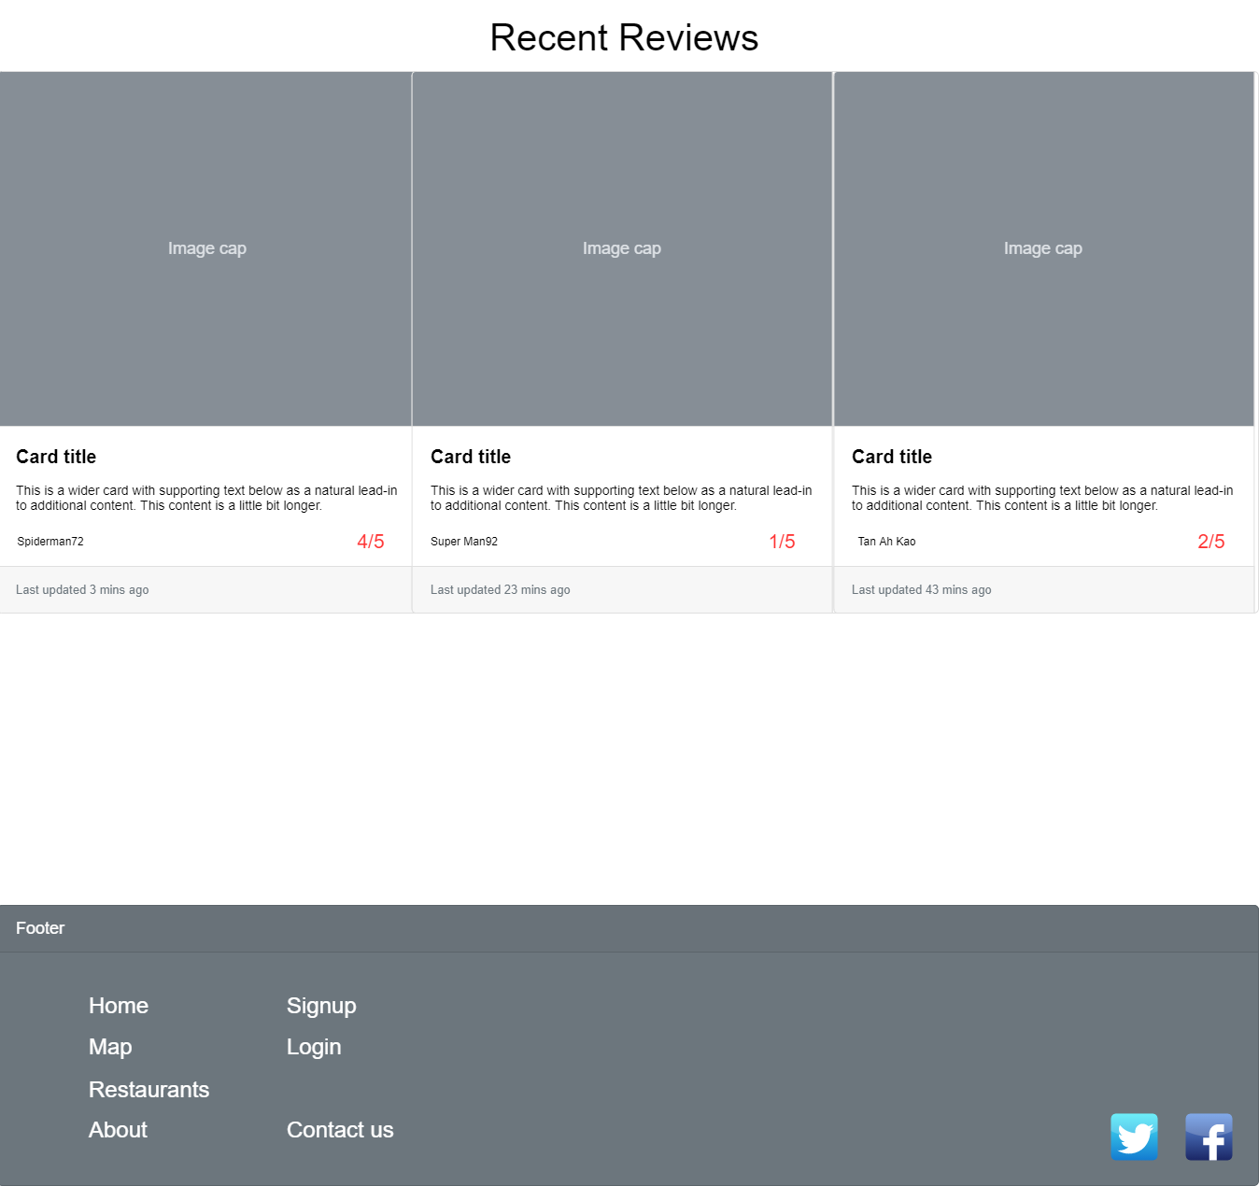
Wireframe
Home page (Bottom half)
Footer provides links to every page on site
1) Recent Reviews
Showing recently reviewed restaurants
Image of restaurant and review heading and review body and reviewer username text shown as cards.
Card can be clicked on to load the restaurant page with full review.
2) Signup/Login links
If user is logged in, Sign Up and Login will be hidden
1
2
index.html (2/2)

Slide 6
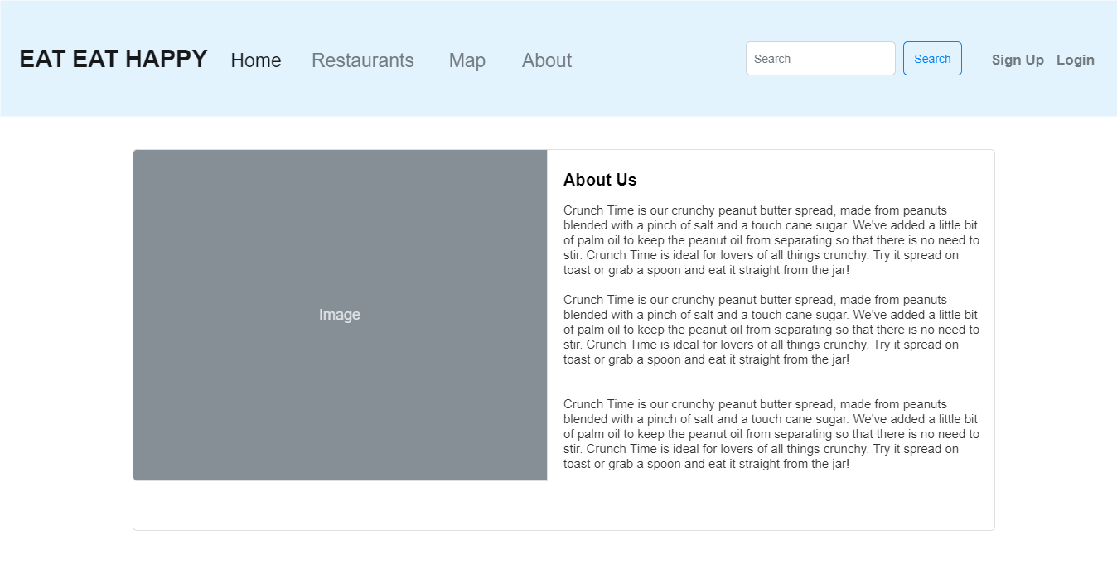
Wireframe
About page (Top half)
Static page describing website history with image of Company office
about.html (1/2)

Slide 7
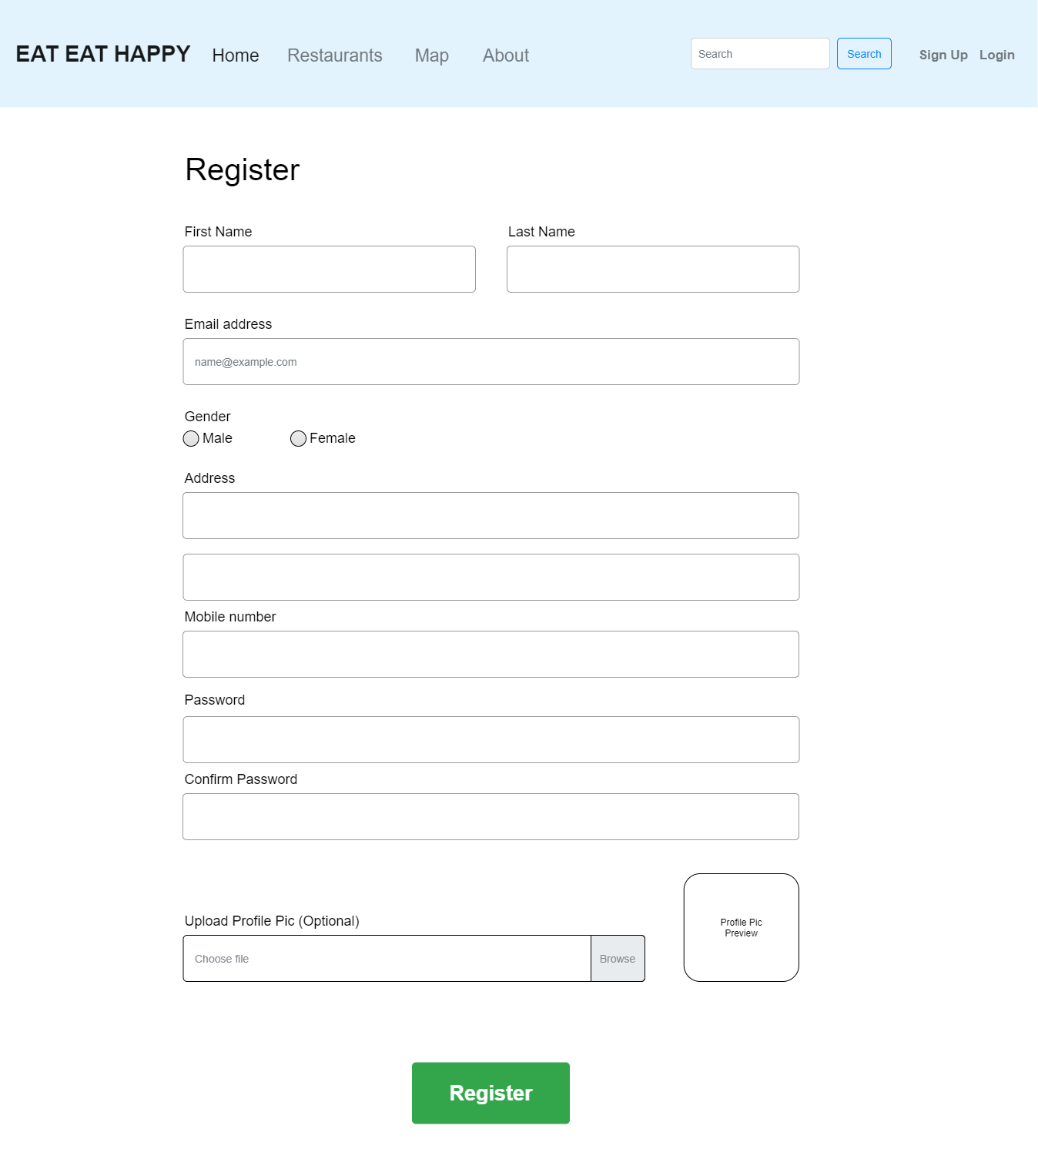
Wireframe
Register/Signup page (Top half)
Allows user to register a new account. All fields except profile pic are required.
If user uploads a profile pic, a preview will appear in the image box, otherwise a default pic will be shown
Upon clicking Register, following checks will be made
1) Valid email address format (ie abc@def.ghi)
2) All required fields filled up
3) Mobile number only consists of numbers
4) Password and Confirm Password are similar and are sufficiently strong (8 characters and consists of both alphabets and numbers atleast)
2
1
3
4
register.html (1/2)

Slide 8
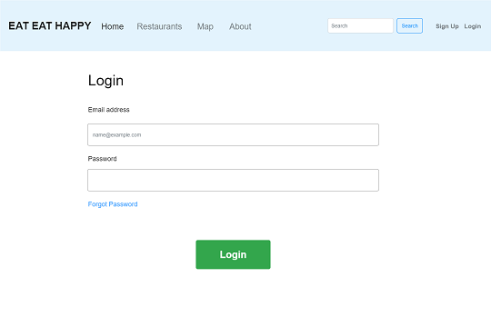
Wireframe
Login page (Top half)
Form submits user credentials.
Upon clicking Login, check will be performed to ensure both email address and password are specified. Validity of email address format will also be checked
1) User can click on Forgot Password if he wishes to reset his password. User will be asked to confirm email address and a reset password URL will be sent to specified email. Accessing the URL in the email will allow User to specify a new password.
1
login.html (1/2)

Slide 9
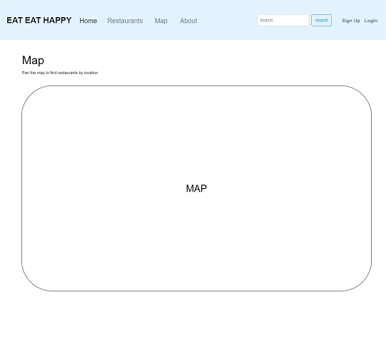
Wireframe
Map (Top half)
Shows a Map which the user can navigate to see listed restaurant pins.
Clicking on the pin will load the restaurant.html page showing the clicked Restaurant page information and description and user reviews.
map.html (1/2)

Slide 10
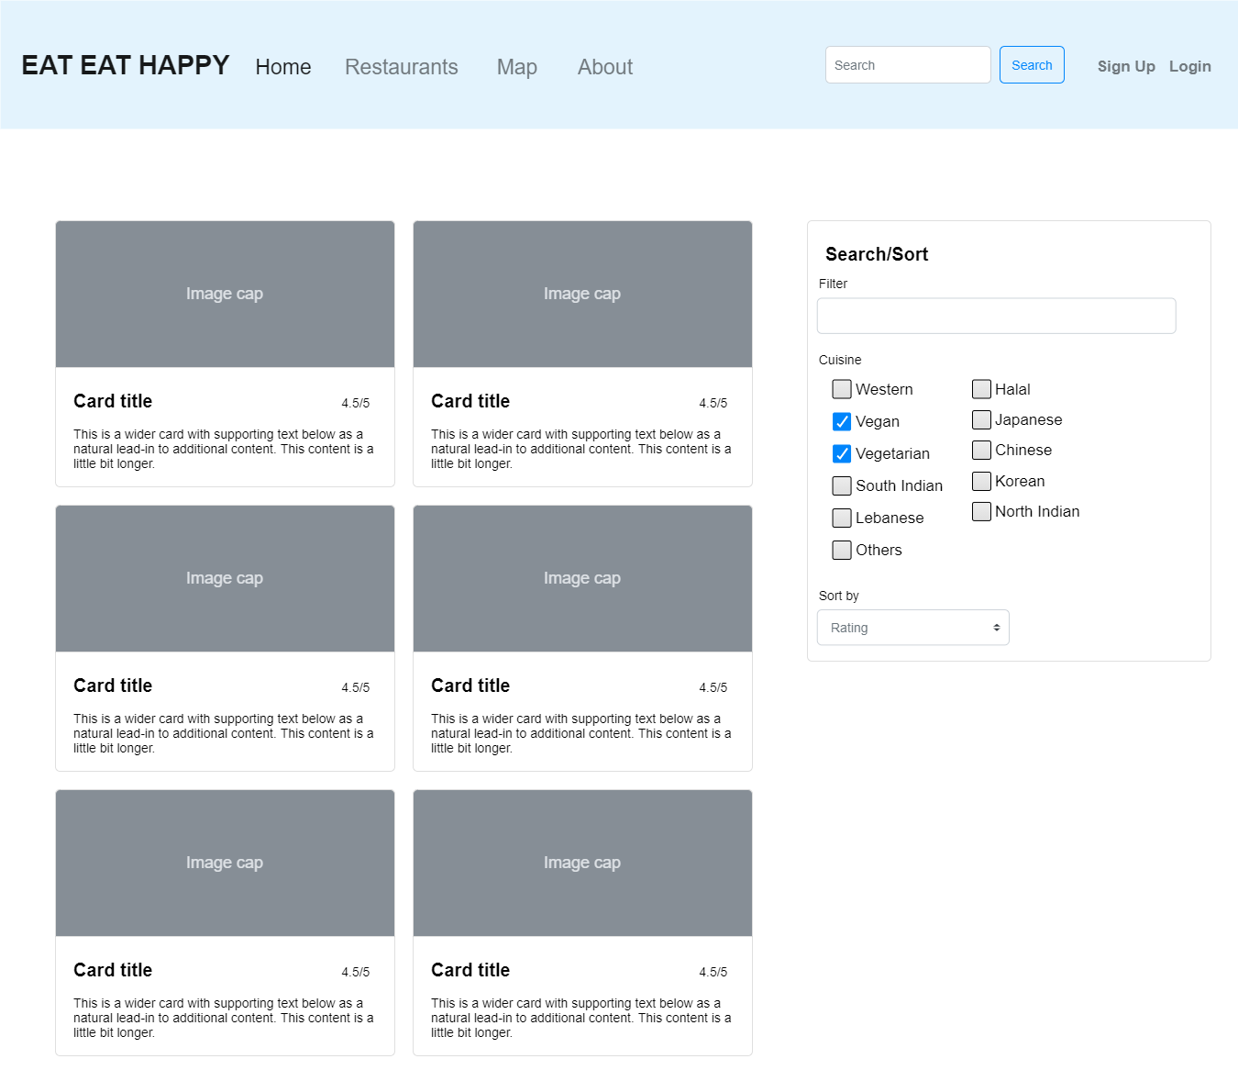
Wireframe
Restaurants (Top half)
Lists restaurants with an image, Restaurant name, brief description and total average review score submitted by users.
Filter by name, cuisine type
Sort by Score or Name
Clicking on any restaurant Card will load the respective Restaurant’s page.
1
2
restaurants.html (1/2)

Slide 11
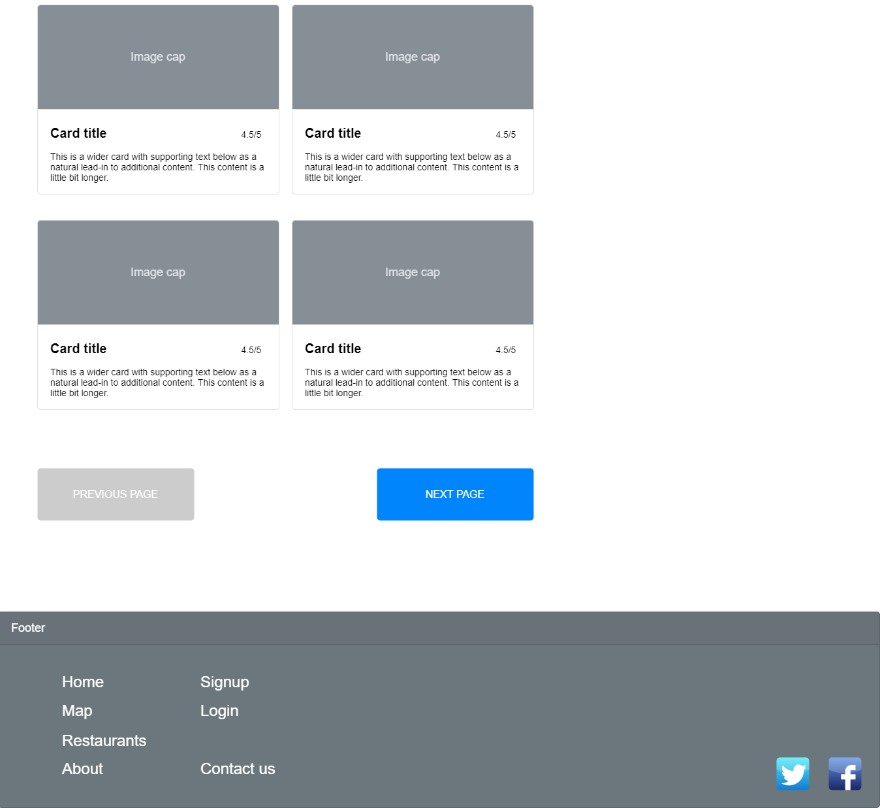
Wireframe
Restaurants (Bottom half)
User can load next and previous pages via respective buttons.
restaurants.html (2/2)

Slide 12
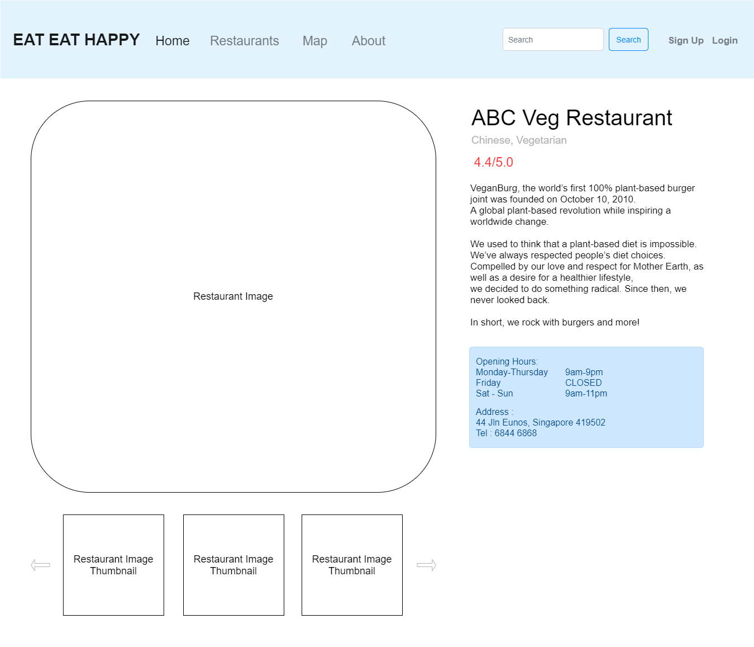
Wireframe
Restaurant (Top half)
Lists restaurant information with selectable images, Restaurant name, brief description and total average review score submitted by users.
Also listed are Opening hours, Address and Telephone number of the restaurant in blue highlighted box.
Currently selected image in larger size
User can select any thumbnail to see a larger version.
1
2
restaurant.html (1/2)

Slide 13
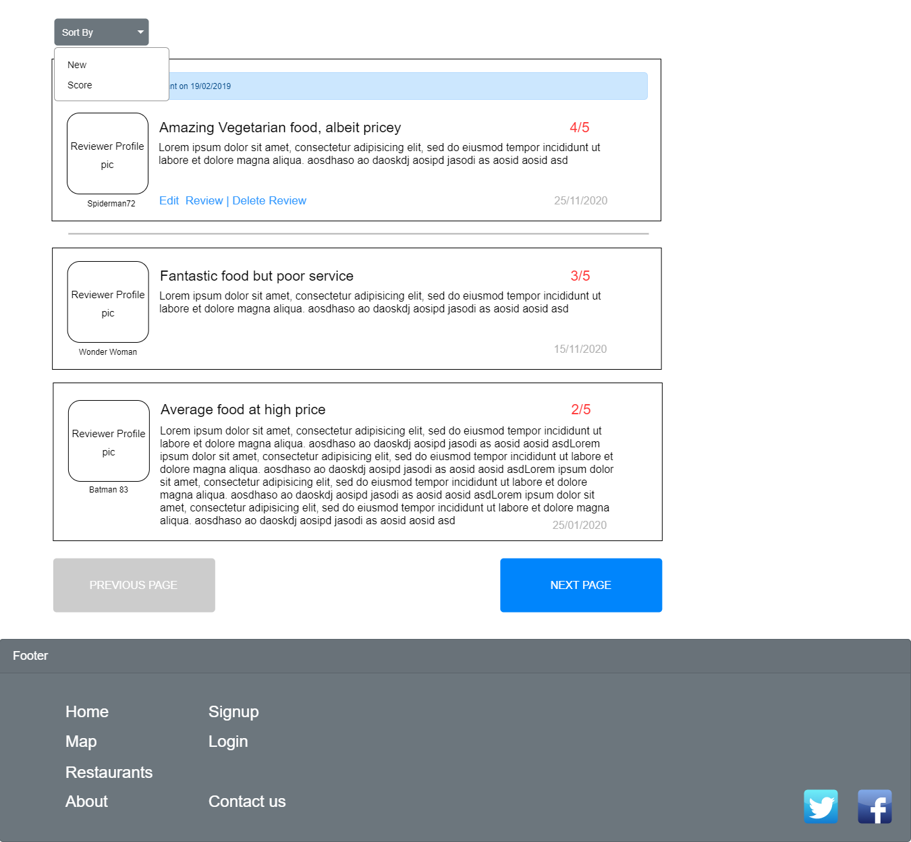
Wireframe
Restaurant (Bottom half)
Lists all the user submitted reviews for this restaurant.
If User is logged in, top review box will appear as follows:
  If user has previously submitted a review for this restaurant, then their review, submitted score will appear along with Edit/Delete Review Options. (As shown to the left)
  If user has not submitted a review, an empty text area box will appear along with a dropdown for scoring and a Submit button.
  Clicking on Edit Review will convert the review into 2 editable text boxes with the initial values being the user’s review
User can browse next and previous pages of reviews via next/previous page buttons
User can sort reviews by Date or Score
3
1
2
restaurant.html (2/2)

Slide 14
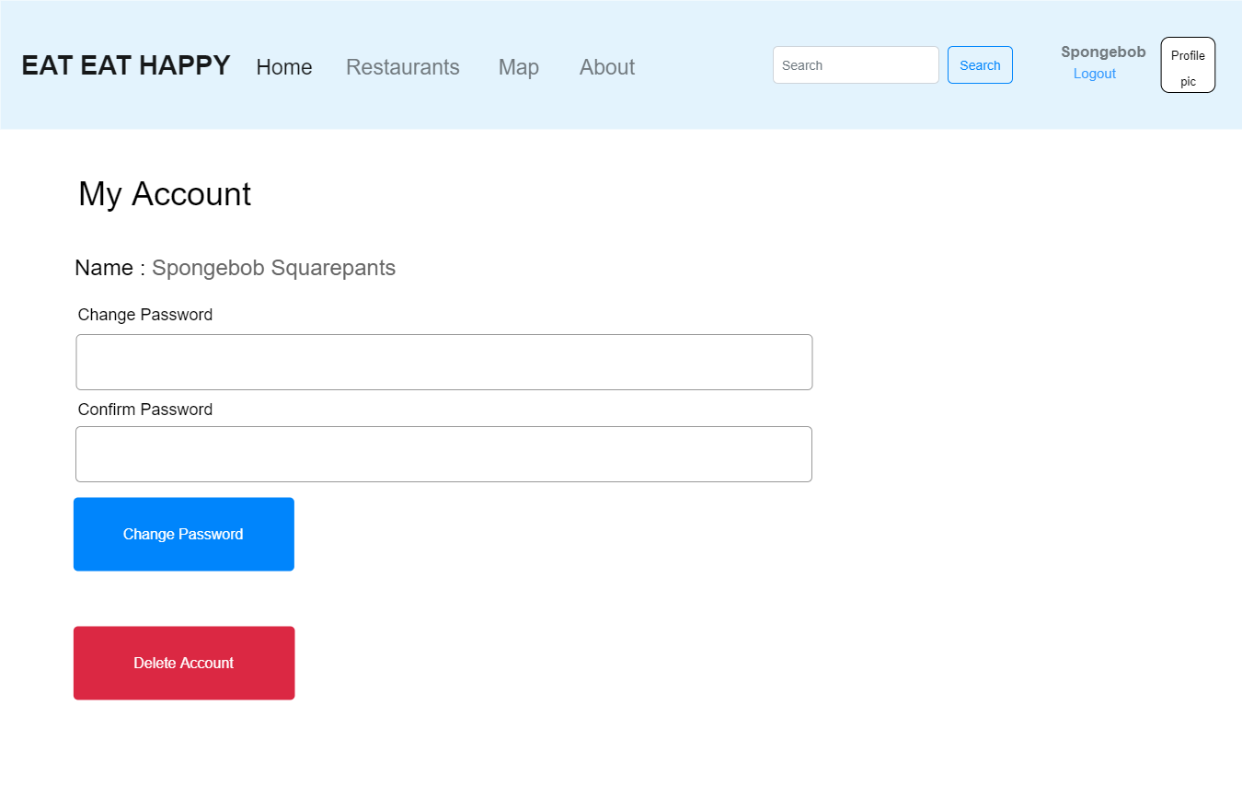
Wireframe
My Account (Top half)
Lists all the user submitted reviews for this restaurant.
If User is logged in, username is displayed along with their profile pic. A logout link also appears below the username to allow the user to logout.
User can change password by typing in a new password and retyping it in the confirm password and clicking Change Password.
User can delete their account. This is irreversible and will delete their account as well as log them out.
1
2
3
myaccount.html (1/2)

Slide 15
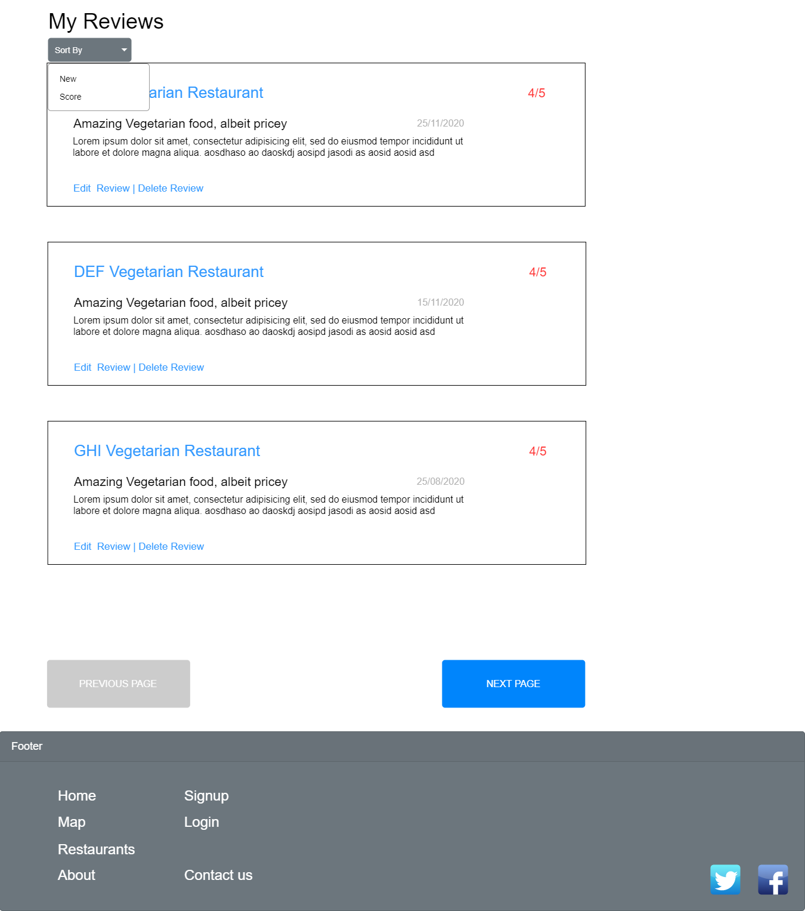
Wireframe
My Account (Btm half)
Lists all the user submitted reviews for all restaurants.
User can sort their submitted reviews via Name or Score.
User can Edit or delete their submitted reviews. Editing will present an inline textbox with their previous review as the content. User can also click on the restaurant name to go to the full restaurant page (restaurant.html)
User can browse next and previous pages of their reviews via next/previous page buttons
1
2
myaccount.html (2/2)

Slide 16
References
1) Hungrygowhere.com

