Slide 1
WELCOME TO RUNTIME TERROR PRESENTATION

Slide 2
INTRODUCTION
TIC-TAC-TOE
This game is very popular and is fairly simple by itself.
It is actually a two player game . In this game, there is board with 3 x 3 squares.
The goal of Tic-Tac-Toe is to be one of the player to get three same symbol in a
Row –Horizontally –Vertically or Diagonally
On a 3 x 3 grid.
Team Members of Runtime Terror
Deepanshu Pal CRN No:-21BCA107
Karan Singh CRN No:-21BCA043
Shikhar Sharma CRN No:-21BCA080
Tushar Sharma CRN No:-21BCA094
Talha Shaad CRN No:-21BCA090
Urvita Rajawat CRN No:-21BCA095

Slide 3
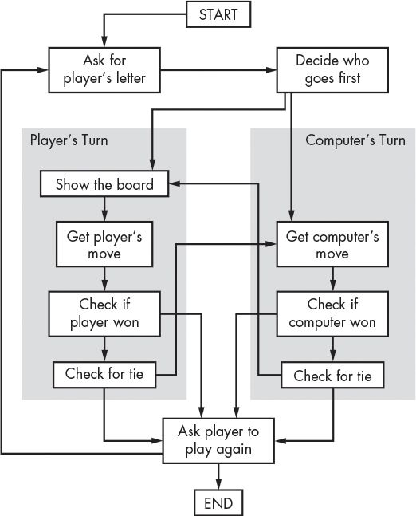
MECHANISM OF THE PROJECT
1

Slide 4
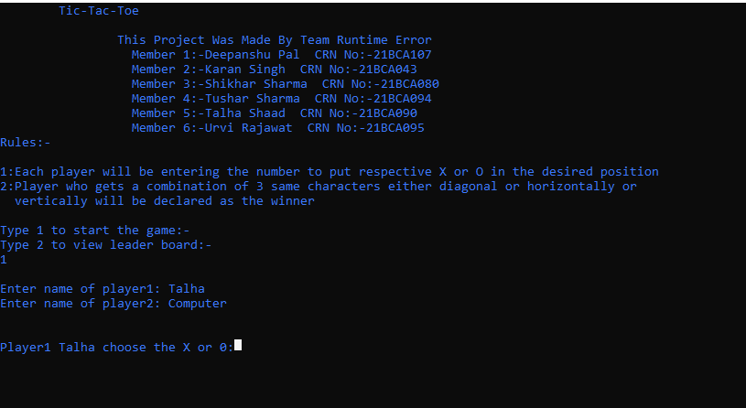
Starting Interface
Here you have:
Selection between Start the
game or to view Result screen.
Start selection will give you
option to a player to enter there name respectively.
After the name entry first player get the chance the select between “X” or “O” which will start the screen.
Result selection shows you the result of previous matches outcome between the players.

Slide 5
Functions
check for win ()
Here all the condition of winning as per rules is checked once the game concluded and winner/tie of the round is decided .
board()
This function is used to struct the board for the game. We use the concept of array declaration and proper use of lines.
rules ()
This function is used to set the rules and regulation of the games .We use concept of the if –else conditional statement inside the function definition.

Slide 6
Main ()
Here we declared and intialized variables like player , choice, symbol , start , dec , etc…..
Decision()
Here we make decision making point that the first person gets to choose between “X” and “O”. Second person is assigned the left over option by it self.
File *p
P is used as pointer for score.txt which will store the result of game about the winner and Draws in game as an seprate file name score.

Slide 7
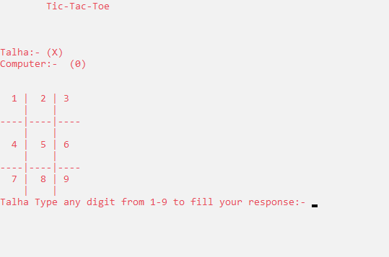
Game Interface
On left side ,there is a game interface how it look like in console screen.
When player 1 enter a number from (1-9) then numbers in grid will replaced by “X”. Afterwards player will switch and 2nd player gets the chance and then he /she can enter any number from (1-9) except the number which had entered by player1 and in grid it will be replaced by “O”.

Slide 8
THANK YOU
TEAM TERROR

