Slide 1
StudentInsight
Student Performance Prediction
Network Engineering
Artificial Intelligence and Intelligent System
Group project
Supervisor Mr C. Zano
26 October 2026
Bindura University of Science Education
1
Notes:
Introduce the group and project. The five milestones form the report chapters. Fill member names in the report before submission. Module: Artificial Intelligence and Intelligent System. Supervisor Mr C. Zano.

Slide 2
Five milestones form five chapters
Chapter | Milestone | Evidence
1 | Proposal Week 4 | Problem, objectives, method and literature
2 | Design Week 7 | Architecture, pipeline, algorithms and ethics
3 | Prototype Week 10 | Working model and measured evaluation
4 | Integration Week 13 | App, tests, notebooks and repository
5 | Final Week 15 | Report, slides and 15-minute demonstration
Project structure
2
Notes:
The prescribed weeks are assessment milestones, not claims that earlier submissions occurred. Source: user-supplied milestone schedule.

Slide 3
Staff need interpretable evidence
01
Estimate final grades after period two.
02
Support teachers, lecturers and school leadership.
03
Compare learned candidates with strong simple baselines.
04
Present uncertainty, review tables and consistent exports.
Chapter 1 Proposal
3
Notes:
Explain the defined use case without claiming institutional interviews. Sources: report Chapter 1; Romero and Ventura 2020, https://doi.org/10.1002/widm.1355; UCI https://archive.ics.uci.edu/dataset/320/student+performance.

Slide 4
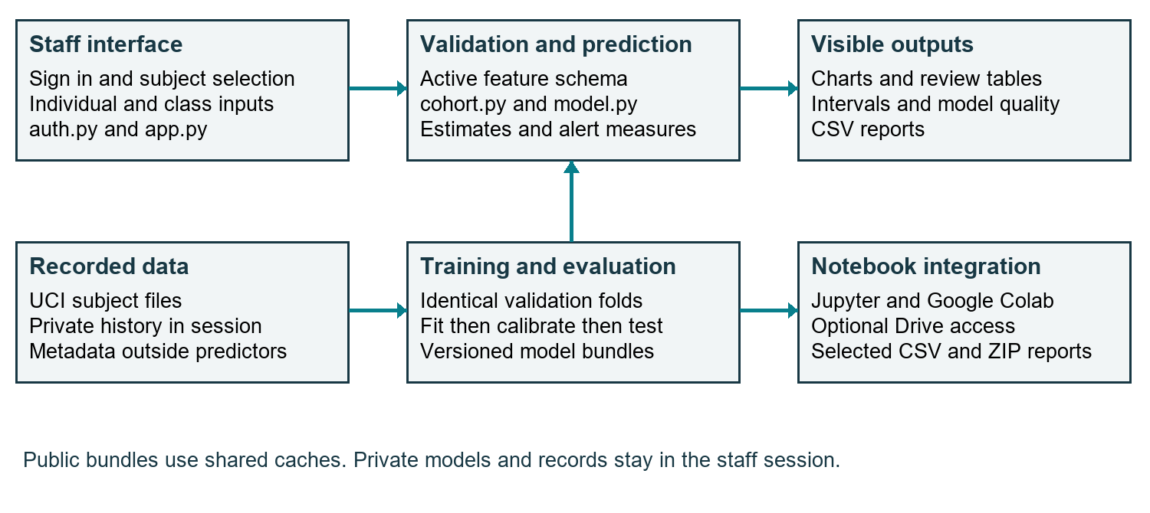
One model workflow serves two interfaces
Chapter 2 Design
4
Notes:
Streamlit and notebooks call the same Python modules. Account storage remains separate from datasets and models. Private uploaded models stay outside shared public caches. Source: app.py, model.py, model_service.py and notebook.

Slide 5
Selection precedes calibration and testing
Subject | Fitting | Calibration | Test
Mathematics | 237 | 79 | 79
Portuguese | 389 | 130 | 130
Six candidates: mean, G2 persistence, two ridge and two forest models.
G3 and student metadata never enter the predictors.
Chapter 2 Design
5
Notes:
Fixed seed 42; five identical validation folds in fitting data. Preprocessing fits only inside each fold. CV MAE selects. Within 0.02 points, prefer simpler procedure. Sources: model.py; https://scikit-learn.org/stable/common_pitfalls.html; https://arxiv.org/abs/2107.07511.

Slide 6
G2 wins the validation comparison
Lower MAE is better. Every candidate uses the same fitting-data folds.
Chapter 3 Prototype
6
Notes:
Both subjects select G2 without invoking the near-tie rule. The label is baseline forecast, with no learned predictive weights. Source: active schema 3 metrics.json comparison entries. Fold SD is variation, not a confidence interval.

Slide 7
Lower MAE comes with a mixed result
Measure | Mathematics before / after | Portuguese before / after
MAE | 1.415 / 1.000 | 0.755 / 0.677
RMSE | 2.195 / 2.072 | 1.159 / 1.170
R2 | 0.765 / 0.791 | 0.862 / 0.860
The test records have already informed development.
A new institution or later cohort still needs independent evaluation.
Chapter 3 Prototype
7
Notes:
Compare reproduced expanded ridge with repaired G2 selection on reused test records. Portuguese RMSE increases and R2 decreases slightly. These are internal comparisons, not new independent confirmation. Source: preserved legacy audit and active schema 3 metrics.

Slide 8
Intervals and alerts describe different things
Measure | Mathematics | Portuguese
Nominal coverage | 80% | 80%
Observed test coverage | 83.5% (66/79) | 93.8% (122/130)
Interval width | 2 grade points | 2 grade points
Alert precision at 10 | 0.813 | 0.560
Alert recall at 10 | 0.963 | 0.933
Alerts compare the forecast with a staff-selected reference grade.
Chapter 3 Prototype
8
Notes:
Nominal interval target 80%; constant radius 1, width 2. Not personalized uncertainty or passing probability. Alert positive is G3 strictly below reference; equality is not positive. Source: model.py and schema 3 test results. Method reference https://arxiv.org/abs/2107.07511.

Slide 9
The staff workflow is implemented
01
Sign in and select the subject.
02
Enter G2 or upload a validated class CSV.
03
Inspect grade charts, review categories and model quality.
04
Download results carrying the active bundle identity.
Chapter 4 Integration
9
Notes:
Live demonstration: sign in using authorized account, choose Mathematics, enter G2 12 with G1 blank, show forecast 12 and interval 11 to 13. Then show historical cohort label, filters and CSV. Do not present historical examples as current live students. Source: AppTest and project modules.

Slide 10
Notebook and Drive reuse the project code
01
Local Jupyter uses the StudentInsight environment.
02
Colab loads the project from GitHub.
03
Optional Drive input: StudentInsight/datasets.
04
Verified report ZIPs: StudentInsight/reports.
Chapter 4 Integration
10
Notes:
Use the notebook for reproducible modelling and exports. Drive support needs Google authorization. Local-folder tests passed; real Google account authorization remains a user action. Sources: notebook, notebook_storage.py, https://research.google.com/colaboratory/faq.html.

Slide 11
56 tests pass across the implemented workflow
56
Passing automated tests
Selection, schemas, calibration, partitions, thresholds, exports, authentication and artifact consistency.
Notebook execution and local report download checks also passed.
Chapter 4 Integration
11
Notes:
Full suite run on 26 October 2026: 56 tests, zero failures. App 12, auth 4, cohort 7, lite 6, model 12, service 6, notebook storage 5, subject training 4. These checks do not replace visual review or live institutional validation. Source: tests/ and executed unittest suite.

Slide 12
The submission is prepared for assessment
01
Five-chapter technical report and presentation materials.
02
A 15-minute demo guide with expected results and fallbacks.
03
Group details, rehearsal and assessed delivery remain.
04
Next research step: genuine local data and temporal validation.
Chapter 5 Final
12
Notes:
Close with honest readiness. The report, slides, guide and code are prepared; group names/roles, rehearsal, live demo, real Google authorization and supervisor assessment still require user action. Do not call the assessed milestone formally complete before delivery. Repository: https://github.com/GamerStudioszw/Student-Performance-Prediction.

