Slide 1
1. Øvelse: Intro til netværksanalyse i R
Alexander Gamerdinger

Slide 2
R set up

Slide 3
Installering af R og Rstudio
# funktion til at vise informationerne om R versionen + andre ting version <- R.Version() # kun R versionen version$version.string
## [1] "R version 4.1.2 (2021-11-01)"
Sådan tjekker du Rstudio version: Help -> About Rstudio
RStudio 2021.09.0+351

Slide 4
Folder struktur
# funktionen til at lave en "working directory" setwd("/Users/alexandergamerdinger/Desktop/PhD/teaching/virksomhedsstrategi_forår_2022") # se hvilken "working directory" du har getwd()
## [1] "/Users/alexandergamerdinger/Desktop/PhD/teaching/virksomhedsstrategi_forår_2022"
# se filerne i din "working directory" - "." betyder at alt skal vises list.files(path = ".")
## [1] "input" "material" "output" "r"

Slide 5
Installering af pakker
# data manipulation install.packages('data.table') install.packages('tidyverse') # data analysis & visualization install.packages('igraph') install.packages('ggraph') # reading and writing data install.packages('readxl') install.packages('writexl')
# data manipulation library('data.table') library('tidyverse') # data analysis & visualization library('igraph') library('ggraph') # reading and writing data library('readxl') library('writexl')

Slide 6
Indlæsning & barbejdning af data

Slide 7
Load data (data.table)
Først skal i downloade elite netværk data sæt fra canvas og gem filen under working_directory_folder/input
#data.table den <- fread("input/den17-no-nordic-letters.csv") head(den)
## name ## 1: Aage Almtoft ## 2: Aage B. Andersen ## 3: Aage Christensen ## 4: Aage Dam ## 5: Aage Dam ## 6: Aage Frandsen ## affiliation ## 1: Middelfart Sparekasse ## 2: Foreningen OEstifterne - Repraesentantskab (Medlemmer af delegeretforsamling) ## 3: AARHUS SOEMANDSHJEM ## 4: Brancheforeningen automatik, tryk & transmission (bestyrelse) ## 5: Dansk Erhverv (bestyrelse) ## 6: Dommere valgt af Folketinget (Rigsretten) ## role tags position_id id ## 1: Member Corporation, FINA, Banks, Finance 1 95023 ## 2: Member Charity, Foundation, Insurance, Socialomraadet 4 67511 ## 3: Chairman Foundation, Marine, Tourism 6 100903 ## 4: Chairman Business association, Interest group, Technology 8 69156 ## 5: Member Employers association 9 72204 ## 6: Member Judges, Law, Parliament, Politics 15 73158 ## sector type ## 1: Corporations ## 2: NGO Organisation ## 3: Foundations ## 4: NGO Organisation ## 5: NGO Stat ## 6: Parliament ## description ## 1: Automatisk CVR import at 2016-03-12 18:01:28: BESTYRELSE i Middelfart Sparekasse (2009-03-31 - ). ## 2: Direktoer ## 3: Automatisk CVR import at 2016-03-12 18:08:31: formand i AARHUS SOEMANDSHJEM (2010-02-05 - ). ## 4: Formand, Adm. direktoer, Bürkert Contromatic A/S ## 5: Adm. dir. Aage Dam- Bürkert-Contromatic A/S ## 6: ## created archived last_checked cvr_person cvr_affiliation ## 1: 2016-03-12 18:01:28 <NA> 2017-11-09 15:38:01 4003983591 24744817 ## 2: 2016-02-05 14:45:10 <NA> 2016-02-12 14:41:09 <NA> NA ## 3: 2016-03-12 18:08:31 <NA> 2017-11-09 15:50:09 4000054465 29094411 ## 4: 2016-02-10 15:18:47 <NA> 2016-02-10 14:19:20 <NA> NA ## 5: 2016-02-16 10:49:01 <NA> 2016-02-16 11:55:34 <NA> 43232010 ## 6: 2016-02-17 10:04:45 <NA> 2016-02-17 09:00:34 <NA> NA ## person_id affiliation_id gender ## 1: 1 3687 Men ## 2: 3 2528 Men ## 3: 4 237 Men ## 4: 5 469 Men ## 5: 5 1041 Men ## 6: 9 1781 Men

Slide 8
Load data (dplyr)
#dplyr den <- read_csv("input/den17-no-nordic-letters.csv")
## Rows: 56849 Columns: 17 ## ── Column specification ──────────────────────────────────────────────────────── ## Delimiter: "," ## chr (8): name, affiliation, role, tags, sector, type, description, gender ## dbl (6): position_id, id, cvr_person, cvr_affiliation, person_id, affiliati... ## dttm (3): created, archived, last_checked ## ## ℹ Use `spec()` to retrieve the full column specification for this data. ## ℹ Specify the column types or set `show_col_types = FALSE` to quiet this message.
head(den)
## # A tibble: 6 × 17 ## name affiliation role tags position_id id sector type description ## <chr> <chr> <chr> <chr> <dbl> <dbl> <chr> <chr> <chr> ## 1 Aage Almt… Middelfart… Memb… Corp… 1 95023 Corpo… <NA> Automatisk… ## 2 Aage B. A… Foreningen… Memb… Char… 4 67511 NGO Orga… Direktoer ## 3 Aage Chri… AARHUS SOE… Chai… Foun… 6 100903 Found… <NA> Automatisk… ## 4 Aage Dam Branchefor… Chai… Busi… 8 69156 NGO Orga… Formand, A… ## 5 Aage Dam Dansk Erhv… Memb… Empl… 9 72204 NGO Stat Adm. dir. … ## 6 Aage Fran… Dommere va… Memb… Judg… 15 73158 Parli… <NA> <NA> ## # … with 8 more variables: created <dttm>, archived <dttm>, ## # last_checked <dttm>, cvr_person <dbl>, cvr_affiliation <dbl>, ## # person_id <dbl>, affiliation_id <dbl>, gender <chr>

Slide 9
Data bearbejdning (data.table)
#data.table select funktion den[,.(name, gender)]
## name gender ## 1: Aage Almtoft Men ## 2: Aage B. Andersen Men ## 3: Aage Christensen Men ## 4: Aage Dam Men ## 5: Aage Dam Men ## --- ## 56845: Jacob Aarup-Andersen 195767 Men ## 56846: Carsten Rasch Egeriis Men ## 56847: Marina Loenning Women ## 56848: Jaap-Jan Linze Postma ## 56849: Andreas Albert Pfisterer Men
#data.table count funktion den[, .N, .(sector)]
## sector N ## 1: Corporations 7989 ## 2: NGO 17720 ## 3: Foundations 6987 ## 4: Parliament 1087 ## 5: Family 207 ## 6: State 13601 ## 7: Events 1948 ## 8: 2349 ## 9: VL_networks 3803 ## 10: Municipal 320 ## 11: Politics 37 ## 12: Organisation 6 ## 13: Commissions 795

Slide 10
Data bearbejdning (dplyr)
#data.table select funktion den %>% select(name, gender)
## # A tibble: 56,849 × 2 ## name gender ## <chr> <chr> ## 1 Aage Almtoft Men ## 2 Aage B. Andersen Men ## 3 Aage Christensen Men ## 4 Aage Dam Men ## 5 Aage Dam Men ## 6 Aage Frandsen Men ## 7 Aage Juhl Joergensen Men ## 8 Aage Krogsdam Men ## 9 Aage Larsen Men ## 10 Aage Lauridsen Men ## # … with 56,839 more rows
#data.table count funktion den %>% group_by(sector) %>% summarize(N = n()) # Or simply den %>% count(sector)
## # A tibble: 13 × 2 ## sector N ## <chr> <int> ## 1 Commissions 795 ## 2 Corporations 7989 ## 3 Events 1948 ## 4 Family 207 ## 5 Foundations 6987 ## 6 Municipal 320 ## 7 NGO 17720 ## 8 Organisation 6 ## 9 Parliament 1087 ## 10 Politics 37 ## 11 State 13601 ## 12 VL_networks 3803 ## 13 <NA> 2349

Slide 11
Netværk visualisering

Slide 12
Two-mode netværk
# subsetting foundations den1 <- den[sector == "Parliament"] # dplyr way: den1 <- den %>% filter(sector == "Family) # cross tabulation som giver en såkaldt "incidence matrix" incidence_matrix <- xtabs(formula = ~ name + affiliation, sparse = T, data = den1) # load two-mode netværk net1 <- graph_from_incidence_matrix(incidence_matrix, directed = FALSE)

Slide 13
One-mode netværk
Option 1
# split two-mode netværk i to one-mode netværk net2 <- bipartite.projection(net1) # one node netværk, individuals net3 <- net2$proj1 # one node netværk, affiliation net4 <- net2$proj2
Option 2
# one node netværk, individuals adjacency <- incidence_matrix %*% Matrix::t(incidence_matrix) net5 <- graph_from_adjacency_matrix(adjacency, mode = "undirected") # one node netværk, affiliation adjacency <- Matrix::t(incidence_matrix) %*% incidence_matrix net6 <- graph_from_adjacency_matrix(adjacency, mode = "undirected")

Slide 14
Netværk visualisering med ggraph
# graph objekt net1%>% # graph layout ggraph(layout = "fr") + # Tilføjer forbindelser mellem aktørene - alpha (fra 0-1 - 0 svag, 1 stærk) geom_edge_link0(color = "gray60", alpha = 0.8) + # Tilføjer punkter eller aktørene geom_node_point(aes(color = type), size = 3) + # Tilføjer beskrivelser af familie geom_node_text(aes(filter=type==TRUE, label = name), repel = TRUE, size = 4) + # ændrer farver + labels scale_color_manual(values = c("lightblue", "darkred"), labels = c("Individuals", "Family")) + # graph thema som skal altid tilføjes theme_graph() + # det gør at "color" titlen ikke bliver vist i forklaringerne labs(color = "")
## Warning: ggrepel: 6 unlabeled data points (too many overlaps). Consider ## increasing max.overlaps

Slide 15
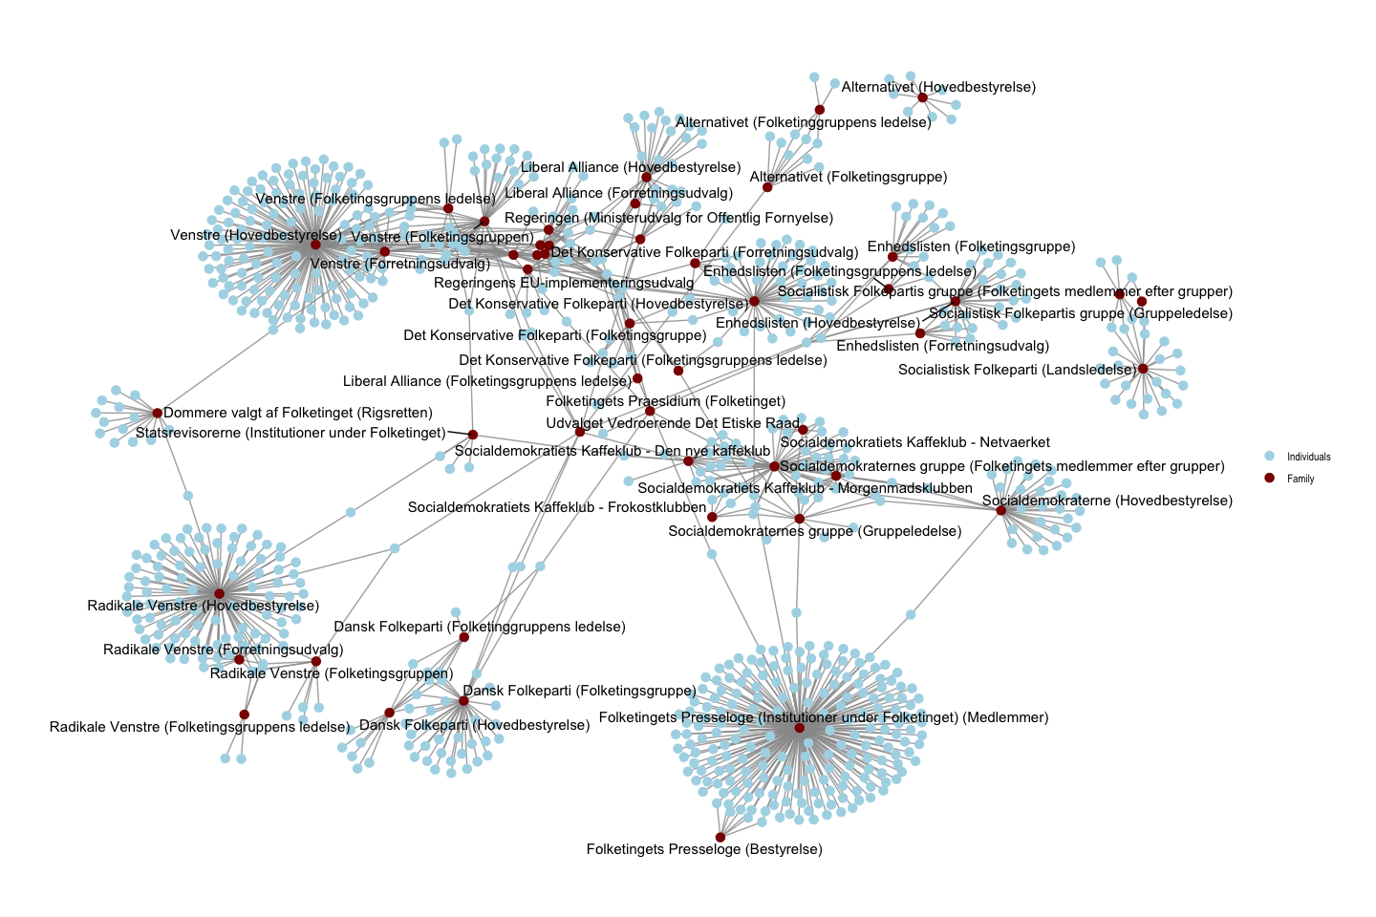

Slide 16
Øvelse

Slide 17
Opgaver
Download tom r-fil: lektion01-øvelse her
Svar på følgende spørgsmål:
Hvilke styrelser (affiliation) har de fleste medlemmer?
Hvor mange kvinder findes der i data sæt?
Hvem sidder i de fleste styrelser?
Lav et nyt datasæt “den1” hvor vi kigger kun på aktørene i sektor “Parliament”
Er der flere kvinder i dette dataseæt?
Lav et one-mode netværk af individuer og visualisere dette.
Beskriv netværket

