Slide 1


Slide 2




Structured Assessment
ASSESSMENT FORM
Artificial Intelligence
Risk of having Covid19

Slide 3








Patient’s Symptom
Travel History
Age
etc
Contact of Covid19
External Factors

Slide 4
Age
etc

Slide 5


Slide 6


Slide 7
Here’s how it works

Slide 8
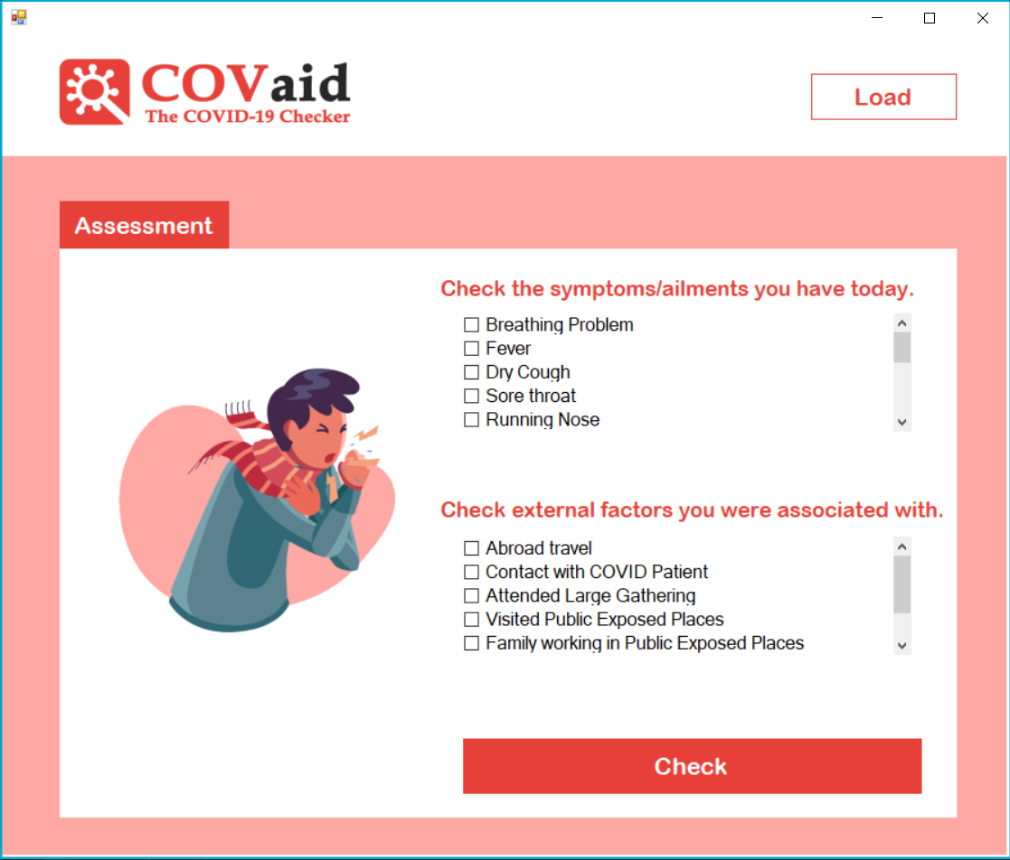

Fill up the form
✓
Click “Check”
button
✓
Wait for the results
✓

Slide 9


Slide 10


fast
reliable

