Slide 1

Canonical Symmetries Tutorial
GamesCrafters 2006
2006-11-15
Yanpei Chen
This slide deck is best viewed as a slideshow

Slide 2
Testing ….
©
UC Berkeley 2006

Slide 3
Canonical Symmetries Tutorial
GamesCrafters 2006
2006-11-15
Yanpei Chen

Slide 4
Canonical Symmetries Tutorial
Agenda
What are canonicals/symmetries
Why are they needed
Common symmetries
How to implement symmetries
©
UC Berkeley 2006

Slide 5
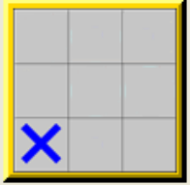
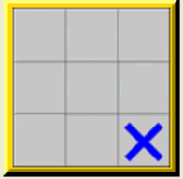
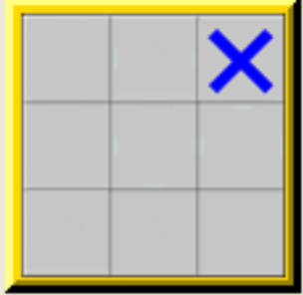
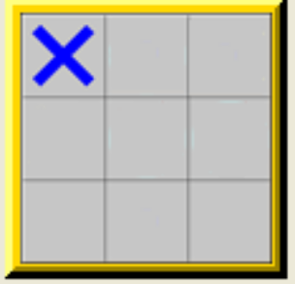
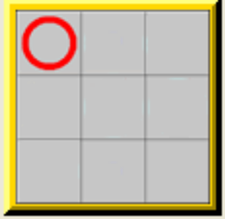
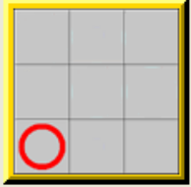
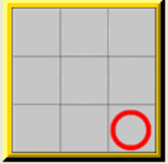
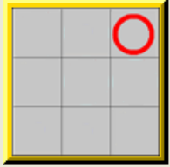
What are canonicals symmetries
Symmetric positions are
Any positions that are the “same” for humans
But “different” for computers
Symmetric as
The position at left is the “canonical position” of all eight positions
Symmetries depend on game rules
©
UC Berkeley 2006

Slide 6

Why do we need symmetries
Computers are not very smart
Human solves
Computer solves
Highly inefficient!!!
Canonicals/symmetries lead to huge space and time savings
©
UC Berkeley 2006

Slide 7
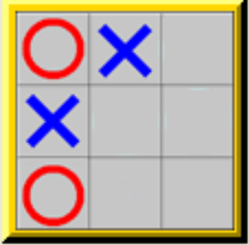
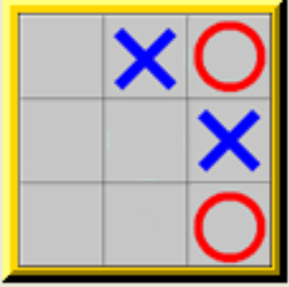
Common symmetries
Geometric symmetries
Rotation
Reflection
Symmetries in pieces
Switching
Other equivalences in pieces
Other game specific stuff
©
UC Berkeley 2006

Slide 8
How to Implement Symmetries
Game modules need to implement only one function
POSITION gCanonicalPosition (POSITION p);
Must adhere to interface
Takes in any position
Returns the canonical position
Freedom in implementing game specific canonicals
e.g. Quarto!
Multiple implementations
POSITION yanpeiGetCanonical(POSITION p);
POSITION marioGetCanonical(POSITION position);
POSITION (*getCanonical)(POSITION p) = &marioGetCanonical;
void InitializeGame () {
……
gCanonicalPosition = getCanonical;
……
}
©
UC Berkeley 2006

Slide 9
How to Turn on Symmetries
----- Main (Pre-Solved) Menu for Quarto -----
s) (S)TART THE GAME
w) START THE GAME (W)ITHOUT SOLVING
Evaluation Options:
o) (O)bjective toggle from STANDARD to REVERSE
d) (D)ebug Module BEFORE Evaluation
g) (G)ame-specific options for Quarto
2) Toggle (2)-bit solving (currently OFF)
p) Toggle Global (P)osition solving (currently OFF)
l) Toggle (L)ow Mem solving (currently OFF)
m) Toggle Sy(M)metries (currently OFF)
h) (H)elp
q) (Q)uit
©
UC Berkeley 2006

Slide 10
Examples
Symmetries implemented in
Tic-Tac-Toe – Simple; mttt.c
Bagh Chal – Simple; mbaghchal.c
Quarto! – Not so simple; mquarto.c
Others?
Add to this list!!!
©
UC Berkeley 2006

Slide 11
Summary
Symmetries = positions that are the “same” to humans
Need because wasteful to solve many symmetrical positions
Common symmetries – geometric, pieces
Implement using POSITION gCanonicalPosition (POSITION p);
Questions
©
UC Berkeley 2006

