Slide 1
Symmetries Tutorial
GamesCrafters 2007

Slide 2
Symmetries Tutorial
Agenda
  What are symmetries
  Why are they needed
  Common symmetries
  How to implement symmetries

Slide 3
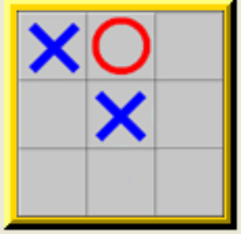
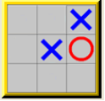
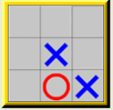
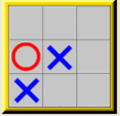
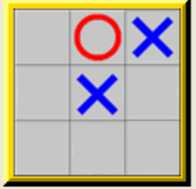
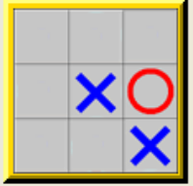
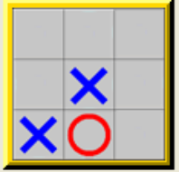
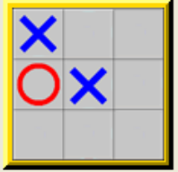
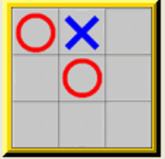
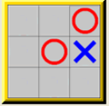
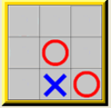
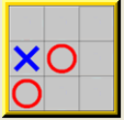
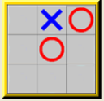
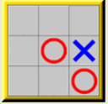
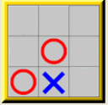
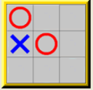
What are symmetries
Symmetric positions are
Any set of positions that are the “equivalent” for humans
But “different” for computers
Symmetric as
The left position is the representative “canonical position” of all positions shown
Symmetries depend on game rules
  e.g. In Gamesman Tic-Tac-Toe, X always moves first
  So piece flipping (second row) does not need to be considered

Slide 4
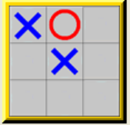

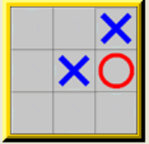
Why do we need symmetries
Computers are not very smart
Symmetries lead to huge space and time savings
Space savings – we could store only the canonical in the database
Time savings – we could solve only the canonical positions
Human solves
Computer solves

Slide 5
Common symmetries
Geometric symmetries
  Rotation Reflection
Symmetries in pieces
  Flipping Other equivalences in pieces
Other game specific stuff

Slide 6
Spinning – Finding the canonical position
Often the canonical position is the position with the smallest hash value
For Gamesman, POSITION is the hash value
So canonical position = smallest POSITION in the equivalent class
Given a POSITION, we find all its equivalent, symmetric “brothers”
This is done by simulating spinning the board around and rehashing
Then we designate board with the smallest hash value as the canonical
Thus, finding the canonical position is often referred to as “spinning”

Slide 7
How to implement symmetries
Game modules need to implement only one function
  POSITION gCanonicalPosition (POSITION p);
  Must adhere to interface
  Takes in any position
  Performs spinning
  Returns the canonical position
Freedom in implementing game specific symmetries
  e.g. Quarto!
  POSITION yanpeiGetCanonical(POSITION p);
  POSITION marioGetCanonical(POSITION position);
  POSITION (*getCanonical)(POSITION p) = &marioGetCanonical;
  void InitializeGame() {
  …
    gCanonicalPosition = getCanonical;
  …
  }
Multiple implementations

Slide 8
How to turn on Symmetries
----- Main (Pre-Solved) Menu for Quarto -----
s) (S)TART THE GAME
w) START THE GAME (W)ITHOUT SOLVING
Evaluation Options:
o) (O)bjective toggle from STANDARD to REVERSE
d) (D)ebug Module BEFORE Evaluation
g) (G)ame-specific options for Quarto
2) Toggle (2)-bit solving (currently OFF)
p) Toggle Global (P)osition solving (currently OFF)
l) Toggle (L)ow Mem solving (currently OFF)
m) Toggle Sy(M)metries (currently OFF)
h) (H)elp
q) (Q)uit

Slide 9
Examples
Symmetries implemented in
  Tic-Tac-Toe – Simple; mttt.c
  Bagh Chal – Simple; mbaghchal.c
  Quarto! – Not so simple; mquarto.c
  Others?
Add to this list!!!

Slide 10
Summary
Symmetries = positions that are “same” for humans
Needed because wasteful to solve equivalent positions
Common symmetries = geometric, pieces flipping
Implement using POSITION gCanonicalPosition(POSITION p)

