Slide 1

Symmetries Tutorial
GamesCrafters 2006
2006-11-15
Yanpei Chen

Slide 2
Symmetries Tutorial
Agenda
What are symmetries
Why are they needed
Common symmetries
How to implement symmetries
©
UC Berkeley 2006

Slide 3
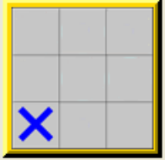
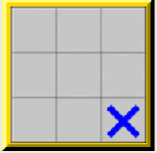
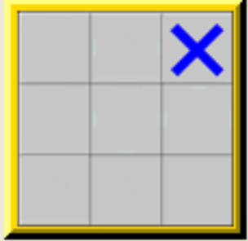
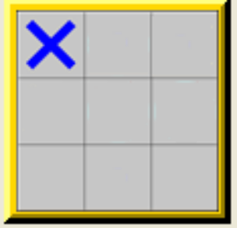
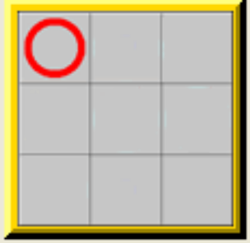
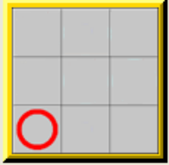
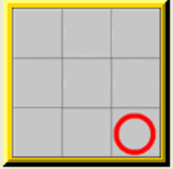
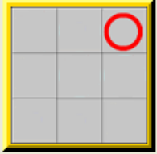
What are symmetries
Symmetric positions are
Any class of positions that are the “equivalent” for humans
But “different” for computers
Symmetric as
The position at left is the representative “canonical position” of all eight positions
Symmetries depend on game rules
©
UC Berkeley 2006

Slide 4

Why do we need symmetries
Computers are not very smart
Highly inefficient!!!
Human solves
Computer solves
Symmetries lead to huge space and time savings
Space savings – we could store only the canonical in the database
Time savings – we could solve only the canonical positions
©
UC Berkeley 2006

Slide 5
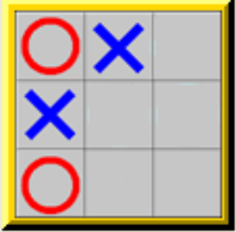
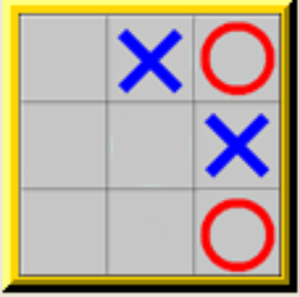
Common symmetries
Geometric symmetries
Rotation
Reflection
Symmetries in pieces
Switching
Other equivalences in pieces
Other game specific stuff
©
UC Berkeley 2006

Slide 6
Spinning – Finding the Canonical Position
Often the canonical position is the position with the smallest hash value
For Gamesman, POSITION is the hash value
So canonical position = smallest POSITION in the equivalent class
Given a POSITION, we find all its equivalent, symmetric “brothers”
This is done by simulating spinning the board around and rehashing
Then we designate board with the smallest hash value as the canonical
Thus finding the canonical position is often referred to as “spinning”
©
UC Berkeley 2006

Slide 7
How to Implement Symmetries
Game modules need to implement only one function
POSITION gCanonicalPosition (POSITION p);
Must adhere to interface
Takes in any position
Performs spinning
Returns the canonical position
Freedom in implementing game specific symmetries
e.g. Quarto!
Multiple implementations
POSITION yanpeiGetCanonical(POSITION p);
POSITION marioGetCanonical(POSITION position);
POSITION (*getCanonical)(POSITION p) = &marioGetCanonical;
void InitializeGame () {
……
gCanonicalPosition = getCanonical;
……
}
©
UC Berkeley 2006

Slide 8
How to Turn on Symmetries
----- Main (Pre-Solved) Menu for Quarto -----
s) (S)TART THE GAME
w) START THE GAME (W)ITHOUT SOLVING
Evaluation Options:
o) (O)bjective toggle from STANDARD to REVERSE
d) (D)ebug Module BEFORE Evaluation
g) (G)ame-specific options for Quarto
2) Toggle (2)-bit solving (currently OFF)
p) Toggle Global (P)osition solving (currently OFF)
l) Toggle (L)ow Mem solving (currently OFF)
m) Toggle Sy(M)metries (currently OFF)
h) (H)elp
q) (Q)uit
©
UC Berkeley 2006

Slide 9
Examples
Symmetries implemented in
Tic-Tac-Toe – Simple; mttt.c
Bagh Chal – Simple; mbaghchal.c
Quarto! – Not so simple; mquarto.c
Others?
Add to this list!!!
©
UC Berkeley 2006

Slide 10
Summary
Symmetries = positions that are the “same” to humans
Need because wasteful to solve many symmetrical positions
Common symmetries – geometric, pieces
Implement using POSITION gCanonicalPosition (POSITION p);
©
UC Berkeley 2006

