Slide 1
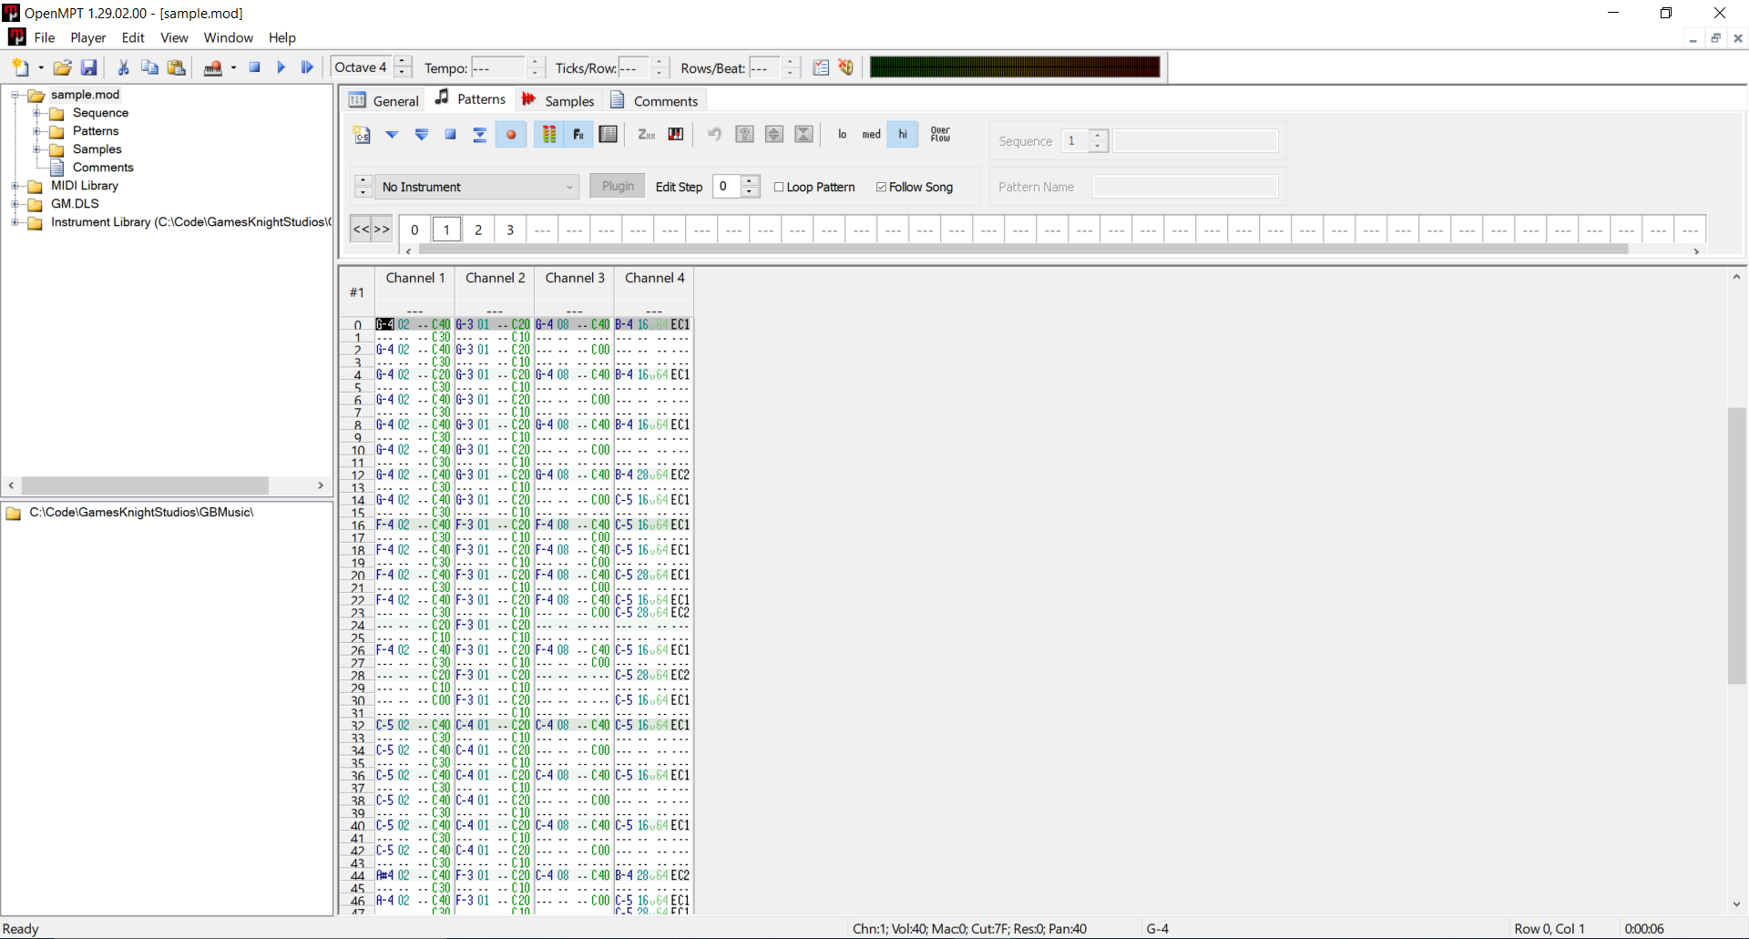
Choose instrument
Set sequence of patterns
Note name
(B-4 = B 4th octave)
Note effect
(C40 = volume to 100%)
Instrument number
Pattern notes

Slide 2
Play sequence from beginning
Stop pattern playback
Stop hanging note
Stop sequence playback
Play pattern from beginning
Play sequence from current position
Play pattern from current position

Slide 3
