Slide 1
Due to the fact that I want the game secret, I would not say the name of the game.

Slide 2
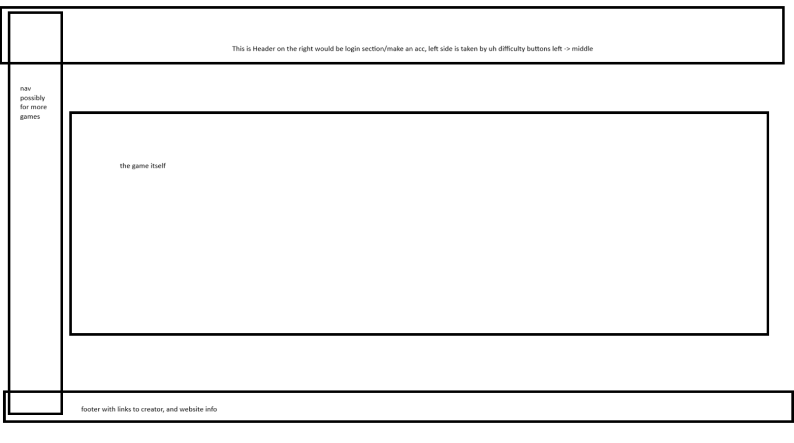
Every webpage starts with a plan, here’s mine, simple? Yes. Good? Eh I’d not say so, but plan is a plan.

Slide 3
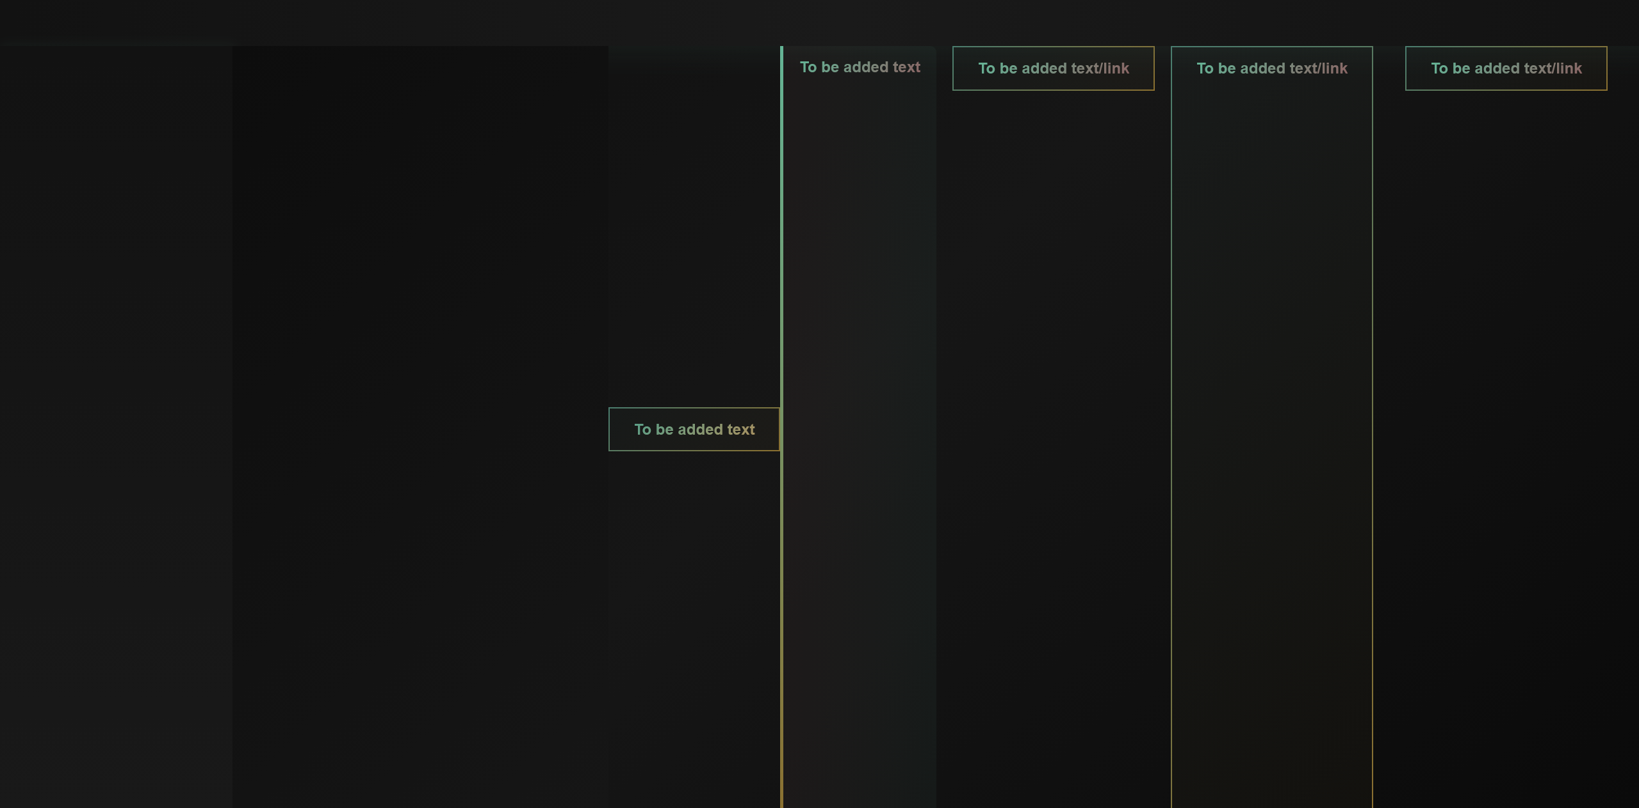
I decided to start this presentation with: template page. This page is used to make all other pages, it is basic style of the every page’s layout.
The design: is obviously, in dark, easy and soft looking colors. Oh and, to not have too much text, every page has :hover and such effects. But it’s not a video showcase so I couldn’t show them.

Slide 4
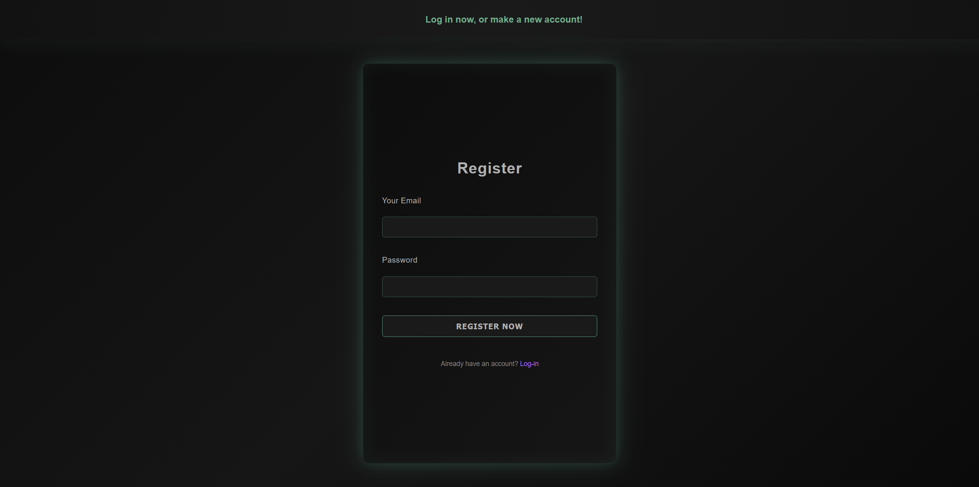
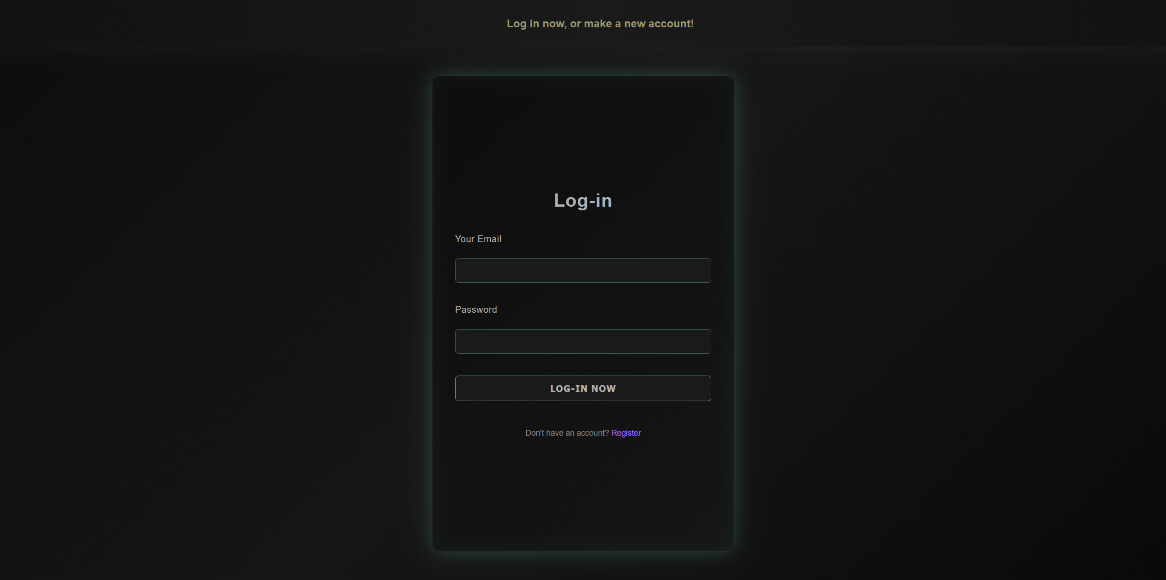
Do they look like twins to you? Yeah I think the same too. I decided to make register and log-in pages similar. Link is clickable.
In future the data (password and email) is going to be saved.

Slide 5
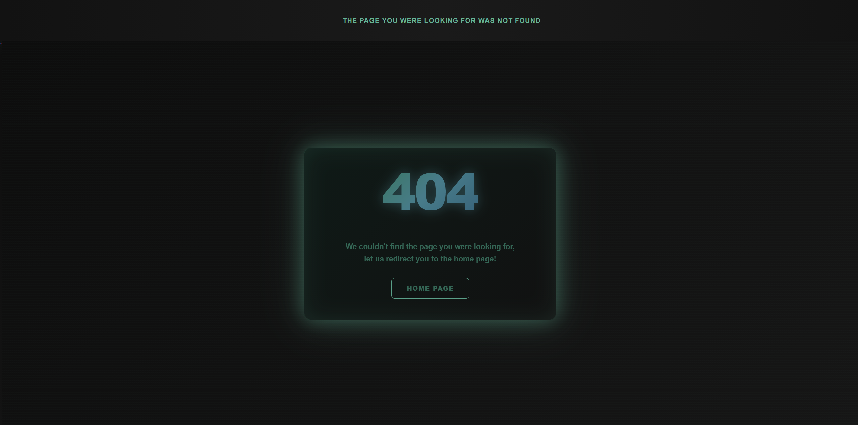
This is an error page, not much to say, I decided to make a little more special than other pages but that’s it.

Slide 6
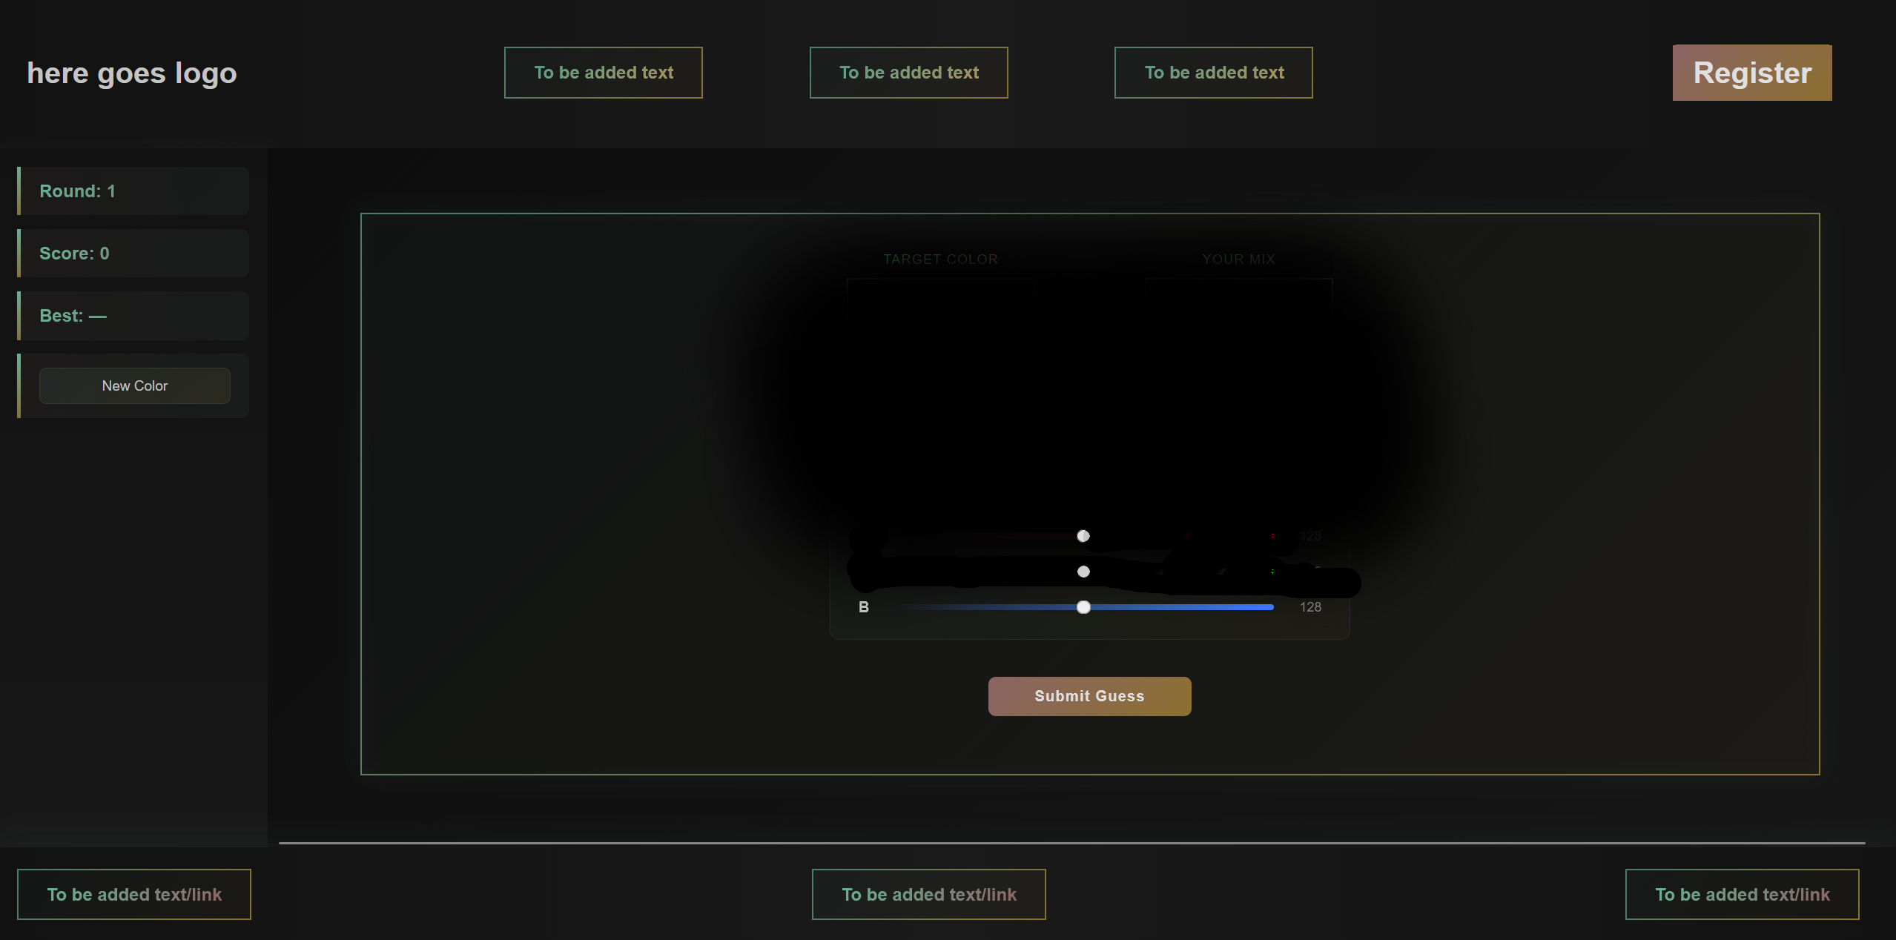
This is the main page where the game would be. It also leads towards registration/log-in. I bet, you noticed already the dark area, the reason is, I keep the game completely hidden, although, to make it more interesting I’ve left small areas that could hint you towards what is this game going to be. The idea is related to colors. Hope you win!

Slide 7
Last note from me: - This game is simple, do not expect it to be a big project.
- Everything up to the last line of code in css files is subject to change.

