Slide 1
Dimensionality reduction for biomedical classification
HAM10000 and blood-cell anomaly data
Measured pilot comparison | 21 October 2026

Slide 2
Study question and design
Can a two-dimensional representation preserve class information for held-out records?
Nine algorithms. Two parameter settings each. Three shared splits. One balanced logistic regression per embedding.
Primary ranking uses setting A only; setting B tests parameter sensitivity.

Slide 3
Two datasets and their limits
HAM10000: 10,015 8 × 8 RGB lesion records, 192 pixel features, melanoma versus other diagnoses. Split by lesion ID.
Blood-cell anomaly table: 5,880 rows, 22 selected numeric features, anomaly versus normal. Patient IDs and independent clinical provenance are unavailable.
Neither dataset supports diagnostic deployment from this pilot.

Slide 4
What the nine methods do
PCA and kernel PCA retain linear or kernel structure. SNE, t-SNE, the PCA plus t-SNE hybrid, and UMAP emphasize neighborhoods.
Metric MDS preserves Euclidean distances. PCoA decomposes cosine distances. Isomap uses graph geodesics.
All output two coordinates, then use the same classifier.

Slide 5
The comparison measures retained class information
Input features are standardized using the training records. Each algorithm reduces them to two coordinates. The same balanced logistic regression then predicts held-out labels.
AUC asks whether positives generally receive higher scores than negatives across thresholds. Accuracy evaluates one fixed threshold. Log loss penalizes confident wrong probabilities. CPU time covers the full fitted pipeline.
A visually neat map is insufficient evidence unless held-out prediction also improves.

Slide 6
Global geometry: PCA, kernel PCA, MDS, PCoA
PCA keeps directions with the most variance. It is fast, but large variance need not represent disease.
Kernel PCA uses an RBF similarity so curved patterns can become separable. Its gamma setting determines the scale of similarity.
MDS tries to preserve Euclidean distances between every pair. PCoA eigendecomposes a centered distance matrix; here cosine distance is primary. Both can devote two dimensions to variation unrelated to the label.

Slide 7
Local geometry: SNE, t-SNE, hybrid, UMAP, Isomap
SNE and t-SNE match neighbor probabilities. t-SNE's heavy tail reduces crowding; perplexity controls neighborhood scale. PCA plus t-SNE first filters the inputs to at most 30 components.
UMAP builds a fuzzy neighbor graph; its neighbor count controls how local the map is. Isomap uses graph shortest paths to estimate geodesic distances.
These maps can reveal local structure, but they may distort global distances and change when the neighborhood parameter changes.

Slide 8
How unseen test records enter each map
PCA, kernel PCA, UMAP, and Isomap transform new records directly. PCoA uses a distance-based Gower extension.
The chosen SNE, t-SNE, and MDS implementations have no native test transform. A five-neighbor weighted regressor estimates test coordinates from their training maps.
The measured ranking therefore compares complete representation pipelines, including this approximation. It does not compare only the training maps.

Slide 9
Method readings: PCA through the hybrid
PCA: blood-cell AUC 0.630, the best there. A simple linear map may suffice for these selected features; it is weakest on HAM AUC at 0.602.
Kernel PCA: 0.638 HAM, 0.624 blood. Curved RBF similarities help modestly, with kernel scale affecting the map.
SNE: 0.616 HAM, 0.581 blood. Local-neighbor matching does not consistently retain the label signal.
t-SNE: 0.638 HAM, 0.622 blood. Better than SNE on both, but its approximate test transform limits interpretation.
PCA plus t-SNE: 0.632 HAM, 0.616 blood. The preprocessing step shows no gain over t-SNE in this pilot.

Slide 10
Method readings: UMAP through Isomap
UMAP: 0.645 HAM, 0.600 blood. The neighbor graph ranks lesions well, but costs about 2.24 CPU seconds per HAM run.
MDS: 0.620 HAM, 0.562 blood. Preserving global Euclidean distances gives the weakest blood-cell AUC.
PCoA: 0.633 HAM, 0.616 blood. Cosine distances give middle-ranking performance; a different distance changes the result.
Isomap: 0.649 HAM, 0.582 blood. Graph geodesics lead HAM AUC but transfer poorly to the blood-cell table.
The mechanisms above are interpretations of measured associations, not proven causes.

Slide 11
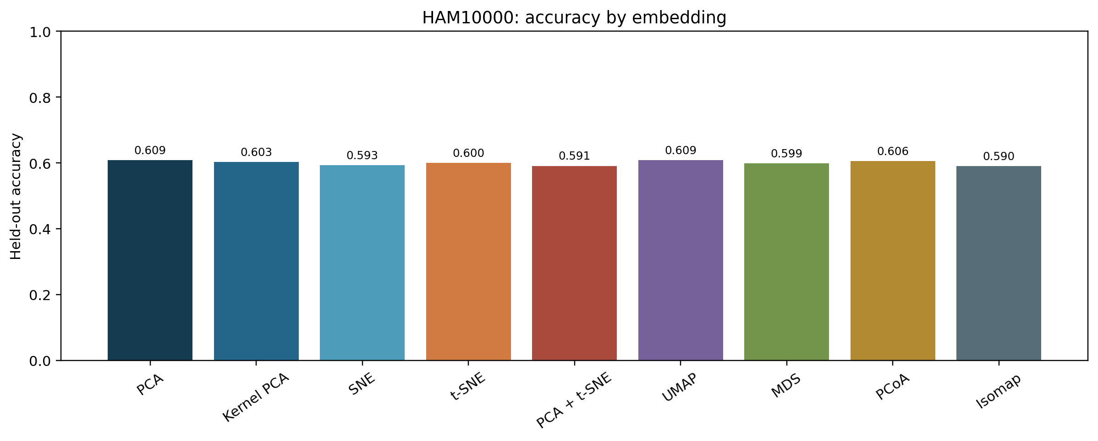
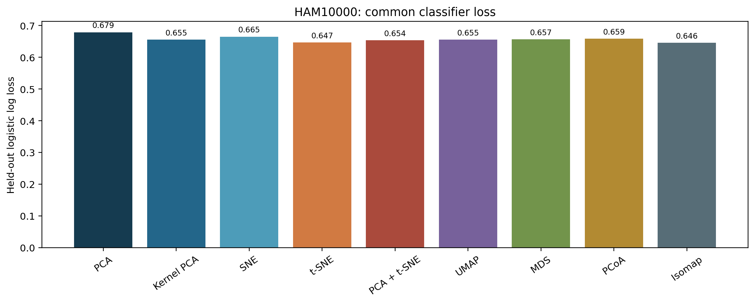
HAM10000: accuracy and loss
Highest mean AUC: Isomap, 0.649. The two charts show why accuracy and probability loss should be read together.

Slide 12
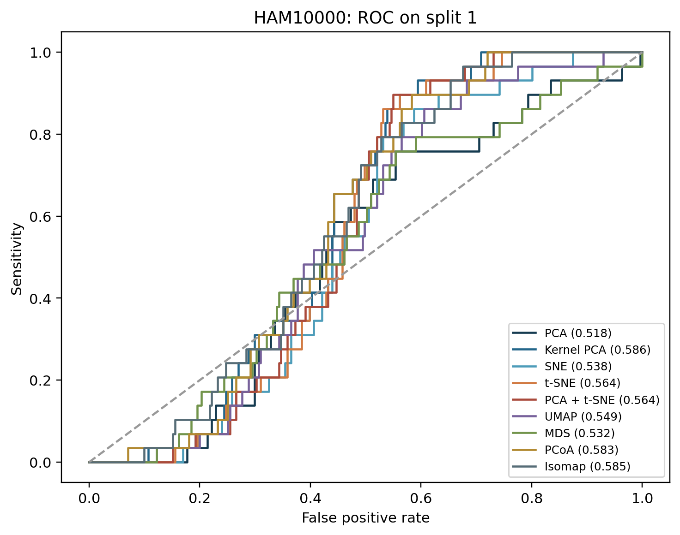
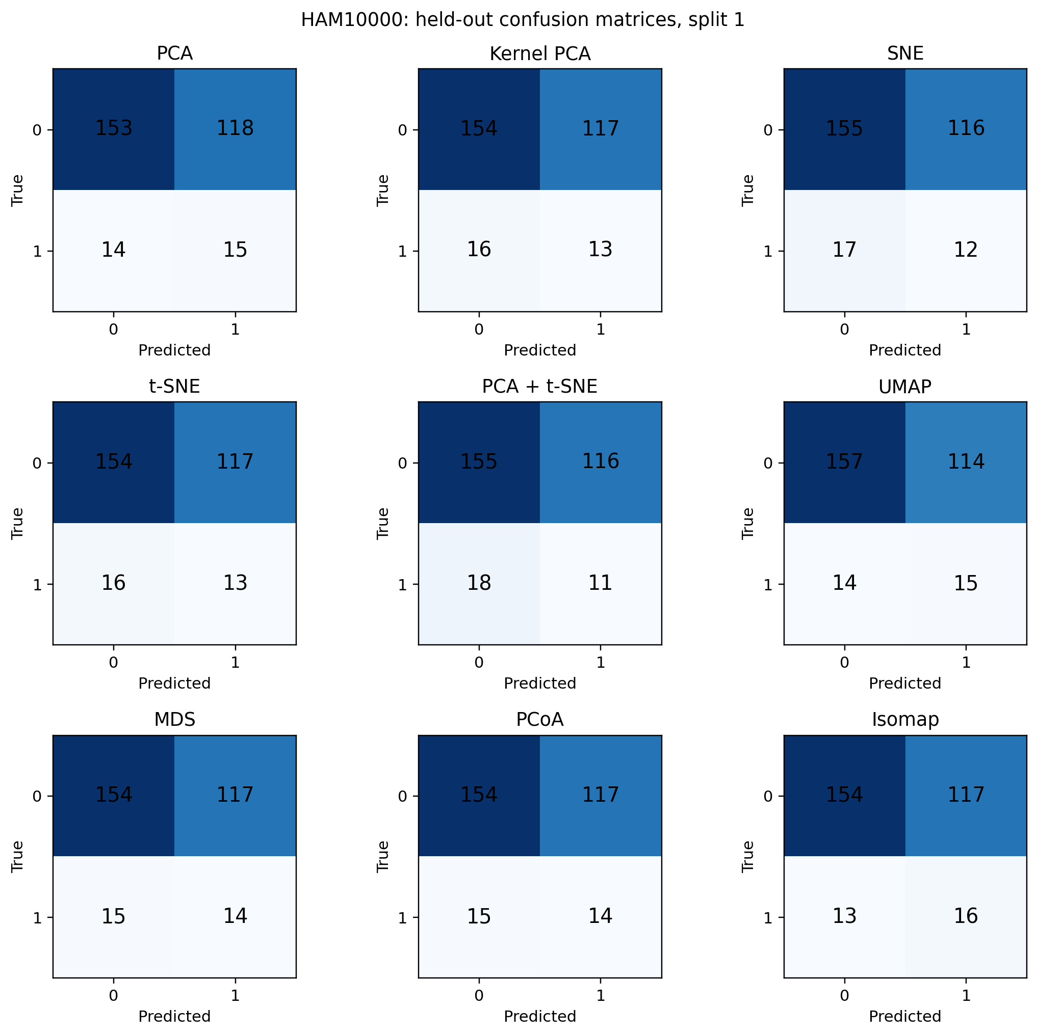
HAM10000: ROC and confusion matrices

Slide 13
HAM10000: better ranking, weak positive precision
Isomap leads mean ROC AUC at 0.649, versus 0.602 for PCA. A neighbor graph may retain class-related structure that the largest-variance PCA axes miss. The experiment does not establish that mechanism.
PCA has slightly higher accuracy, 0.609 versus 0.590. AUC measures ranking across thresholds, while accuracy uses the prespecified 0.5 threshold.
Isomap precision is 0.134: most positive calls are false positives. The 8 × 8 pixels and low melanoma prevalence limit clinical meaning.

Slide 14
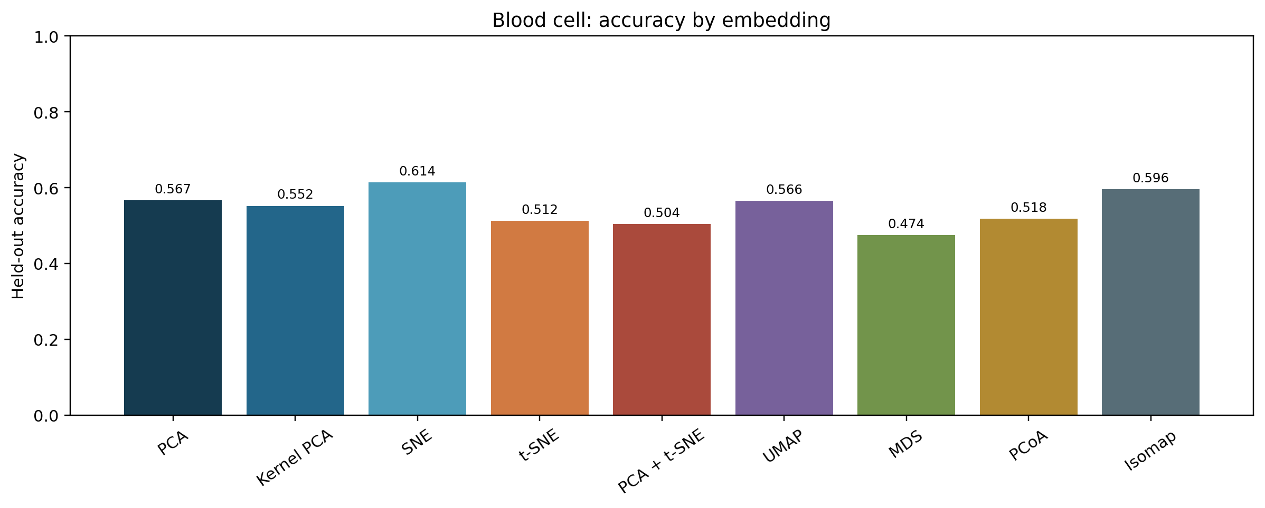
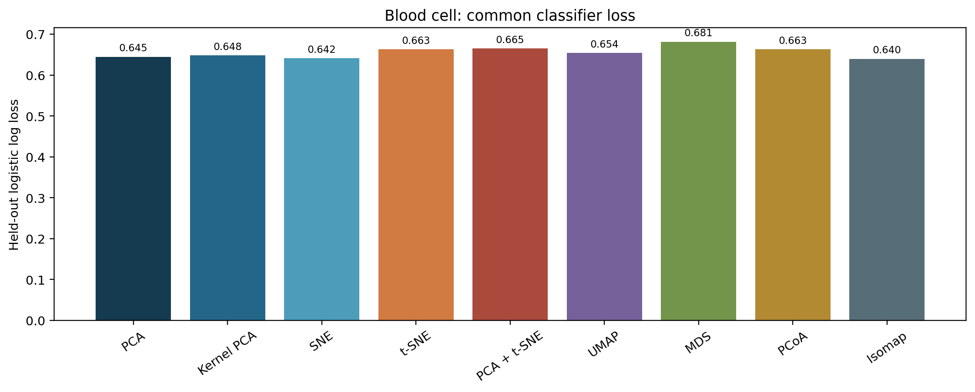
Blood cell: accuracy and loss
Highest mean AUC: PCA, 0.630. The two charts show why accuracy and probability loss should be read together.

Slide 15
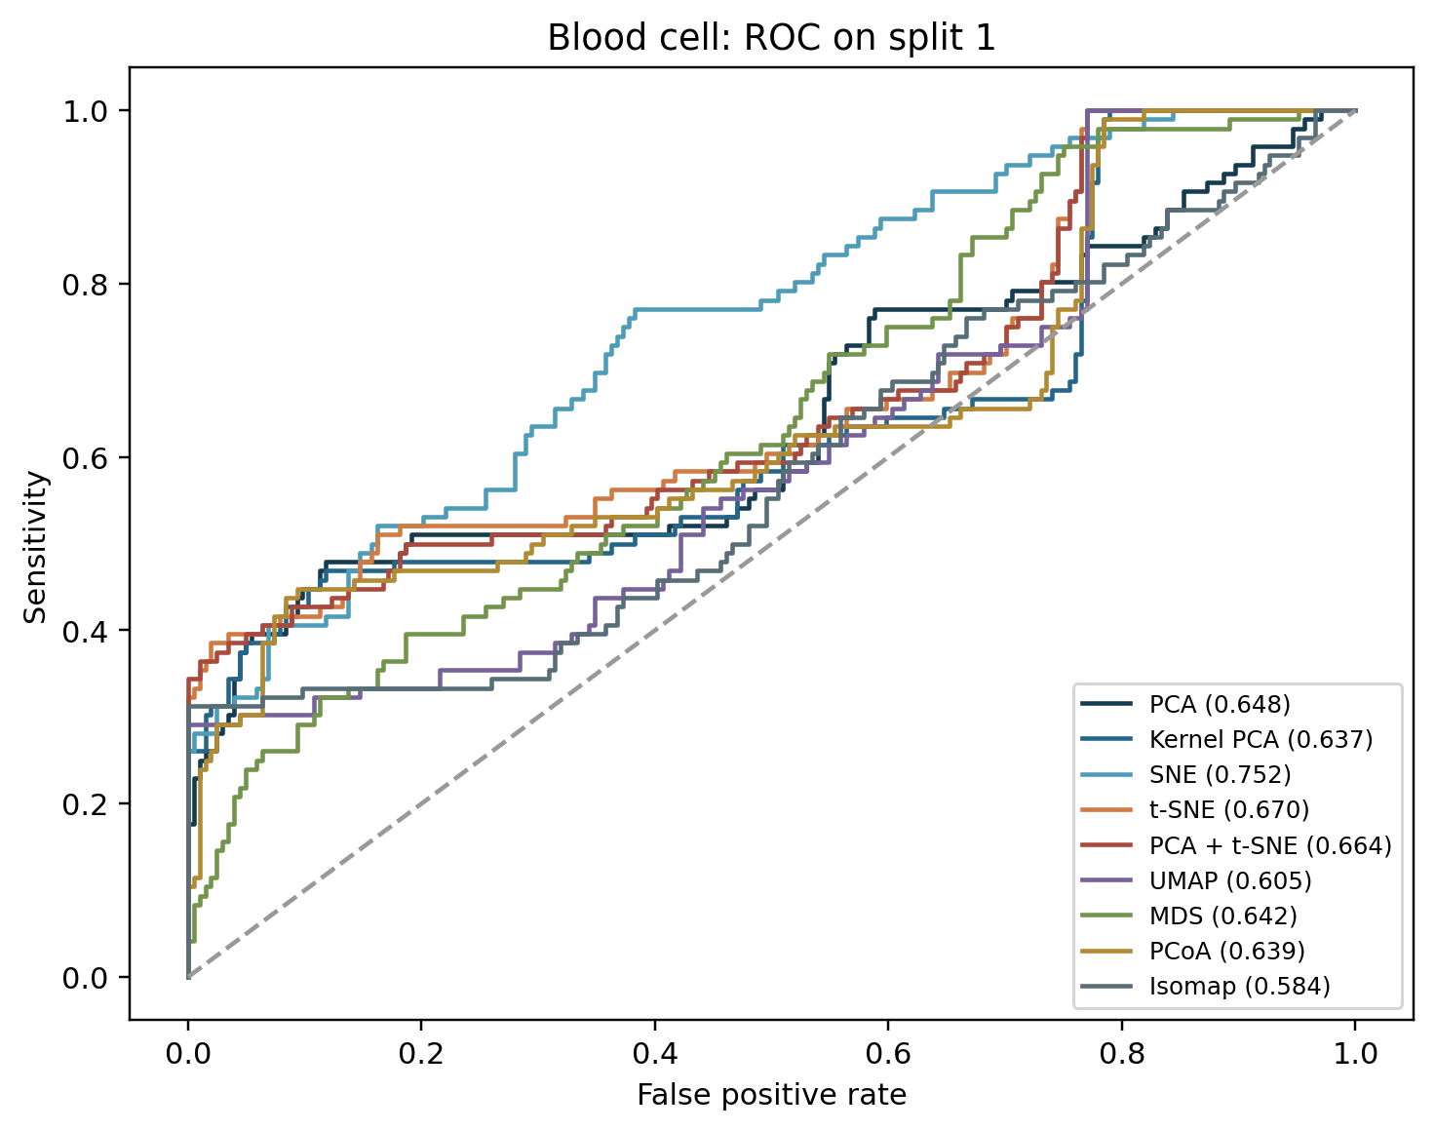
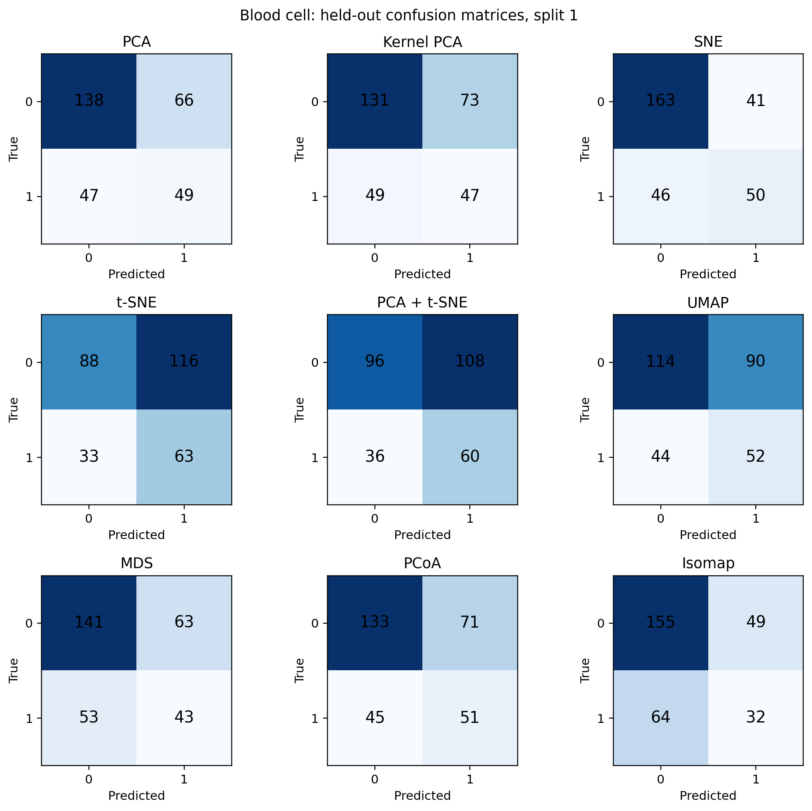
Blood cell: ROC and confusion matrices

Slide 16
Blood cells: fast PCA wins on ranking
PCA leads mean ROC AUC at 0.630 and takes about 0.02 CPU seconds. Broad linear variation may capture useful signal in the 22 selected features.
SNE reaches 0.614 accuracy but only 0.581 AUC. Its threshold decisions look better than its overall ranking; accuracy alone would give a misleading winner.
MDS has 0.562 AUC and takes about 1.06 CPU seconds. Keeping global distances in two dimensions did not retain much class signal here. Patient-level generalization remains untested.

Slide 17
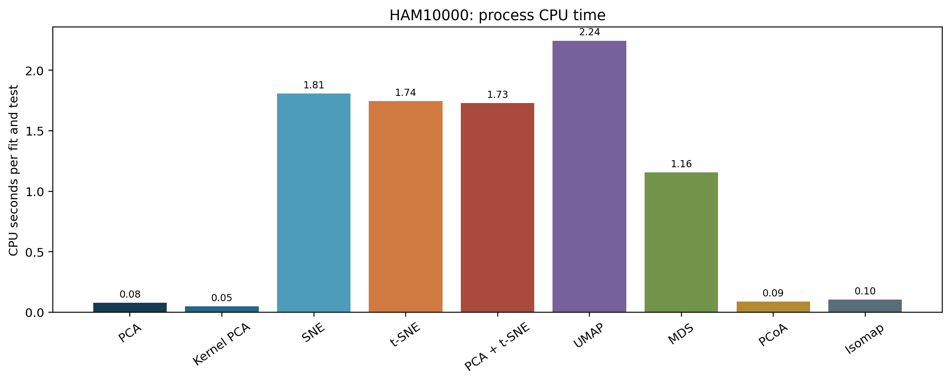
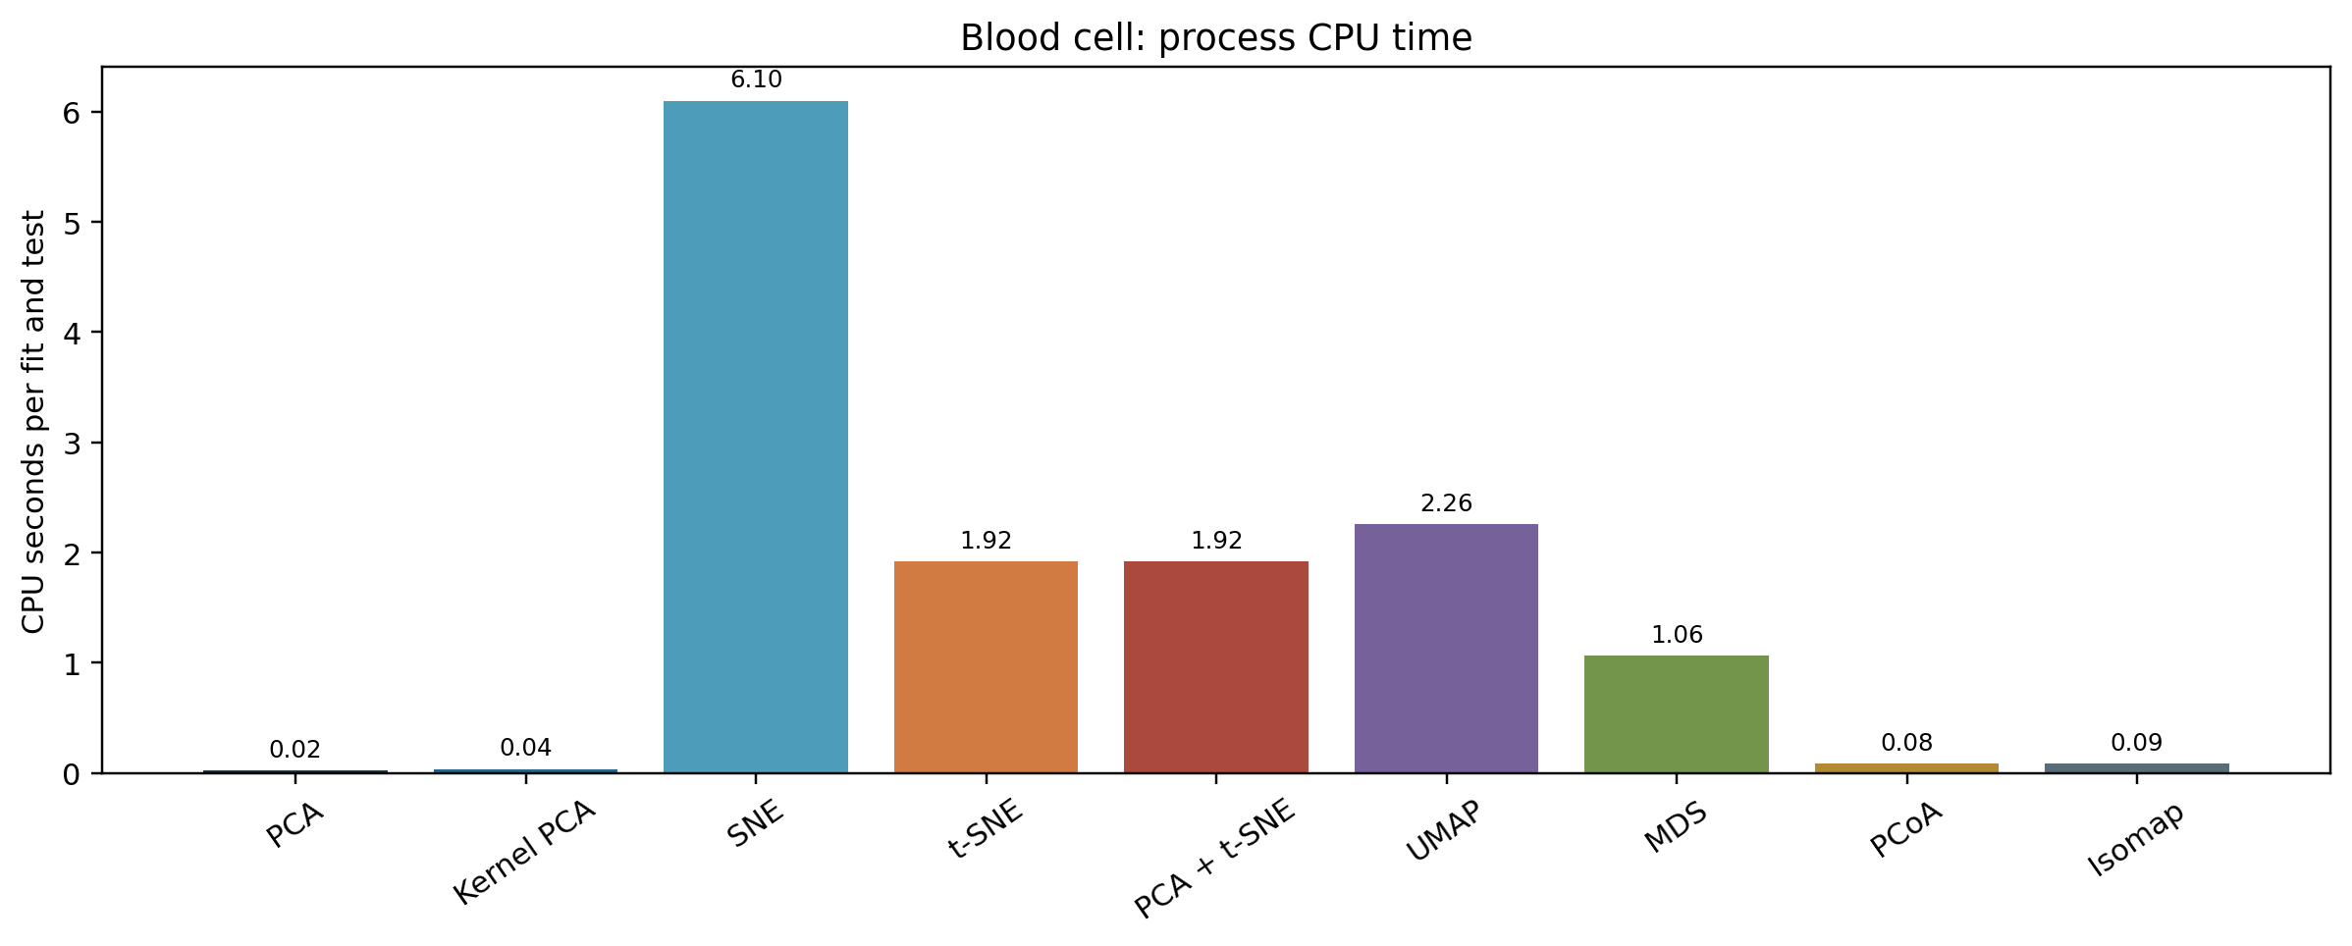
CPU time has a steep method cost
PCA and kernel PCA are fastest in this sample-size range. UMAP, SNE, and t-SNE require substantially more CPU time. UMAP's first compilation is measured separately.

Slide 18
CPU cost changes the practical choice
On blood cells, PCA needs about 0.02 CPU seconds and SNE about 6.10 seconds per run. SNE does not gain AUC in exchange for that extra compute (0.581 versus 0.630).
On HAM10000, Isomap leads AUC at about 0.10 CPU seconds; UMAP is close in AUC (0.645 versus 0.649) but takes about 2.24 seconds.
These are process CPU times for 750 training and 300 test records. UMAP's one-time compilation warmup is excluded and recorded separately; scaling can change the order.

Slide 19
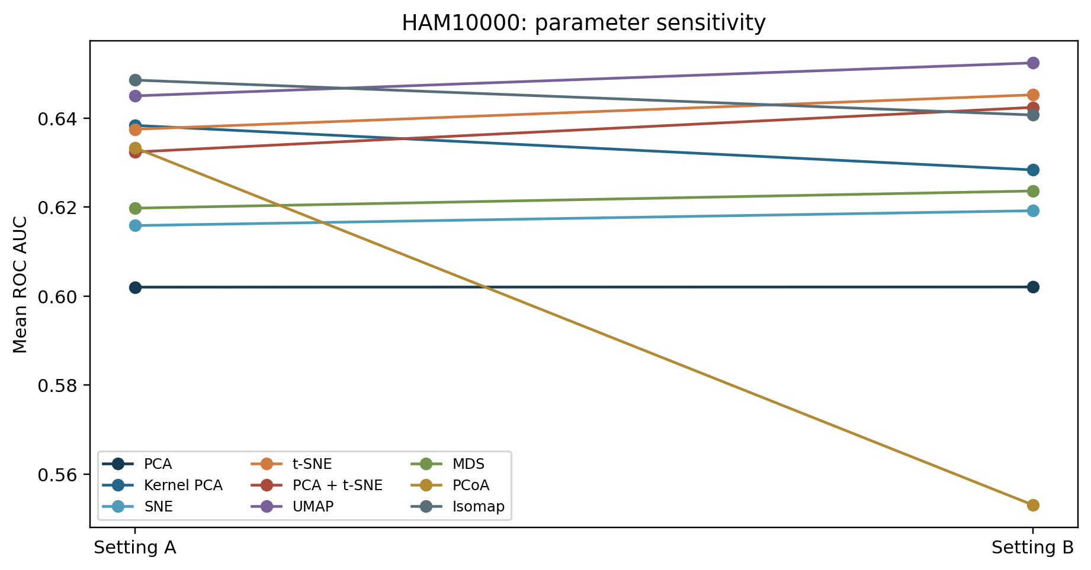
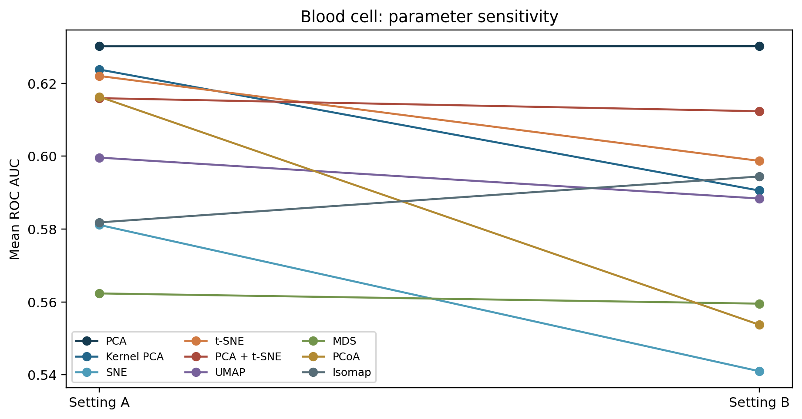
Parameter settings change the ranking
A second setting changes neighborhood size or perplexity. Selecting a winner on the test set would inflate the reported result.

Slide 20
What the parameter comparison can and cannot say
Setting A was declared primary before reading test results. Setting B checks whether whitening, kernel scale, perplexity, neighbor count, MDS iterations, or PCoA distance changes the result.
Large A-to-B shifts show tuning sensitivity, especially for methods that define neighborhoods. They do not justify choosing the better test-set setting after the fact.
A stronger study would tune parameters inside each training fold and then evaluate once on an untouched outer test fold.

Slide 21
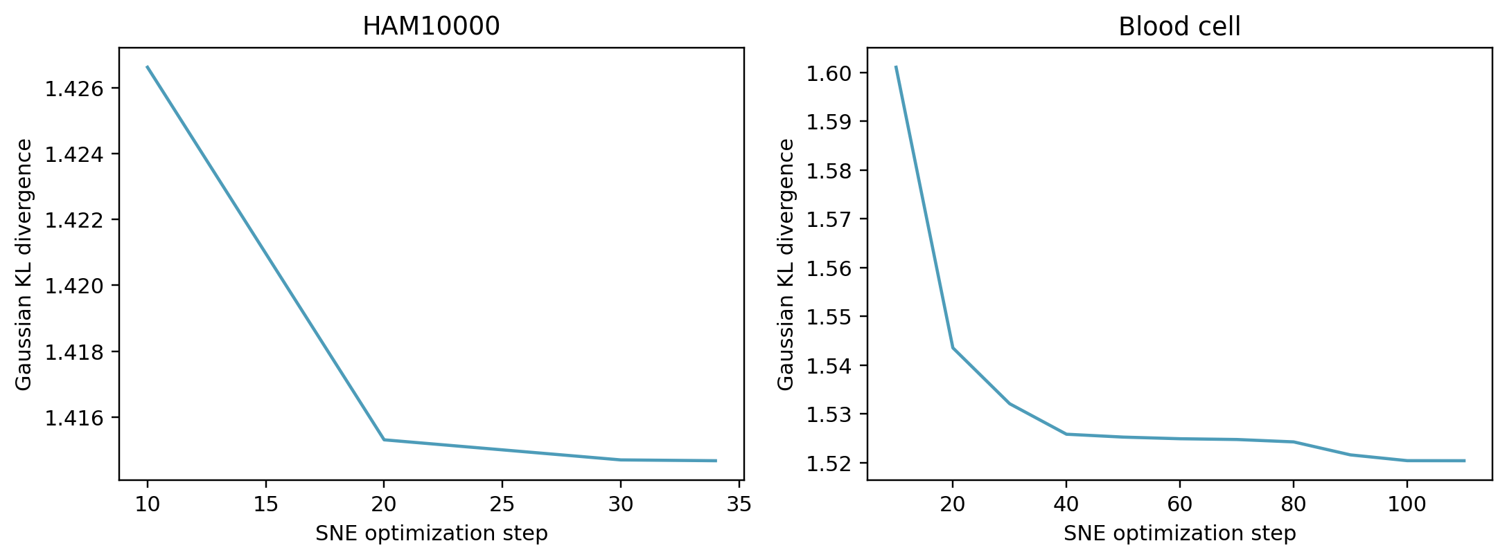
Gaussian SNE optimization loss
The plotted KL objective tracks Gaussian SNE fitting. Native PCA, t-SNE, and UMAP objectives have different meanings. The earlier classifier log-loss charts are comparable across methods.

Slide 22
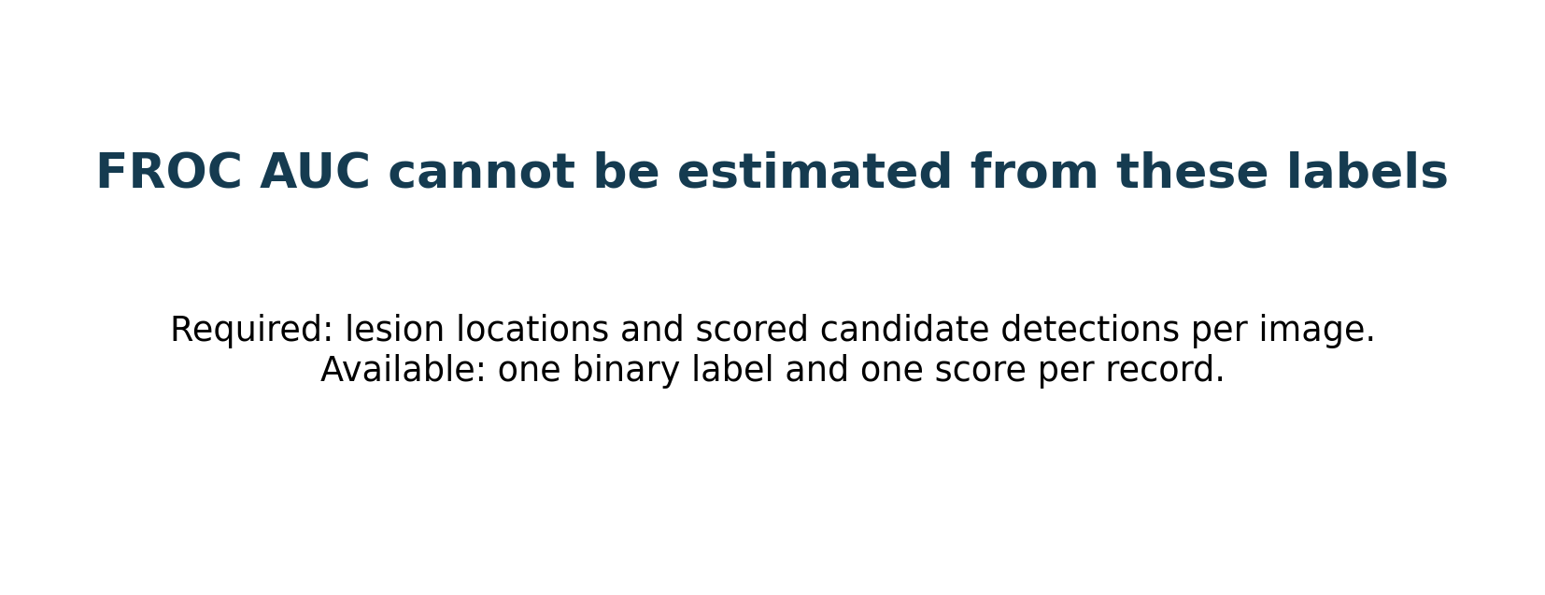
FROC AUC is not available
ROC AUC is reported. A valid FROC needs scored candidate lesion locations and false positives per image. These tables have one label and one score per record.

Slide 23
Statistical tests are exploratory
Repeated-measures ANOVA of AUC: F(8,40)=0.673, p=0.712. Descriptive MANOVA method term: Wilks' lambda=0.840, p=0.945.
Paired t, Wilcoxon, and McNemar z comparisons are in the repository. Three overlapping splits have low power. MANOVA's independence assumption is violated. Read all p values as diagnostics.

Slide 24
What counts as good or bad evidence here
A good result would combine high held-out AUC with useful sensitivity and precision, low log loss, stable parameters, and an acceptable CPU cost. None of these pilot AUCs exceeds 0.65.
A method can look good on one metric and weak on another: SNE has the highest blood-cell accuracy but lower AUC than PCA; Isomap leads HAM AUC but its positive precision is only 0.134.
Three overlapping splits do not provide a reliable superiority claim. The statistical tests and plots describe this experiment, not clinical readiness.

Slide 25
Interpretation and next steps
Performance changes with split and parameter choice. The 8 × 8 lesion images limit clinical meaning. The blood-cell table lacks patient-level validation.
For a journal study: use original or validated features, external cohorts, nested tuning, uncertainty intervals, and lesion locations if FROC is required.
Sources and exact numbers: AML_research_report.docx and results/primary_summary.csv

