Slide 1
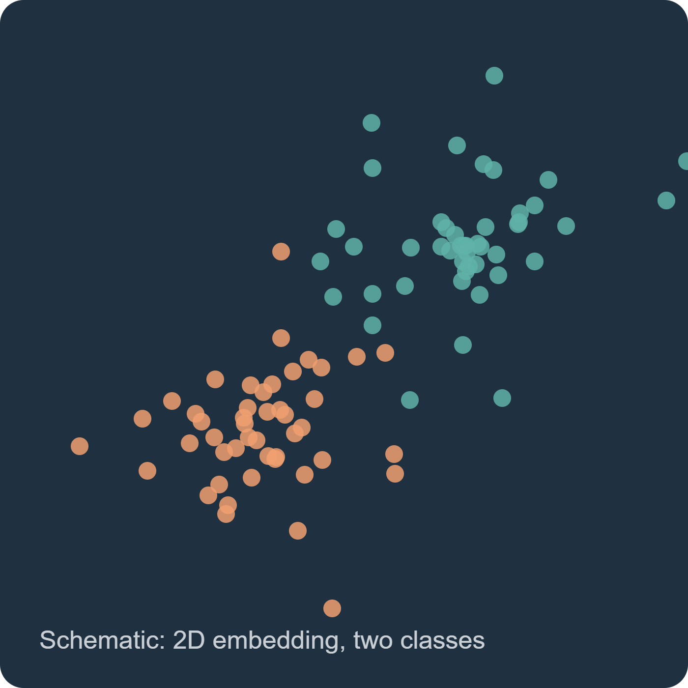
Three-part study on two biomedical datasets
COMPARING CLASSIFICATION METHODS
2D embeddings · Metaheuristics · RLWOA-SOFL

Slide 2
Three parts, one pair of datasets
PART I
PART II
PART III
2D representation
Feature selection
Paper adaptation
PCA, kernel PCA, SNE, t-SNE, UMAP, MDS, PCoA, Isomap, LLE, and hybrids.
GA, PSO, DE, and two hybrids select original variables for logistic regression.
RLWOA-style feature search and online fuzzy prototypes on both datasets.
Question: how much class signal survives in two coordinates?
Question: does a smaller mask justify its search cost?
Question: do the paper’s ideas transfer to these endpoints?
HAM10000: melanoma versus other lesions, grouped by lesion ID. Blood cells: anomaly versus normal, stratified rows.
The three experiments have distinct feature representations and model comparisons.

Slide 3
Study question and design
Can a two-dimensional representation preserve class information for held-out records?
Nine algorithms. Two parameter settings each. Three shared splits. One balanced logistic regression per embedding.
Primary ranking uses setting A only; setting B tests parameter sensitivity.

Slide 4
Does a 2D embedding keep what matters?
Compare
Test
Report
PCA, RBF kernel PCA, Gaussian SNE, t-SNE, PCA + t-SNE, UMAP, metric MDS, PCoA and Isomap.
A fixed, class-balanced logistic regression on each 2D embedding for a binary decision.
Predictive performance, parameter sensitivity and process CPU time.

Slide 5
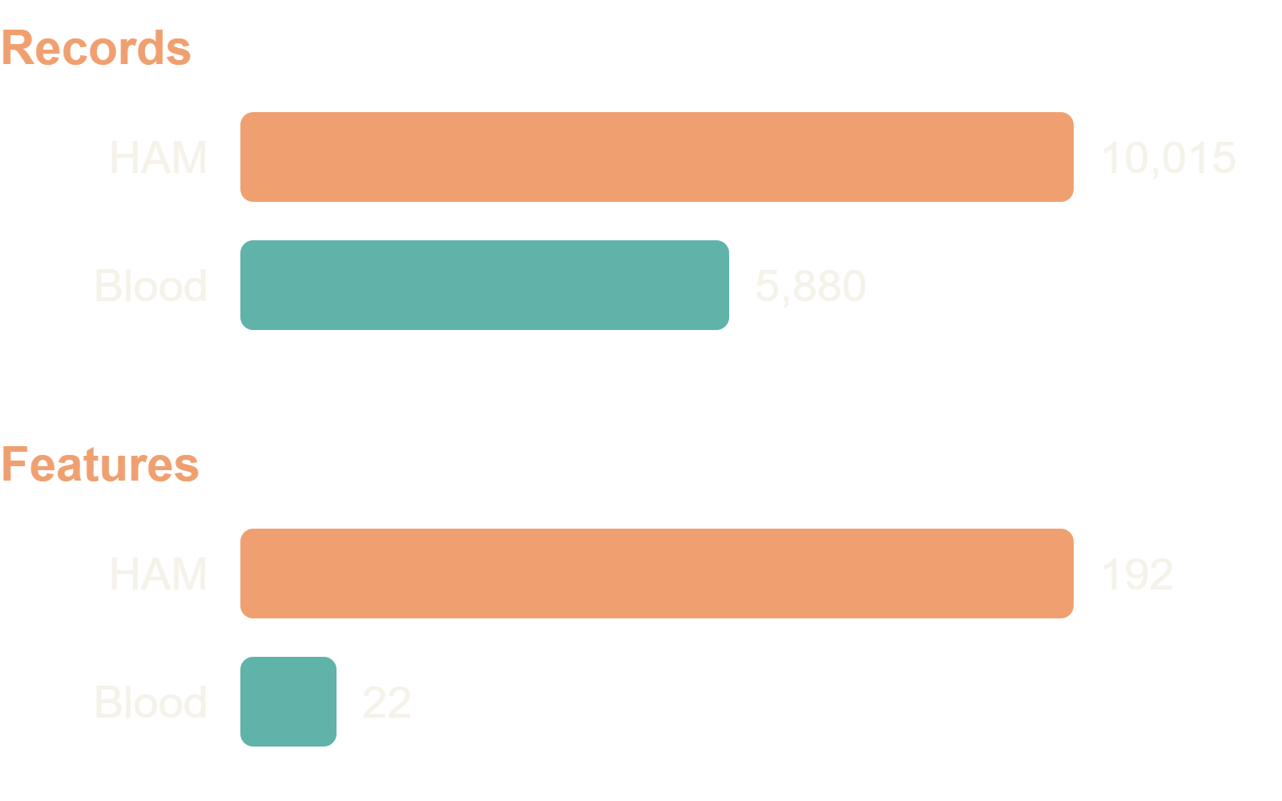
Two public Kaggle tables
HAM10000 lesions
8 × 8 RGB pixels. Melanoma versus all other diagnoses. Split grouped by lesion_id.
Blood cell records
Morphology, color and blood-count variables. Endpoint: anomaly_label.

Slide 6
Two datasets and their limits
HAM10000: 10,015 8 × 8 RGB lesion records, 192 pixel features, melanoma versus other diagnoses. Split by lesion ID.
Blood-cell anomaly table: 5,880 rows, 22 selected numeric features, anomaly versus normal. Patient IDs and independent clinical provenance are unavailable.
Neither dataset supports diagnostic deployment from this pilot.

Slide 7
What the nine methods do
PCA and kernel PCA retain linear or kernel structure. SNE, t-SNE, the PCA plus t-SNE hybrid, and UMAP emphasize neighborhoods.
Metric MDS preserves Euclidean distances. PCoA decomposes cosine distances. Isomap uses graph geodesics.
All output two coordinates, then use the same classifier.

Slide 8
The comparison measures retained class information
Input features are standardized using the training records. Each algorithm reduces them to two coordinates. The same balanced logistic regression then predicts held-out labels.
AUC asks whether positives generally receive higher scores than negatives across thresholds. Accuracy evaluates one fixed threshold. Log loss penalizes confident wrong probabilities. CPU time covers the full fitted pipeline.
A visually neat map is insufficient evidence unless held-out prediction also improves.

Slide 9
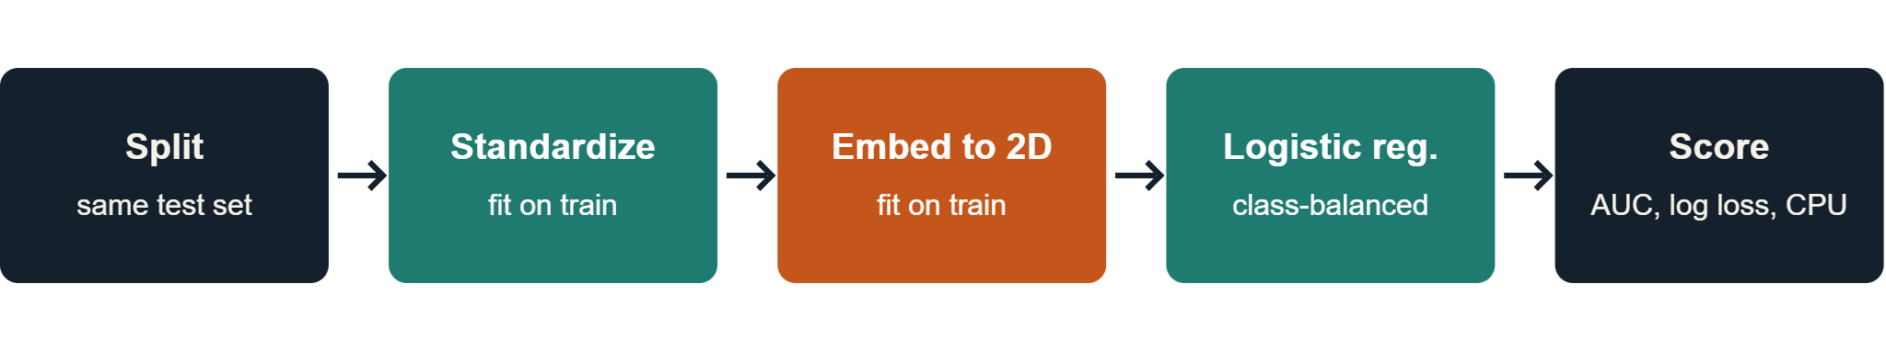
Leak-free evaluation protocol
Same test records for every method per dataset and seed. Setting A is the primary comparison; setting B is a sensitivity check, never picked on the test set.

Slide 10
The prediction model used in every run
1 Split records: HAM10000 by lesion ID; blood cells by stratified rows. Each seed uses 750 training and 300 held-out records.
2 Fit StandardScaler on training features only. Fit an unsupervised 2D embedding on those standardized records; map held-out records into the same coordinates.
3 Fit LogisticRegression(class_weight='balanced', max_iter=1000, random_state=100+seed) on the training coordinates. predict_proba gives the positive-class score; a fixed 0.5 cutoff gives class predictions.
The embedding is a feature extractor. Logistic regression is the classifier; its settings are identical across methods.

Slide 11
What the fixed classifier lets us compare
The same linear decision rule in two coordinates makes changes in held-out ROC AUC, log loss, and confusion counts reflect the complete representation pipeline. Class weighting increases the influence of the minority class during fitting.
A high AUC means better ranking across thresholds; it does not imply a useful 0.5 cutoff or calibrated probabilities. Accuracy may favor the majority class. Read sensitivity and precision together when positives are rare.
SNE, t-SNE, and MDS use a five-neighbor weighted approximation for unseen points. Their scores include the quality of that approximation. These are small pilot samples, not validated diagnostic models.

Slide 12
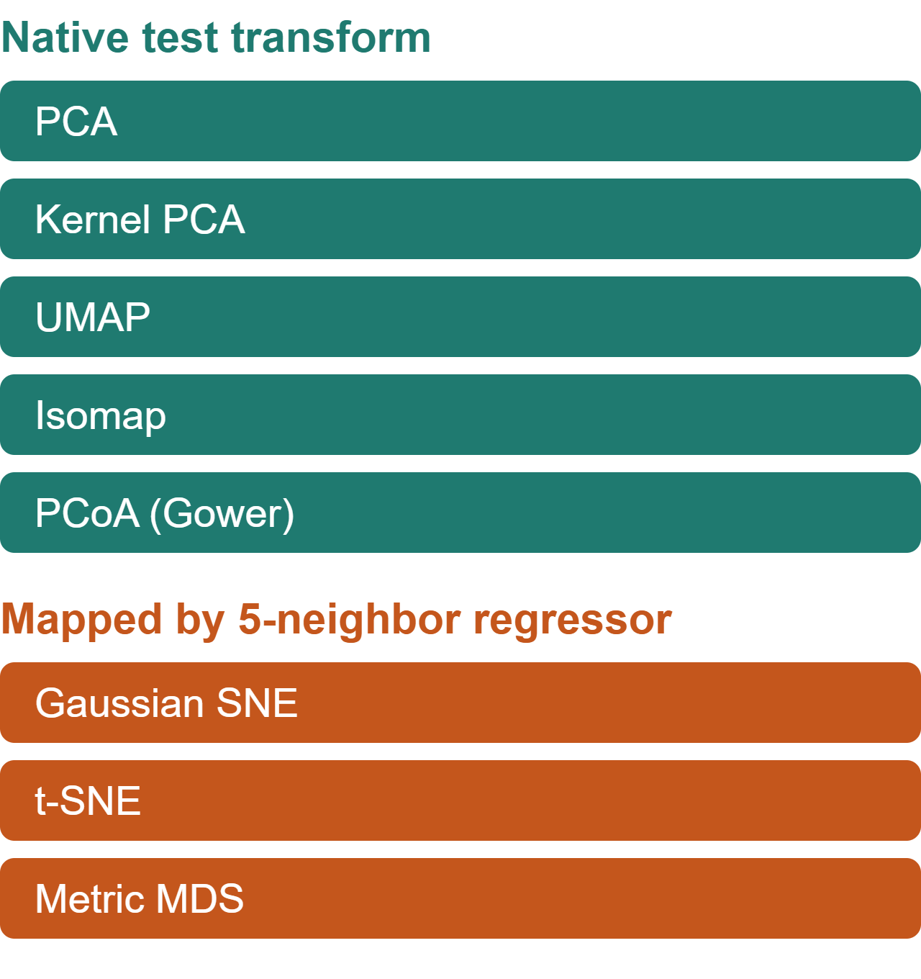
Two settings per method
Method | Setting A | Setting B
PCA | whiten false | whiten true
Kernel PCA | gamma 0.5 / f | gamma 2 / f
SNE, t-SNE | perplexity 15 | perplexity 30
UMAP | 15 neighbors | 30 neighbors
Metric MDS | 80 iterations | 150 iterations
PCoA | cosine | Manhattan
Isomap | 10 neighbors | 25 neighbors

Slide 13
Global geometry: PCA, kernel PCA, MDS, PCoA
PCA keeps directions with the most variance. It is fast, but large variance need not represent disease.
Kernel PCA uses an RBF similarity so curved patterns can become separable. Its gamma setting determines the scale of similarity.
MDS tries to preserve Euclidean distances between every pair. PCoA eigendecomposes a centered distance matrix; here cosine distance is primary. Both can devote two dimensions to variation unrelated to the label.

Slide 14
Local geometry: SNE, t-SNE, hybrid, UMAP, Isomap
SNE and t-SNE match neighbor probabilities. t-SNE's heavy tail reduces crowding; perplexity controls neighborhood scale. PCA plus t-SNE first filters the inputs to at most 30 components.
UMAP builds a fuzzy neighbor graph; its neighbor count controls how local the map is. Isomap uses graph shortest paths to estimate geodesic distances.
These maps can reveal local structure, but they may distort global distances and change when the neighborhood parameter changes.

Slide 15
How unseen test records enter each map
PCA, kernel PCA, UMAP, and Isomap transform new records directly. PCoA uses a distance-based Gower extension.
The chosen SNE, t-SNE, and MDS implementations have no native test transform. A five-neighbor weighted regressor estimates test coordinates from their training maps.
The measured ranking therefore compares complete representation pipelines, including this approximation. It does not compare only the training maps.

Slide 16
Read the results with care
No native transform
Low power
No FROC
SNE, t-SNE and MDS map test samples through a 5-neighbor regressor. That approximation is part of the pipeline.
Three repeated splits share training data. Tests are exploratory, not significance claims.
One label and score per record give an ROC curve, not a free-response ROC.

Slide 17
Method readings: PCA through the hybrid
PCA: blood-cell AUC 0.630, the best there. A simple linear map may suffice for these selected features; it is weakest on HAM AUC at 0.602.
Kernel PCA: 0.638 HAM, 0.624 blood. Curved RBF similarities help modestly, with kernel scale affecting the map.
SNE: 0.616 HAM, 0.581 blood. Local-neighbor matching does not consistently retain the label signal.
t-SNE: 0.638 HAM, 0.622 blood. Better than SNE on both, but its approximate test transform limits interpretation.
PCA plus t-SNE: 0.632 HAM, 0.616 blood. The preprocessing step shows no gain over t-SNE in this pilot.

Slide 18
Method readings: UMAP through Isomap
UMAP: 0.645 HAM, 0.600 blood. The neighbor graph ranks lesions well, but costs about 2.24 CPU seconds per HAM run.
MDS: 0.620 HAM, 0.562 blood. Preserving global Euclidean distances gives the weakest blood-cell AUC.
PCoA: 0.633 HAM, 0.616 blood. Cosine distances give middle-ranking performance; a different distance changes the result.
Isomap: 0.649 HAM, 0.582 blood. Graph geodesics lead HAM AUC but transfer poorly to the blood-cell table.
The mechanisms above are interpretations of measured associations, not proven causes.

Slide 19
Findings and reproduction
Results
Reproduce
Scope
Results figure gallery added on the following slides (accuracy, ROC, CPU time, loss and sensitivity).
python data/download_data.py, then src/benchmark.py --seeds 3 --train-n 750 --test-n 300, then src/analyze.py.
Methodological demonstration, not a diagnostic claim. Cite source datasets separately.

Slide 20
Evaluation figures — HAM10000
Skin-lesion binary classification • original plot files linked below
PREDICTIVE PERFORMANCE
DISCRIMINATION
PROBABILITIES
Accuracy
ROC curves
Log loss
Compare predictive correctness across 2D embeddings.
Compare discrimination across decision thresholds.
Compare probabilistic predictions and calibration sensitivity.
HAM10000_accuracy.png
HAM10000_roc.png
HAM10000_loss.png
COMPUTATIONAL COST
SENSITIVITY
ERROR DISTRIBUTION
CPU time
Parameters
Confusion matrices
Compare processor usage for the pipelines.
Inspect sensitivity between setting A and B.
Inspect classification outcomes by label.
HAM10000_cpu.png
HAM10000_parameters.png
HAM10000_confusion.png
SOURCE / github.com/Gamila-Elfayoumi/comparing-classification-methods

Slide 21
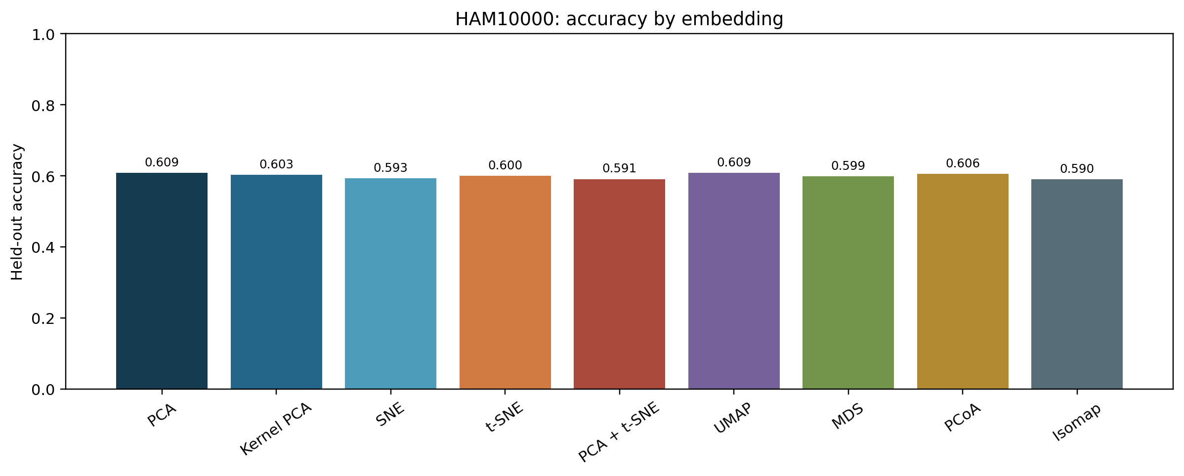
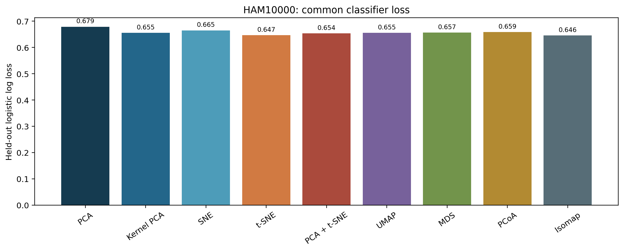
HAM10000: accuracy and loss
Highest mean AUC: Isomap, 0.649. The two charts show why accuracy and probability loss should be read together.

Slide 22
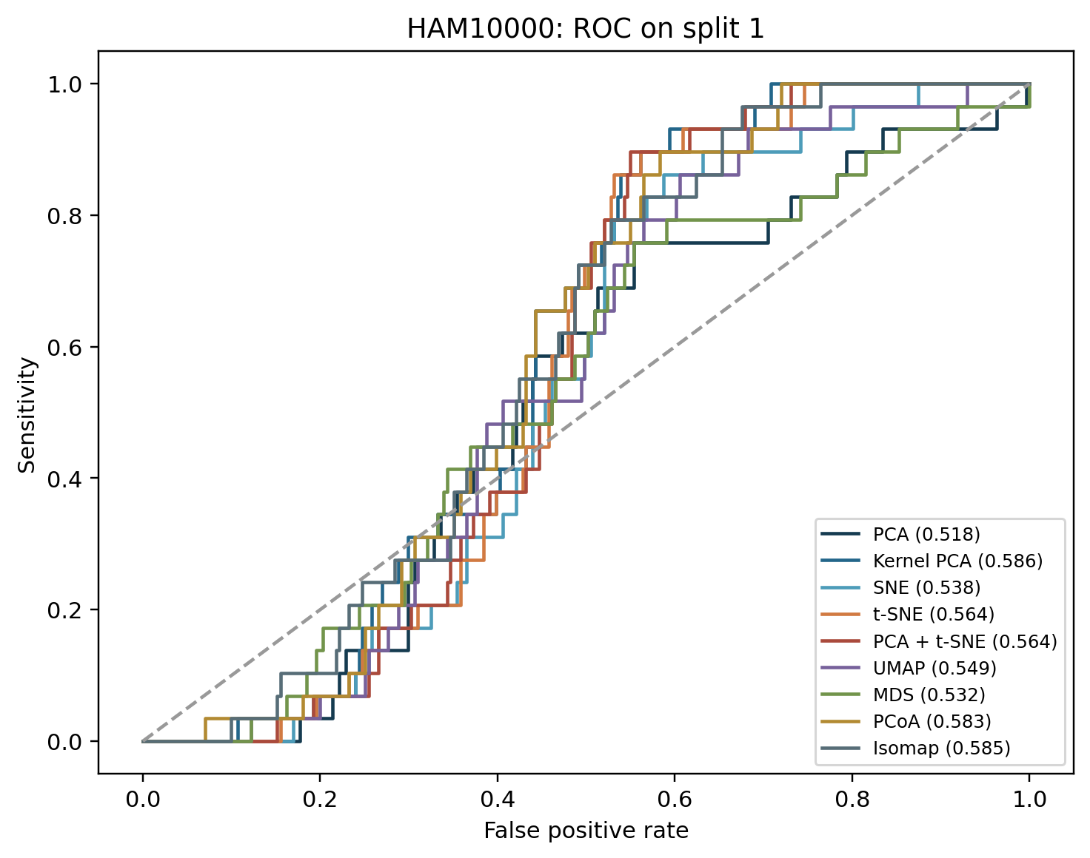
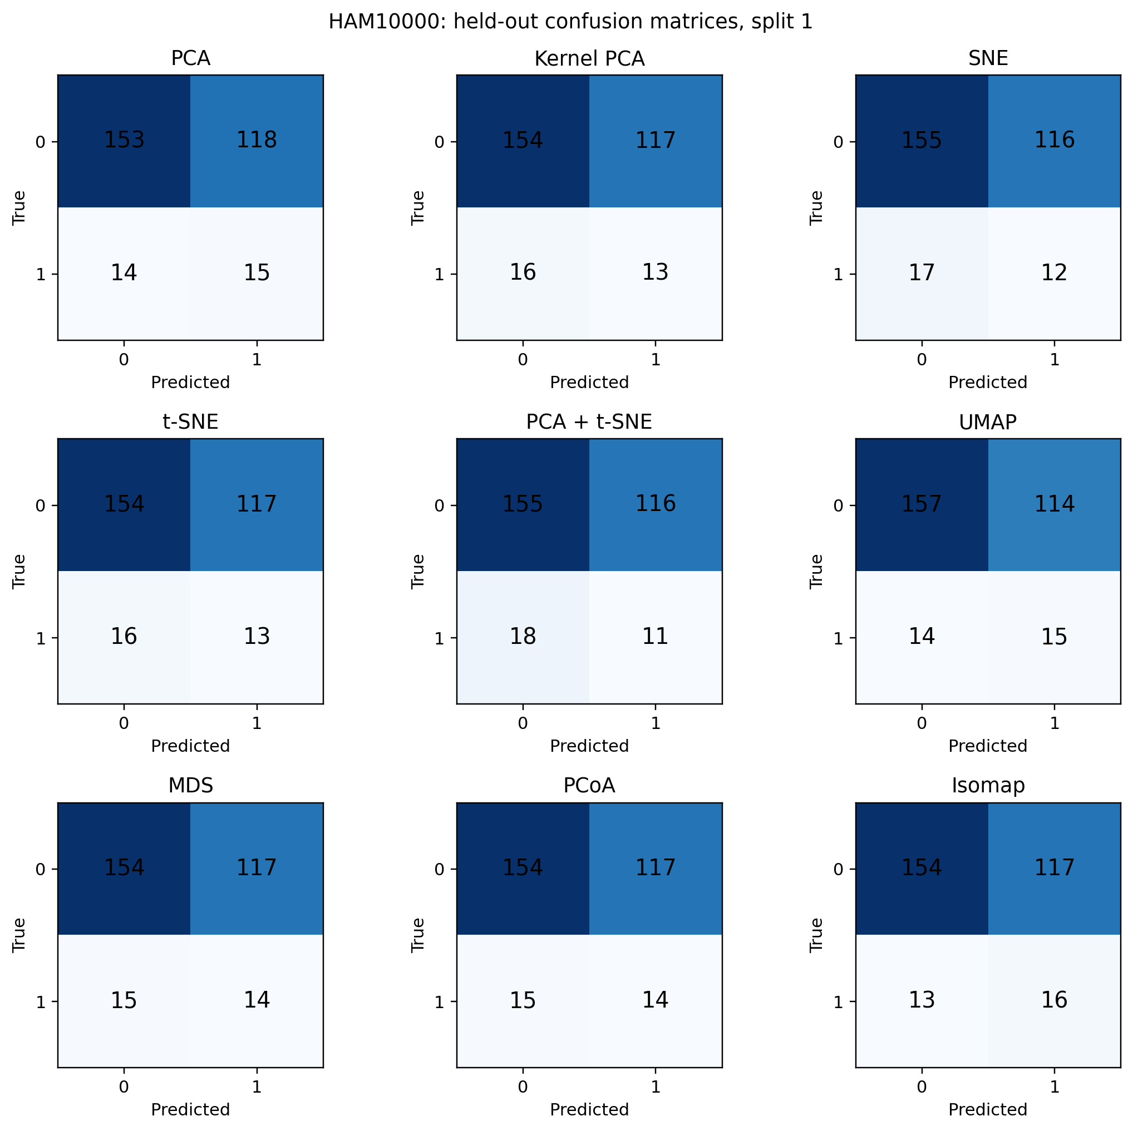
HAM10000: ROC and confusion matrices

Slide 23
HAM10000: better ranking, weak positive precision
Isomap leads mean ROC AUC at 0.649, versus 0.602 for PCA. A neighbor graph may retain class-related structure that the largest-variance PCA axes miss. The experiment does not establish that mechanism.
PCA has slightly higher accuracy, 0.609 versus 0.590. AUC measures ranking across thresholds, while accuracy uses the prespecified 0.5 threshold.
Isomap precision is 0.134: most positive calls are false positives. The 8 × 8 pixels and low melanoma prevalence limit clinical meaning.

Slide 24
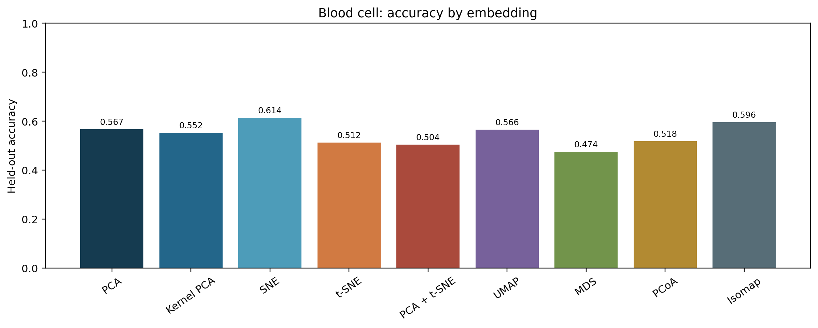
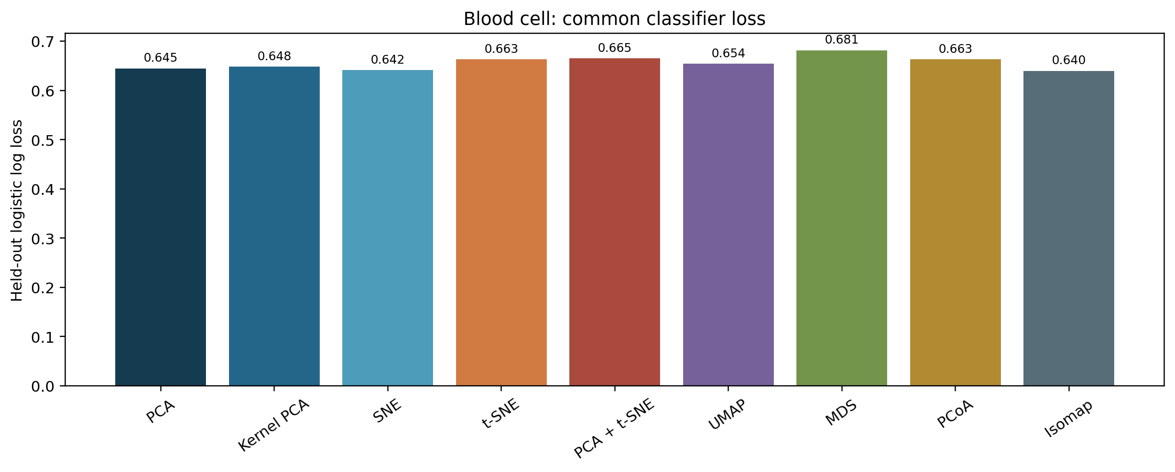
Blood cell: accuracy and loss
Highest mean AUC: PCA, 0.630. The two charts show why accuracy and probability loss should be read together.

Slide 25
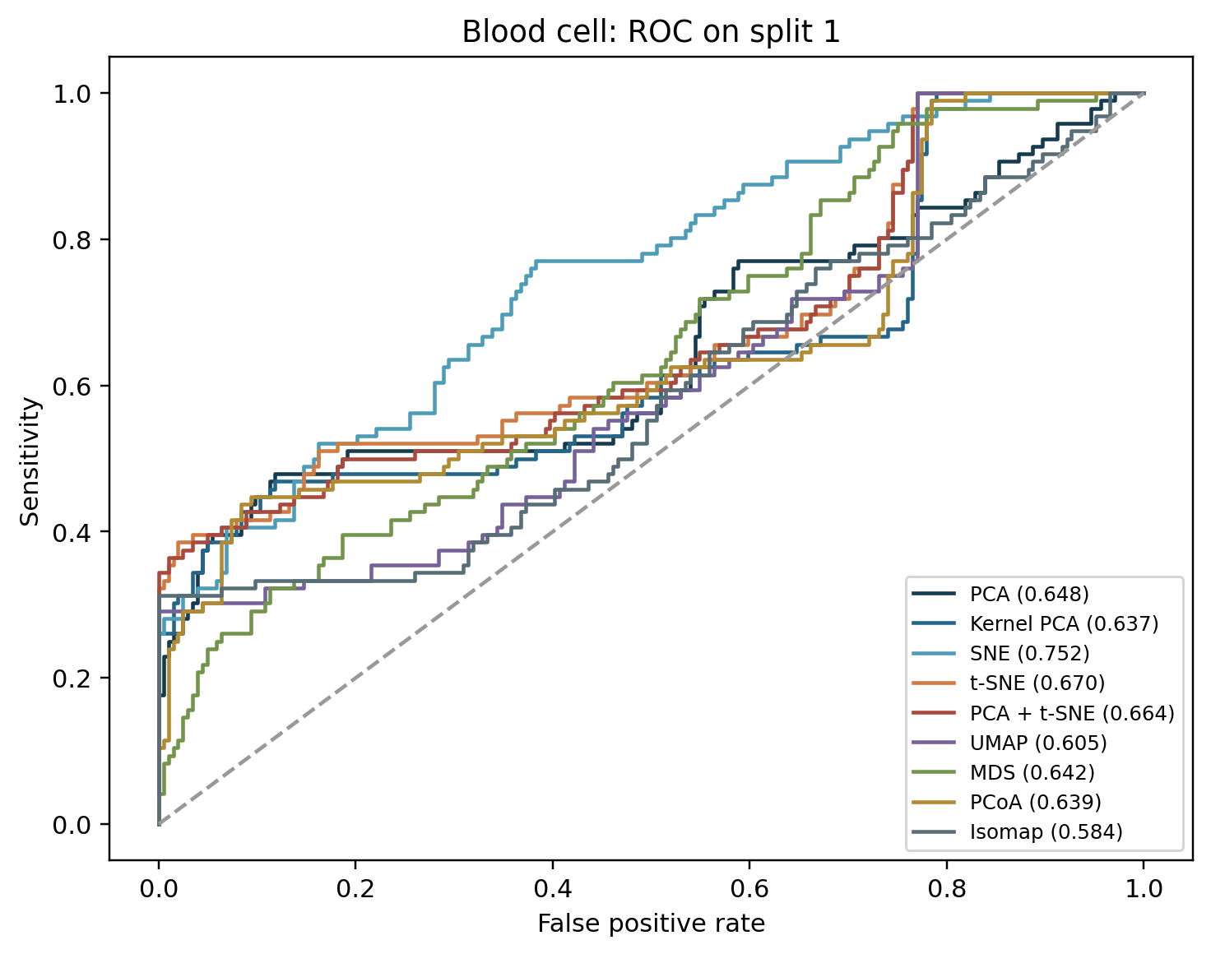
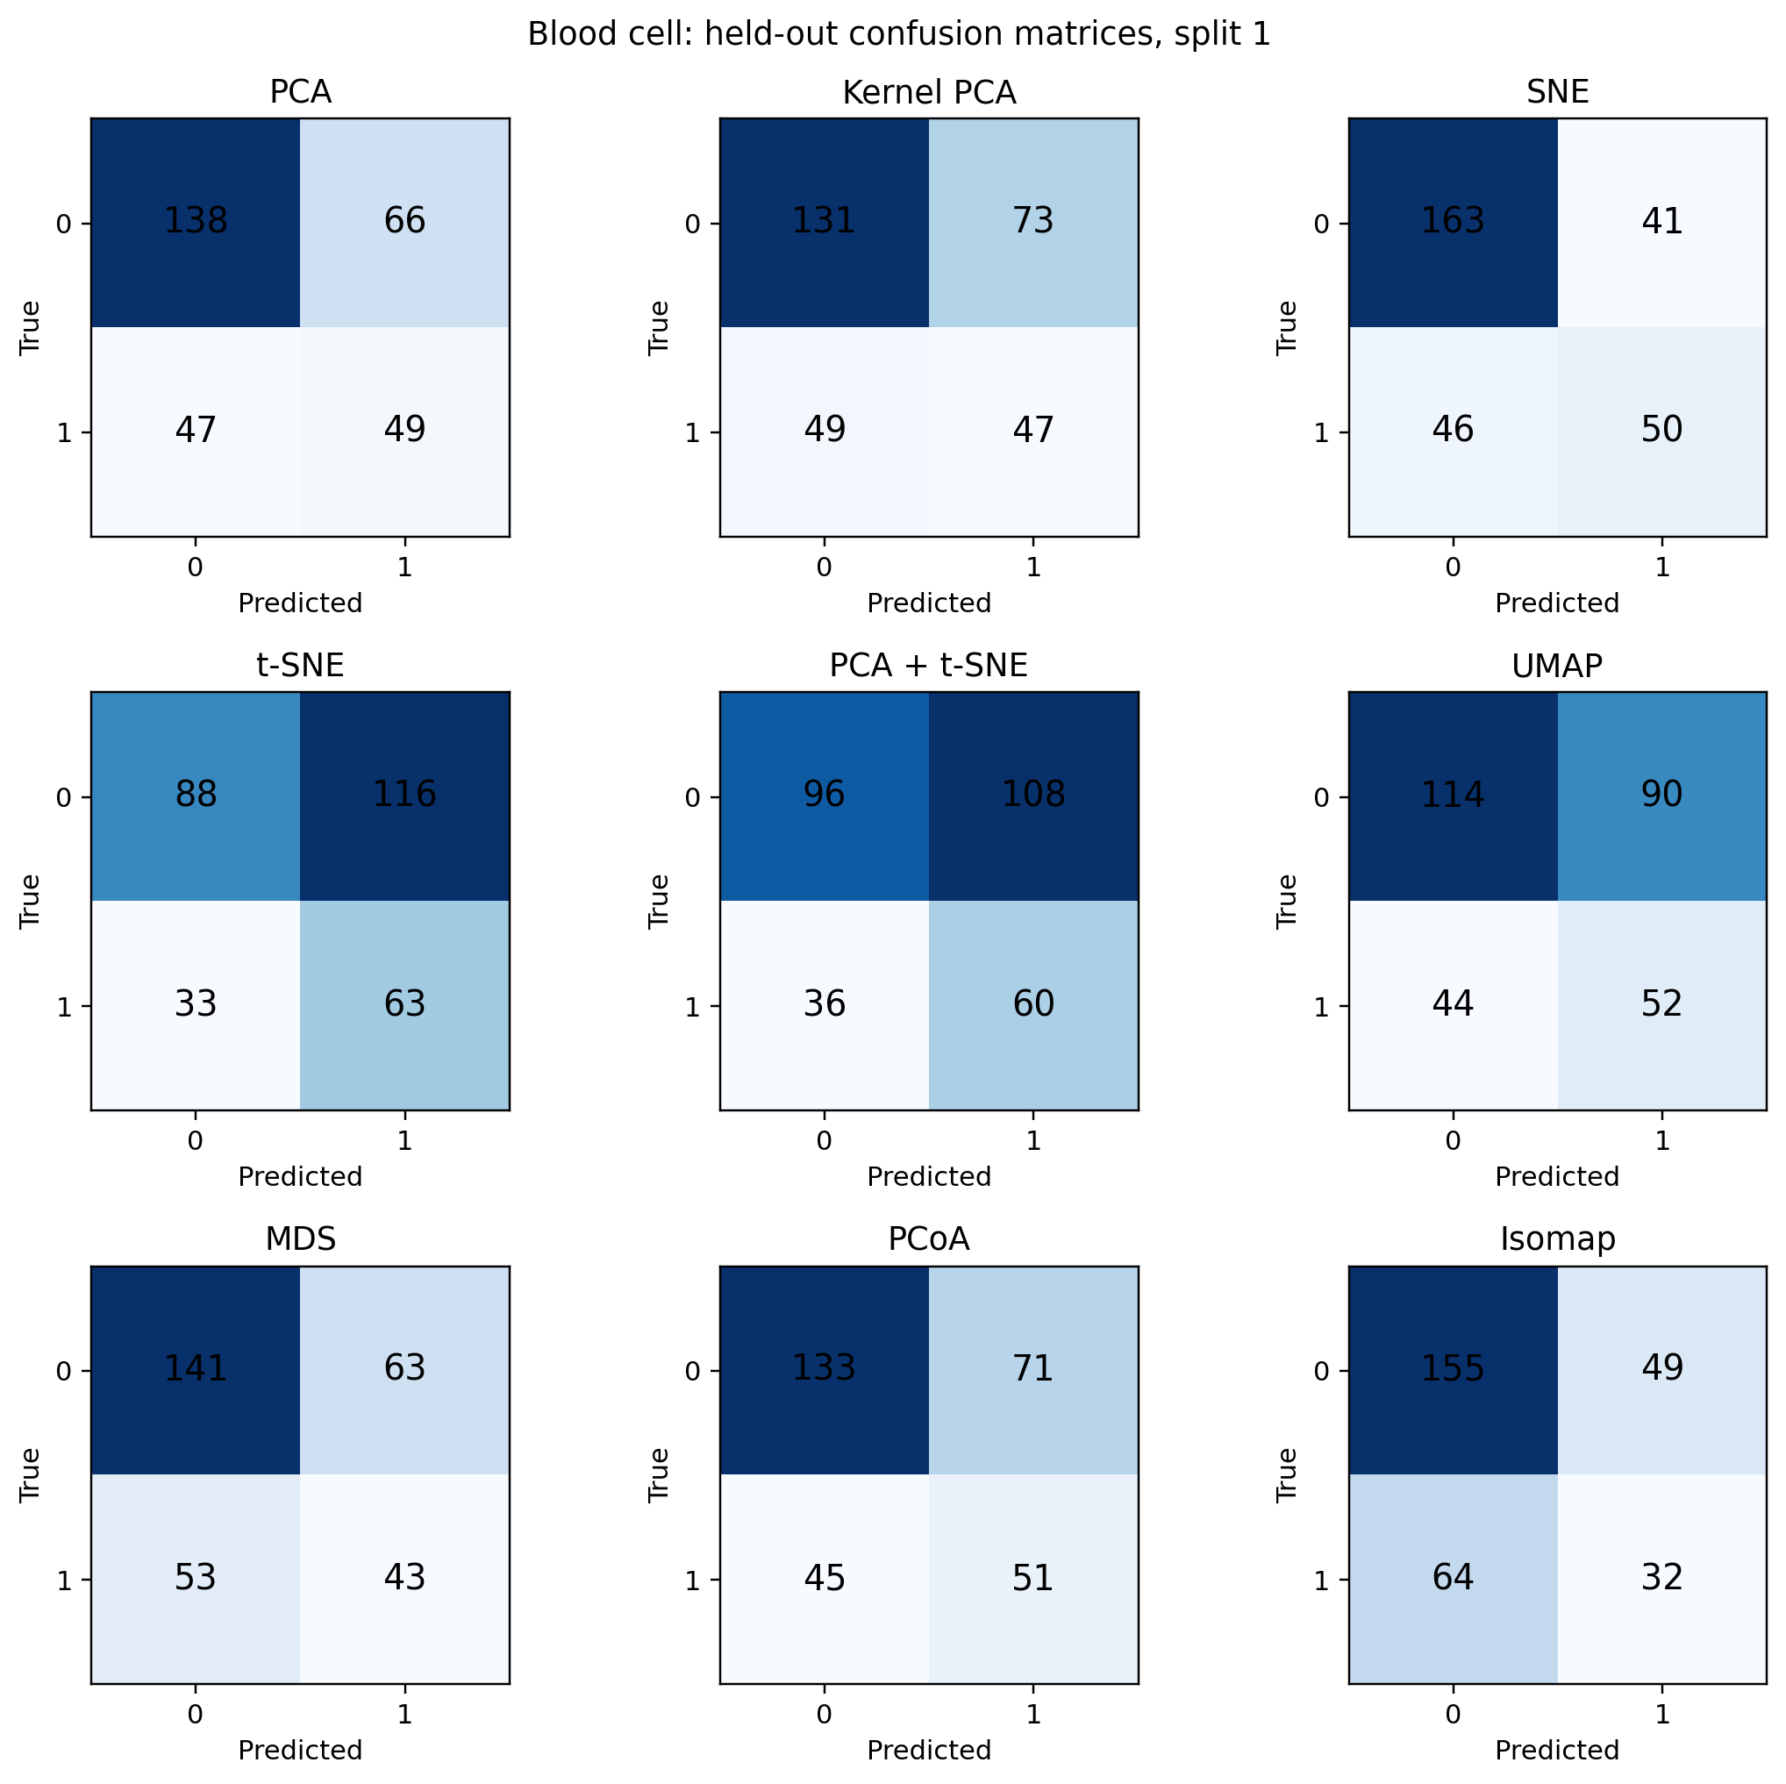
Blood cell: ROC and confusion matrices

Slide 26
Blood cells: fast PCA wins on ranking
PCA leads mean ROC AUC at 0.630 and takes about 0.02 CPU seconds. Broad linear variation may capture useful signal in the 22 selected features.
SNE reaches 0.614 accuracy but only 0.581 AUC. Its threshold decisions look better than its overall ranking; accuracy alone would give a misleading winner.
MDS has 0.562 AUC and takes about 1.06 CPU seconds. Keeping global distances in two dimensions did not retain much class signal here. Patient-level generalization remains untested.

Slide 27
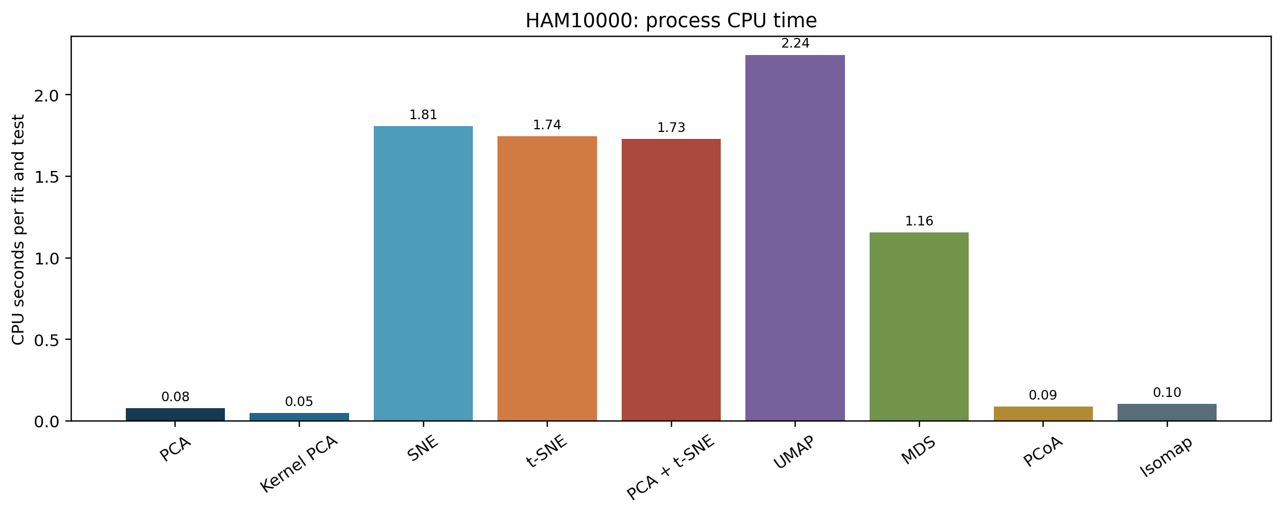
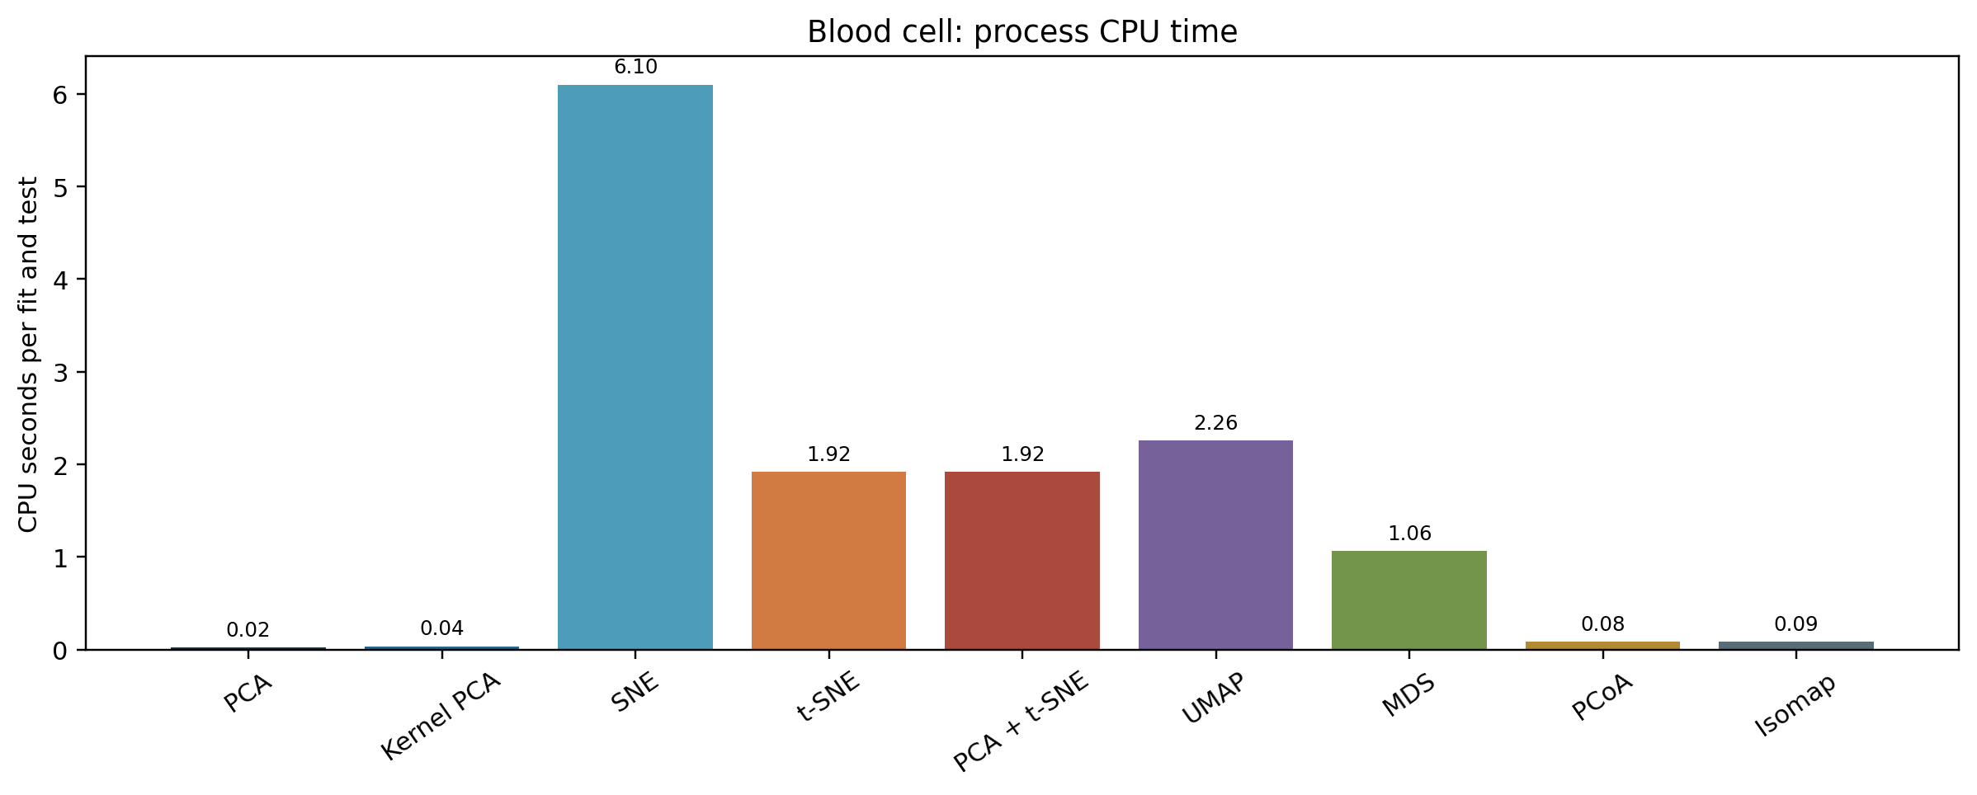
CPU time has a steep method cost
PCA and kernel PCA are fastest in this sample-size range. UMAP, SNE, and t-SNE require substantially more CPU time. UMAP's first compilation is measured separately.

Slide 28
CPU cost changes the practical choice
On blood cells, PCA needs about 0.02 CPU seconds and SNE about 6.10 seconds per run. SNE does not gain AUC in exchange for that extra compute (0.581 versus 0.630).
On HAM10000, Isomap leads AUC at about 0.10 CPU seconds; UMAP is close in AUC (0.645 versus 0.649) but takes about 2.24 seconds.
These are process CPU times for 750 training and 300 test records. UMAP's one-time compilation warmup is excluded and recorded separately; scaling can change the order.

Slide 29
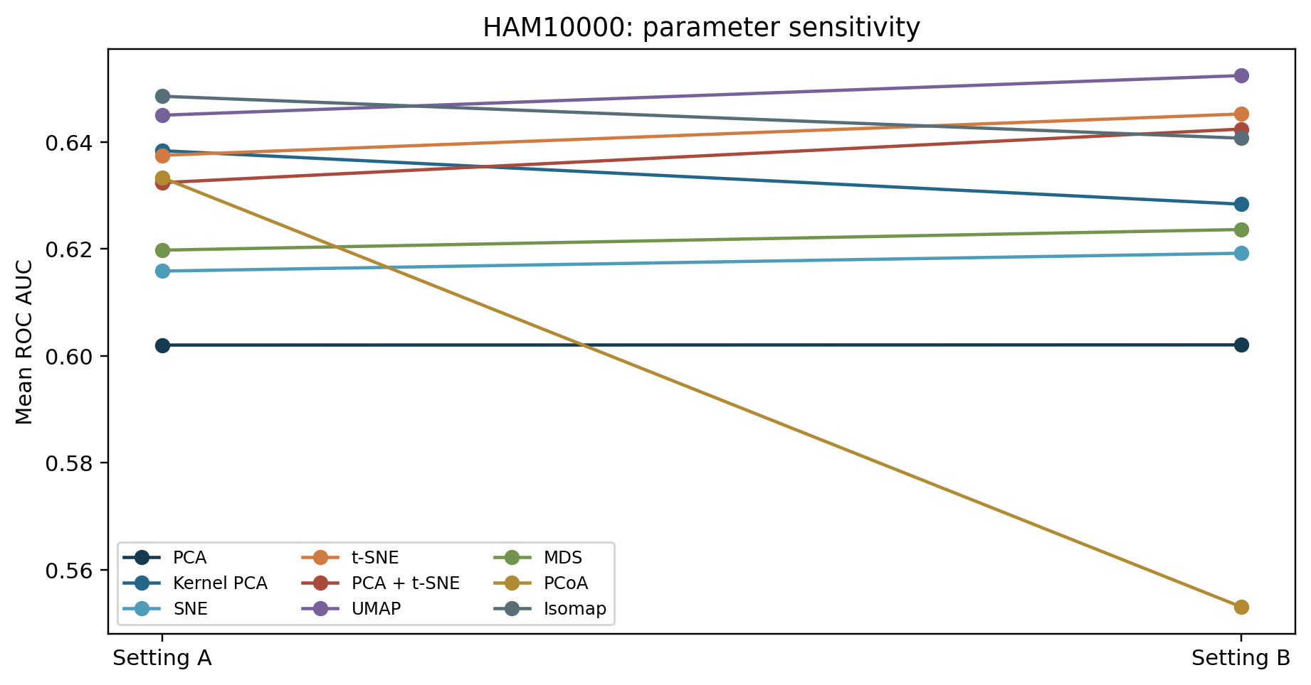
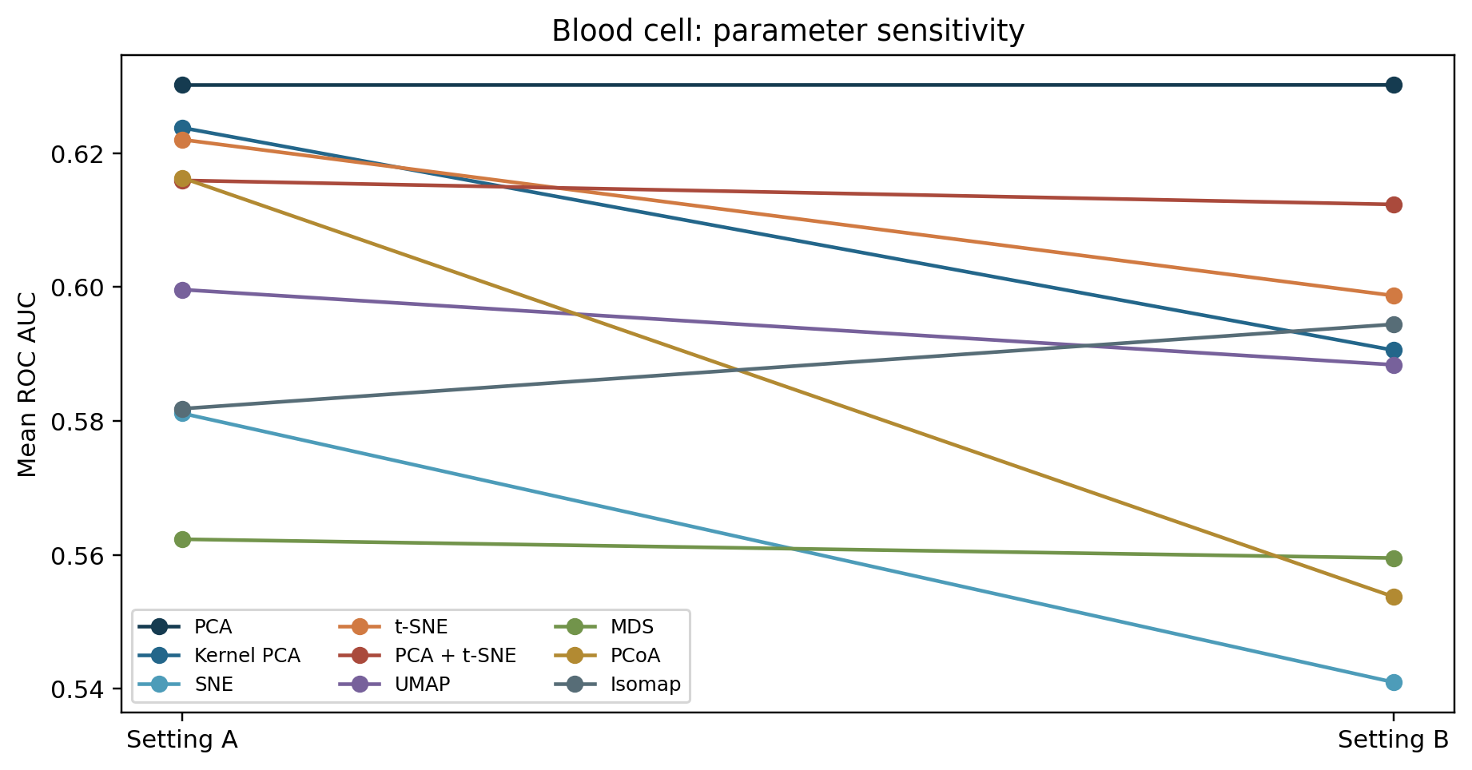
Parameter settings change the ranking
A second setting changes neighborhood size or perplexity. Selecting a winner on the test set would inflate the reported result.

Slide 30
What the parameter comparison can and cannot say
Setting A was declared primary before reading test results. Setting B checks whether whitening, kernel scale, perplexity, neighbor count, MDS iterations, or PCoA distance changes the result.
Large A-to-B shifts show tuning sensitivity, especially for methods that define neighborhoods. They do not justify choosing the better test-set setting after the fact.
A stronger study would tune parameters inside each training fold and then evaluate once on an untouched outer test fold.

Slide 31
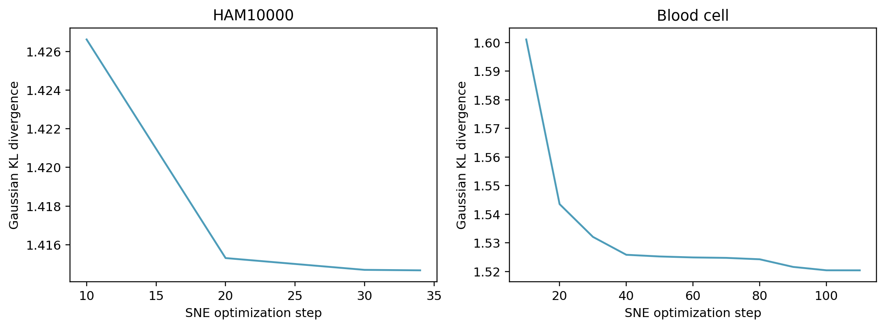
Gaussian SNE optimization loss
The plotted KL objective tracks Gaussian SNE fitting. Native PCA, t-SNE, and UMAP objectives have different meanings. The earlier classifier log-loss charts are comparable across methods.

Slide 32
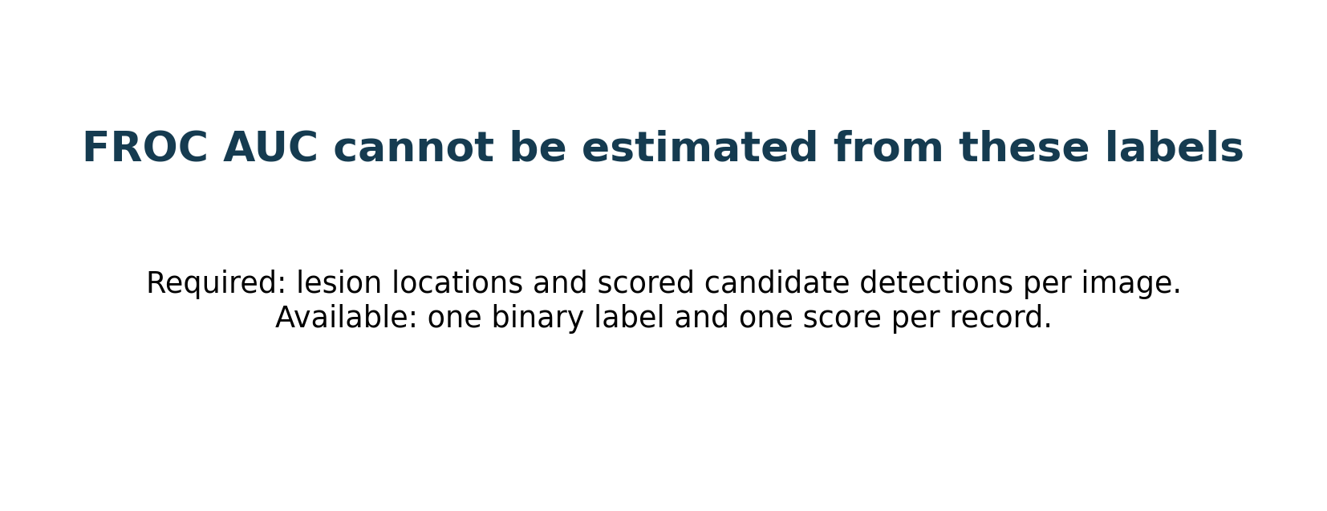
FROC AUC is not available
ROC AUC is reported. A valid FROC needs scored candidate lesion locations and false positives per image. These tables have one label and one score per record.

Slide 33
Statistical tests are exploratory
Repeated-measures ANOVA of AUC: F(8,40)=0.673, p=0.712. Descriptive MANOVA method term: Wilks' lambda=0.840, p=0.945.
Paired t, Wilcoxon, and McNemar z comparisons are in the repository. Three overlapping splits have low power. MANOVA's independence assumption is violated. Read all p values as diagnostics.

Slide 34
What counts as good or bad evidence here
A good result would combine high held-out AUC with useful sensitivity and precision, low log loss, stable parameters, and an acceptable CPU cost. None of these pilot AUCs exceeds 0.65.
A method can look good on one metric and weak on another: SNE has the highest blood-cell accuracy but lower AUC than PCA; Isomap leads HAM AUC but its positive precision is only 0.134.
Three overlapping splits do not provide a reliable superiority claim. The statistical tests and plots describe this experiment, not clinical readiness.

Slide 35
Notebook extension: eleven methods
The full Kaggle notebook adds locally linear embedding (LLE) and an exploratory PCA + UMAP hybrid to the original nine methods. It applies the same two settings, three seeds, held-out classifier, and metrics.
LLE reconstructs local neighborhoods from weighted neighbors. PCA + UMAP first reduces the feature space to at most 30 PCA coordinates, then builds the UMAP neighbor graph. Both are unsupervised two-dimensional representations.
Across three splits, HAM AUC is 0.648 for PCA + UMAP versus 0.649 for Isomap. Blood-cell AUC is 0.632 for PCA + UMAP versus 0.630 for PCA. These tiny differences do not establish superiority, and the hybrid costs more CPU time.

Slide 36
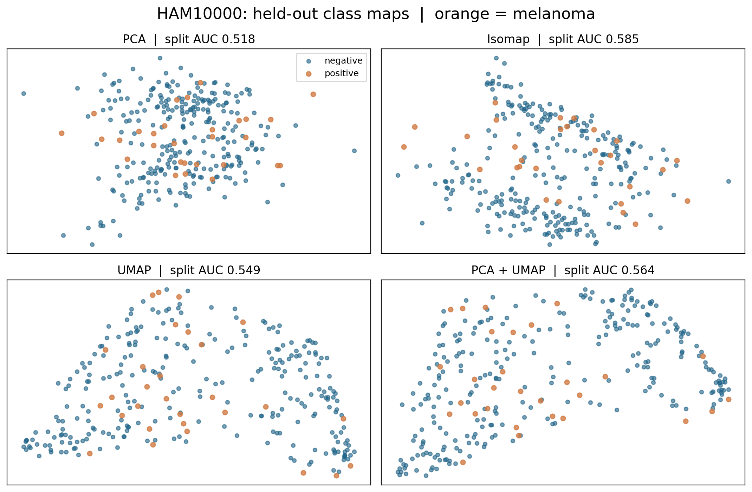
HAM10000: class maps remain mixed
Orange melanoma points overlap blue non-melanoma points in every map. Isomap and PCA + UMAP curve the geometry, but neither creates a clean class boundary.
This first split has lower AUC than the three-split mean for several methods. The change across splits is evidence of instability. Visual separation alone cannot select a winner.
Notebook extension: setting A, first split shown; AUC beside each map is for that split only.

Slide 37
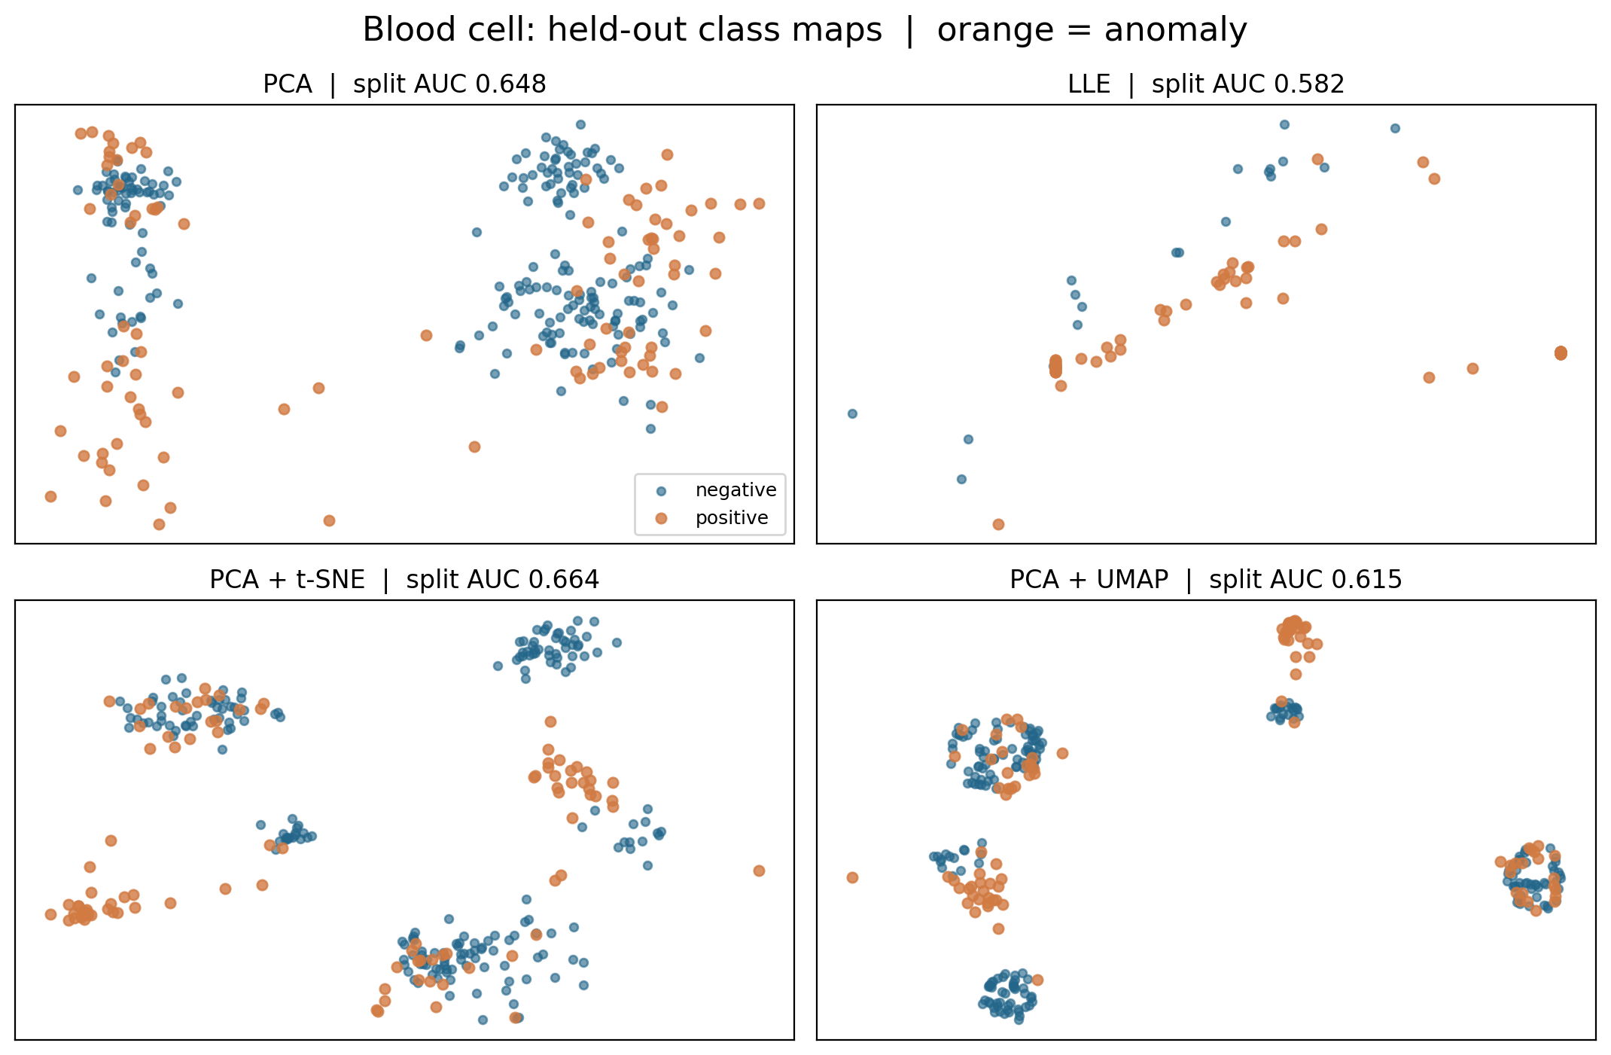
Blood cells: clusters are not class labels
PCA, LLE, PCA + t-SNE, and PCA + UMAP create different clusters. Both labels appear in several clusters, so cluster count or visual compactness does not measure classification quality.
PCA + t-SNE has a good AUC on the pictured split, but the three-split average favors PCA + UMAP narrowly. The table lacks patient IDs for patient-level testing.
Notebook extension: setting A, first split shown; AUC beside each map is for that split only.

Slide 38
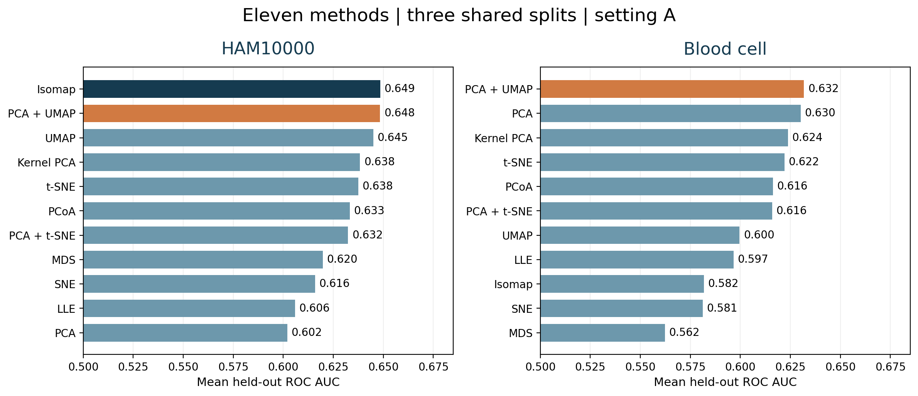
Eleven-method AUC comparison
Top differences of 0.001–0.002 are too small for a reliable superiority claim; compare CPU cost and uncertainty before choosing a method.
Source: kaggle/example_outputs/primary_summary.csv; figures generated by the full notebook.

Slide 39
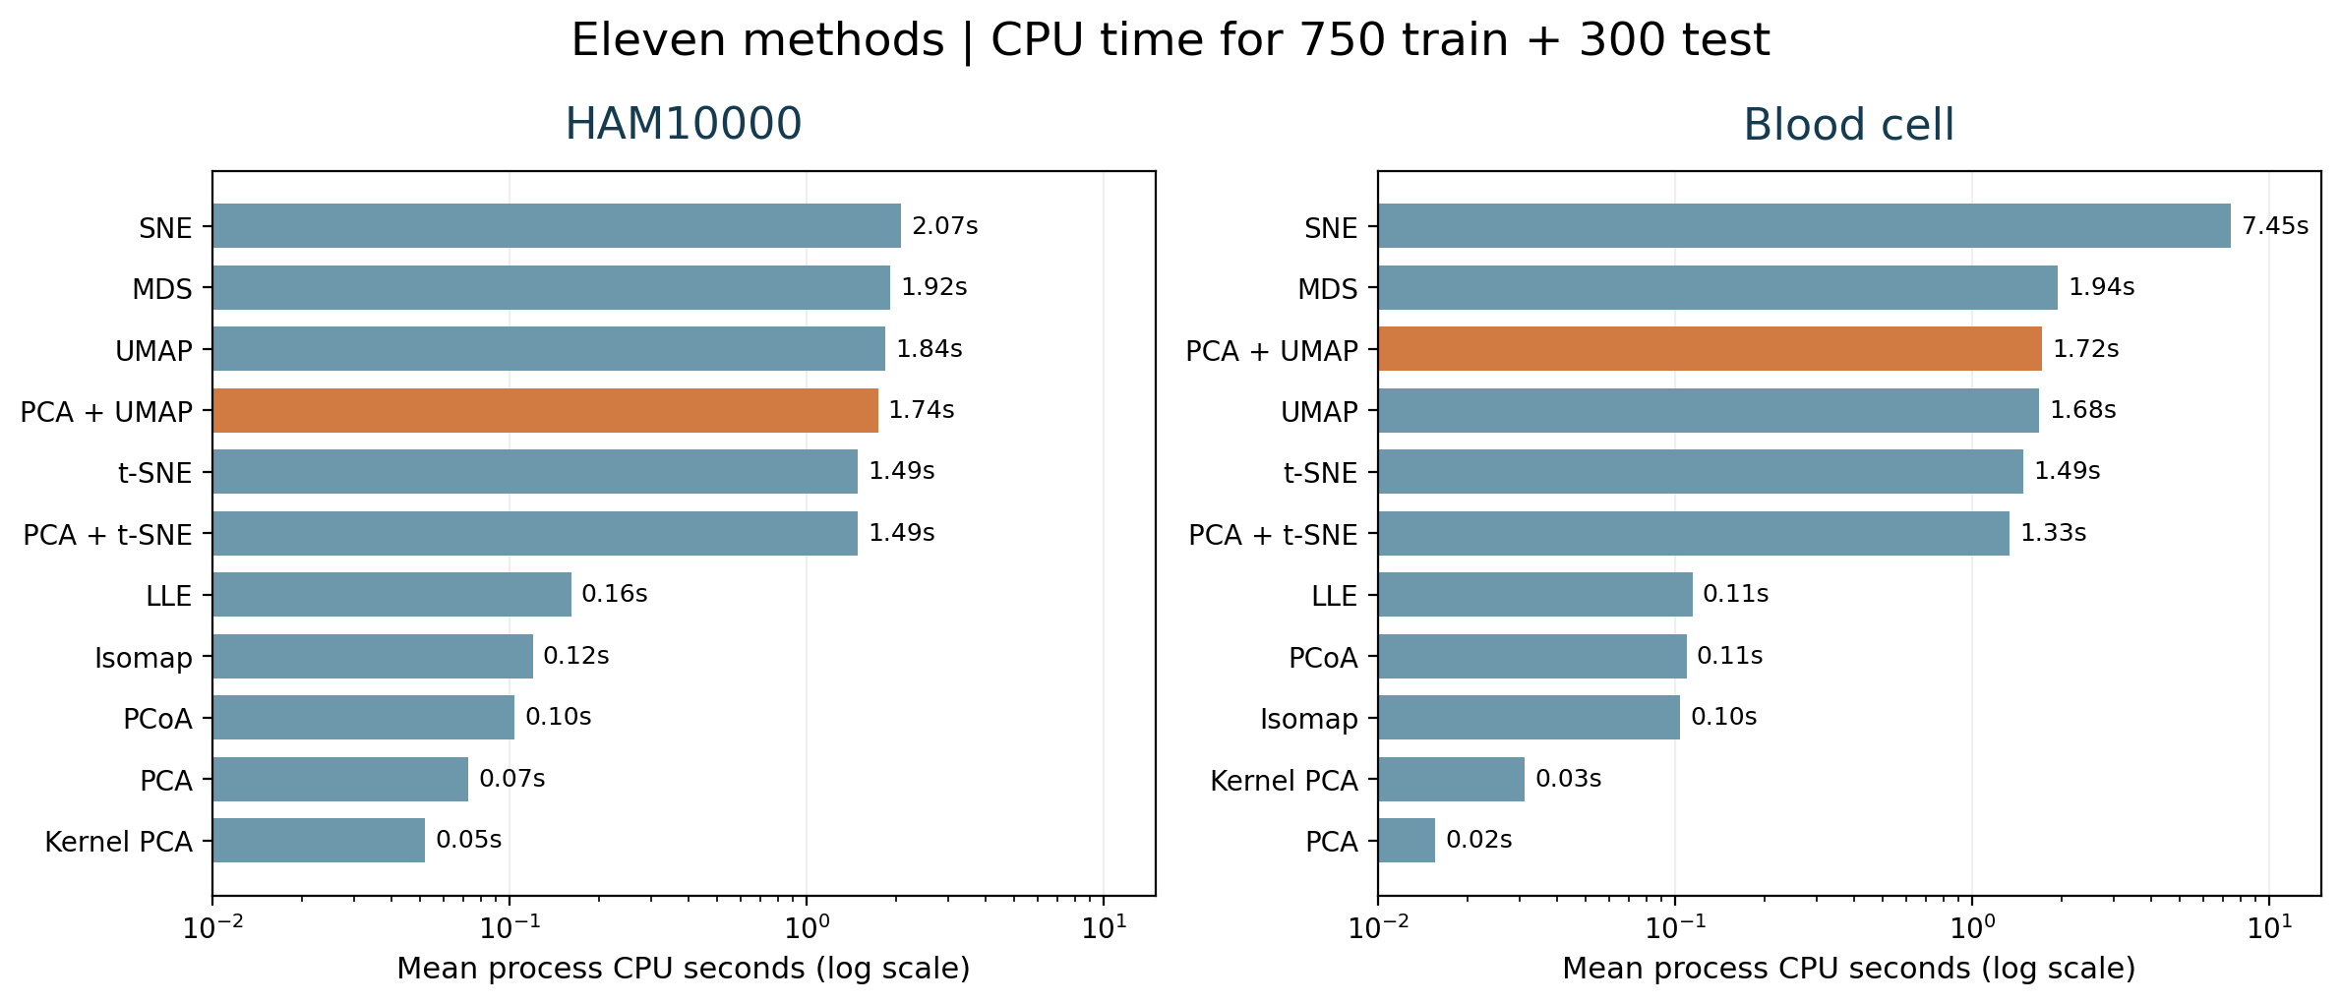
Eleven-method CPU comparison
PCA + UMAP uses about 1.74s on HAM and 1.72s on blood cells. The nearest AUC leaders use about 0.12s (Isomap) and 0.02s (PCA). Times depend on hardware and sample size.
Process CPU time excludes UMAP compilation warmup; logarithmic horizontal axis.

Slide 40
Interpretation and next steps
Performance changes with split and parameter choice. The 8 × 8 lesion images limit clinical meaning. The blood-cell table lacks patient-level validation.
For a journal study: use original or validated features, external cohorts, nested tuning, uncertainty intervals, and lesion locations if FROC is required.
Sources and exact numbers: AML_research_report.docx and results/primary_summary.csv

Slide 41
PART II
Metaheuristic feature selection
for two biomedical tables
GA · PSO · DE · GA + PSO · GA + DE
Separate wrapper study on selected original features; three shared outer splits.

Slide 42
Feature-selection protocol
Outer evaluation: 750 training and 300 held-out records per seed; three shared splits. HAM10000 separates lesion IDs. Blood-cell data use stratified rows because patient IDs are unavailable.
Candidate fitness: mean two-fold inner ROC AUC − λ × selected-feature fraction. Scaling and balanced logistic regression are refit inside each inner fold.
Setting A: λ = 0.02. Setting B: λ = 0.05. Each search attempts 56 mask evaluations; duplicate masks are cached. The test set never chooses masks or the penalty.
Source: results/feature_selection/; setting A unless stated.

Slide 43
Search mechanisms and equal budgets
GA: tournament selection, uniform crossover, bit mutation, and best-mask preservation.
PSO: binary particles update velocities from personal and global best masks.
DE: real-valued mutation and crossover, then binary thresholding and one-to-one replacement.
GA + PSO and GA + DE: three GA generations hand their population and best mask to three generations of the second optimizer. All searches use eight candidates and six generations.
Source: results/feature_selection/; setting A unless stated.

Slide 44
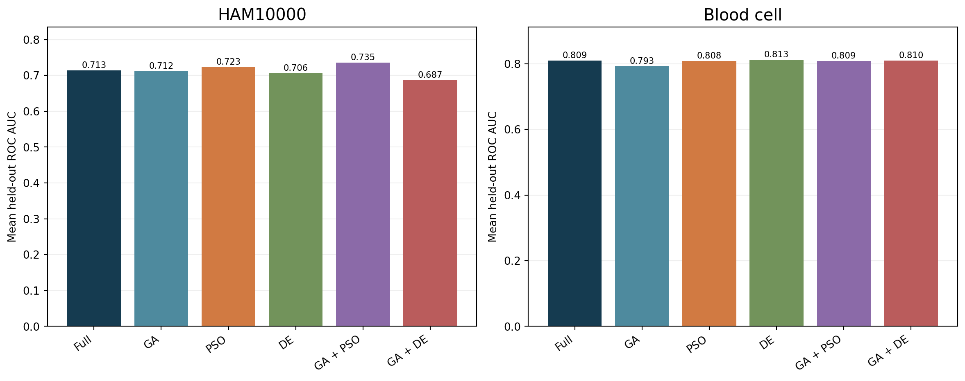
Feature selection: held-out ROC AUC
HAM: GA + PSO 0.735 versus full 0.713. Blood: DE 0.813 versus full 0.809. These small differences are exploratory.
Source: measured three-split feature-selection run; charts are descriptive.

Slide 45
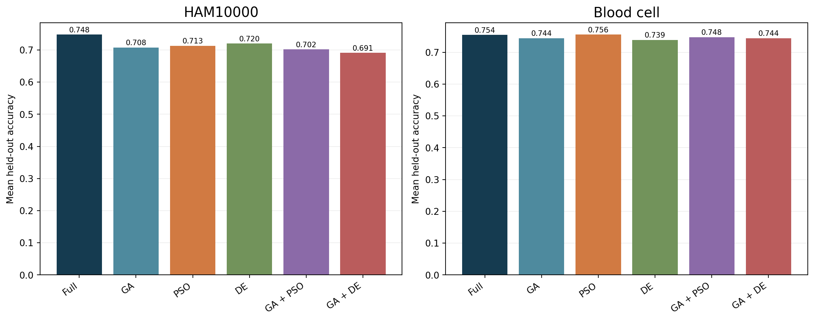
Accuracy at the fixed threshold
Accuracy depends on the 0.5 cutoff and class prevalence; read it with AUC, sensitivity, and precision.
Source: measured three-split feature-selection run; charts are descriptive.

Slide 46
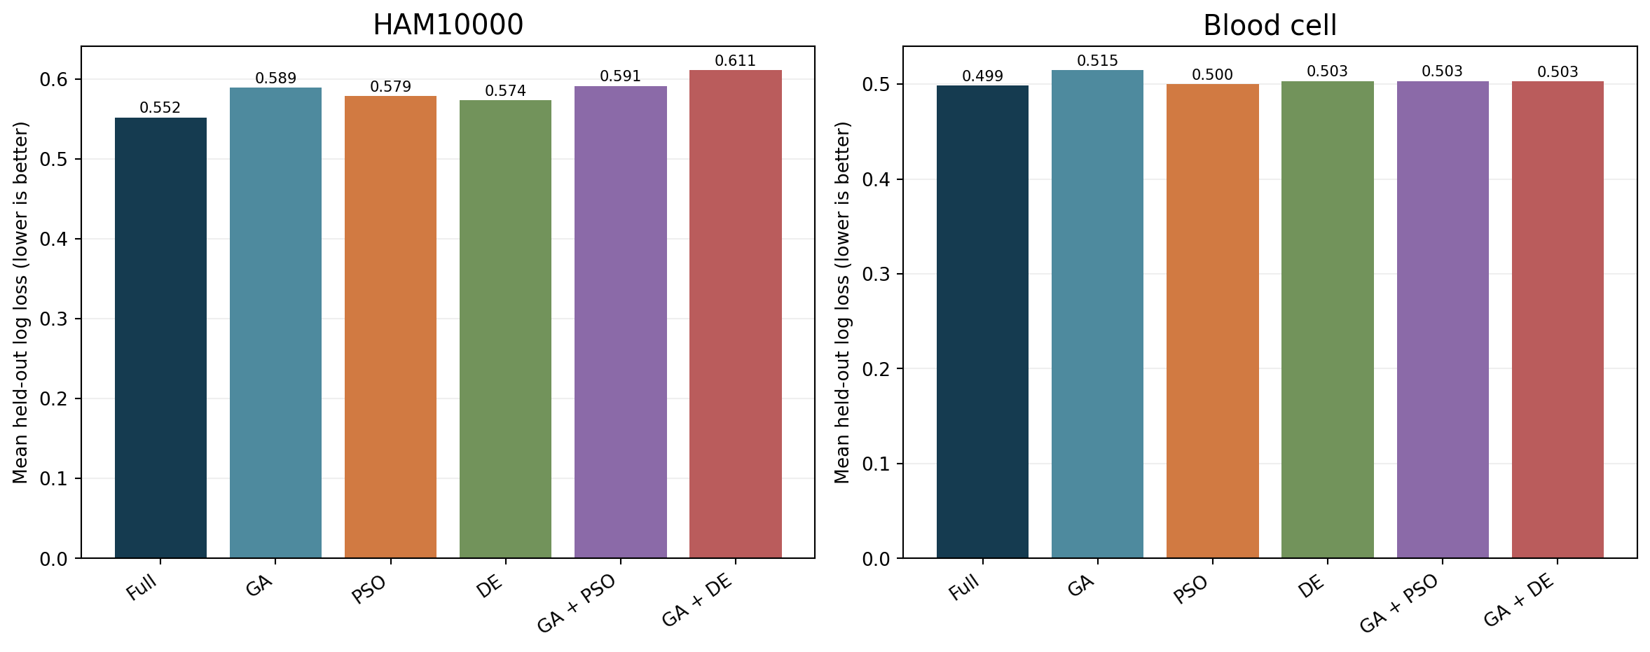
Probability log loss
Lower log loss is better; it penalizes confident wrong probabilities and complements AUC.
Source: measured three-split feature-selection run; charts are descriptive.

Slide 47
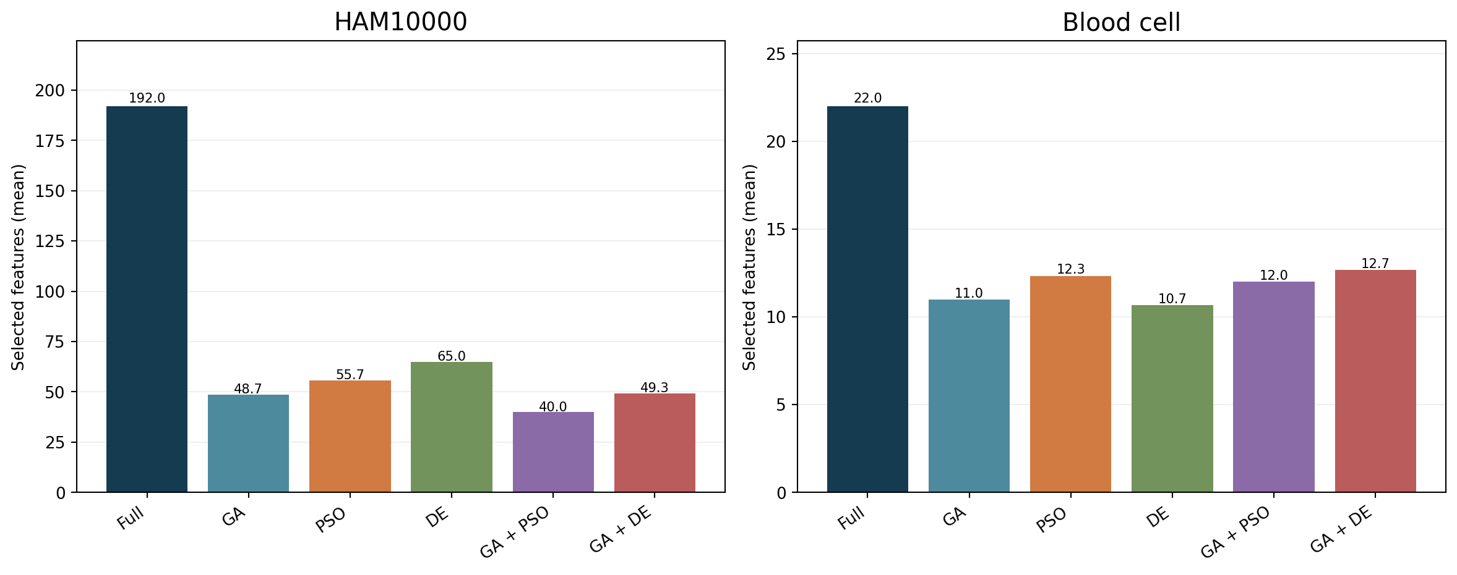
Feature reduction
GA + PSO retains 40/192 HAM features on average; DE retains 10.7/22 blood-cell features.
Source: measured three-split feature-selection run; charts are descriptive.

Slide 48
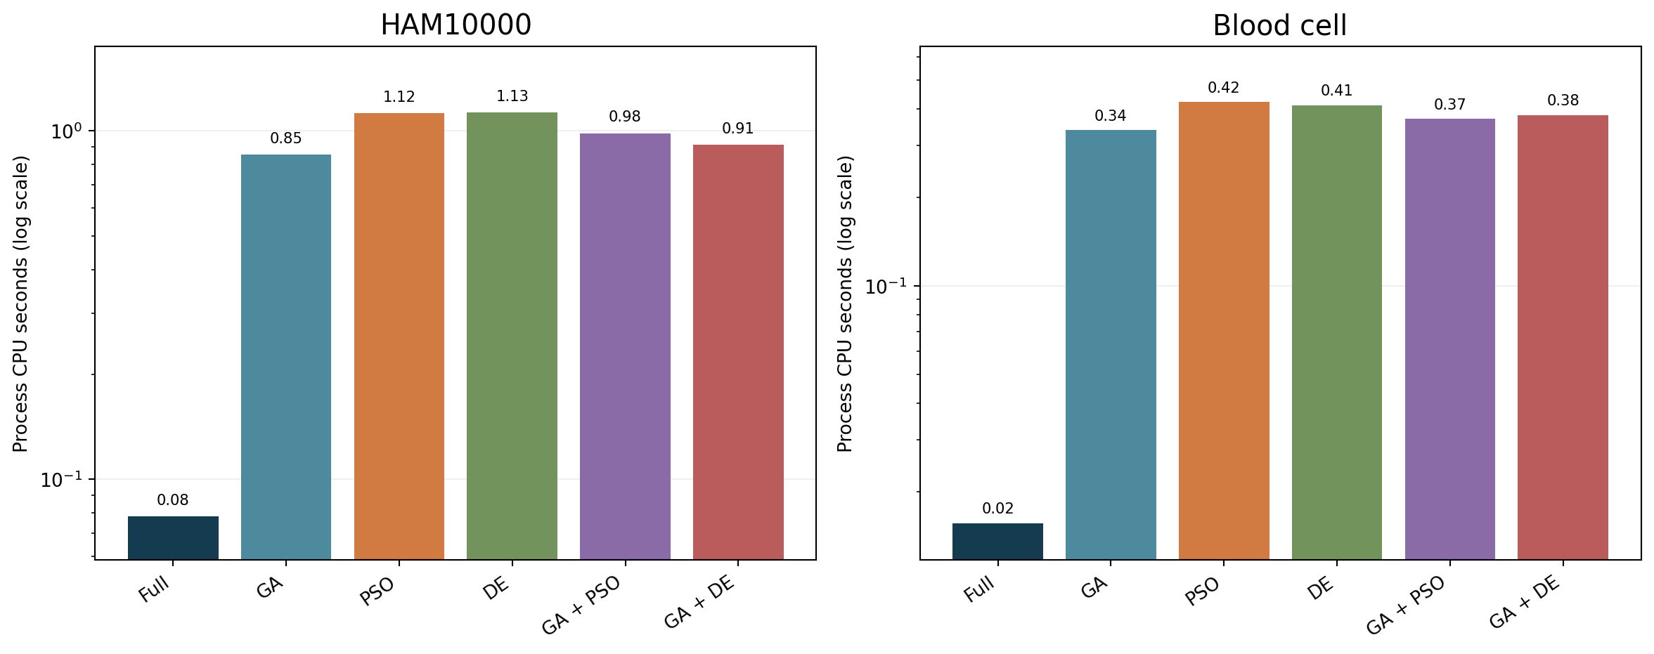
CPU cost of feature selection
Search adds CPU time: about 0.98 versus 0.08 seconds for HAM GA + PSO/full; 0.41 versus 0.02 for blood DE/full.
Source: measured three-split feature-selection run; charts are descriptive.

Slide 49
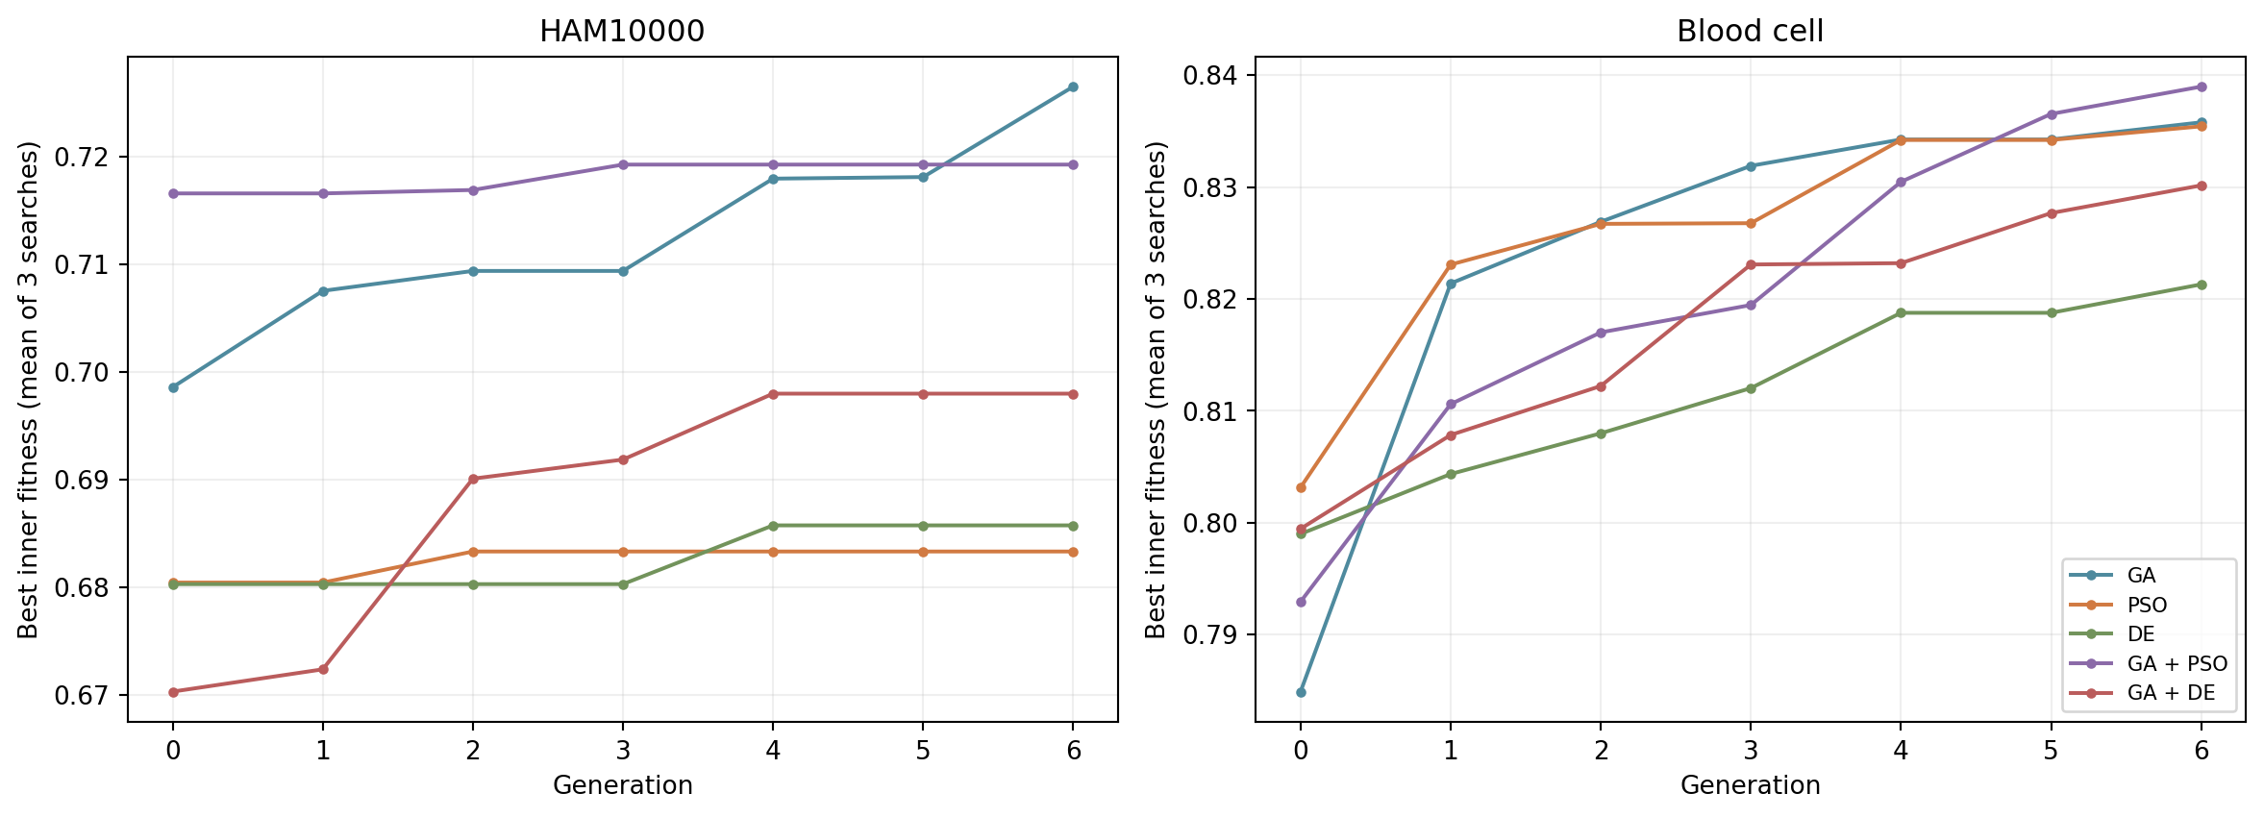
Search convergence is an inner-fold result
Fitness improves during search, but rising inner fitness does not guarantee better held-out AUC. Curves average three searches.
Source: measured three-split feature-selection run; charts are descriptive.

Slide 50
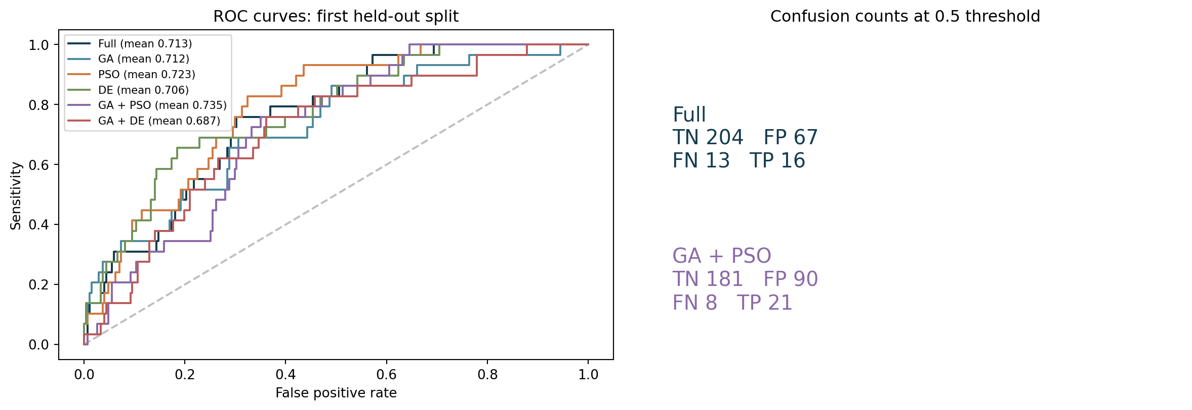
HAM10000: ROC and confusion counts
First split ROC curves and 0.5-threshold confusion counts; legend shows three-split mean AUC.
Source: measured three-split feature-selection run; charts are descriptive.

Slide 51
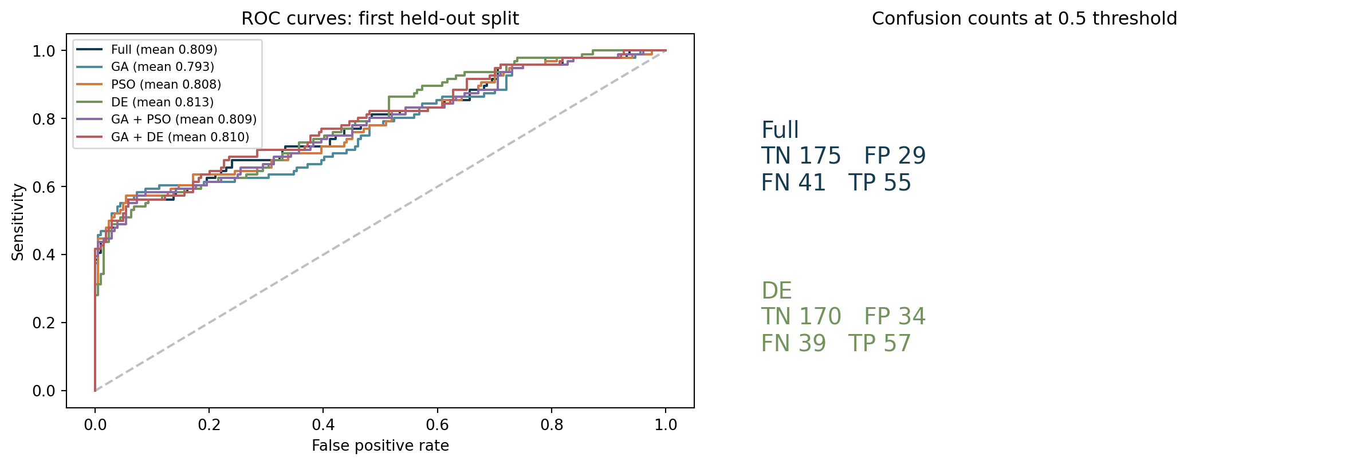
Blood cells: ROC and confusion counts
First split ROC curves and 0.5-threshold confusion counts; no patient-level validation is available.
Source: measured three-split feature-selection run; charts are descriptive.

Slide 52
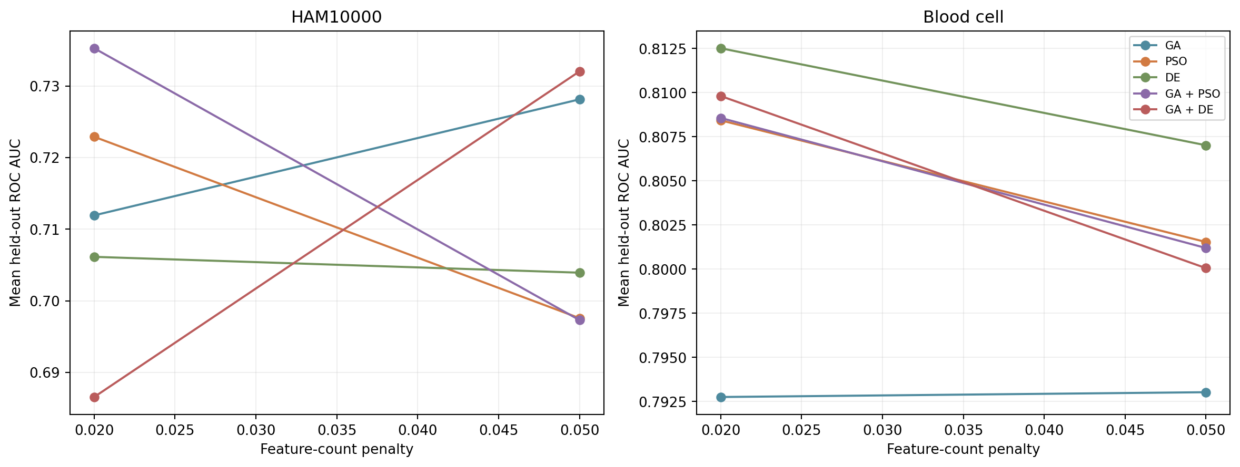
Penalty sensitivity
Changing λ changes masks and held-out AUC. Setting A was primary; do not select the better setting on the test set.
Source: measured three-split feature-selection run; charts are descriptive.

Slide 53
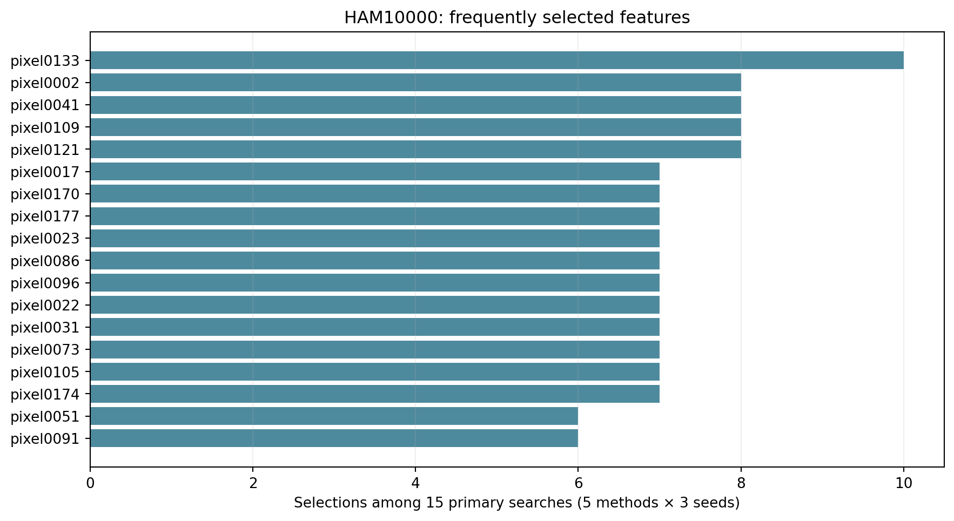
HAM10000: selected pixel frequencies
Top 18 pixels selected across 15 setting-A searches. Frequency is not a clinical importance estimate.
Source: measured three-split feature-selection run; charts are descriptive.

Slide 54
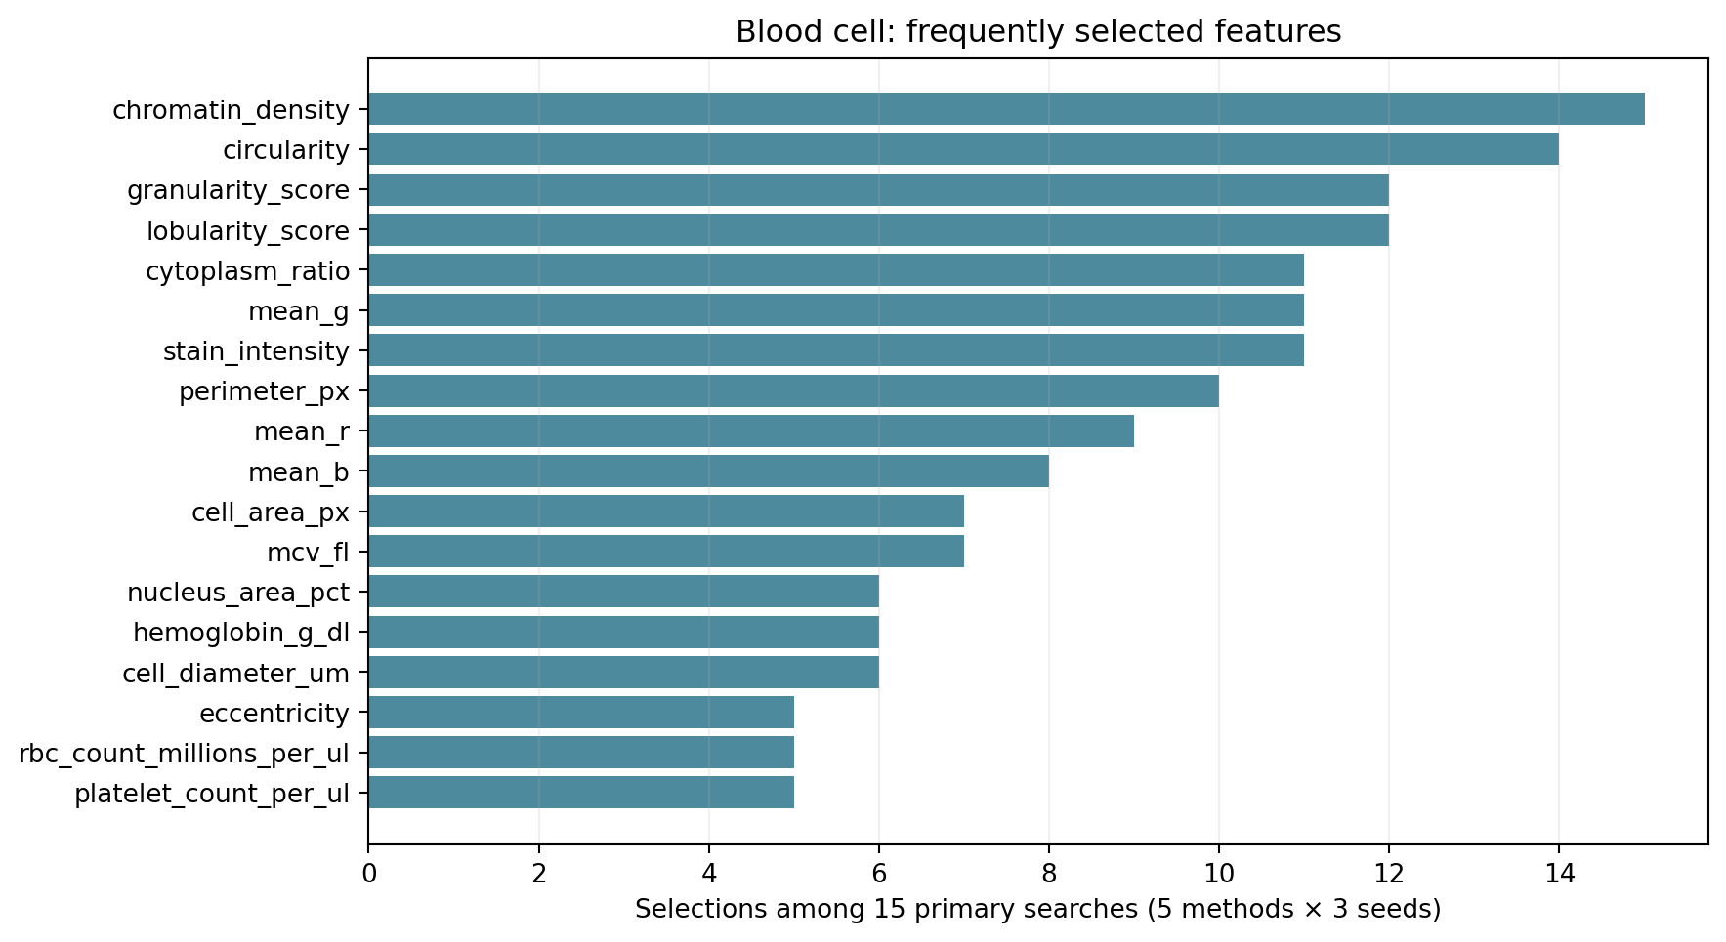
Blood cells: selected feature frequencies
Top 18 input fields selected across 15 setting-A searches. Correlated features can substitute for one another.
Source: measured three-split feature-selection run; charts are descriptive.

Slide 55
Interpretation and study limits
The hybrid is not always better: GA + DE has mean HAM AUC 0.687, below the full-feature baseline 0.713. Across three overlapping splits, all paired t and Wilcoxon comparisons against full features have p > 0.15.
HAM results vary strongly by split (full-feature AUC 0.762, 0.794, 0.584). The 8 × 8 lesion pixels limit biological interpretation. Blood cells lack patient IDs and verified external cohort provenance.
These selected-feature classifiers are not directly comparable with the earlier 2D embedding classifiers. A journal study needs independent groups, nested tuning, uncertainty intervals, and external validation. FROC cannot be computed from record labels alone.
Source: results/feature_selection/; setting A unless stated.

Slide 56
Two-dataset methodology: the same evaluation logic
HAM10000 · melanoma positive · lesion-separated records
Input
Outer split
Inner search
Final model
Held-out test
10,015 records
192 RGB pixel values
Group by lesion ID
750 train · 300 test
2 group folds
56 mask attempts
Selected features
Balanced logistic regression
ROC AUC · loss
Confusion · CPU
Blood cells · anomaly positive · stratified rows
Input
Outer split
Inner search
Final model
Held-out test
5,880 records
22 eligible variables
Stratified row split
750 train · 300 test
2 stratified folds
56 mask attempts
Selected features
Balanced logistic regression
ROC AUC · loss
Confusion · CPU
Selection and scaling use training data only. The blood table has no patient ID, so patient-level generalization is untested.
Source: src/benchmark.py and src/feature_selection.py; three seeds, setting A shown.

Slide 57
Three model paths and what each comparison means
All paths end with class-balanced logistic regression and held-out probabilities.
2D embedding
study
Original inputs
Unsupervised map
Classifier
Question
192 / 22 features
2 coordinates
LR on 2D map
Class signal in 2D?
Full-feature
baseline
Original inputs
No selection
Classifier
Question
192 / 22 features
Keep all features
LR on all inputs
Reference AUC / CPU
Metaheuristic
selector
Outer train only
Inner wrapper
Classifier
Question
Group / row split
GA · PSO · DE
Two hybrid searches
LR on chosen inputs
AUC vs count / CPU
Direct head-to-head test: full features vs selectors within the same outer split. The 2D study uses a different representation.
Sources: results/primary_summary.csv; results/feature_selection/primary_summary.csv.

Slide 58
Measured model tradeoffs on both datasets
Setting A · mean of three shared outer splits · selected original features
HAM10000
Blood cells
Full features
GA + PSO
Full features
DE
AUC 0.713
192 features
CPU 0.08 s
Δ AUC
+0.022
AUC 0.735
40 features
CPU 0.98 s
AUC 0.809
22 features
CPU 0.02 s
Δ AUC
+0.003
AUC 0.813
10.7 features
CPU 0.41 s
The selector reduces the input count but adds search time. AUC changes are small compared with split variation; no superiority claim follows.
All paired t and Wilcoxon comparisons against full features have p > 0.15 with only three overlapping splits.
Source: results/feature_selection/primary_summary.csv and exploratory_tests.csv. Process CPU time depends on hardware.

Slide 59
PART III
RLWOA-SOFL paper adaptation
Paper structure · algorithm concepts · results on two datasets
The original paper studies fMRI pain decoding. This section tests an explicit adaptation on HAM10000 and blood-cell tables.

Slide 60
The paper and the two-dataset adaptation
Original study
This project
Pain-evoked fMRI → selected voxels → multi-level pain decoding
HAM10000 melanoma and blood-cell anomaly → selected tabular features → binary classification
Transferable concepts
Changed experimental setting
WOA search • per-agent learned exploration • class-specific fuzzy prototypes
Different input modality, labels, representation, and clinical meaning. The original paper’s accuracy is not a benchmark for these data.
The implementation is an auditable adaptation, not an exact reproduction of the paper’s AnYa rules.
Source: Anter and Zhang (2023), DOI 10.1109/TAFFC.2023.3285997; project adaptation and measured results.

Slide 61
Original paper: fMRI inputs and reported findings
Acquisition
Preprocessing
Feature extraction
Decoder
31 people × 40 trials = 1,240 pain-evoked observations; 56,260 candidate voxels.
Motion and slice-time correction, spatial alignment/smoothing, high-pass filtering.
Peak BOLD response, onset normalization, correlation screening, empirical mode decomposition.
RLWOA feature selection → granular SOFL pain-level rules.
Paper-reported performance at granularity level 7
Accuracy 0.9073 · Sensitivity 0.8988 · Specificity 0.9906 · F1 0.8872
These are results for fMRI pain decoding under the paper’s validation and cannot be compared numerically with the two binary datasets.
Source: Anter and Zhang (2023), DOI 10.1109/TAFFC.2023.3285997; project adaptation and measured results.

Slide 62
SOFL granularity and validation concepts
Granularity
Paper evaluation
Coarser rules use fewer local regions and may generalize better. Finer rules describe more detail but use more prototypes, time, and memory and may overfit.
The paper compares granular levels, conventional classifiers, and neural architectures; it reports 10-fold cross-validation and paired tests for some contrasts.
Our adaptation fixes prototype radius at 0.25 and uses three shared outer holdouts. It does not recreate the paper’s full multi-layer AnYa rule system.
Within our study, AUC comparisons use the same test records; small overlapping splits make p-values exploratory.
Source: Anter and Zhang (2023), DOI 10.1109/TAFFC.2023.3285997; project adaptation and measured results.

Slide 63
WOA searches binary feature masks
1 Candidate mask
2 Search move
3 Inner score
4 Best mask
Each search agent holds continuous feature positions. Sigmoid sampling maps them to selected or excluded columns.
Encircle the best solution, explore around another agent, or follow a spiral toward the best.
Two training folds: 5-NN accuracy + α × (1 − selected fraction). No test labels enter search.
Keep the best inner score. Every method makes 105 attempted evaluations.
The published α = 0.8 strongly rewards sparsity. A high search score does not guarantee a high held-out AUC.
Our comparison also runs α = 0.2 as an exploratory sensitivity check.
Source: Anter and Zhang (2023), DOI 10.1109/TAFFC.2023.3285997; project adaptation and measured results.

Slide 64
Agent-adaptive WOA learns when to explore
Recent state
Neural policy
Action
Feedback
For each agent: signs of its last three fitness changes.
Small per-agent network assigns probabilities to three actions.
Decrease, keep, or increase that agent’s exploration rate by 10%.
Fitness gain: +1; loss: −1. Online reward updates the policy.
Standard WOA
Adapted RLWOA
One linearly decreasing exploration schedule for every agent.
Each agent changes its own schedule using experience. Our compact policy approximates the paper’s BPNN controller.
Source: Anter and Zhang (2023), DOI 10.1109/TAFFC.2023.3285997; project adaptation and measured results.

Slide 65
Self-organizing fuzzy prototypes classify records
Training record
Class prototypes
Fuzzy evidence
Prediction
Scale selected variables using training data only. Associate each record with its known class.
If far from the nearest same-class prototype, create one; otherwise update the nearest center.
Compare an unseen record with prototypes from each class using cosine similarity.
Softmax similarities → class probabilities and a 0.5 decision.
Radius = 0.25 controls prototype creation. More prototypes may describe finer structure but cost more and may overfit.
This classifier captures online class prototypes; it does not reproduce all AnYa density equations or deep granular layers.
Source: Anter and Zhang (2023), DOI 10.1109/TAFFC.2023.3285997; project adaptation and measured results.

Slide 66
Matched evaluation on HAM10000 and blood cells
HAM10000
Blood cells
Input
Split
Input
Split
192 RGB pixel values
Melanoma positive
10,015 records
Lesion ID groups separate train, inner folds, and held-out test.
22 measured variables
Anomaly positive
5,880 records
Stratified rows; no patient ID is available.
For each of three seeds: 750 training records → two inner folds for search → 300 untouched test records.
Four matched model paths: WOA + LR; adaptive WOA + LR; adaptive WOA + fuzzy; full features + fuzzy.
Outputs: ROC AUC, confusion metrics, log loss, feature count, convergence, CPU time. FROC is unavailable.
Source: Anter and Zhang (2023), DOI 10.1109/TAFFC.2023.3285997; project adaptation and measured results.

Slide 67
Published sparsity weight: held-out AUC and feature count
HAM10000
Blood cells
WOA + LR
WOA + LR
0.714
22.7 features
0.720
2.7 features
Adaptive + LR
Adaptive + LR
0.733
17.3 features
0.701
3.0 features
Adaptive + fuzzy
Adaptive + fuzzy
0.744
17.3 features
0.734
3.0 features
Full + fuzzy
Full + fuzzy
0.756
192.0 features
0.916
22.0 features
Full-feature fuzzy has the highest mean AUC in both datasets. Aggressive selection particularly harms blood-cell AUC.
Source: results/paper_rlwoa_sofl/summary.csv; mean of three 750/300 splits, α = 0.8.

Slide 68
Sparsity sensitivity changes the blood-cell result
Adaptive WOA + fuzzy
HAM AUC
HAM features
Blood AUC
Blood features
α = 0.8
0.744
17.3
0.734
3.0
α = 0.2
0.708
20.7
0.895
5.7
At α = 0.2, blood AUC rises while HAM AUC falls. This is dataset sensitivity, not evidence of a universal optimal penalty.
Source: results/paper_rlwoa_sofl/summary.csv and results/paper_rlwoa_sofl_alpha02/summary.csv; three shared splits.

Slide 69
What the paper adaptation shows and does not show
Search cost
Predictive tradeoff
At α = 0.8, adaptive WOA + fuzzy takes about 1.02 CPU s on HAM and 0.92 s on blood, versus 0.05 and 0.04 s for full-feature fuzzy.
Selected masks are far smaller but have lower mean AUC than the full fuzzy model. The blood α = 0.8 mask retains only 3 of 22 variables on average.
Interpretation
A rising inner fitness curve reports success on KNN accuracy plus a sparsity reward. It is not a held-out classifier loss curve. ROC AUC and confusion metrics decide whether the final model generalizes.
Three overlapping splits, 8×8 lesion pixels, no blood patient ID, and an approximate SOFL prevent clinical or paper-reproduction claims.
Source: results/paper_rlwoa_sofl/summary.csv, exploratory_tests.csv; docs/PAPER_ADAPTATION.md.

Slide 70
Paper structure: seven sections
I
Introduction
II
Background
III
RLWOA
IV
SOFL
Pain-decoding problem and contribution
WOA search and reinforcement learning
Agent state, action, reward, and BPNN policy
Self-organizing fuzzy prototypes and rules
V
Application
VI
Results
VII
Conclusion
fMRI preprocessing and full decoding pipeline
Selection, granularity, classifier comparisons
Findings, constraints, and future work
The project implements the feature-search and prototype-classification ideas, then evaluates them on different binary endpoints.
Source: Anter and Zhang (2023), DOI 10.1109/TAFFC.2023.3285997.

Slide 71
Paper results and adapted results
ORIGINAL PAPER · fMRI PAIN
PROJECT ADAPTATION · BINARY TABLES
31 participants × 40 trials; granularity level 7
Adaptive WOA + fuzzy, α = 0.8; three shared splits
Accuracy
0.9073
HAM10000 AUC
0.744
17.3 / 192 features
Sensitivity
0.8988
Blood-cell AUC
0.734
Specificity
0.9906
3.0 / 22 features
Full fuzzy AUC
0.756 / 0.916
F1
0.8872
HAM / blood
Different modalities, endpoints, and validation designs: these numbers must not be ranked against each other.
Sources: Anter and Zhang (2023), DOI 10.1109/TAFFC.2023.3285997; results/paper_rlwoa_sofl/summary.csv.

Slide 72
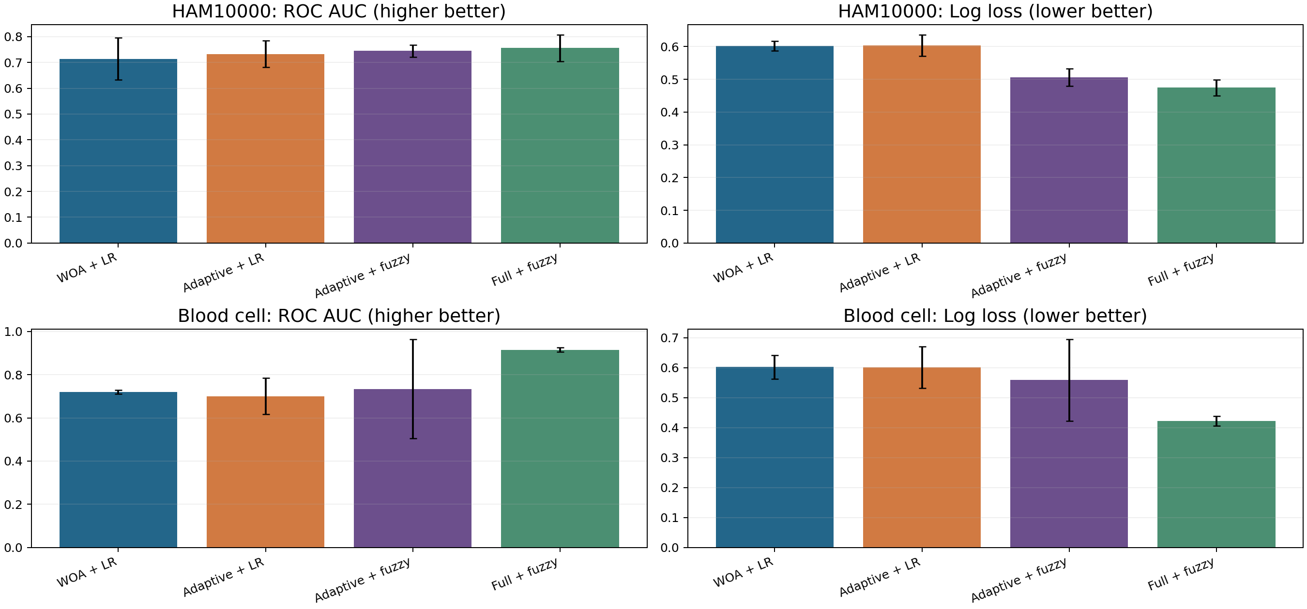
AUC and probability loss across four models
Full-feature fuzzy has the highest mean AUC and lowest mean log loss in both datasets. Bars are mean ± SD over three splits.
Source: results/paper_rlwoa_sofl/; three shared outer splits unless stated.

Slide 73
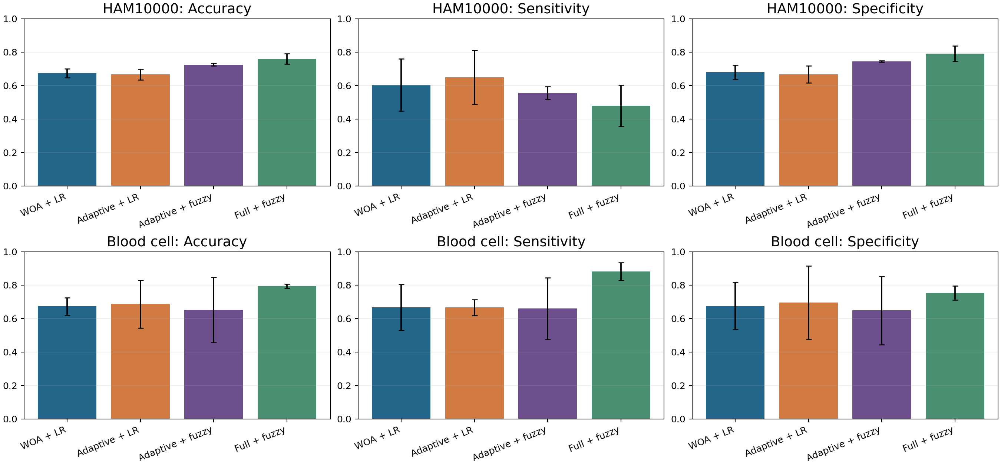
Accuracy, sensitivity and specificity
The 0.5 decision threshold changes the balance of missed positives and false alarms. HAM full fuzzy has lower sensitivity than its accuracy alone suggests.
Source: results/paper_rlwoa_sofl/; three shared outer splits unless stated.

Slide 74
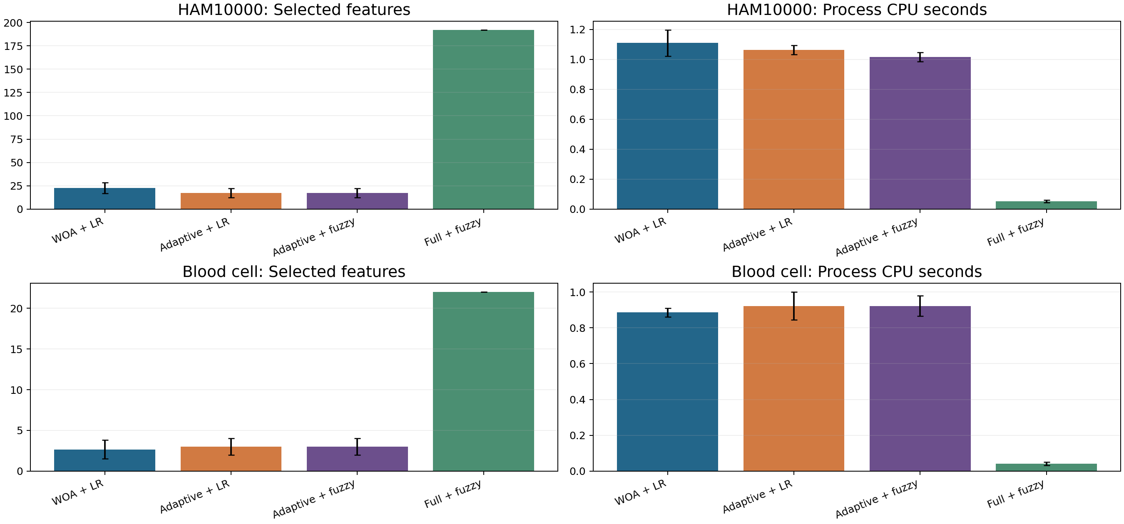
Selected features and CPU cost
Sparse masks use far fewer inputs, but each search takes about 1 CPU second here; full-feature fuzzy avoids that optimization cost.
Source: results/paper_rlwoa_sofl/; three shared outer splits unless stated.

Slide 75
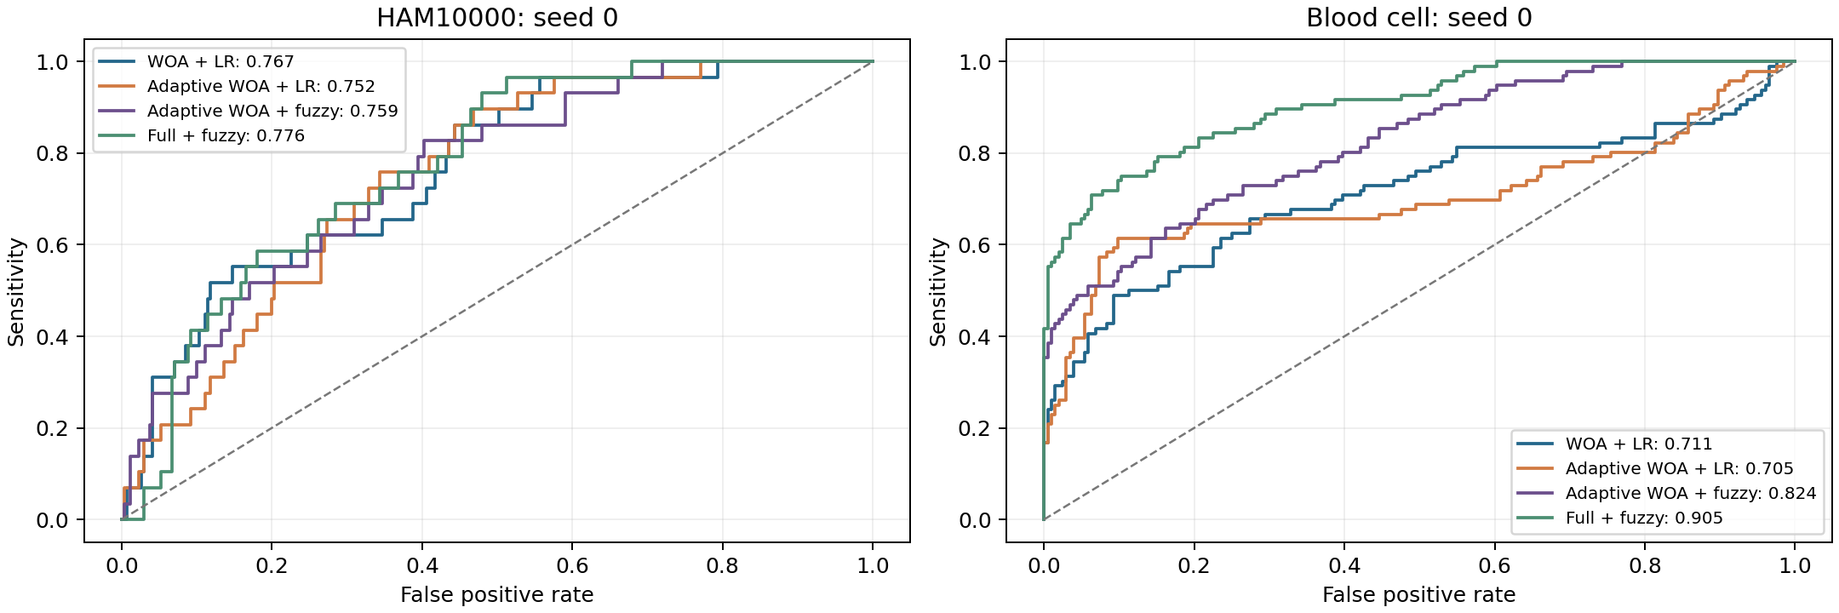
Held-out ROC curves for both datasets
These curves use the first held-out split. The mean AUC values on earlier slides summarize all three splits; blood full fuzzy ranks best on this split.
Source: results/paper_rlwoa_sofl/; three shared outer splits unless stated.

Slide 76
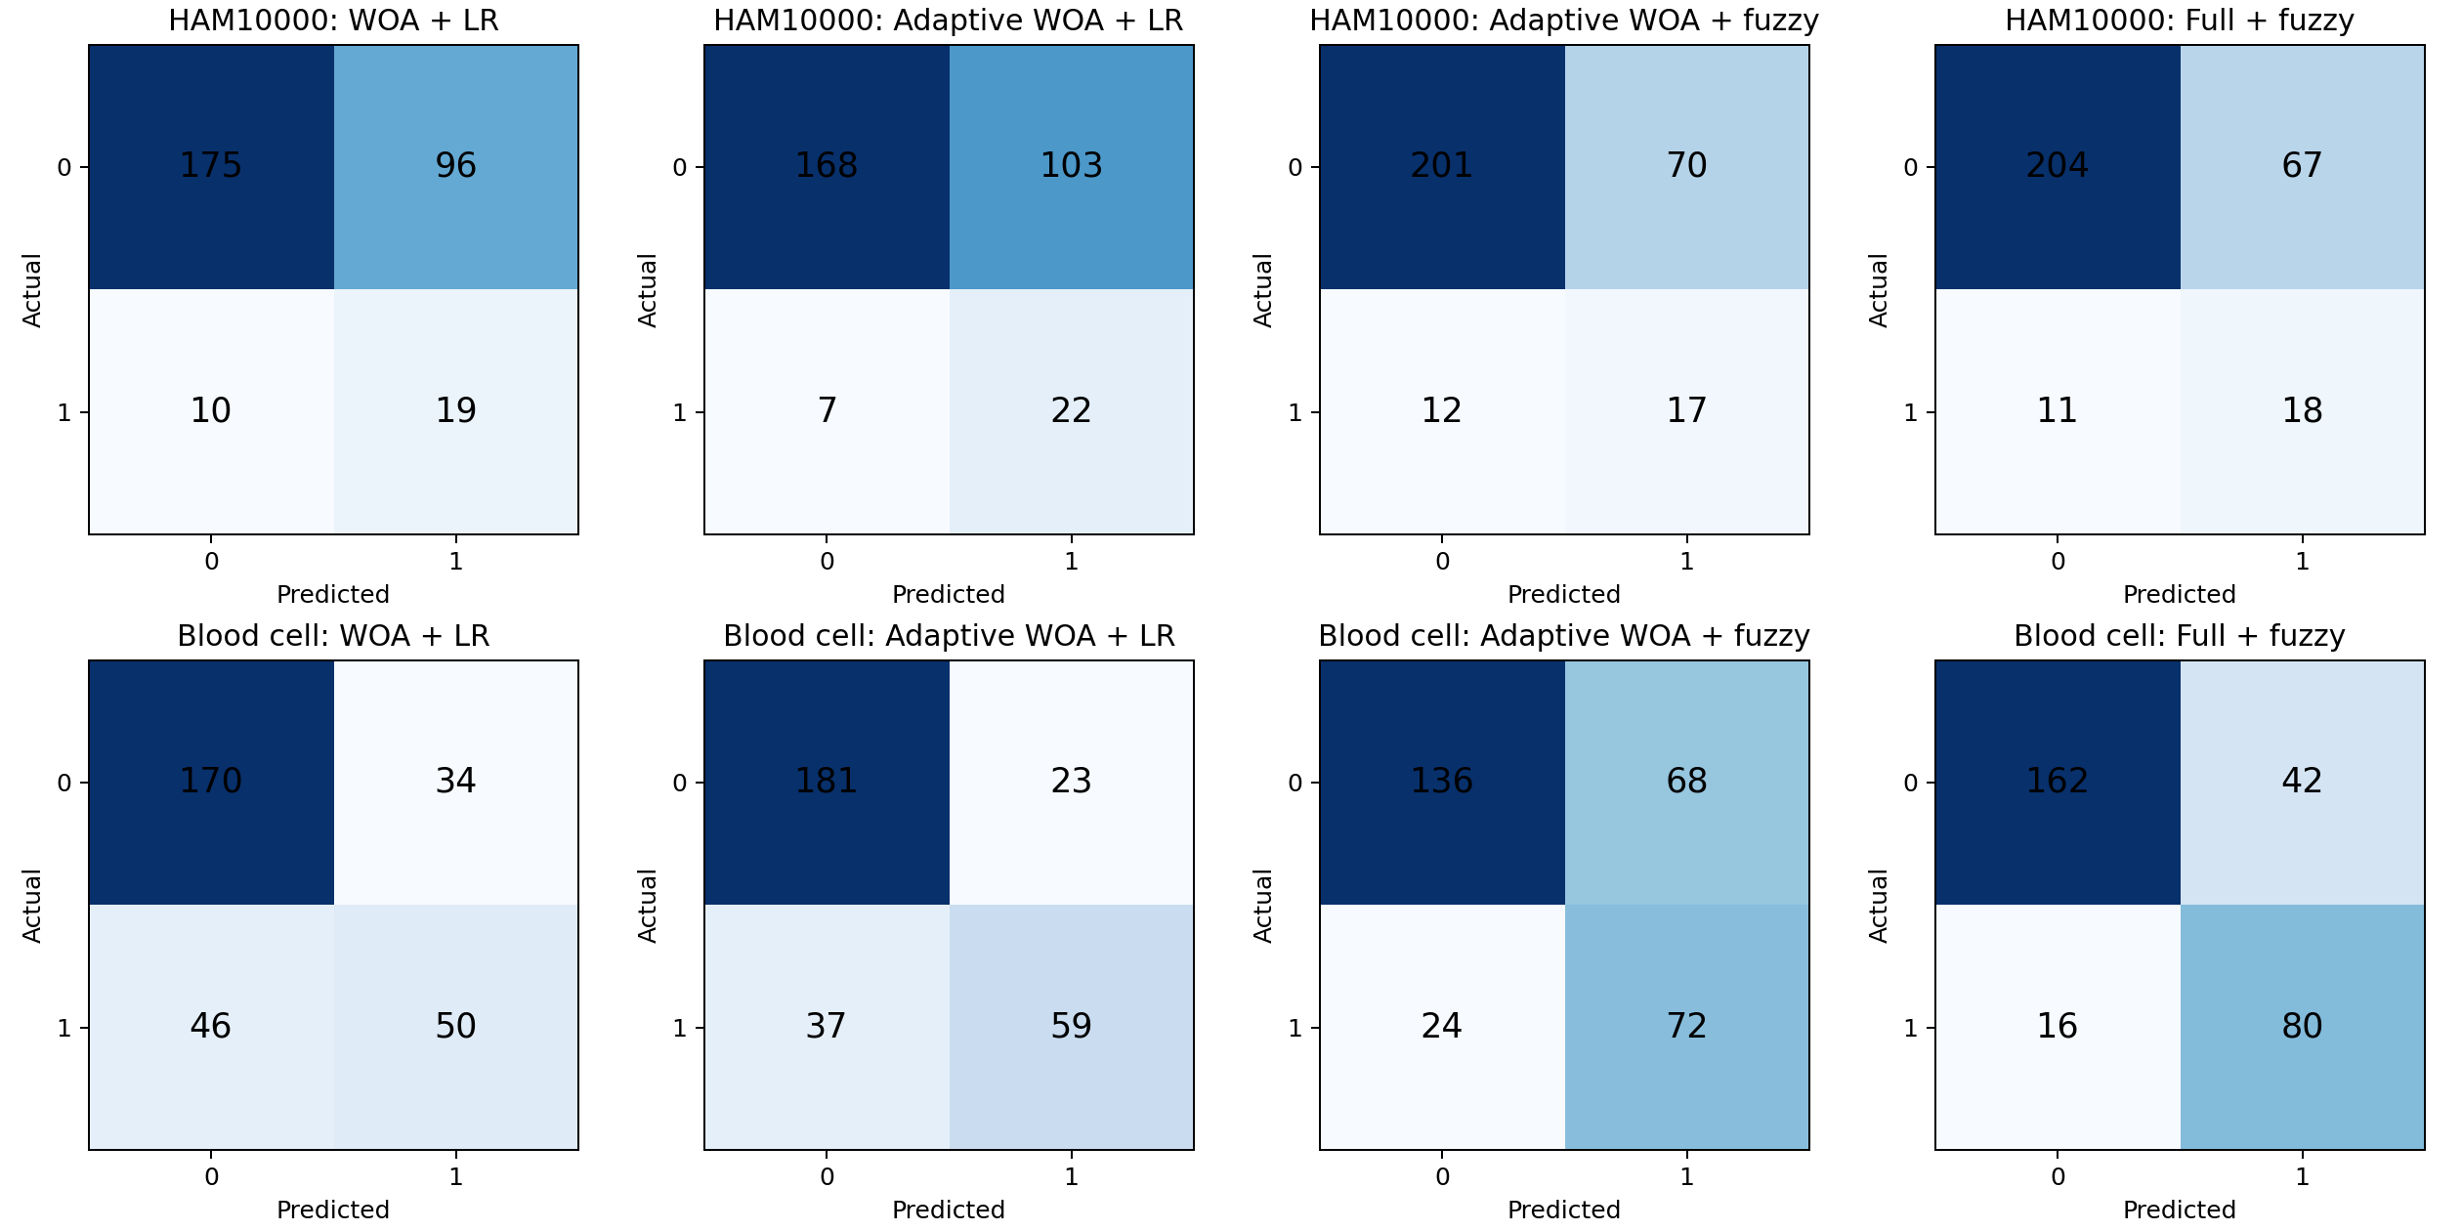
Confusion matrices at the 0.5 threshold
First split counts: rows are true labels and columns are predictions. Melanoma is positive for HAM10000; anomaly is positive for blood cells.
Source: results/paper_rlwoa_sofl/; three shared outer splits unless stated.

Slide 77
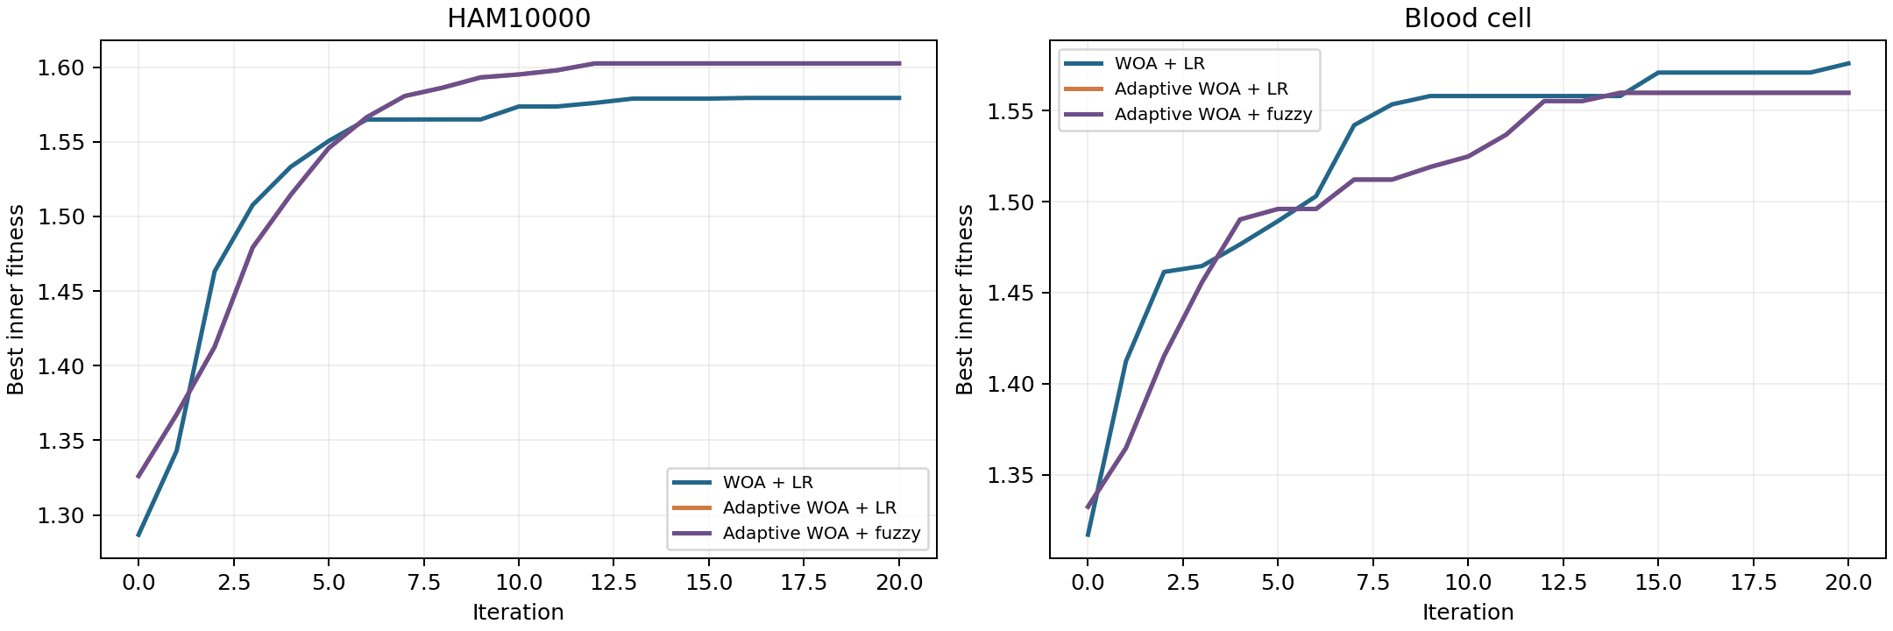
Inner search convergence
The curves track the best KNN accuracy-plus-sparsity fitness inside training folds. Rising fitness is not evidence of improved held-out AUC.
Source: results/paper_rlwoa_sofl/; three shared outer splits unless stated.

Slide 78
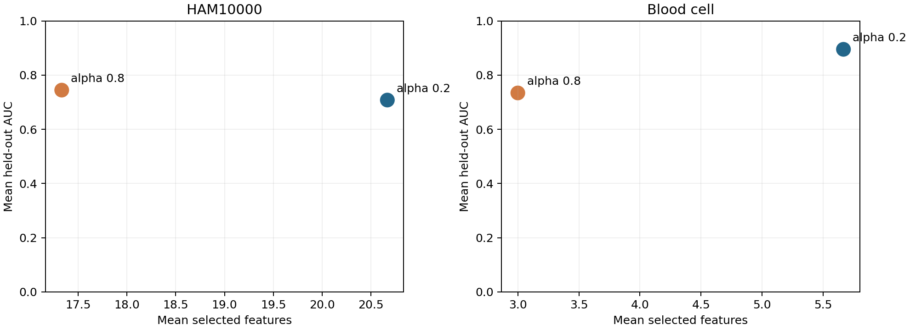
Sparsity-weight sensitivity
Changing α from 0.8 to 0.2 raises blood-cell fuzzy AUC while HAM AUC falls. This is an exploratory sensitivity run, not test-selected tuning.
Source: results/paper_rlwoa_sofl/ and results/paper_rlwoa_sofl_alpha02/; three shared outer splits.

Slide 79
What each part establishes
PART I
2D embeddings
Class-colored maps are useful to inspect geometry, but overlap remains; held-out AUC and CPU measure usefulness.
PART II
Metaheuristic selection
Some masks reduce input count with small AUC changes, while search adds CPU time. Three splits limit inference.
PART III
RLWOA-SOFL adaptation
Agent adaptation and fuzzy prototypes are testable here; full fuzzy features outperform the α = 0.8 sparse pipeline.
These are three different experimental paths on two datasets. None establishes clinical performance or reproduces the paper’s fMRI study.
Sources: results/primary_summary.csv; results/feature_selection/primary_summary.csv; results/paper_rlwoa_sofl/summary.csv.

